Slide 1

Non Salaried Inspectors
Supplier Event
30 August 2018

Slide 2
Welcome
Gemma Warren, Senior Commercial Manager
Notes:
Welcome to all
Intro to PINS attendees
Fire exits and toilets

Slide 3
Agenda
Introduction
Tony Thickett, Director of Wales
About NSIs
Christine Thorby, General Manager of Inspectors
Procurement overview and how we contract with NSIs
Julie Oakes, Commercial Manager
Break
Questions and Answers
Notes:
Welcome
No alarms planned
Run through of the afternoon
Leave questions until the end

Slide 4
Introduction
Tony Thickett, Director of Wales

Slide 5
About the Planning Inspectorate
What is PINS?
What does PINS do?
Joint Executive Agency of the Ministry of Housing Communities & Local Government and Welsh Government
£35m budget allocation, 26% further costs recovered through income
Approx. 650 staff: c300 home-based Inspectors and c350 staff in Bristol and Wales, c80 NSIs
Chair and non-executive Board
Our work is focussed in 3 key areas:
A fair planning system
Helping meet future infrastructure needs
Helping communities shape where they live
Our values are:
Impartiality
Fairness
Openness

Slide 6
Strategic Priorities
The Strategic Plan 2017-2020 sets out the organisation’s ambition of being:
  an exemplar of public service customer delivery, championing openness and transparency;
  recognised as a highly efficient and effective organisation; and,
  in the top quartile of staff engagement across the Civil Service.
Provide
excellent customer
service
Improve efficiency
&
effectiveness
Increase
staff
engagement
Strategic Plan Priorities

Slide 7
Related Projects
Operational Delivery Transformation
Performance Recovery
Directorate of Corporate Services Review
Notes:
This slide sets out the projects related to the NSI procurement:
ODT – may change the way we work with NSIs moving forward
PR – NSIs will help us recover our performance
DCS review – may change how we work with NSIs moving forward

Slide 8
About Non Salaried Inspectors
Christine Thorby, General Manager of Inspectors

Slide 9
The Requirement
We require around 100 NSIs who can demonstrate the required skills and experience, including but not limited to:
  Educated to at least degree level
  Membership of a relevant professional body
  At least 5 years post graduate experience
  Have demonstrable experience of the application of relevant planning law etc
A detailed list can be found on page 7 of the Invitation to Tender

Slide 10
Non Salaried Inspector’s Role
What is our role in the planning system?
What do we do?
How do we do it?
Why do we do it?
Notes:
Role is to determine appeals – sounds easy enough!
We know that Everyone has the right to appeal against the decision or non determination of an LPA to the SoS for MHCLG
But He has transferred the responsibility to come to a decision on an appeal to the Planning Inspectorate
So Inspectors are actually standing in the shoes of the secretary of state - we must be mindful of this and of course have regard to his policies
What do we do – we determine appeals
Must have regard to the laws of natural justice that means that treating people fairly and understanding that all parties must be able to put their case to you
It means being non- partisan – you’re not on the side of the LPA or appellant – must be impartial
It means being open to scrutiny – remember there is always a losing party
Must act reasonably – of course
How do we do it – details of casework
Why do we do it – apart from the salary!
We take the role very seriously and are proud to be Inspectors.
Generally the feedback we receive that that there a very High opinion of Inspectors skills in the planning world
We do it because we have a responsibility to the government and the public

Slide 11
Working as a Non Salaried Inspector…
What does a typical programme look like?
How Long does casework take?
What type of casework could you get?
What is it like working for the Inspectorate as a contractor?

Slide 12
The Procurement & Contract Model
Julie Oakes, Commercial Manager

Slide 13
Procurement Timeline – Key Dates
Work starts
31 Aug
7 Sept
14-24 Sept
8-19 Oct
31 Oct
Final
Questions
to be
submitted
Tenders to
be submitted
Written
test
Interviews
Contract
Award
Notes:
These are the key dates for suppliers
Go through each stage

Slide 14
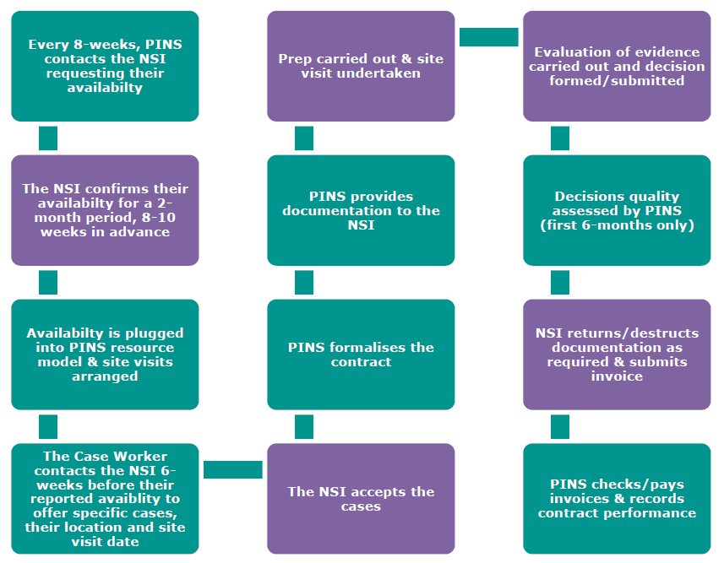
How Casework is Contracted
Notes:
This process sets out how we will work with successful NSIs

Slide 15
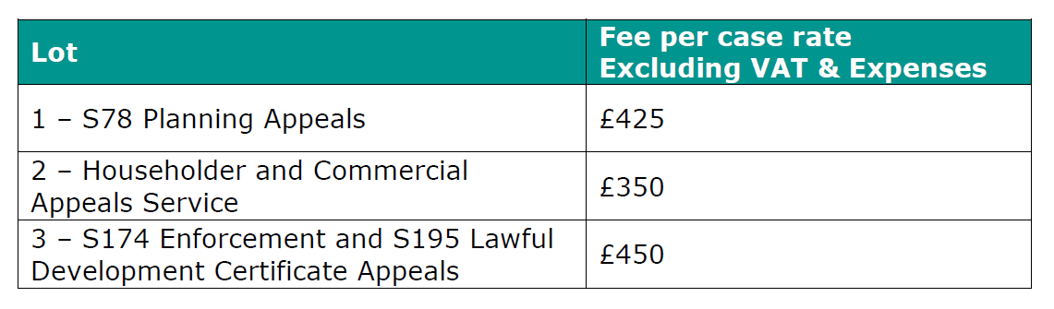
Fee Per Case Rates

Slide 16

Deliverables
Set out for each Lot in the Invitation To Tender, including:
Preparation
Conducting site visits
Providing an evidence based decision
Responding to queries
Meeting timescales

Slide 17
How contracts will be monitored
KPIs
Quality
Timeliness
Availability
Data protection
Communication
Notes:
Go through each of the elements

Slide 18
Benefits of Contracting with PINS
Quick payment
Transparent
Work at the heart of Government
Prestigious
Flexible
Unique

Slide 19
Break

Slide 20
Group Q&A Session

Slide 21
End

