Slide 1






Slide 2



Fund for International Collaboration (FIC)
Evaluation Pre-market Engagement
20th January, 12.30-15.30
Astor Court Hotel, Fitzrovia W1W

Slide 3


Agenda
1 Introductions
2 Overview of the FIC
3 Evaluation Expectations
4 Procurement Overview
*Coffee Break*
5 Discussion

Slide 4
Introductions
Georgina Tyson FIC Global Portfolio Manager |  | Dr Jana Gessner FIC Senior Manager
Jean Brown NPIF Evaluation Lead, UKRI Central Analysis |  | Declan Ward Category Manager – Research Procurement UK SBS

Slide 5


Overview of the FIC

Slide 6
Background
The FIC is a new £160 million* cross-UKRI fund which will enable the UK to develop strategic partnerships with global R&D leaders. ​
collaborate with the best international partners;
carry out world-leading research and innovation which delivers new knowledge, and societal and economic impact, to the mutual benefit of the UK and partner countries;
support BEIS and wider Government objectives, including science diplomacy, enabling the UK to strengthen its collective voice in research and innovation policy.
The Principal Objectives of the FIC
The FIC is part of a package of UKRI measures to maintain the UK’s global leadership and thereby deliver against the ambitions of the Industrial Strategy.
*At business case the FIC funding profile total was £160m. The initial timeframe was 2018/2019 to 2020/2021, however there are 3 post Spending Review commitment years, 21/22, 22/23 and 23/24. Within the initial timeframes, for waves 1 and 2, the total is approximately £110m.

Slide 7
Background
The FIC complements other cross-UKRI Official Development Assistance funds (Newton/ GCRF). Both Newton and GCRF focus on the economic and social development of Development Assistance Committee (DAC) list countries.
The FIC is a non-ODA fund. UKRI, in consultation with BEIS, has identified countries of focus as part of an evolving framework for international investment (e.g. USA, Canada, Japan and China).
The FIC focuses on responding to changes in the global research and innovation landscape, and thereby enhancing the UK’s bilateral and multilateral partnerships with global R&D leaders.

Slide 8
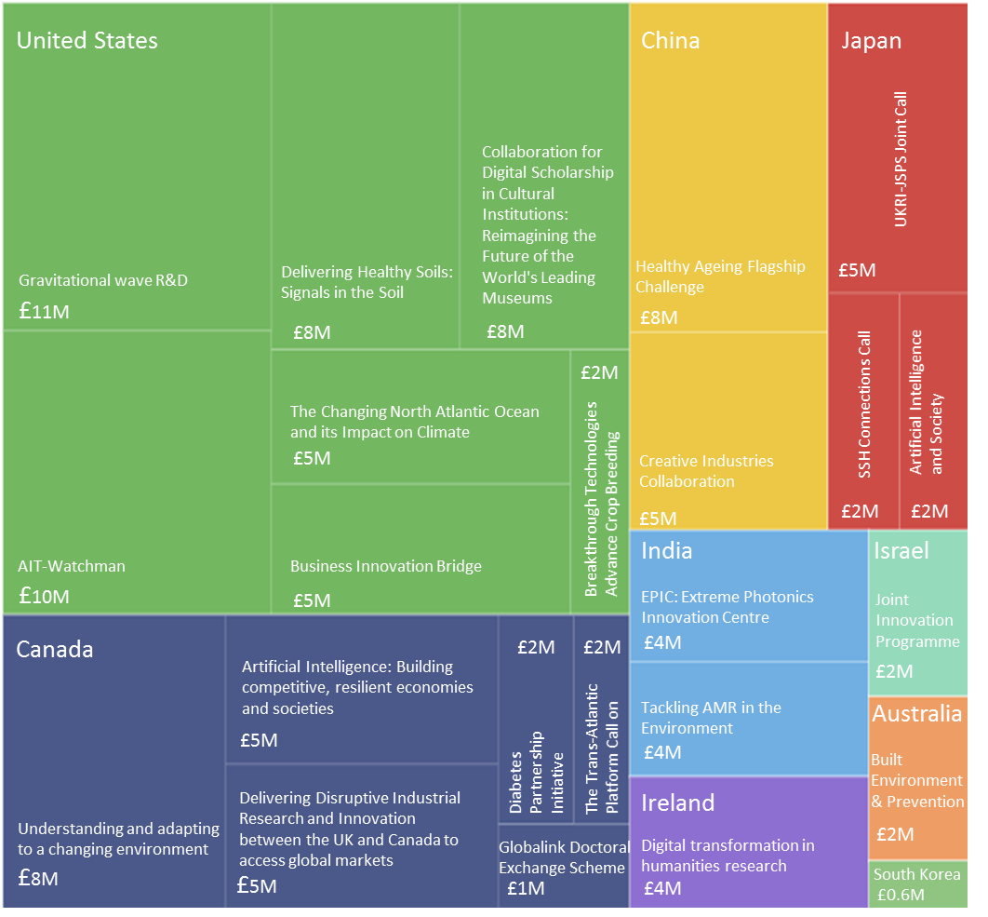
FIC Wave 1 & 2 UKRI Support for Bi-lateral Collaborations by Country
Wave 1 and 2
The FIC is a cross-UKRI Fund:
UKRI’s constituent Councils bid in an internal assessment process for funds to deliver FIC programmes.
Councils’ bids are examined by the FIC Board with representatives from a range of internal and external stakeholders.
The competitive biding process for FIC Wave 1 and 2 was open to all 9 UKRI Councils operating individually or in partnership.
The successful FIC bids are being delivered by the respective UKRI Councils, with the day-to-day coordination of the fund led by the UKRI International Shared Capability.

Slide 9
FIC Programmes
The aim of the FIC is to build a portfolio which captures a diversity of international partners and research areas.
Consequently, the FIC consists of a diverse range of research and innovation activities at various stages of development. In addition, the nature and maturity of the partnerships varies between programmes.
29 of the 32 FIC programmes have now launched. 147 research grants have been awarded so far and further funds have been invested in infrastructure.

Slide 10
Evaluation Expectations

Slide 11
Purpose
UKRI is committed to rigorous evaluation of all our key programmes, including the FIC. UKRI would like to commission an independent evaluation of our investment in the FIC wave 1 and 2 portfolio.
The aim of the evaluation is to inform ongoing and future improvements of the fund to maximise the value of public funding (in particular, the possibility of future growth of the FIC) and demonstrate what the fund delivered for taxpayers and help UKRI build the evidence base on ‘what works’ in internationally collaborative Research and Innovation (R&I)
The evaluation will be at the fund level.

Slide 12
Expectations
Phase |  | Dates
1 | Planning Phase | April 20 – Aug 20
 | Break clause in the contract to review the deliverables for UKRI and to make a decision on the continuation of contract
2 | Baseline measurement | Sept 20 – Feb 21
3.1 | Interim process evaluation | Sept 20 – Feb 21
 | Break clause in the contract to review the deliverables for UKRI and to make a decision on the continuation of contract
3.2 | Interim impact and economic evaluation | Mar 21 – Sept 22
3.3 | Final evaluation | Oct 22 – Dec 24
(4) | Evaluation post FIC | ITT does not include Phase 4 of the evaluation, proposals must clearly set out how a delivery of a longer-term continuation of the evaluation could be conducted

Slide 13
Phase 1 – Planning Phase
The planning phase will ensure that there is a solid foundation for the FIC evaluation
Key components include:
  Evaluation framework
  Review of evaluation questions and indicators
  FIC logic model refinement
  Scoping and feasibility considerations

Slide 14
Phase 2 – Baseline Measurement
The purpose of establishing a baseline is to provide a clearly defined starting point which can be used as a counterfactual scenario for the impacts of FIC (in which the research or innovation activity did not take place)
The baseline will consist of multiple sources of data, it will not be possible to rely solely on programme administrative data to construct a baseline.
Need to consider what additional data is required and how it will be collected

Slide 15
Phase 3 – Evaluation
Process
To understand how FIC was delivered (the associated processes, the activities involved in its implementation and the pathways by which FIC was delivered) and why the policy was delivered in the ways it was with recommendations for ongoing and future improvements.
Impact
To understand what difference FIC is making over and beyond other existing UKRI international programmes and why.
Economic
It is acknowledged that it will be difficult to derive a robust assessment of value for money based on an estimate of the value of impacts. Nonetheless, we are keen to understand if the benefits of FIC justify the costs and how the costs and benefits were generated.

Slide 16
Procurement Overview

Slide 17
Timescales
January
February
Procurement process | Dates
Advertise pre-market engagement event | 6th January 20
Pre-market engagement event | 20th January 20
Issue of competition to all bidders | 27th January 20
Deadline for clarification questions | 17th February 20
Latest date clarification answers | 2nd March 20
Deadline for Bid to be submitted through Delta | 23rd March 20
Selection and de-selection of Bids | 30th March 20
Interviews of shortlist | 6th - 10th April
Anticipated Award Date | 20th April
Anticipated Contract start date | 27th April 20
Anticipated Contract end date | 31 December 24
M | T | W | T | F | S | S
 |  | 1 | 2 | 3 | 4 | 5
6 | 7 | 8 | 9 | 10 | 11 | 12
13 | 14 | 15 | 16 | 17 | 18 | 19
20 | 21 | 22 | 23 | 24 | 25 | 26
27 | 28 | 29 | 30 | 31
M | T | W | T | F | S | S
 |  |  |  |  | 1 | 2
3 | 4 | 5 | 6 | 7 | 8 | 9
10 | 11 | 12 | 13 | 14 | 15 | 16
17 | 18 | 19 | 20 | 21 | 22 | 23
24 | 25 | 26 | 27 | 28 | 29
March
April
M | T | W | T | F | S | S
 |  |  |  |  |  | 1
2 | 3 | 4 | 5 | 6 | 7 | 8
9 | 10 | 11 | 12 | 13 | 14 | 15
16 | 17 | 18 | 19 | 20 | 21 | 22
23 | 24 | 25 | 26 | 27 | 28 | 29
30 | 31
M | T | W | T | F | S | S
 |  | 1 | 2 | 3 | 4 | 5
6 | 7 | 8 | 9 | 10 | 11 | 12
13 | 14 | 15 | 16 | 17 | 18 | 19
20 | 21 | 22 | 23 | 24 | 25 | 26
27 | 28 | 29 | 30

Slide 18
The Research Marketplace
The Research Marketplace is a Dynamic Purchasing System (DPS)
It can take up to 5 days for a supplier to register on the DPS
Bespoke supplier shortlists are created for each procurement by selecting ‘filters’ to create a shortlist of suppliers with the necessary skills
Due to the breadth of this evaluation no filters have been applied
If you would like to register as a supplier on the Research Marketplace DPS, please follow the online guidance and register at https://supplierregistration.cabinetoffice.gov.uk/dps#research

Slide 19


Coffee Break
Notes:
To edit the background image, select ‘Format’ from the PowerPoint menu and ‘Slide Backgound’ from the drop-down menu. Within the new list of options that appears on the right of the screen, select the ‘File’ button under ‘Insert picture from’ and select your image from your file browser.

Slide 20


Discussion
Notes:
The abstract pattern can be removed or repositioned if required. Be careful to ‘Send to Back’ so that it does not obscure any important information.

Slide 21






@UKRI_news
UK Research and Innovation
UK Research and Innovation
Notes:
The abstract pattern can be removed or repositioned if required. Be careful to ‘Send to Back’ so that it does not obscure any important information.

