Slide 1
Using CSV Schema and DROID reports for digital preservation
David Underdown
28 February 2020

Slide 2
Colossus electronic digital computer

Slide 3
Section aim
This section of the day will:
Give you further hands on experience with the CSV Validator
Show how you can combine DROID reports with CSV Schema to undertake integrity checking on your collections
Show how you can move to using the command line version of the CSV Validator to automate these checks
Demonstrate using the Windows Task Scheduler to set up a regular integrity check

Slide 4
Fixity and integrity checking
We want to demonstrate over time that file content is fixed (unchanged)
Part of the provenance of a digital file
We can demonstrate that the file is the same thing that we received
Contributes to authenticity of the file and trust in the archive
Typically use a cryptographic hash function (CHF) to generate a checksum (also known as a hash or message digest) eg
MD5
SHA-1
SHA-2
SHA-256
SHA-512
Notes:
MD5 and SHA-1 are broken – no longer cryptographically secure. Attackers can potentially generate a new file with the same checksum as another, so in our use case, could replace original file with an altered one and we wouldn’t be able to detect it. Still OK to use if you’re just verifying that files have copied OK.
This type of fixity only helps to show that a file is identical, more complex considerations if you want to show, for example, that an image or video is fundamentally unchanged even if it’s been converted from one file format to another (eg creating a streaming version of a video). Some work done on this in Archangel Project where computer scientists from the Univeristy of Surrey developed a content hashing algorithm

Slide 5
One-way functions and hash collisions
CHFs (and digital encryption more generally) rely on one-way (trapdoor) functions
For example, it’s easy to multiple two numbers together, but to retrieve the original factors is time consuming.
Only a finite (though large) set of values for each type of checksum, so always a risk of “collision”, two different files producing same checksum
Elevation for clock dial for Big Ben tower
Notes:
To find factors, basically have to try every (prime) number up to half your number.
For a checksum, you can’t work out original content from the derived checksum.
SHA 256 checksum is 256 bits long (usually written as as 64 hexadecimal characters) – 1.15e77 values!
Smaller example, a very quick way of checking is to use modulo (clock) arithmetic, give a list of numbers plus remainder after division by some value for each. (clock runs 0-11). Final digit of ISBN uses this basic idea (though a bit more complicated)
Chance of collision – how likely is it that two people here today share a birthday? 23 people for 50/50; 15, approx 0.2; 30 – 0.6 (assume 365 days in a year – even though it’s a leap year!)

Slide 6
CSV Validator and CSV Schema Language
Developed by The National Archives for handling archival metadata in CSV format
Result of our experiences with inconsistent metadata in Home Guard digitisation pilot
Can specify that a column is date/time (various formats) and falls in a particular range, numeric, matches a regular expression
Also conditionals, so appropriate check can depend on the value of another column
Check a file exists and checksum matches value
Check that no files present within folders that are not listed in your metadata file (integrityCheck)
CSV Validator
An example from the CSV Schema Language, declaring that a column called “a_column” must contain a valid URI. See documentation
Notes:
For Home Guard initially developed validation tool specific to that project, then generalised.
Seen unique check for deduplication already?
FileExists/Checksum allows us to use the metadata files as a batch manifest and verify that all content has transferred to us without corruption
Both DROID and CSV Validator require JAVA. Some IT departments are showing a bit of nervousness about this due to Oracle licensing changes. For DROID we will shortly release a new version with an open licensed JAVA included in the distribution. We should then be able to look at doing the same for CSV Validator.

Slide 7
Working with DROID exports
As you’ve seen in earlier sessions, having run DROID over a collection of files, you can then export to CSV to do further analysis
Checking for duplicate files, for this we are not using the feature of verifying checksums against the stored files, so it is desirable to use the DROID feature that can read files inside ZIPs and other “archive” formats
Unfortunately, for the use case of integrity checking this feature causes problems, as CSV Validator cannot read inside “archives” so having rows for such files in the export causes problems with the integrityCheck feature which allows us to verify that there are no additional, undocumented, files within collections
Two choices:
New DROID run not looking in “archives”
Copy existing DROID export and remove these rows
Notes:
Second option potentially more prone to error, but you know that the checksums are unchanged since you first ran. Would suggest using LibreOffice Calc (rather than Excel) for editing CSV as it gives greater control over text encoding and formatting

Slide 8
Example files and CSV Schemas
All available at https://github.com/digital-preservation/droid-csv-schema
Example DROID export CSVs
CSV Schema
“Good” and “Bad” file sets
Just click on green “Clone or download” button and then “Download ZIP”
For today, already on your laptops in “C:\Users\<machine name>\Documents\Archive School Session 4\droid-csv-schema-master”
droid-csv-schema repo
Click the green “Clone or download” button, then “Download zip”
Notes:
Ie Good fileset should validate against the schema, Bad fileset should fail validation
<machine name> will be something like ASD14, depending which laptop you have

Slide 9
DROID integrity check schema
version 1.1
//several columns omitted here for clarity
URI: fileExists integrityCheck("","files","includeFolder")
//replace "files" in integrityCheck with name of top level folder within your DROID report (in quotes)
SHA256_HASH: if($URI/ends("/"),empty,if($URI/starts("file:"),checksum(file($URI),"SHA-256"),notEmpty))
//folders do not have a checksum
Notes:
Each bit really on a single line
There are two elements to the test on the URI field (linked by an implicit and statement):
fileExists
This checks the file system for a file at the URI in this row of the CSV file
integrityCheck
the options following this say:
do not add a prefix to the URI,
the top level folder to check from is called “files”,
folders in the folder structure are explicitly mentioned in the CSV file
Any files or folders in the folder structure below the top level folder given which are not explicitly referenced in the CSV file will be considered an error by the CSV validator.
For SHA256_HASH there is only really one test, checksum for which we have to supply the file path, here by referring to the URI field, the prefix $ means “use the contents of the following field”, and stating the relevant checksum algorithm. However, because folders do not have a checksum we use the if condition to exclude these from checking (and further assert that in this case the checksum field should be blank) by looking to see if the URI ends with a /. We also check that we are actually dealing with a file URI.

Slide 10
Running the integrity check 1
DROID report probably not created where the files will be stored
Use “path substitution” to update path so CSV Validator can still find the files, for example:
Originally C:\files\
Now:
C:\Users\<machine name>\Documents\Archive School Session 4\droid-csv-schema-master\good\files\
C:\Users\<machine name>\Documents\Archive School Session 4\droid-csv-schema-master\bad\files\
Notes:
As it’s a URI, have to “escape” things like spaces
Replace <machine name> with the relevant one for your laptop, eg ASD14
Try checking the good files (should pass) with the path substitution info here. Then change so you run against the bad files – what errors are you seeing, what do you think they mean?

Slide 11
Running the integrity check 2
Represented in DROID CSV as URI, so:
from file:/C:/files/
to file:/C:/Users/<machine name>/Documents/Archive%20School%20Session%204/droid-csv-schema-master/good/files/
Notes:
As it’s a URI, have to “escape” things like spaces
Replace <machine name> with the relevant one for your laptop, eg ASD14
Try checking the good files (should pass) with the path substitution info here. Then change so you run against the bad files – what errors are you seeing, what do you think they mean?

Slide 12
Does it work?
Try running the integrity check yourself, details given on previous slide should get you a pass result
Then amend the path substitution so that you run against the “bad” file set
What validation errors do you see?
What do you think they mean?

Slide 13
Automating the integrity check
Need to use the command line version of CSV Validator
Download from https://search.maven.org/remotecontent?filepath=uk/gov/nationalarchives/csv-validator-cmd/1.1.5/csv-validator-cmd-1.1.5-application.zip (choose save if prompted), then extract the contents of the zip file where you like
Already installed for you at:
C:\Users\<machine name>\Documents\Archive School Session 4\DU\csv-validator-cmd-1.1.5-application\csv-validator-cmd-1.1.5\bin\validate.bat
All the same options are available as in the GUI, but using the command line allows automation, by calling the CSV Validator direct at the command line, from other programs, or task scheduling software (to carry out regular checks)
Details at http://digital-preservation.github.io/csv-validator/#toc10
Notes:
Just type Task in the search bar in Windows 10 – you should see Task Scheduler in the results, click
For other operating systems you’ll have to find equivalent scheduler, eg cron
Program/script – this points to wherever you downloaded the command line CSV Validator – for *nix (including Apple) use validate shell script
The optional arguments are the path substitution we saw previously (preceded by –p) and then the paths to the report you are validating, and the schema, followed by where you want the output saved
Ideally you’d actually have this running on a server, not your own machine

Slide 14
Finding Task Scheduler
Task Scheduler usually found under Windows Administrative Tasks in the Start menu
Click on “magnifying glass” option next to Start button, start typing task and the scheduler should appear in results

Slide 15
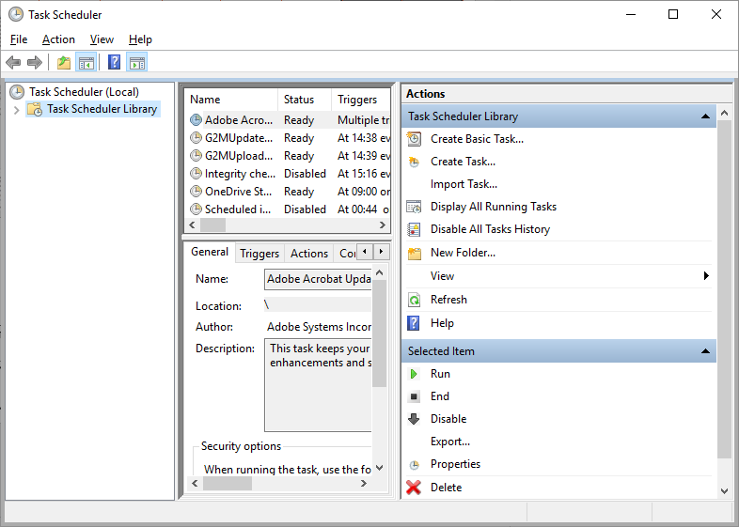
Using Task Scheduler
After launching the Task Scheduler you should see an application divided into panes
Select Task Scheduler Library on left, shows existing tasks in centre
To create a new task, click “Create Basic Task…”
Once your task has been created you should see it in upper central pane, right click and select “Properties” to review/edit settings
This will schedule on own PC, you will probably want it to run on a server (ask your IT)
Initial layout of application after launching task scheduler

Slide 16
Creating a task 1
First screen when using “Create Basic Task…” allows you to give your task a name (mandatory) and also a description (optional)
Description allows you to give a bit more info about what the task is doing, might be useful to list all record groups you are checking with a particular task here
Initial “Create a Basic Task” screen
Notes:
Having launched the Create Basic Task wizard,

Slide 17
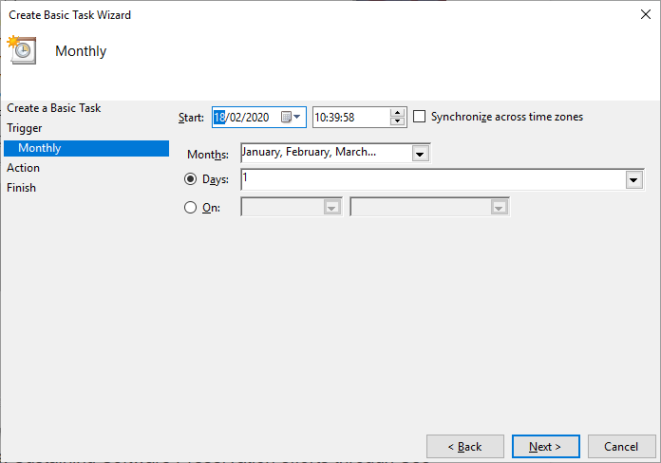
Creating a task 2
Trigger: Choose a frequency eg Monthly, “Next”
Then choose when you want it to run, eg 1st day of every month, 10pm, “Next”
Action: “Start a program”, “Next”
Program/script: “C:\Users\<machine name>\Documents\Archive School Session 4\DU\csv-validator-cmd-1.1.5-application\csv-validator-cmd-1.1.5\bin\validate.bat”
Add arguments (optional): -p file:/C:/files/=file:/C:/Users/<machine name>/Documents/Archive%20School%20Session%204/droid-csv-schema-master/good/files/ “C:\Users\<machine name>\Documents\Archive School Session 4\droid-csv-schema-master\DROID_report_2.csv” “C:\Users\<machine name>\Documents\Archive School Session 4\droid-csv-schema-master\DROID_integrity_check.csvs” > “C:\Users\<machine name>\Documents\Archive School Session 4\integrity_check.out”
Finish: creates your task
Scheduling screen
Screen for inputting “Start a program” parameters
Notes:
Program/script – this points to wherever you downloaded the command line CSV Validator – for *nix (including Apple) use validate shell script
The optional arguments are the path substitution we saw previously (preceded by –p) and then the paths to the report you are validating, and the schema, followed by where you want the output saved
Ideally you’d actually have this running on a server, not your own machine

Slide 18
Automation considerations
Calculating a checksum means reading the whole file
So runtime is largely dependent on the volume of data you check and the read speed of your storage
On cloud storage you could also rack up data access costs
Think hard about how often you want to check
What’s the impact on your network, or other people trying to read or write files?
Check part of the collection at a time (ideally you’ll have a DROID report for each accession, so you can group things together)
For a less intensive check you could just check fileExists, plus the integrityCheck, and schedule this more frequently
This only has to interrogate the file system metadata rather than reading back the files themselves
Notes:
From my own recent experience of checking 7 TB of data, that took 2-3 days to verify checksums.
This blog post from the Science History Institute also has a good look at various things you might want to consider https://bibwild.wordpress.com/2019/12/17/intentionally-considering-fixity-checking/
Checking only existence won’t catch bit flips or other changes, but there’s fairly good evidence (journal articles etc) that human error tends to be a more important consideration overall than the random side
Could also talk to your IT to see if there’s any way of verifying file size and last modified date on file system against what’s recorded in your DROID CSVs

Slide 19
Other possible validation checks
CSV Schema could also be used to implement a format blocklist for material that you don’t want in your archive
To exclude thumbs.db (Windows) and .ds_store (Mac) files
NAME: if(is("thumbs.db"),$PUID/not("fmt/111")) @ignoreCase
PUID: not("fmt/682") and not("fmt/394")
https://github.com/digital-preservation/csv-schema/tree/master/example-schemas has various other examples of schemas we have used at The National Archives
Notes:
Thumbs.db could potentially include thumbnails of images not selected for accessioning. Could even be “risky” material. There are tools available to extract the thumbnails from these files.
Do the check by name as well because DROID can currently only identify the Windows XP thumbs.db precisely (fmt/682). Others ID as the generic fmt/111 OLE2 Compound Document Format too, so combine a check on name with looking for /111

Slide 20
Questions and follow up
Time for questions now
Will share slides
Comment on the original blog post https://openpreservation.org/blog/2019/05/28/droid-report-as-basis-for-collection-integrity-checks/
Twitter: @davidunderdown9
Email: digitalpreservation@nationalarchives.gov.uk
GitHub: https://github.com/digital-preservation/droid-csv-schema
https://github.com/digital-preservation/csv-validator
https://github.com/digital-preservation/csv-schema
Notes:
This whole thing came about following a Twitter discussion between me and Rachel!
On GitHub you can raise an “issue” could be a bug report, a suggestion for improvement or additional functionality, or just asking a question.

