Slide 1
Market engagement event Thursday 2nd February 2017 09.30 12.30 County Hall Chelmsford
Semi Independent Accommodation and Support
Clare Burrell, Lead Commissioner

Slide 2
Agenda
09.30 Arrival, Refreshments and Registration
09.40 Welcome, Housekeeping, Aims and Event Objectives
09.45 Introduction and update
10.00 Statistical Forecast: current and projected demand for services
10.05 Proposed service model and project timeline
10.15 Introduction to Round Robin table discussions
Defining packages of care
Transitional arrangements post-18
Unaccompanied asylum seeking children challenges
Commissioning for Outcomes
Workforce
11.15 Refreshment break
11.30 Continue table discussions
12.00 Key points from table discussions and discussion
12.20 Plenary and next steps
12.30 Close

Slide 3
Work to date
Work to date
Market analysis
Workshop with current providers
Engagement with social workers and personal advisors
Engagement with young people
Visits to provision
Analysis of demand
Benchmarking
Legislative context

Slide 4
Current Demand
Essex has just over 900 young people in Care (excluding Unaccompanied Asylum Seeking Children (UASC))
Approximately 5% are in SIA placements
In addition, there are 110 UASC in Essex care. Just over 40 of these are in SIA placements at present
Essex also has a cohort with no recourse to public funds (NRPF). There are currently 11 families and 23 18+ year olds being supported by Essex.

Slide 5
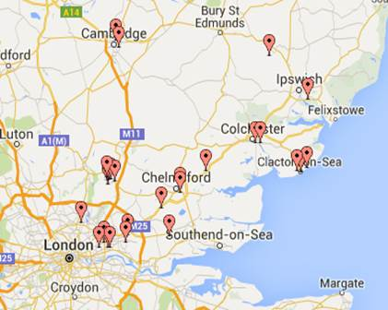
SIA Placement Locations

Slide 6
Likely Future Demand
Year on year Demand Forecast:
Expected increase by approximately 5% each year
Home Office UASC target for Essex is 210.
65% (137) are likely to be in SIA.
Service | Current | 2017/18 | 2018/19 | 2019/20
SIA | 43 | 43 | 45 | 47
UASC | 43 | 137 | 137 | 137
NRPF 18+ | 23 | 28 | 28 | 28
NRPF Families | 11 | 13 | 13 | 13

Slide 7
Outcomes focussed Defined and costed packages of care Defined and costed accommodation models
Service model

Slide 8
Procurement Process Overview
Open, single stage process – no pre-qualification.
Preferred option – framework encompassing 3 lots:
Register on Oracle iSupplier via the following link: http://www.essex.gov.uk/Business-Partners/Supplying- Council/Pages/Supplier-portal.aspx
Framework
Lot A | Lot B | Lot C
Semi-independent accommodation and support for young people in the Essex Care system | Semi-independent accommodation and support for Unaccompanied Asylum Seeker Children | Accommodation for individuals and families with no recourse to public funds

Slide 9
Specification considerations
Provision of beds for age assessment
Accommodation 24/7 support
Accommodation supervised support
Needs defined with maximum support £
Accreditation for independent living
Common evaluation tool for evidencing outcomes
Outcomes framework
Transition
Cultural demands
Training indicators of risk

Slide 10
Indicative Procurement Timescales
Date | Activity
24th March 2017 | Contract notice published – OJEU and Contracts Finder
27th March 2017 | Invitation to Tender
17th April 2017 | Deadline for clarification questions
2nd May 2017 | Deadline for tender submissions – 12 Noon
3rd May – 18th May 2017 (inclusive) | Evaluation period
22nd May 2017 | Candidates notified of evaluation outcome
22nd May - 5th June 2017 (inclusive) | Standstill period
5th June – 3rd July 2017 | Internal governance
3rd July 2017 | Anticipated contract award
16th September 2017 | Anticipated commencement of service

Slide 11
Questions

Slide 12
Table discussions
Defining packages of care
Transitional arrangements post-18
Workforce
UASC challenges
Commissioning for Outcomes

Slide 13
Questions

Slide 14
Plenary and next steps Feedback to; Jane.bloom@essex.gov.uk

