Slide 1
Ealing 0-19 Healthy Child Programme Marketing Event

Slide 2
Demographics and social determinants of health
3rd most populous borough
Higher proportion of under 19s compared to England and London
0-4 years 26,500
5-19 years 61,200
Ethnically diverse:
83.6% pupils in maintained schools from minority ethnic groups
Notes:
Ethnicity- higher than England and London

Slide 3
Demographics and social determinants of health
Deprivation:
19.2% children under 16 in child poverty (2013)
Family homelessness:
589 families in Ealing in 2015/16
Notes:
Child poverty lower than London but family homelessness – rate is higher than England and London

Slide 4
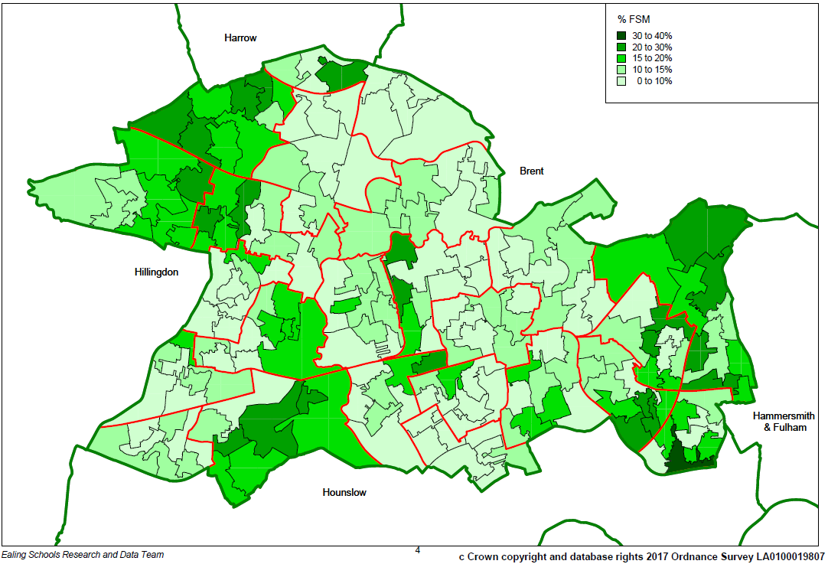
Percentage of pupils entitled to free school meals
Notes:
Variation by locality – pockets of deprivation

Slide 5
Schools
4 Nurseries
68 primary schools
14 secondary schools
6 special needs schools
2 pupil referral units
22 independent schools

Slide 6
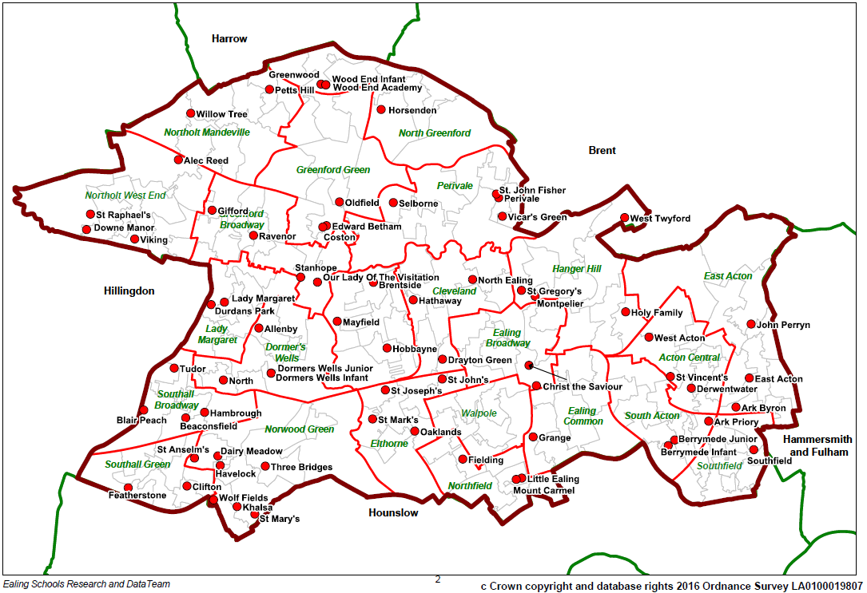
Location of primary schools by ward

Slide 7
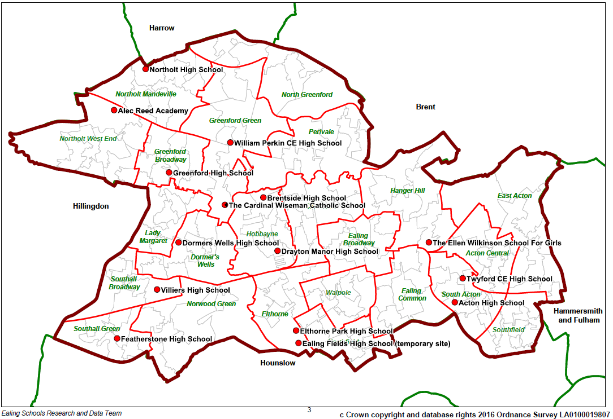
Location of secondary schools by ward

Slide 8
Health issues across 0-19
Mortality:
The infant mortality rate is similar to the London average (although stillbirth rate is higher)
The child mortality rate is lower than the London average
Healthy weight and obesity:
Similar to the London average for reception and year 6 (although significantly higher than England)
Oral health:
Highest rate of decayed, missing or filled teeth amongst 5 years olds in London
Higher than London average admissions for dental caries (0-4 years)

Slide 9
Health issues in early years
Breastfeeding:
Similar to London average for breastfeeding initiation (although higher than England)
Childhood immunisations:
Similar to London for vaccinations by 2 years
A&E attendance rate (0-4 years):
Similar to London average (although higher than England)
School readiness:
Lower than London average for 2015/16 (although has previously been consistently higher)

Slide 10
Health issues amongst young people
Sexual health:
Lower than London (and England) averages for under 18 conceptions
Mental health:
Similar for hospital admissions resulting for self-harm (10-24 years), although lower than England
Risk-taking behaviours:
Similar for hospital admissions due to alcohol and substance misuse (10-24 years) compared to London, although lower than England

Slide 11

Health issues and inequalities experienced by vulnerable groups
Notes:
Health inequalities amongst vulnerable groups

Slide 12
Questions? Further information- JSNA

