Slide 1
Procurement of laboratory services
supporting the delivery of HPV Primary Screening within the NHS Cervical Screening Programme
Market Engagement Event
Sam Cramond Head of Public Health Transition NHS England (PH Commissioning)
Alison Cowie Senior Programme Lead NHS England
Divyang Jagiwala Procurement Manager NHS Arden and GEM CSU

Slide 2
Content
Welcome and introductions
Overview of the session
Background to the changes
Procurement process
Table top discussions
Wrap up / next steps

Slide 3
Welcome and introductions
Sam Cramond/Alison Cowie

Slide 4
Overview of the session
Sam Cramond/Alison Cowie

Slide 5
Overview of the session
The purpose of the session is to:
provide attendees with the opportunity to input into the design of key elements for the new service
confirm next steps in terms of the overview of the timescales and procurement process
This session is about obtaining information from you, as potential bidders, not for NHS England to provide you with further detail about the tender
We are not expecting attendees to share commercially sensitive information in this session
Please use this as an opportunity to help shape the tender documentation and service specification

Slide 6
Background to the changes
Sam Cramond/Alison Cowie

Slide 7
Background to the changes
July 2016: UKNSC Recommendation
The National Screening Committee recommended that the NHS Cervical Screening Programme should replace cytological screening with the Human Papilloma Virus (HPV) primary screening test.
The key reasons for this are:
a primary test for HPV will save more lives by determining a woman’s risk earlier.
HPV testing means that if the woman tested does not have high risk HPV, her chances of developing a cancer within five years are very small
the HPV vaccination offered to girls aged 12 to 13 strengthens the rationale for primary HPV screening. The vaccination will offer prevention of HPV and result in a falling number of women who remain at risk of catching HPV and developing cervical cancer

Slide 8
Background to the changes
January 2017: HPV Options Appraisal
External consideration was initially made as to how the service change could be delivered safely, effectively and sustainably on a national level via an options appraisal process, commissioned by PHE but with representation from NHS England and other key stakeholders.
A number of options were considered against 10 key criteria, including service quality and linkage to local services.
February 2017: NHS England internal due diligence
As the commissioner of the national Cervical Screening Programme, there was a requirement to undertake an internal due diligence exercise to ensure that the recommended options were both operationally and financially deliverable.

Slide 9
Background to the changes
Key decisions:
In October 2017, following extensive engagement within NHS England, the decision was made to procure a maximum of 13 centralised laboratories to deliver HPV Primary Screening from April 2019 with a suggested two-stage procurement strategy; National Framework and Regional Mini-Competitions.

Slide 10
Anticipated Timeline for the HPV Primary Screening procurement
2018 |  |  |  |  |  |  |  |  | 2019
Apr | May | Jun | Jul | Aug | Sep | Oct | Nov | Dec | Jan | Feb | Mar | Apr | May | Jun | Jul | Aug | Sep | Oct | Nov | Dec
Pre-procurement (Documentation and approvals)
 |  | National Framework Procurement Process (ITT, evaluation, award)
 |  |  |  |  |  | Regional Mini-Comp Process (ITT, evaluation, award)
 |  |  |  |  |  |  |  |  | Contract Mobilisation
 |  |  |  |  |  |  |  |  |  |  |  | Contracts to Commence
 |  |  |  |  |  |  |  |  |  |  |  |  |  |  |  |  |  |  |  | Full national coverage of HPV PS

Slide 11
Overview of Procurement process
Divyang Jagiwala

Slide 12
Introduction to NHS Arden & GEM CSU
NHS Arden & GEM CSU acts as an internal consultants to the NHS England.
It supports NHS England to run a fair and transparent procurement process treating all bidders equally.
Notes:
Divyang

Slide 13
NHS Arden & GEM CSU’s Procurement Process
Complies with the Public Contract Regulations 2015 Light Touch Regime.
Comply with Section 75 of the Health and Social Care Act 2012:
http://www.legislation.gov.uk/ukpga/2012/7/section/75/enacted
Conducts all communication via the e-tendering portal to ensure full audit trail.
Uses Best Practice
Notes:
Divyang

Slide 14
Anticipated Procurement Procedure:
Open Procedure
It is anticipated that an Open procedure will be used for establishing a national framework consisting of following steps:-
Contract Notice published on OJEU and Contracts Finder
ITT (Invitation to Tender) published on the e-tendering Bravo portal
Evaluation of Tenders
Appointment of the most eligible bidders on the framework
Notes:
Divyang

Slide 15
Anticipated Procurement Procedure:
Mini Competitions
Following an appointment of the most eligible bidders on the framework, mini competitions will be conducted amongst them for each region.
Aim of the mini competitions will be to award contract for the respective regions to winning bidder(s). Mini competitions will include following steps:
Invitation to Mini competition published on the e-tendering portal
Evaluation of bids/forms submitted by the shortlisted bidders
Appointment of the winning bidder(s) to carry out HPV screening for a particular region
Contract Award
Notes:
Divyang

Slide 16
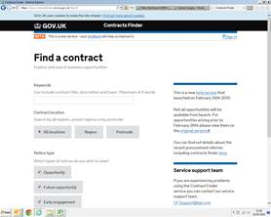
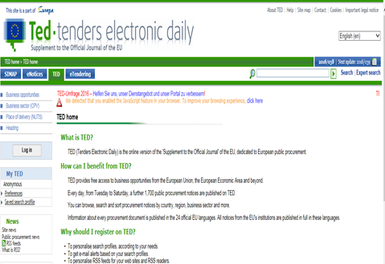
Procurement Adverts
Initial information regarding the procurement will be advertised on following websites:
Contracts Finder (https://www.contractsfinder.service.gov.uk/Search) and
OJEU TED (http://ted.europa.eu/TED/main/HomePage.do)

Slide 17
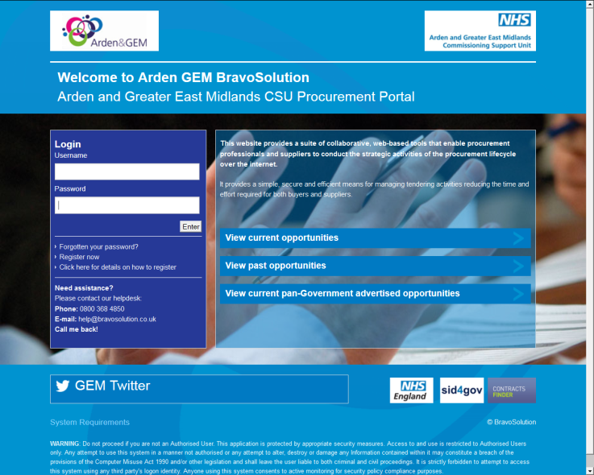
Arden & GEM e- Procurement Portal
The procurement will be managed using a web portal known as BravoSolutions (https://ardengemcsu.bravosolution.co.uk)
BravoSolutions shortly known as ‘Bravo’, is Arden & GEM CSU’s e-tendering procurement portal.
Notes:
Divyang

Slide 18
Table Top Discussions
Sam Cramond/Alison Cowie

Slide 19
Overview
4 discussion areas:
Transport and Logistics
Finance and Pricing
Footprints and Coverage
Mobilisation
You will have been assigned a group number on the register – please stay with this group for all four table top discussions:
Group 1 will start with finance and pricing
Group 2 will start with footprint and coverage
Group 3 will start with mobilisation
Group 4 will start with transport and logistics
25 minutes at each table to discuss with a facilitator
This is the opportunity for you to input into these elements for the procurement, not for detailed questions to be answered by the facilitator
There will be a 10 minute break after the first two table top discussions

Slide 20
Next Steps
Sam Cramond/Alison Cowie

Slide 21
Next Steps
Thank you all for attending.
NHS England and Arden and GEM CSU will now work through the information gathered from this session and all other market engagement sessions to inform decision making in relation to the service specification and tender.
We will come back out to the market via two Bidder Events in the week commencing 21st May (dates TBC) to inform of the decisions which have been made and run through the procurement process in further detail.

