Slide 1

Market engagement event for schools and NHS Children and Young People’s Mental Health Services Link Project
Friday 14th September, 2018

Slide 2
Agenda
11:00 – 11:15 Welcome and Introductions
11:15 – 11:35 Ecorys: The pilot programme and evaluation findings
11:35 – 12:00 Green Paper delivery context/update and Current thinking in relation to procurement
12:00 – 12:20 Commercial Context
12:20 – 13.00 Small group discussions and feedback
13:00 – 13:30 Q&A
13:30 – 14:00 Networking

Slide 3
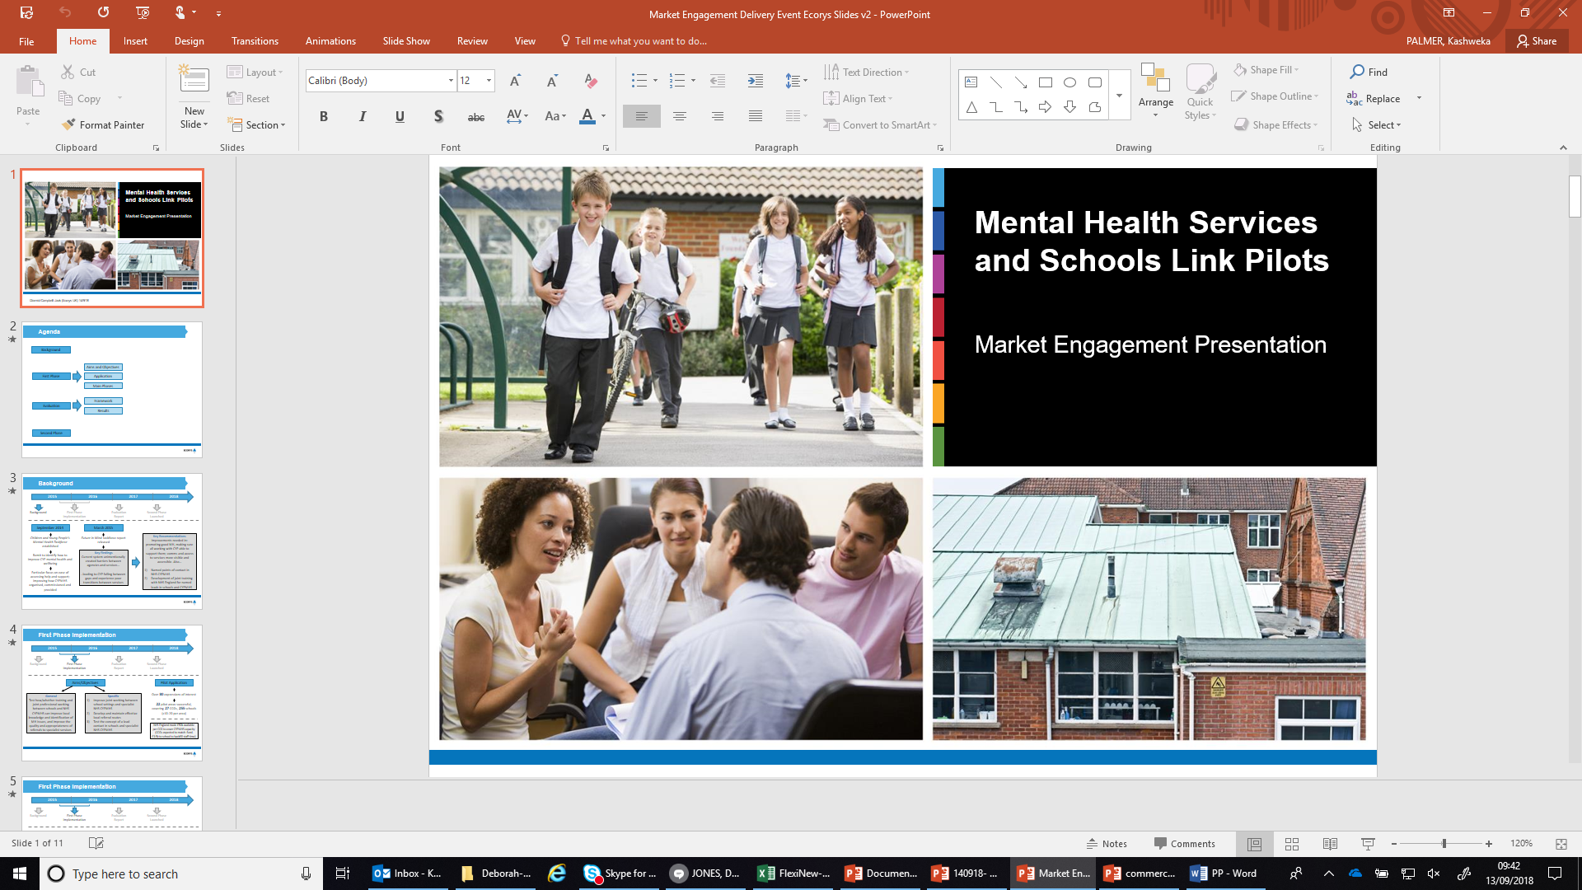
Ecorys: The Pilot programme and evaluation findings

Slide 4
Agenda
Background
Aims and Objectives
First Phase
Application
Main Phases
Evaluation
Framework
Results
Second Phase

Slide 5
Background
2015
2016
2017
2018
Background
First Phase Implementation
Evaluation
Report
Second Phase Launched
September 2014
March 2015
Key Recommendations
Improvements needed in: promoting good MH, making sure all working with CYP able to support them; comms and access to services more visible and accessible. Also…
Named points of contact in NHS CYPMHS
Development of joint training with NHS England for named leads in schools and CYPMHS
Children and Young People’s Mental Health Taskforce established
Future In Mind taskforce report released
Remit to identify how to improve CYP mental health and wellbeing
Key Findings
Current system unintentionally created barriers between agencies and services…
..leading to CYP falling between gaps and experience poor transitions between services
Particular focus on ease of accessing help and support; improving how CYPMHS organised, commissioned and provided

Slide 6
First Phase Implementation
2015
2016
2017
2018
Background
First Phase Implementation
Evaluation
Report
Second Phase Launched
Aims/Objectives
Pilot Application
Over 80 expressions of interest
General
Test how/whether training and joint professional working between schools and NHS CYPMHS can improve local knowledge and identification of MH issues, and improve the quality and appropriateness of referrals to specialist services
Specific
Improve joint working between school settings and specialist NHS CYPMHS
Develop and maintain effective local referral routes
Test the concept of a lead contact in schools and specialist NHS CYPMHS
22 pilot areas successful, covering 27 CCGs, 255 schools (c10-20 per area)
NHS England made £50k available per CCG to cover CYPMHS capacity (CCGs expected to match-fund. £3.5k to school to backfill staff time)

Slide 7
First Phase Implementation
2015
2016
2017
2018
Background
First Phase Implementation
Evaluation
Report
Second Phase Launched
Three Separate Pilot Programme Phases
Phase 1
Workshop 1
Forming schools and children and young people’s mental health partnerships (Sept to Dec 2015)
Phase 2
Workshop 2
Embedding partnerships and building sustainability (Jan to March 2016)
Supporting ongoing learning and development of best practice, and ensuring ongoing sustainability (Jan to March 2016)
Phase 3
2 National Events

Slide 8
Evaluation Framework
2015
2016
2017
2018
Background
First Phase Implementation
Evaluation
Report
Second Phase Launched
Mixed Methods Evaluation
Quantitative
Surveys
Structured Observations
Qualitative Interviews
Case Study
Visits
Pre/post: SPOC in schools and CYPMHS
Pre/post: sub-sample “whole school”
Snapshot:
other local stakeholders
In-depth:
CYPMHS
leads
Detailed
workshop observations
Pilot site case studies: focus groups and ints
Accessed admin data
Accessed CASCADE data

Slide 9
Evaluation Results
Workshops & National Events
Met needs for majority (some commissioned extra)
Established new contacts, shared knowledge
Need to consider prior joint working
National events almost unanimously welcomed
Most commonly individual with student welfare responsibilities (e.g. SENCO, inclusion co-ordinator) or deputy/assistant headteacher
School Lead contact
Lead role reporting to senior manager
Occasionally combined lead role and senior manager
3 models for NHS CYPMHS lead
No single set model used in each area – different models used depending on local context
Lead delivering services/support to YP and staff
Lead offering support/training to school-based professionals
Lead as single point of access

Slide 10
Evaluation Results
Key Factors
Key as importance of ownership by CCGs and LAs – incl. tailoring content.
Variety of approaches developed. No single model ‘most effective’ overall. Key success factors that helped contribute:
Strategic leadership from health and education
Open channels of communication where possible
Clearly defined protocols and pathways to specialist support
Making best use of existing resources (e.g. CYPMHS network)
Key Challenges
Staffing capacity (e.g. CYPMHS requiring lead-in time)
Lead role in school having too many responsibilities
“
At a national level, the pilot programme very much demonstrates the potential added value of providing schools and NHS CAMHS with opportunities to engage in joint planning and training activities, improving the clarity of local pathways to specialist mental health support, and establishing named points of contact in schools and NHS CAMHS.
”

Slide 11
Evaluation Results
Key Outcomes
Wider outcomes relating to:
Contribution towards improvements in frequency and quality of school-CYPMHS communication
Perceived improvement in quality and consistency of referrals (without net overall increase in referrals) – reduced mismatch between school expectations and CYPMHS capacity
Early signs of change to whole school policies, resource and staffing
Increase in types of mental health support in pilot schools (incl. staff training, therapeutic support, whole school strategies)
More limited evidence of impact on use of evidence-based interventions or common outcome measurements
Evidence from surveys backed up by self-assessment CASCADE data
Strong and statistically significant outcomes relating to:
Knowledge and awareness of mental health issues
Understanding and awareness of referral routes
Confidence in supporting CYP with mental health issues
Broader surveys among staff suggested promising signs of capacity building beyond the lead points of contact

Slide 12
Evaluation Results
Sustainability
“
Pilots often developed with a view to wider roll-out (e.g. drawing on Transformation Plan budgets)
Was broad support for maintaining close CYPMHS-school links but different views on how to maintain (primarily around whether in-school presence required or not).
Primary challenge around finding right balance between scale and contact time. Range of different options being examined (e.g. menu of cost options for schools; cluster/locality-based support; single point of access for schools around triage/duty system etc.)
The real lesson, that’s hard to admit with commissioning and with budgets, is that you need to develop relationships. There’s no point if schools only ring up when they have a crisis. It’s got to be a proper relationship, so that the clinician gets to know the school and is enhancing things from the bottom up
NHS CYPMHS lead contact
”

Slide 13
Second Phase
2015
2016
2017
2018
Background
First Phase Implementation
Evaluation
Report
Second Phase Launched
Overall Objectives
Launch
Sept 2017
New Areas
Pre/post data collection
Case studies
Original Areas
Light touch data collection
Qual interviews
Further testing of certain delivery aspects
…sufficient buy-in at outset, enhanced pre-workshop activity (inc. time for workshops to be tailored for local context)
Test the efficacy of scaled-up delivery…
…across 20 new CCGs and much larger number (1,200) of educational institutions, including sixth form and vocational collected
Delivery Ends
Mar 2019
Evaluation
May 2019

Slide 14
Green Paper delivery context/update

Slide 15
Schools Link pilot in the Green Paper (2017) and Green Paper consultation response (2018)
Green Paper: ‘We will roll out the NHS Mental Health Services / Schools Link pilot to all areas by 2025’
Highlighted the value of training in joint working
Green Paper consultation response: ‘we will roll out our NHS Mental Health Services/ Schools Link pilot’
Acknowledgement that the MH/schools link programme will help areas which are not part of the initial Trailblazer roll-out to develop effective joint working
Strands of Green Paper delivery are stand-alone, but mutually reinforcing

Slide 16
Designated Senior Leads for Mental Health: Building on, but separate from, existing practice and learning from schools link pilots
‘a common successful element of the Schools Link pilot was the identification of specific leads in schools and mental health services’
Over half of schools and colleges have already identified a ‘Lead’
We aim to incentivise schools and colleges to continue putting in place Designated Senior Leads for Mental Health by offering free of charge training to build, or enhance/ complement their existing knowledge
We envisage the DSL(MH) as a strategic role, ensuring that the school or college takes a well thought-through approach to mental health and wellbeing which runs through the whole school or college’s activities
We are currently scoping a separate procurement around provision of DSL(MH) training with a view to offering this from late 2019

Slide 17
Differentiating the training packages
Schools/CYPMHS Link Pilot Training
Historical commitment from 2015 Future in Mind Report
Improves joint working between schools/colleges and local CYPMHS services
Schools must identify a lead in order to take part, but the training provided is focussed on strengthening joint working arrangements
Aiming for national roll-out from Spring 2019
Aiming for first phase of national rollout to contain a sample of Phase 1 of the trailblazer areas
DSL for Mental Health Training
New commitment in the 2017 CYPMH Green Paper
The identified lead will receive training
Training will be substantial, and cover a range of topics
Aiming for roll out to commence in first term of 19/20 academic year, and continue over five years
Aiming to synchronise with start of trailblazers so that their identified leads can receive DSL training as quickly as possible

Slide 18
Mental Health Support Teams/ Trailblazers
The third part of the jigsaw are the new mental health support teams which will ‘wrap around’ the school/ college
They will be staffed up by trained Education Mental Health practitioners, and funded via CCGs
The ‘Trailblazers’ refer to test beds for the new teams…want to cover as wide a range of local characteristics as possible
CCGs are currently submitting bids for the EOI process to become Trailblazers – in collaboration with relevant providers, commissioners and education officials in the local area
First Trailblazers – between 10 and 20 - should come online by the end of 2019…
And we aim to deliver to at least a quarter to a fifth of the country by the end of 2022/23
Link with single point of contact and trailblazers – it would be advantageous if areas have a chance to do this before they take on Mental Health Support Teams…
We would therefore aim for the first phase of national rollout of single point of contact to include a selection of Phase 1 trailblazer areas

Slide 19
Current thinking in relation to procurement

Slide 20
What’s been delivered under the programme so far?
2015 and 2017
Anna Freud National Centre for Children and Families appointed under competitive tender
PHASE 1 – Pilot Phase
PHASE 2 – Current until March 2019
Delivered to 255 primary and secondary schools across 27 CCG areas between September 2015 and March 2016
Being delivered to around 1,200 primary and secondary schools and colleges across 20 CCG areas between January 2018 and November 2019

Slide 21
Our future plans for the programme
Up to 2022/2023
December 2017
Delivery will be over a 4 year period covering 241 cohorts per year.
(Each cohort contains up to 20 schools)
Joint DH/DfE Green Paper ‘Transforming Children and Young People’s Mental Health’
All schools (excl. Independent schools)
They will be offered training – we estimate that 965 cohorts will need to be trained in order to reach a total of 17,266 schools

Slide 22
Plans for Procurement
The purpose of today is to explore your views on the market’s capacity to deliver the programme nationally and to test the potential for involvement of multiple organisations
We want to test with you a potential delivery model and get your feedback on the viability of this approach to inform future procurement strategy
Group discussions to consider:
Whether or not the proposed delivery model could work?
Are there sufficient suppliers with the capacity to deliver it? (With a strong understanding of how schools/colleges support pupils’ mental health; and experience of facilitating joint working between health and education service)
What other delivery approaches might we consider? (i.e. Breaking the contract down into smaller lots. For example: regionally to make it more accessible to smaller organisations or suppliers)

Slide 23
Plans for Procurement
The current model on the table – commissioning two separate strands of the programme with each strand potentially led by multiple suppliers or a consortia of suppliers
The two strands are:
Recruiting and managing CCGs nationally to participate in training workshops and identifying and managing a strategic lead for each CCG area to recruit schools/colleges and coordinate delivery of the training
Delivery of a workshop-based joint- training model to mental health leads in children and young people’s mental health services including, NHS CYPMHS and allied CYP mental health and local authority professionals and schools/colleges

Slide 24
Strand 1: Key Aspects
To identify and manage a strategic lead for each CCG area responsible for recruiting NHS CYPMHS, and schools and colleges and other relevant professionals to participate in the workshops
This could be the CCG commissioning lead for CYPMHS or someone from another organisation. E.g. A CYPMHS provider, or someone in a local authority who is in a leadership position
Evaluation demonstrates that the strategic lead is key to success of the programme – (S)he will:
Coordinate and act as the overall point of contact with the training provider, schools and Mental Health Services
Recruit participants and ensure they know what level of commitment is required
Undertake pre-workshop review activity with senior stakeholders in each CCG and local authority in advance of delivering the workshops to map existing mental health support for children and young people in their area, so workshops can be tailored towards local need

Slide 25
Strand 2: Key Aspects
To deliver 2 consecutive workshops over 2 full days, with sufficient time (approx. 6 weeks) between the workshops to allow for the development and completion of agreed actions tailored to meet the needs of each CCG
The content of the workshops based on the model developed during the pilot phase of the programme with each workshop made up of 20 schools and their MH service counterparts centred around the following themes:
Developing a shared view of the roles, remit and responsibilities of everyone involved in supporting the mental health of children and young people
Developing knowledge of existing structures, processes, policies and resources and how they support/hinder collaborative working and could operate more effectively
‘Forward look’/action planning to develop more effective joint working between education and mental health professionals and timely access to appropriate support for children and young people

Slide 26
Commercial Context

Slide 27
Procurement Context
At this point the Department has not committed to running a full procurement
We are using this event to engage with suppliers and request feedback on our proposals
Timelines and processes are therefore indicative
The following advice includes general procurement principles

Slide 28
Procurement- Draft Timeline*
The final procurement route has not yet been established but we will look to go to the market in November/December 2018
Contract notice published in Contracts Finder and OJEU and tender documents released on Bravo system
November/ December 2018
Early 2019
Responses assessed against a set of published criteria
February/ March 2019
Successful organisation(s) informed
April 2019
Contract in place
*All timelines are indicative and activity is subject to funding being available, proposals meeting the required standards and Ministerial approval

Slide 29
Contractual Approach
The final contract will be based on government standards, the key commercial principles will be reflected in the contract
The contract will be based on DfE’s specification and the commitments that suppliers make in their tender submissions
This programme supports the government target for a third of central government buying to be with SMEs by 2020
Notification of call to bidders will be published in Contracts Finder in gov.uk

Slide 30
Group Discussions and Feedback
We want to test with you a potential delivery model and get your feedback on the viability of this approach to inform future procurement strategy
1. Whether or not the proposed delivery model could work?
2. Are there sufficient suppliers with the capacity to deliver it? (With a strong understanding of how schools/colleges support pupils’ mental health; and experience of facilitating joint working between health and education service)
3. What other delivery approaches might we consider? (i.e. Breaking the contract down into smaller lots. For example: regionally to make it more accessible to smaller organisations or suppliers)

Slide 31
Feedback from groups

Slide 32
Q&A Session
Any Questions?

Slide 33
Networking Opportunity

Slide 34
Thank you for your time and contribution today

