Slide 1
Social Worker Early Career Framework Market Engagement March 2024

Slide 2
Aims of the session
In this session we are aiming to provide:
an overview of the background and purpose of the ECF
an update on the work we have done/are doing to develop the programme
a high-level view of the elements of the programme we will look to procure

Slide 3
Initial session
Welcome and introduction
ECF Overview including progress to date and next steps
Q & A
Roundtables

Slide 4
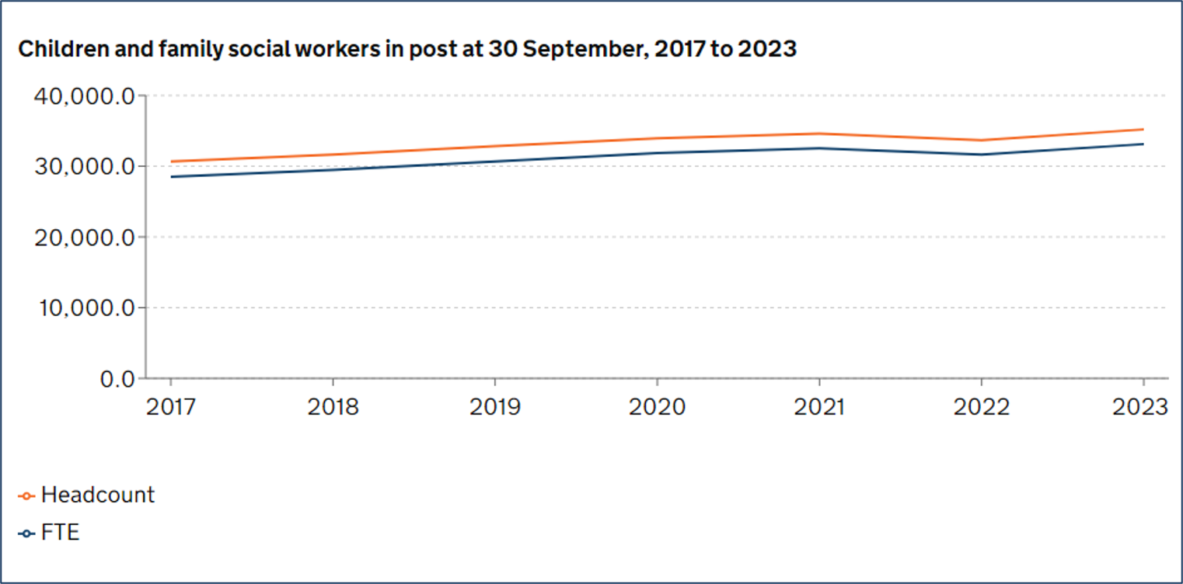
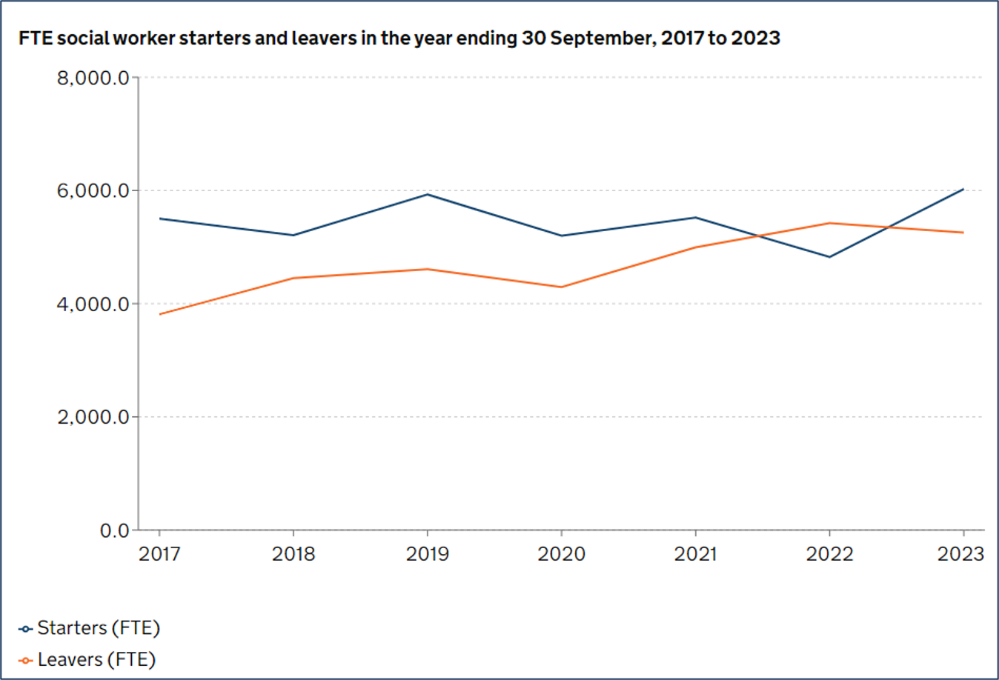
Headline facts and figures 2023
Information taken from Children’s social work workforce statistics: Year ending 30 September 2023 and published in February 2024.
For Social Work ECF, we anticipate between 2,700 and 3,000 new starters a year from September 2026.
Children's social work workforce, Reporting year 2023 – Explore education statistics – GOV.UK (explore-education-statistics.service.gov.uk)

Slide 5
On Thursday 2nd February, we published Stable Homes, Built on Love – an implementation strategy and consultation, backed by £200m additional investment.
The strategy sets out a vision to rebalance children’s social care away from costly crisis intervention to more meaningful and effective early support.
It sets out actions that seek to:
Address urgent issues facing children and families now
Lay the foundations for whole system reform
Set national direction for change
We will reform in phases, investing £200m over the next two years.
After two years we will refresh this strategy, scaling up new approaches we have tested and bringing forward legislation (subject to parliamentary time).
Three reviews were published last year, provided impetus and vision to transform children’s social care.
The Independent Review of Children’s Social Care
National Review into the murders of Arthur Labinjo-Hughes and Star Hobson
The Competition and Markets Authority study into Children’s Social Care Placements
There are six pillars of reform
Pillar 1: Family Help provides the right support at the right time so that children can thrive with their families
Pillar 2: A decisive multi-agency child protection system
Pillar 3: Unlocking the potential of family networks
Pillar 4: Putting love, relationships and a stable home at the heart of being a child in care
Pillar 5: A valued, supported and highly-skilled social worker for every child who needs one
Pillar 6: A system that continuously learns and improves, and makes better use of evidence and data

Slide 6
Pillar 5: A valued, supported and highly-skilled social worker for every child who needs one
In Stable Homes, Built on Love we committed to developing a five-year Early Career Framework for Child and Family Social Workers, and to “…explore how we can make the ECF an entitlement for all child and family social workers from September 2026”
The programme will provide a two-year induction pathway for all new social workers and an advanced pathway of up to three years for those who wish to take it
The primary purpose of the programme is to support continued improvements in the quality of practice of the social work workforce in line with the National Framework
By investing in the early development of new social workers, and supporting them through the steep learning curve at the beginning of their careers we aim to improve retention in the profession

Slide 7
Specifically, we said…
“Once it is established, it will replace the current ASYE programme for child and family social workers.”
“We will look to develop an ‘expert practitioner’ level of the ECF for years 3 to 5 post-qualifying…we want to use years 3 to 5 of the ECF to ensure that more social workers stay in front-line roles, carry out complex work with children and families and model excellent practice for others.”
“The ECF will be based on a framework document setting out the detailed, comprehensive skills and knowledge…[and] this will align with the Children’s Social Care National Framework”
“The support and training provided to early career social workers should balance national consistency with the ability to adjust to the local realities of individual local authorities”
“We will work with early adopter local authorities and social workers to design and test the early career offer”
“As with ASYE…we will expect social workers to evidence that they have achieved the skills and knowledge required by each level of the framework, in line with other professions.”
“We want to recognise the achievement of completing the ECF. We will work with Social Work England, DHSC and local authorities to consider how best to recognise career progression”

Slide 8
What are we aiming to deliver?
The first two years of the ECF should replace the Assessed and Supported Year in Employment (AYSE) with a more detailed curriculum to build knowledge and skill. | Years three to five should continue to invest in developing expertise, including in child protection, with recognition as ‘Expert practitioners’. | The optional Expert Practitioner pathway would allow social workers to progress in their careers whilst remaining in front line practice. | There should be a common assessment in the second year (replacing the ASYE assessment) and at the end of the Expert Practitioner pathway.
End state: a programme which delivers:
High level vision of 5-year ECF Pathway:
The building blocks of a full, national ECF programme would include:
A Framework which sets the expectations, and reflects the best evidence in child and family social work
A delivery mechanism which provides all social workers with high quality training and support to enable them to meet the standards set out in the framework
Fair and accurate assessment which assures the quality of practise and supports learning
National Recognition of progression through the programme, which is understood by social workers, employers and the public
Newly Qualified Pathway
Experienced Practitioner Pathway
Experience in front line practice
Standards
Post-Qualifying Standards & Early Career Framework
Early career & experienced practitioner CPD
DfE support
Reduced caseload
Local Authority based support
The ECF will be a significant reform, changing the architecture of the profession. We are learning from how other professions operate, including Teaching and their recent ECF.
A structured entry and assessment of capability is common in many other professions, including medical professions; the ECF will bring social work more in line with them, but needs to be designed for our specific context.
Assessment
Integrated assessment
Progression & recognition
Child and Family Social Work Practitioner
Expert Practitioner
This is a high-level overview of what a programme could include; further engagement and decisions are needed to finalise the detail of what will be delivered. We also anticipate that some of the language used within the programme will be updated following stakeholder feedback.

Slide 9
Progress to date
Early Adopters
Expert Writing Group
Policy Development & Engagement
Appointed 8 ‘Early Adopter’ LAs:
Achieving for Children
Birmingham
East Sussex
Gloucestershire
Plymouth
Stockport
Together for Children Sunderland
Tower Hamlets
To be eligible, LAs needed to have an Ofsted rating of RI or higher, have an extended ASYE programme in place, and be able to participate in the programme.
Early adopters are working with us to co-design the ECF, test and provide insights into the proposed programme, and help us understand needs of early career social workers.
We will expand the number of Early Adopters this year and recently published the selection process.
Formed an expert writing group, to write the framework document setting out the knowledge and skills expected of social workers in their early career.
The group is led by Laura Eden (PL, Islington), with four other sector experts recruited from Local Authorities.
The Group also includes a framework development expert, an expert by experience, and Social Work England.
The Expert writing group have now drafted an outcomes Framework for Y1-2 and are working on describing the underpinning knowledge that will help social workers to meet those outcomes.
We have tested the Framework through a Delphi process and will consult on the content later in the year.
Significant stakeholder engagement to inform policy development against the four building blocks of the ECF programme.
Understanding and balancing policy tensions within to inform programme design, within each of the building block.
Developing our understanding of the overarching risks to successful implementation of an ECF, specifically:
The sufficiency of the social work workforce
Local authority capacity to engage with and deliver ECF training
We will continue to engage widely with the sector on the options for ECF design, and expect to provide more detailed updates in the Spring.

Slide 10
The knowledge pillar will be based on prioritised sections of the framework
DRAFT ONLY – NOT GOVERNMENT POLICY
We ran a competitive recruitment and set up an Expert Writing Group to develop the framework. They want to understand what the sector thinks should be prioritised in the framework, reaching out to as many social workers as possible prior to formal consultation to influence their writing.
CSC Sector engagement pre-consultation ​
Workshops & regular feedback from Early Adopter LAs​
Regular meetings with PSW Network and Practice Leaders on framework, and ADCS, Ofsted, BASW, Unison on programme design​
Expert Writing Group ​
Wider group of experts – 4 experienced SW and 1 expert by experience ​ Help pen holders get robust understanding of level expected and draft and review detail. ​
Social Work England​ Provides regular input on draft to ensure overlap with readiness for practice guidance & professional standards​
Framework expert​ (Joe Oakley) Consultant with experience developing frameworks in other fields helps us develop the writing process and ensures all content is informed by latest pedagogy evidence, is clear, detailed and measurable/assessable ​
Sector expert Chair (Laura Eden) Holds pen on whole framework and develops descriptors of skills & knowledge. ​
Formal Consultation
Wider stakeholder engagement ​
Representatives of children & young people and experts by experience ​
Representatives of foster carers, kinship carers & parents ​
OGDs and safeguarding partners ​
Engagement on specific cohorts & issues

Slide 11
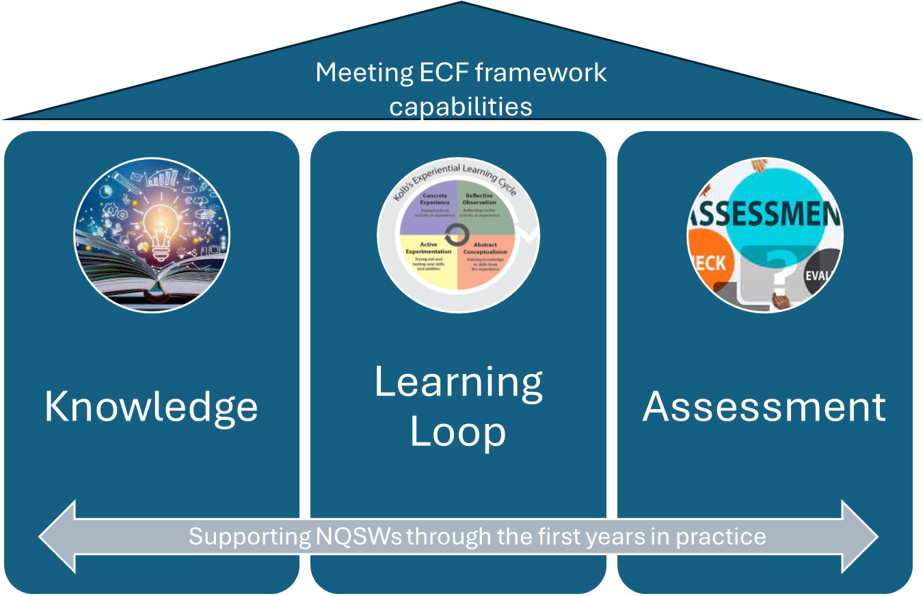
Programme Design Blueprint
We are developing a programme Blueprint which will set out the overall design of the programme. We are talking to a range of stakeholders as we develop the programme. We will consult on the Blueprint and Framework later in the year.
The blueprint design is based on the following design principles:
Greater consistency (of outcomes and experience)
Flexibility built in (meeting the needs of individuals and local authorities)
Mitigate against exacerbating the sufficiency challenge
Make the programme simple to implement
…and it sets out:
The programme purpose
Roles and responsibilities of actors in the system
Entitlement and eligibility for the programme
The structure of the training and support offer
Programme delivery model, including what we will buy, build, and fund
Quality assurances mechanisms
Implementation plan
The structure of training and support will be based on three pillars:
Knowledge – Training on the key areas of the framework which have been pulled out because they either help a new social worker to step into practice or they are related to persistent problems in the sector
Learning loop – A process of observation (both observing experienced practitioners and being observed) and being supported to reflect on and develop practice (link into training and assuring the quality of Practice Educators/Supervisors in Y3-5)
Assessment – to provide assurance that social workers have met the standards set out in the Framework with a future link to the social work register
To be successful, these three elements need to work together, drawing on the framework document, to reinforce the learning and development NQSWs undertake.

Slide 12
Delivering the ECF
Local Authorities will be responsible for:
Delivery of the learning loop and Assessment
Ensuring ECSWs engage with the programme
Employment and work of ECSWs
Contractor(s) will be responsible for knowledge provision and supporting national consistency through:
Assurance
Supporting local authorities to accurately and fairly assess EYSWs against the ECF Framework
Includes assessor training and moderation
Learning Loop support
Supporting local authorities to deliver observation and reflective support to EYSWs
Includes support and training for Practice Educators and Practice Supervisors
Knowledge
Face to face and virtual learning against priority elements of the framework

Slide 13
Programme Next steps
The Expert Writing Group will finalise the Framework and the description of the underpinning skills and knowledge
We will expand the Early Adopter programme from September 2024. Early Adopters will continue to input into overall ECF design, and begin to test specific elements of a potential programme
Development of the ECF delivery model, including requirements for digital delivery and for delivery partners
Formal consultation on the draft framework and overall programme design, Summer 2024
We are exploring making the ECF and entitlement for C&F social workers from September 2026. We will build up to that through our Early Adopter programme, procurement activity and digital development.
We will consider implementation plans and transition from ASYE to ECF, and consult with the sector
The ASYE programme for child & family social workers, and associated funding, will continue while the ECF is in development.

Slide 14
Discussion Sessions – March 2024
The purpose of these sessions is to encourage open discussion with each sector and create an environment that allows deeper exploration and understanding of sector specific issues, and to invite feedback from the market on the design of the programme before final decisions are taken.
Organisations are encouraged to register on Jaggaer, outputs and themes from all sessions and updated PIN notices will be shared via Jaggaer.
Date | Time | Registration closes | Audience
19th March 2024 | 09:15 - 10:45 | 18th March at 13:00 | Social work/care specialist training providers
21st March 2024 | 13:15 - 14:45 | 20th March at 13:00 | Higher Education Institutions
26th March 2024 | 14:15 - 15:45 | 25th March at 13:00 | All other potential providers
Your organisation is invited to sign up to ONE of the above sessions, as appropriate to your organisation. Up to 2 people from your organisation can attend the event.
Please register for the appropriate event via Eventbrite, no later than the advertised registration close date for each event.
You will receive to links to register by the end of today.
If you are unable to attend the date appropriate to your organisation, please do not join one of the other groups. The Department will be reviewing attendee lists and based on your registration details, reserves the right to allocate your organisation to an alternative session, in which case, you will be notified.

Slide 15
Over to you
Q & A

