Slide 1

Summary of dashboard content for Nature
Development status of indicator
Extent of ecosystem assets
→ Slide 2
Condition of ecosystem assets – Designated Sites
→ Slide 4
Condition of ecosystem assets – Water quality
→ Slide 5
Condition of ecosystem assets – Hydrology
→ Slide 6
Condition of ecosystem assets – Species composition
→ Slide 7
Condition of ecosystem assets – Connectivity
→ Slide 8
Condition of ecosystem assets – Soil and sediment health
→ Slide 9

Slide 2
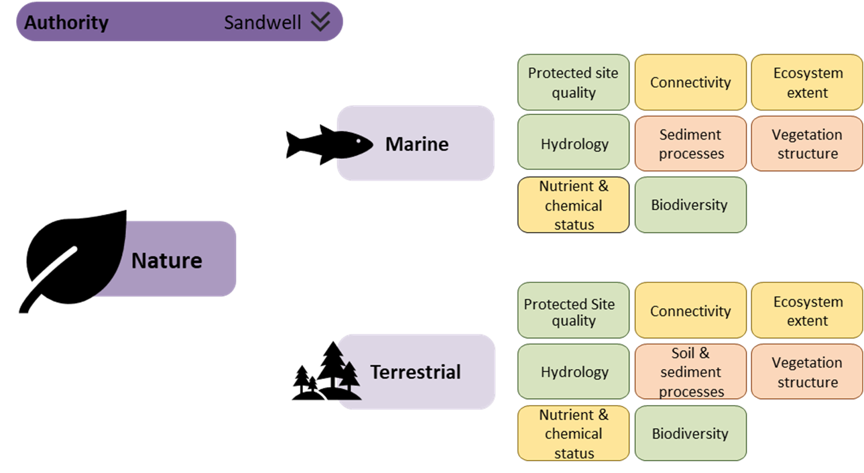



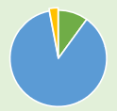
Extent of ecosystem assets
Area = 86,000 ha
To recover nature we need increasing amounts of semi-natural and wildlife-rich habitats.
Terrestrial
 | % cover
Semi-natural habitats | 10
Urban (excluding semi-natural habitats) | 87
Farmland (arable, horticulture, improved grassland, bare soil) | 3
Coniferous woodland
To see more detail on what is in your area click here (to slide 3)
To understand which habitats are particularly special and which are priorities for creation or restoration refer to your Local Nature Recovery Strategy (once available)
 | % cover
Wildlife-rich habitats: Priority habitat* | 6
Urban green and blue space
Marine and coastal
Habitats (to 6 nautical miles) | Ha | % cover
Salt marsh
Sand dunes
Beach
Intertidal sand
Intertidal mud
Seagrass beds
Blue mussel beds
Sabellaria reefs
Subtidal rock
Subtidal sand
Subtidal mud
Really want to show change over time but using Living England (LE) it will only be possible to display this as a snapshot in the short term. Longer term the ambition would be to show this as a trend over time but this will not be possible until LE 2+ cycles of data exist and change due to refinement and ground-truthing has settled.
* NB Updating of the Priority Habitat Inventory is limited, data do not give an indication of habitat quality, and there are known to be gaps. Refer to Spatial Register of Wildlife-rich habitats when this is available.

Slide 3
Extent of ecosystem assets - detail
Terrestrial
 | Ha | % cover
Urban woodland
Urban semi-natural habitats (not woodland)
Acid, calcareous, neutral grassland
Bog
Bracken
Dwarf shrub heath
Inland rock
Broadleaved, mixed and yew woodland
Scrub
Fen, marsh & swamp
Water
Marine and coastal
Habitats | Ha | % cover
Salt marsh
Sand dunes
Beach
Intertidal sand
Intertidal mud
Seagrass beds
Blue mussel beds
Sabellaria reefs
Subtidal rock
Subtidal sand
Subtidal mud
 | Ha | % cover
Arable & horticultural
Improved grassland
Bare soil
Coniferous woodland
 | Ha | % of urban area
Urban green and blue space (combined; excluding built up areas and gardens)
Urban (excluding semi-natural habitats)
This slide provides the detail behind the data on the previous slide and could be made visible through a button on the previous slide.
 | Ha | % cover
Priority habitat

Slide 4
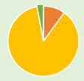
Condition of ecosystem assets – Designated Sites
Area = 86,000 ha
Sites protected for their habitats, species and geology are critical for nature recovery and represent core areas which need buffering and connecting as part of an ecological network. Improving the condition of SSSIs is a priority for enhancing nature recovery networks.
Terrestrial (including coastal)
Sites of Special Scientific Interest (SSSIs)* | Ha | % of total
Extent
Condition - favourable
Condition - unfavourable (recovering)
Condition – unfavourable (no change or declining)
% at each status
What is impacting on SSSI condition?
Refer to Designated Sites View for details
Marine and coastal
Marine Protected Areas (MPAs) | Ha
Extent
Condition - favourable condition
Condition - unfavourable (recovering)
Condition - unfavourable (no change)
Condition – unfavourable (declining)
Condition – unfavourable (unknown)
Condition – unfavourable (part destroyed)
Condition – unfavourable (destroyed)
% at each status
MPA is a collective term used to describe a protected area with a marine component. It covers a variety of sites including Marine Conservation Zones(MCZ), Special Protection Areas (SPA), Special Areas of Conservation (SAC) and Ramsar sites. What are Marine Protected Areas? - Marine developments (blog.gov.uk)
What is impacting on MPA condition?
Refer to MPA Conservation Advice packages for further details
And Marine Condition Reports ?
Check this is the right resource
* NB How recently SSSIs have been assessed varies and this information may no longer be accurate.

Slide 5
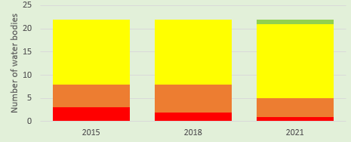
Condition of ecosystem assets – Water quality
Area = 86,000 ha
Water quality is critical to the condition of many habitats, as well as to people, but nature also has an important role to play in regulating water quality.
Terrestrial
including coastal & estuarine
Operational catchments | Number of water bodies with respective ecological water quality status*
 | Bad | Poor | Moderate | Good | High | Total
Tame Upper Rivers | 1 | 0 | 3 | 0 | 0 | 4
Tame Lower Rivers and Lakes | 0 | 8 | 14 | 0 | 0 | 22
Data will need cutting by LA area – need to decide how to reflect catchments as quality in LA area may be due to factors upstream of area
For further detail on water quality in your area visit the Catchment Data Explorer
Need to make sure that previous years’ data are comparable.
*Ecological status is a composite assessment of the quality of surface water ecosystems. It shows the combined impact of pressures such as pollution, habitat degradation and climate change.
Marine
Number of bathing waters with respective bathing water quality status**
Poor | Sufficient | Good | Excellent | Total
Bathing water status
Need further exploration of whether there is alternative data reflecting ecological status for marine waters at appropriate scale
For further detail on bathing water quality in your area visit
Swimfo.
**Bathing water status predominantly reflects the management of human waste treatment and agricultural effluent. This impacts on ecological quality but is not a direct measure of this.

Slide 6
Condition of ecosystem assets – Hydrology
Area = 86,000 ha
Terrestrial including coastal & estuarine
Hydrological regime status | % of water bodies in area
Supports good Ecological Status
Does not support good Ecological Status
Not assessed
For freshwater habitats natural ecosystem function is critical to thriving biodiversity and the provision of other ecosystem services such as water quality, flood regulation, and water supply.
The ‘naturalness’ of function relates to a number of factors such as the extent of artificial drainage, the degree of channel modification and presence of water control structures, whether the floodplain can function, and the extent and complexity of habitat mosaics in the catchment and vegetation along watercourses.
Morphology status | % of water bodies in area
Supports good Ecological Status
Does not support good Ecological Status
Not assessed
For further detail refer to Catchment Data Explorer for rivers and lakes, and the Water Body Summary Table for coastal and estuarine water bodies.
Marine
Maintaining the marine hydrodynamic regime helps to support a healthy and diverse marine ecosystem by providing the necessary physical conditions for species to thrive. It plays a key role in regulating the Earth's climate by controlling the exchange of heat, moisture and carbon between the ocean and the atmosphere, and is critical for the safety and economic viability of coastal communities and industries, such as fishing and shipping. New infrastructure has the potential to alter the hydrodynamic regime and may impact on benthic habitats.

Slide 7
Condition of ecosystem assets – Species composition
Area = 86,000 ha
The more ‘natural’ the communities of plant and animal species and their interactions in a place, the more resilient they are likely to be to climate change and other pressures. This is in terms of which species are present, their abundance and diversity, the presence of invasive species, and their ecological functioning.
Terrestrial (including coastal)
Annual number of water birds (WEBS)
Breeding bird numbers
Butterfly numbers
For further detail… LNRS?
Check can access data as will need cutting by LA area. Would reporting by habitat (farmland, woodland, wetland) be more meaningful?
You can find information on individual sea bird populations in the BTO’s Seabird Monitoring Report as part of the Seabird Monitoring Programme for internationally important seabird species at coastal and inland colonies across the UK.
The GB Non-Native Species Secretariat has responsibility for helping to coordinate the approach to invasive non-native species (INNS) in Great Britain and their website is a key one stop shop for all INNS information Home » NNSS (nonnativespecies.org).
Marine
To understand the trends in marine animals, birds and benthic communities in the wider seas see Summary of progress towards Good Environmental Status - Marine online assessment tool (cefas.co.uk).

Slide 8
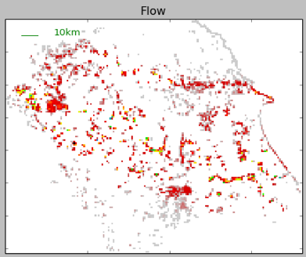
Condition of ecosystem assets – Connectivity
Area = 86,000 ha
Terrestrial
Habitat loss and fragmentation can reduce ecosystem function, reduce the size of populations and hinder the movement of species. This makes them more vulnerable to change and can threaten long-term viability.
Consider calculating connectivity using a tool such as Condatis which highlights pathways for dispersal, bottlenecks and helps you rank sites for habitat creation, restoration or protection.
Link to case study
To enhance connectivity:
Create new habitat connecting existing habitat
Remove barriers to species movement
Make the wider landscape more wildlife-friendly through messy pockets of nature and reducing damaging activities
For more information on improving ecological networks see Nature Networks – a summary for practitioners
To understand the opportunities for enhancing nature networks in your area see the Habitat Networks data layer.
Marine and coastal
The dynamic transition between marine and coastal habitats is critical for a range of both marine and coastal habitats and species. The movement of sediment between the marine and terrestrial environment is essential for healthy habitats such as sand dunes and salt marsh. These habitats play a vital role in reducing the impact of wave energy on coastal communities.
Barriers in the marine environment can affect the movement and distribution of marine organisms:
Physical barriers such as landmasses, islands, and underwater mountains that can restrict the movement of marine organisms.
Chemical barriers including changes in water temperature, salinity, and oxygen levels that can limit the survival and reproduction of certain species.
Biological barriers such as the presence of predators or competitors that can limit the growth and survival of certain species.
Man-made barriers such as harbours and associated sea walls and gates, power stations etc. that can limit the movement of marine organisms.

Slide 9
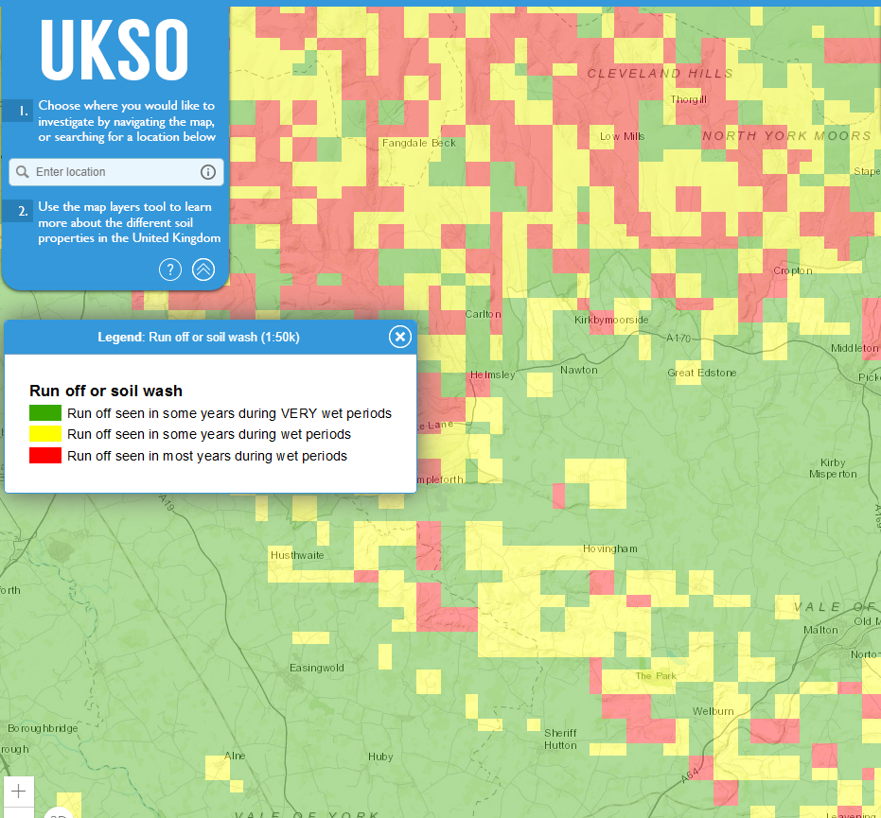
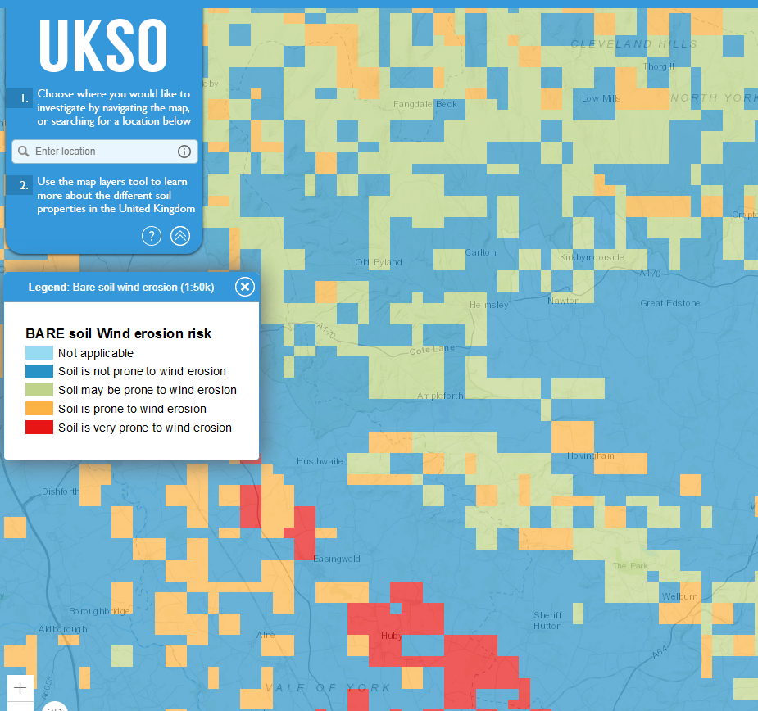
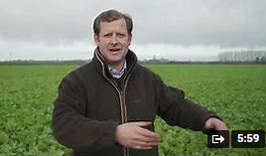
Condition of ecosystem assets – Soil and sediment health
Area = 86,000 ha
Terrestrial
Soil health reflects the capacity of the soil to provide ecosystem functions appropriate to the environment; storing carbon, supporting biodiversity and plant growth, regulating water flows, filtration and storage, and toxin and waste breakdown.
Poor management and land use causes degradation. Threats to soil health include compaction, nutrient and chemical inputs, loss of carbon, soil erosion.
Risk of soil erosion through run-off
Risk of wind erosion
Video?
For more information see UK Soil Observatory
Marine & coastal
The existence of many of our important coastal and estuarine habitats is dependent on the dynamic movement of sediment in the transitional zone between land and sea. These dynamic processes can be greatly impacted by human infrastructure limiting movement, mis-management such as over-grazing, and recreation activities.
For further information see the descriptions of these SAC/SPA habitats.
NESST (Natural England Spatial Sensitivity Tool) will provide valuable information when it becomes available.
There is a huge diversity of life inhabiting the sea floor in UK waters. Human activities such as fishing, sand extraction, and offshore construction cause physical disturbance to these benthic habitats. Some habitats, such as Maerl beds (calcareous algae) are highly sensitive to disturbance as they are easily damaged and take many years to recover, whereas other habitats, like mobile sediments, are more resilient and less affected.
For further detail see the Marine online assessment tool

Slide 10
Air quality
Explore whether possible to cut data to LA area to report e.g. % area of N-sensitive habitats where nutrient N critical loads are exceeded (used in SONC)
Data used in: Trends Report 2021: Trends in critical load and critical level exceedances in the UK Microsoft Word - Trends Report 2021.docx (defra.gov.uk)

Slide 11
Points to note
With the exception of water quality, hydrology and designated site condition there are no thresholds or description of what good looks like, which makes it more difficult to interpret for decision-making.
Where possible it would therefore be helpful to show trends over time (include info on frequency of data updates).
Longer term the use of the Biodiversity Intactness Index (BII) could be explored, calculated by LA area. The NHM are already doing this for some Las/post code areas and we are hoping to test use of BII for SONC in 2023-4.

Slide 12
Exclusions
No obvious meaningful data available for reporting on soils, connectivity or vegetation structure.
Have excluded vegetation structure & diversity completely as unlikely to play a significant role in strategic decision-making; more relevant at delivery level. This may also be the case for soils.
Haven’t included ground water status or water resource availability and abstraction reliability as these more relevant to services to people than biodiversity, but could be included from WFD data.

