Slide 1




Slide 2


Strategic Priorities Fund (SPF)
Evaluation pre-market engagement
20th March, 13.00-15.00
58 Victoria Embankment, London

Slide 3


Agenda
1 Introductions
2 Overview of the SPF
3 Evaluation Expectations
4 Procurement Overview
*Coffee Break*
5 Discussion

Slide 4

Introductions
Richard Meadows
SPF Lead
UKRI Strategy
Will Naughton
SPF Evaluation Lead
UKRI Analysis
Declan Ward
Category Manager – Research Procurement
UK Shared Business Services

Slide 5


Overview of the SPF

Slide 6
Background
The Strategic Priorities Fund (SPF), established in 2018 and led by UKRI, is one the UK’s largest, publicly funded, programmes of work to spearhead multi- and inter-disciplinary research and innovation (MIDRI).
The SPF builds upon Sir Paul Nurse’s vision of a ‘common fund’, to support high quality MIDRI programmes, which could have otherwise been missed through traditional funding channels.
The SPF is funded through the government’s National Productivity Investment Fund (NPIF), with a highly diverse portfolio consisting of 34 programmes at various stages of maturity, with a combined total investment of ~£830m.

Slide 7
The SPF’s objectives
Objective 1: Drive an increase in high-quality MIDRI
De-risk the process of preparing/submitting MIDRI proposals for the research and innovation community
Improve the efficacy of the funding system in assessing MIDRI proposals
Objective 2: Ensure that UKRI’s investment links up effectively with government research and innovation priorities and opportunities;
Improve join-up across Departments to establish consensus on key Government priorities for R&D
Increase understanding of Government priorities among research and innovation funders
Improve the ability of the R&D funding system to deliver cross-Government priorities through enabling PSREs to bid for open competitions funded through the SPF
Objective 3: Ensure the system responds to strategic priorities and opportunities.
Provide a funding route for high quality medium scale projects
Improve agility of the funding system to respond to emerging opportunities

Slide 8
The application process
SPF programmes were developed and selected through two waves of funding. All UKRI’s Councils along with six BEIS-funded bodies were eligible to develop proposals for programmes in any area which would address one or more of the fund’s three aims.
The fund has provided an ideal opportunity for organisations to work together, developing shared bids on specific research and innovation areas, with input from across the research and innovation community and government.
SPF programmes were selected through a competitive funding process. Assessment panels recommended programme selection and funding allocation.
There are 34 programmes across the portfolio, with work underway to grow a portfolio of calls as the programme matures. The organisations eligible to apply to the programmes are: Higher Education Institutes (HEIs), Research Institutes (RIs), Independent Research Organisations accredited by the UKRI Research Councils, and an expanded list of Public Sector Research Establishments (PSREs).

Slide 9
Wave 1: programmes by theme
Wave 1 | Environment (£60 million) | UK Climate resilience (DEFRA) Clean air: Analysis & Solutions (DEFRA, DHSC, DfT) | Constructing a digital environment (Cabinet Office) Landscape Decisions (DEFRA)
 | Bioscience (£55 million) | The Human Cell Atlas initiative Physics of Life | UK Animal and plant health (DEFRA, Scottish Government)
 | AI (£78 million) | Living with Machines AI and Data Science for engineering, health, science and government (Home Office, MoJ, DfT, DEFRA, DHSC) | Ensuring the security of digital technology at the periphery (DCMS, Home Office)
 | Large Capital Projects (£125 million) | European Bioinformatics Institute | Extreme Photonics Application Centre (MoD)
 | Productivity (£23 million) | Transforming productivity research (BEIS, DHSC, DWP)

Slide 10
Wave 2: programmes by theme
Wave 2 | Environment (£143 million) | Greenhouse gas removal demonstraters (BEIS, DEFRA) Clean Air: Indoor/Outdoor interface (Defra, Scottish Govt, Welsh Govt, DHSC, DfT) Transforming the UK Food system (DEFRA, DHSC, FSA) | National Interdisciplinary Circular Economy Research Programme (DEFRA) Sustainable management of UK marine resources (DEFRA, Scottish govt)
 | Health, Wellbeing & Human Rights (£105 million) | Policy and Evidence Centre for modern slavery and human rights (Home Office) Nucleic Acid Therapy Accelerater (DHSC, OLS) The Advanced Pain Discovery Platform | UK Centre of evidence implementation in adult social care (DHSC, Welsh Govt, Scottish Govt, NI Govt, MHCLG, Cabinet Office) Tackling multimorbidity at scale (DHSC) Adolescence, mental health and the developing mind (DfE, DCMS, Welsh Govt)
 | Digital (£37 million) | Towards a national collection (DCMS) | Protecting citizens online (DCMS, Home Office, National Security)
 | Productivity and Technical (£212 million) | Space weather innovation, measurement, modelling and risk (BEIS, MoD, DfT) Productivity institute (HMT, BEIS, DWP) Quantum technologies for fundamental physics | Trustworthy autonomous systems (National Security, MoD, DCMS, DfT) Harnessing exascale computing (MoD) National timing centre (MoD, BEIS, DfT)

Slide 11
Evaluation expectations

Slide 12
Purpose of the evaluation
UKRI is committed to rigorous evaluation of all our key programmes, including the SPF. We are commissioning an independent evaluation of our investment in the SPF wave 1 and 2 portfolio.
The aim of the evaluation is to:
inform ongoing and future improvements of the fund to maximise the value of public funding (in particular, the possibility of future growth of the SPF);
demonstrate what the fund delivered for taxpayers; and
help UKRI build the evidence base on ‘what works’ in successfully supporting high-quality MIDRI (R&I) and ensuring R&I responds to strategic opportunities and priorities.

Slide 13
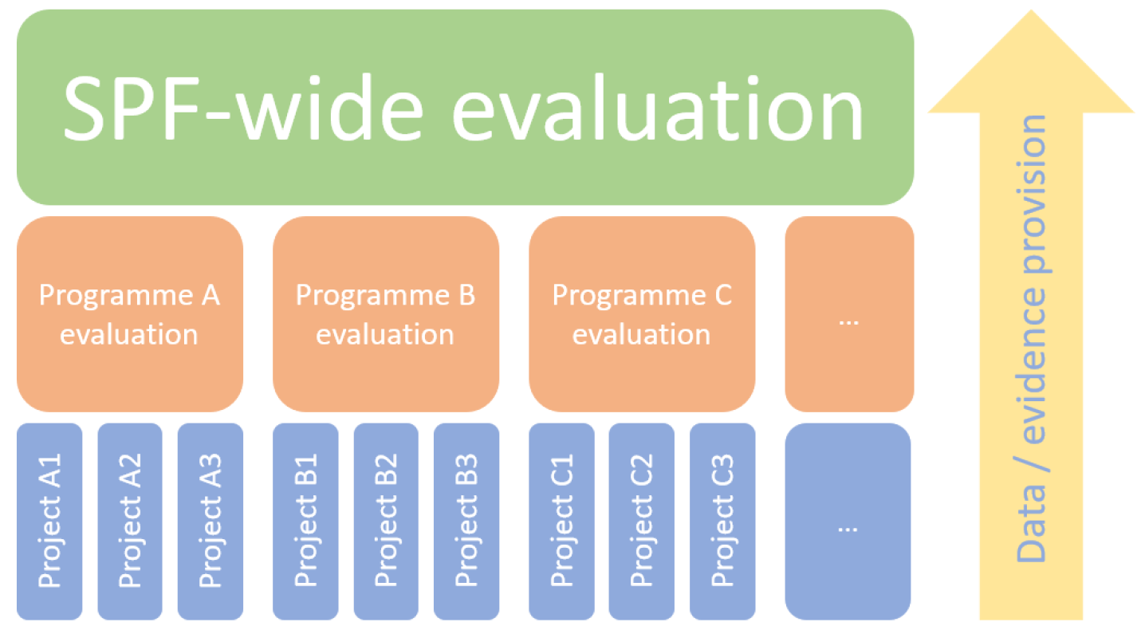
Overview of evaluation activity
We are commissioning the SPF-wide evaluation at the fund-level.
There is a range of evaluation activity being undertaken at the programme-level. While some of the SPF’s larger investments will commission their own independent evaluations, most programmes will not be subject to independently commissioned evaluations.

Slide 14
Evaluation expectations
Phase* |  | Dates
1 | Planning Phase | Jun 20 – Oct 20
2 | Baseline measurement | Oct 20 – Mar 21
3.1 | Interim process evaluation | Oct 20 – Apr 21
3.2 | Interim impact and economic evaluation | May 21 – Oct 22
3.3 | Final evaluation | Nov 22 – Dec 25
4 | Evaluation post-SPF | The ITT does not include Phase 4 of the evaluation; however, proposals must clearly set out how a delivery of a longer-term continuation of the evaluation could be conducted
*There will be a break clause in the contract at the end of each phase where UKRI will review the deliverables and make a decision on the continuation of the contract.

Slide 15
Phase 1: planning phase
The planning phase is intended to ensure there is a solid foundation for the SPF evaluation.
The key components of this stage are:
A detailed evaluation framework
Scoping and feasibility considerations
Review and refinement of evaluation questions and indicators
Validation and refinement of the SPF logic model

Slide 16
Phase 2: baseline report
The purpose of establishing a baseline is to provide a clearly defined starting point which can be used as a counterfactual scenario for the impacts of the SPF (in which the research or innovation activity did not take place). It is also to understand the current funding landscape in the UK to facilitate a detailed comparison with changes driven by the SPF.
It is expected that the baseline for the SPF will consist of multiple sources of data; as such, it will not be possible to rely solely on programme administrative data to construct a baseline. Proposals should, therefore, set out what additional (quantitative and qualitative) data is required, and how it will be collected.
The final report should set out the baseline ‘position’ for quantitative and qualitative indicators, with a description of all caveats and assumptions surrounding the evidence that forms part of the baseline report.

Slide 17
Phase 3: evaluation
Process
To understand how the SPF was delivered (the associated processes, the activities involves in its implementation, and the pathways by which the SPF was delivered), and why the policy was delivered in the way it was, with recommendations for ongoing and future improvements
Impact
To understand what difference the SPF is making in terms of economic, social and knowledge impacts, in addition to whether it is meeting its stated aims and objectives.
Economic
To understand if the benefits of the SPF justified the costs, and how the costs and benefits were generated

Slide 18
Procurement overview

Slide 19
Timescales
Procurement process | Dates
Advertise pre-market engagement event | 6th March 20
Pre-market engagement event | 20th March 20
Issue of competition to all bidders | 27th March 20
Deadline for clarification questions | 8th May 20
Latest date clarification answers | 15th May 20
Deadline for Bid to be submitted through Delta | 22nd May 20
Selection and de-selection of Bids | 29th May 20
Anticipated Interviews of shortlist | 8th to 12th June
Anticipated Award Date | 19th June
Anticipated Contract start date | 26th June 20
Anticipated Contract end date | 31st December 25

Slide 20
The Research Marketplace
The Research Marketplace is a Dynamic Purchasing System (DPS)
It can take up to 5 days for a supplier to register on the DPS
Bespoke supplier shortlists are created for each procurement by selecting ‘filters’ to create a shortlist of suppliers with the necessary skills
Due to the breadth of this evaluation no filters have been applied
If you would like to register as a supplier on the Research Marketplace DPS, please follow the online guidance and register at https://supplierregistration.cabinetoffice.gov.uk/dps#research

Slide 21
The Research Marketplace
The purpose of establishing a baseline is to provide a clearly defined starting point which can be used as a counterfactual scenario for the impacts of the SPF (in which the research or innovation activity did not take place). It is also to understand the current funding landscape in the UK to facilitate a detailed comparison with changes driven by the SPF.
It is expected that the baseline for the SPF will consist of multiple sources of data; as such, it will not be possible to rely solely on programme administrative data to construct a baseline. Proposals should, therefore, set out what additional (quantitative and qualitative) data is required, and how it will be collected.
The final report should set out the baseline ‘position’ for quantitative and qualitative indicators, with a description of all caveats and assumptions surrounding the evidence that forms part of the baseline report.

Slide 22

Coffee break

Slide 23



Slide 24





@UKRI_news
UK Research and Innovation
UK Research and Innovation

