Slide 1
Print collateral
Examples

Slide 2
Events handout
Front and introduction pages
Collateral is bilingual in English and Welsh.

Slide 3
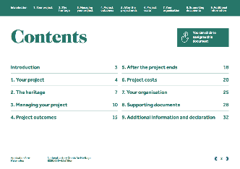
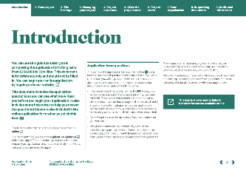
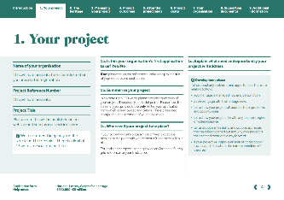
Application help notes
Example pages

Slide 4
Desktop banners

Slide 5
Digital
Examples

Slide 6
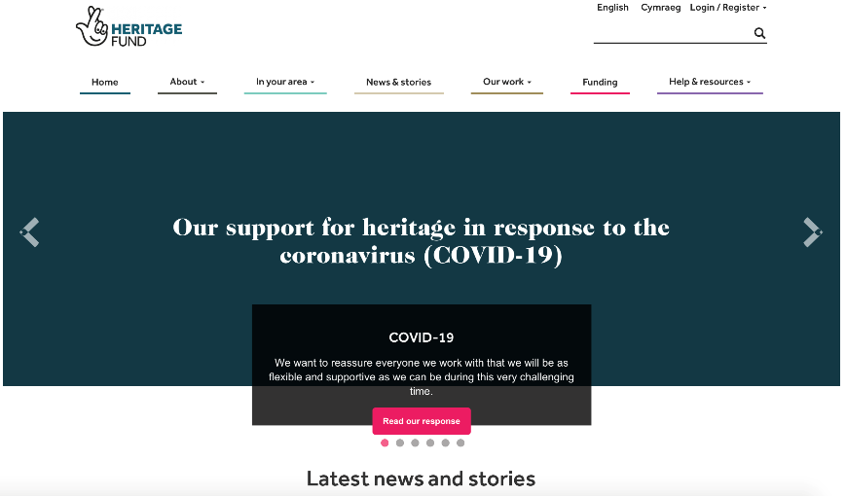
Website
Home page

Slide 7
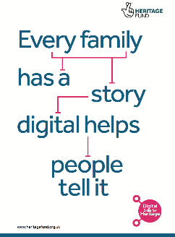
Digital skills
Printable posters

Slide 8
Photography

Slide 9
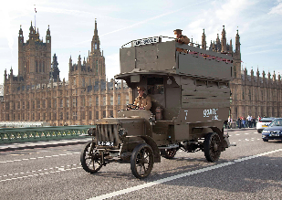
Photography
Examples

