Slide 1
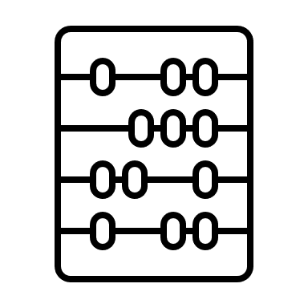
The Innovation Fund theory for change
INPUTS
OUTPUTS
INTERMEDIATE OUTCOMES
Flexible, staged funding
Data & Intelligence of innovation readiness, ‘state of nation’ on pan sector challenges
New capacity for change & innovation
Non-financial, tailored innovation
support
Sector becomes more aware of ‘how’ to transition to future-fit ways of working
Portfolio of experiments of
future fit workforce models
Cohort of pan-heritage leaders committed to learning & shaping themselves & their sector
Increased understanding of how to fund innovation & how that feeds & connects to internal systems & culture
Over Time: Proven models for future-fit ways of working in heritage sector
IMPACT
LONGER TERM OUTCOMES
New workforce models create:
Improved health & well-being of staff and volunteers
New career pathways for a more diverse workforce
New ways of delivering value to visitors/audiences through alternative models of provision
Further growth in leadership capacity for
change & innovation
Pan-sector collaboration on key issues, (perhaps in key localities)
Wider influence and leadership of Fund in sector & other lottery distributors

