Slide 1
To register on the Supply Southampton Tendering Portal
Please follow the instructions below. If you require assistance please call the Curtis Fitch Helpline on
01242 530900

Slide 2
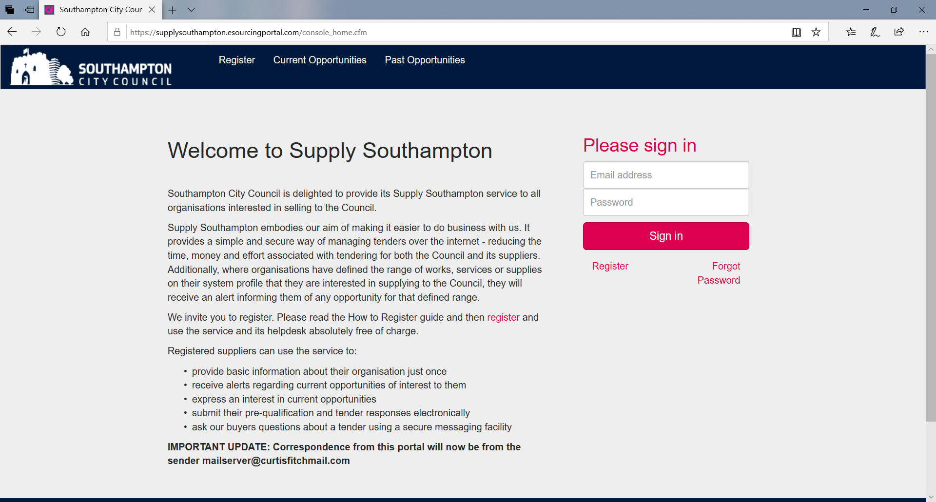
Register at https://supplysouthampton.esourcingportal.com/

Slide 3
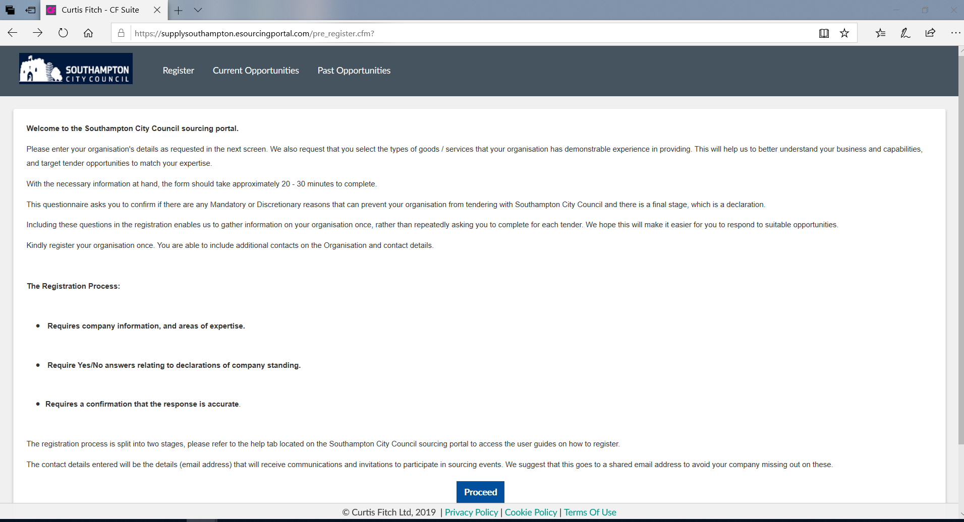

Slide 4
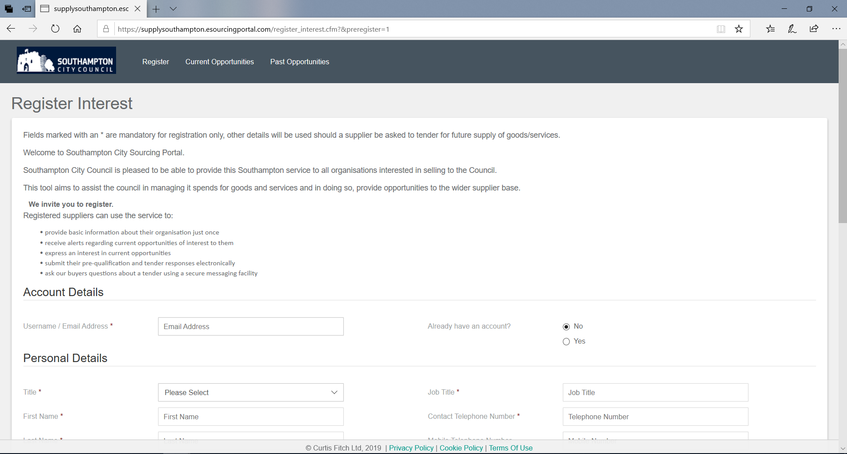
Notes:
When completing your organisation details, consider the email address used, as communications/alerts will be sent to this address, a generic email address is best to use.

Slide 5
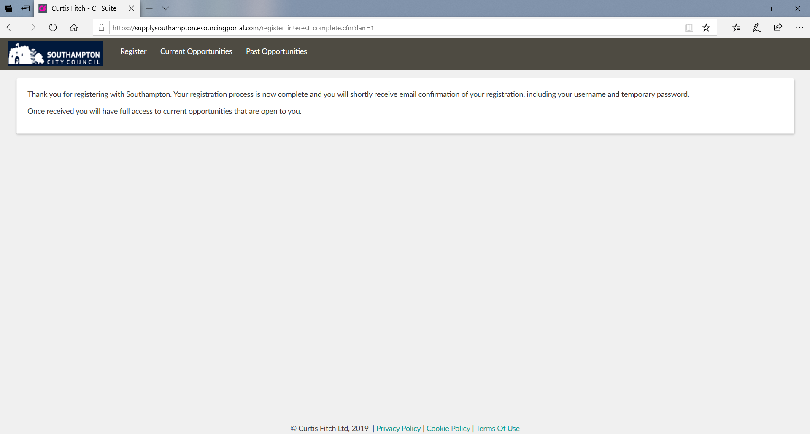

Slide 7
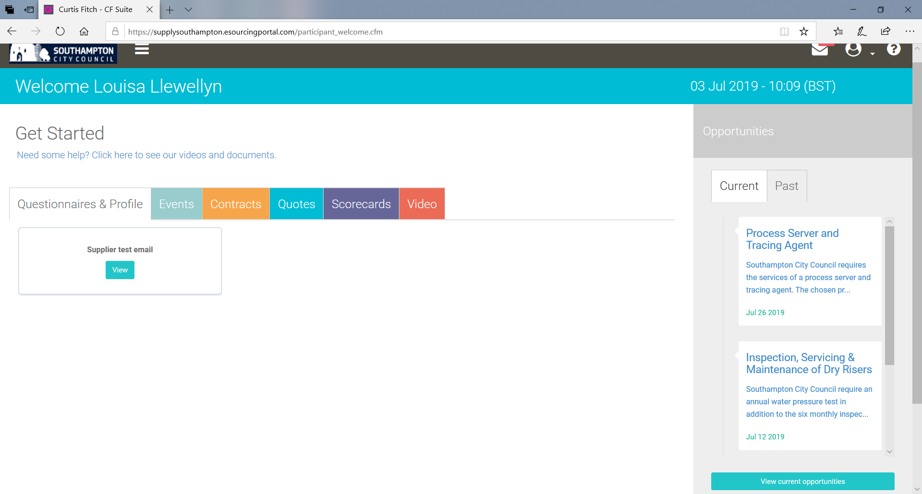
Registering for an event

Slide 8
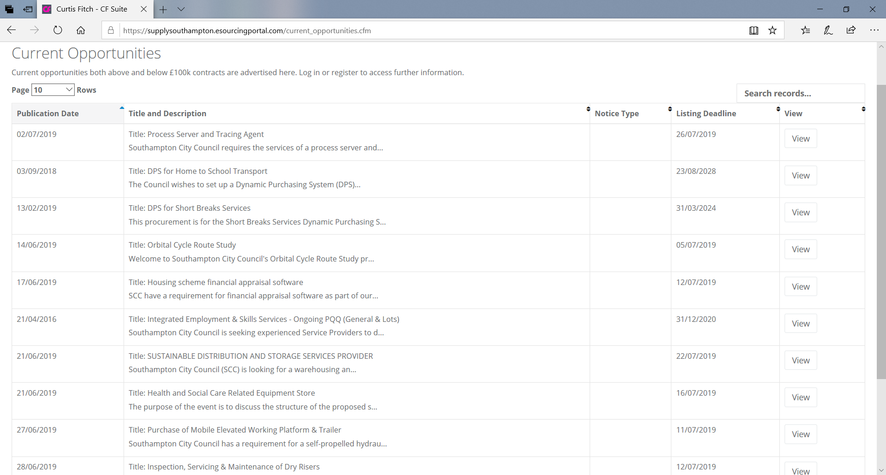
View opportunity of interest
Notes:
Point out the section marked emails, as this will be used for viewing clarification responses from SCC and can also be used by you to ask a clarification question.

Slide 9
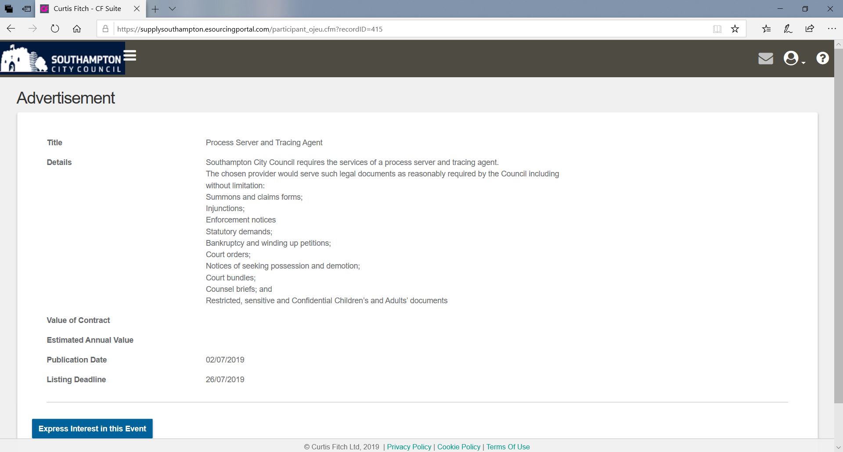

Slide 10
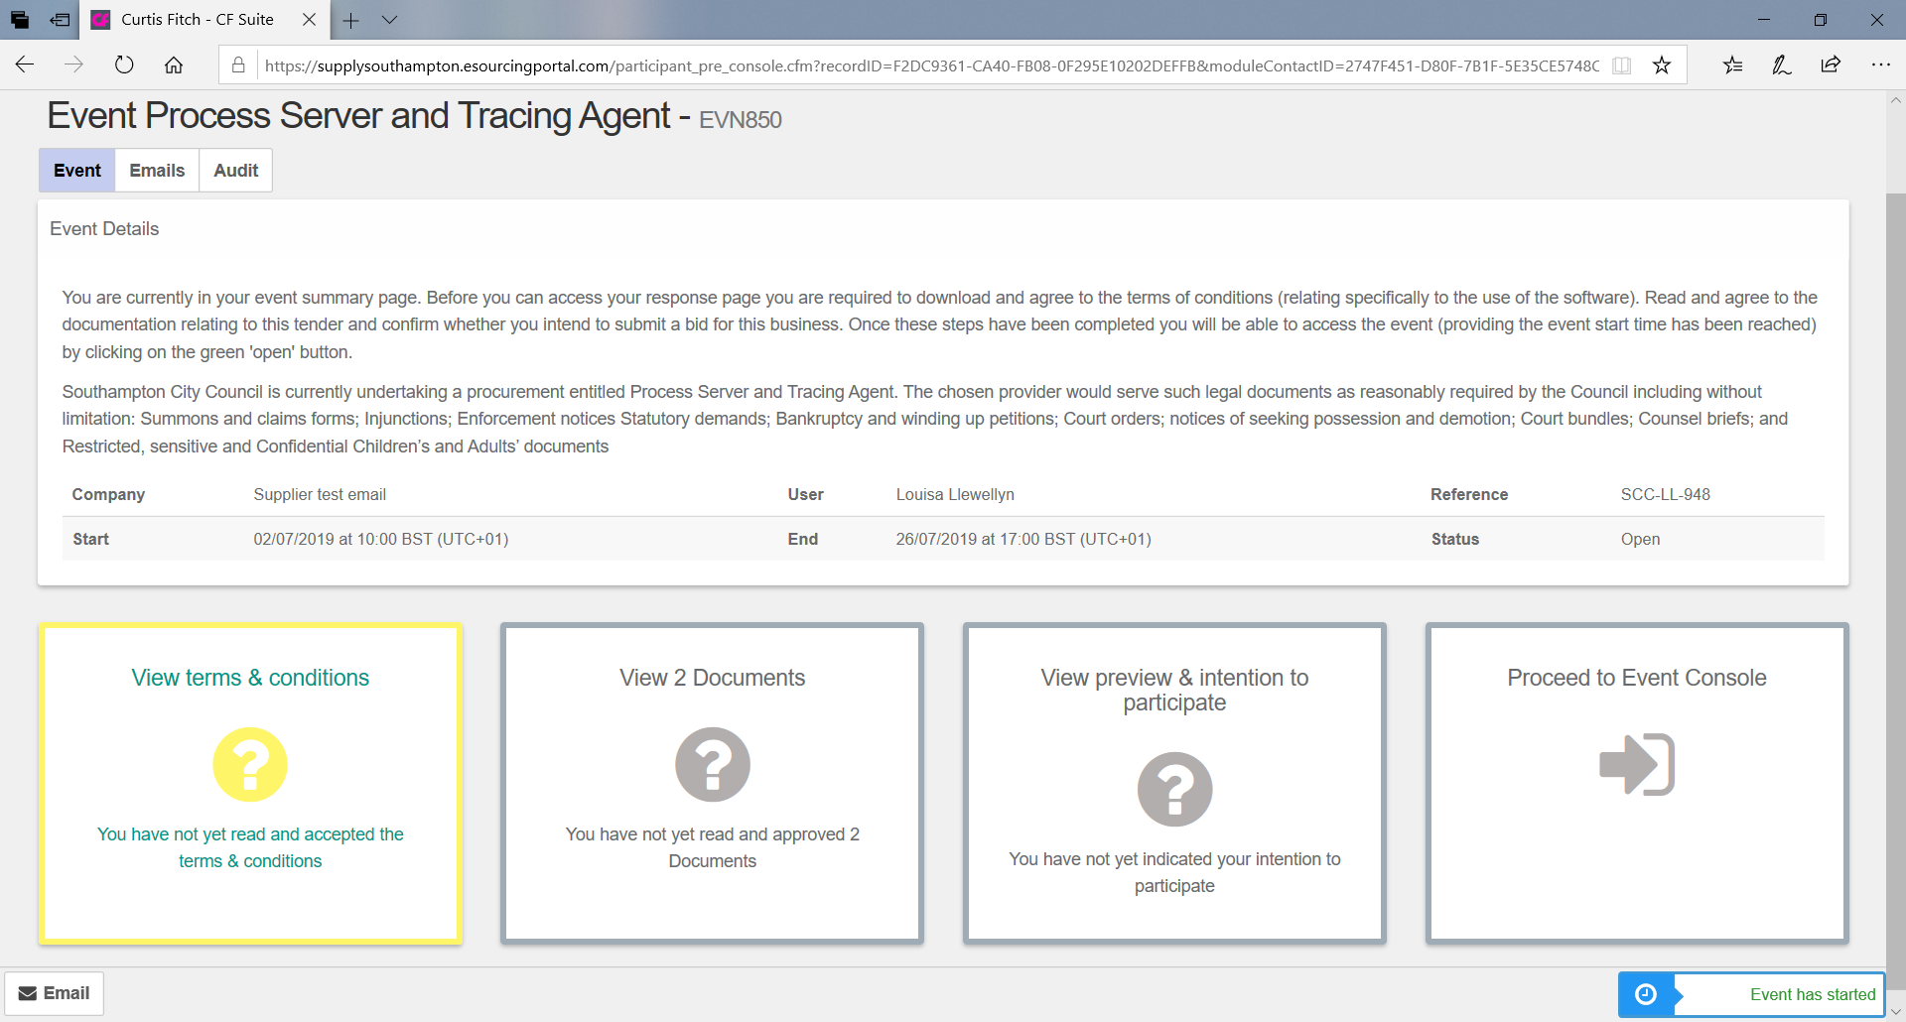

Slide 11
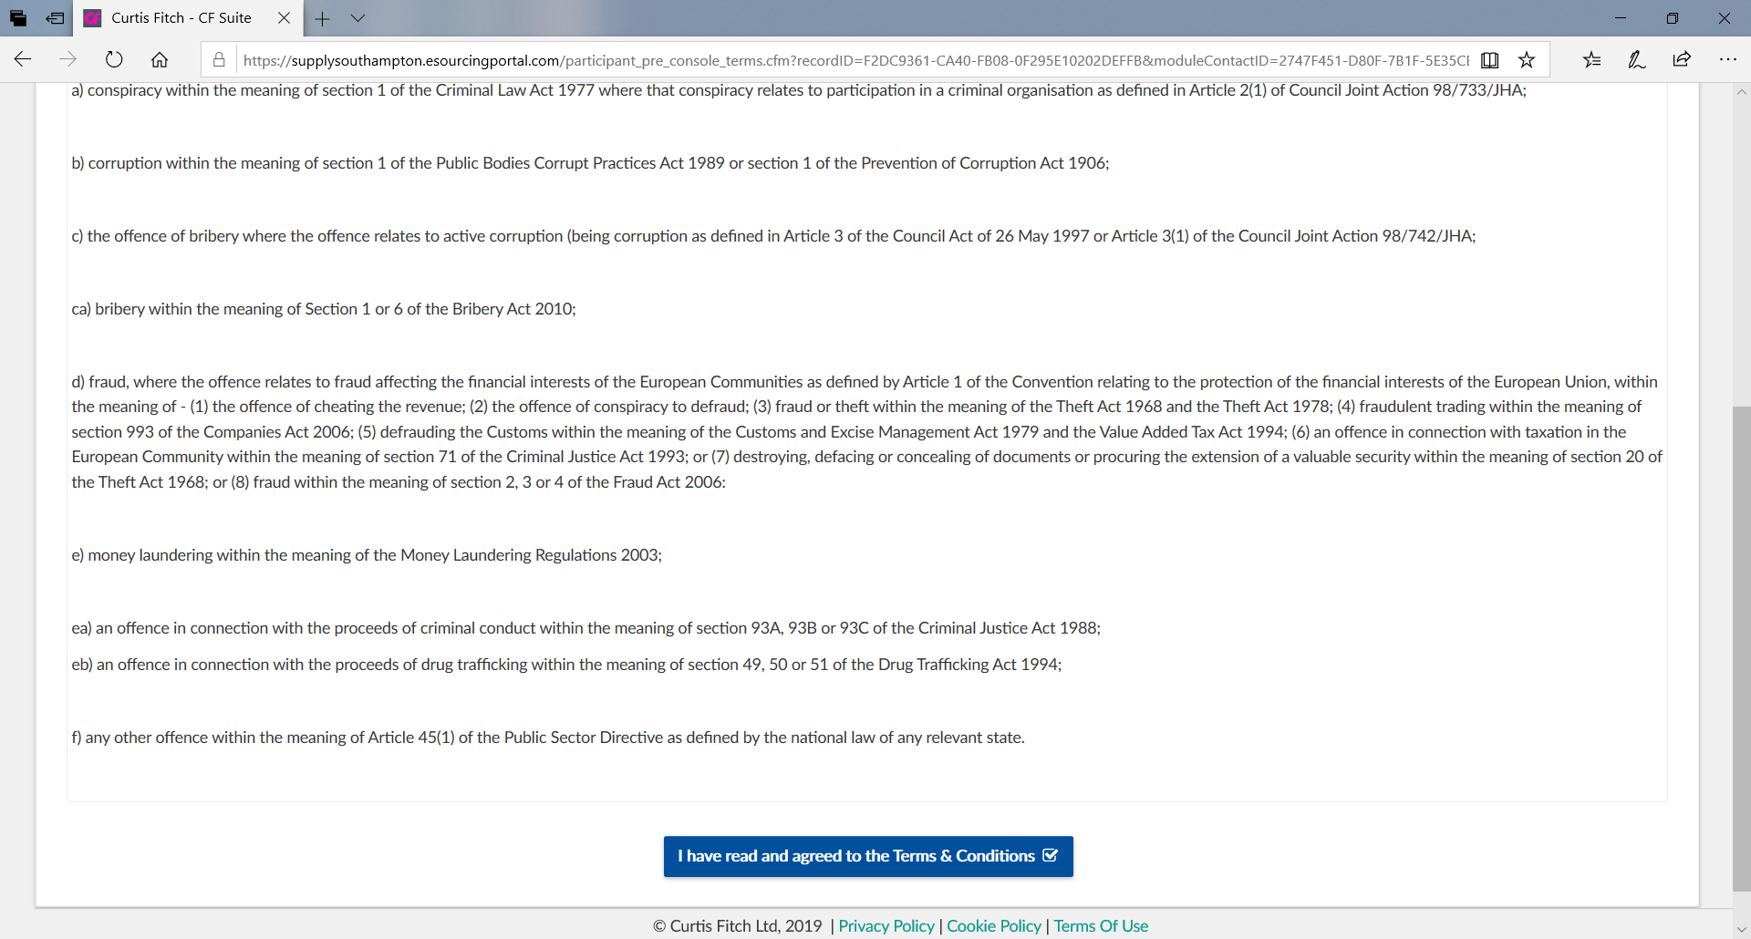
Accept Portal Terms and Conditions

Slide 12
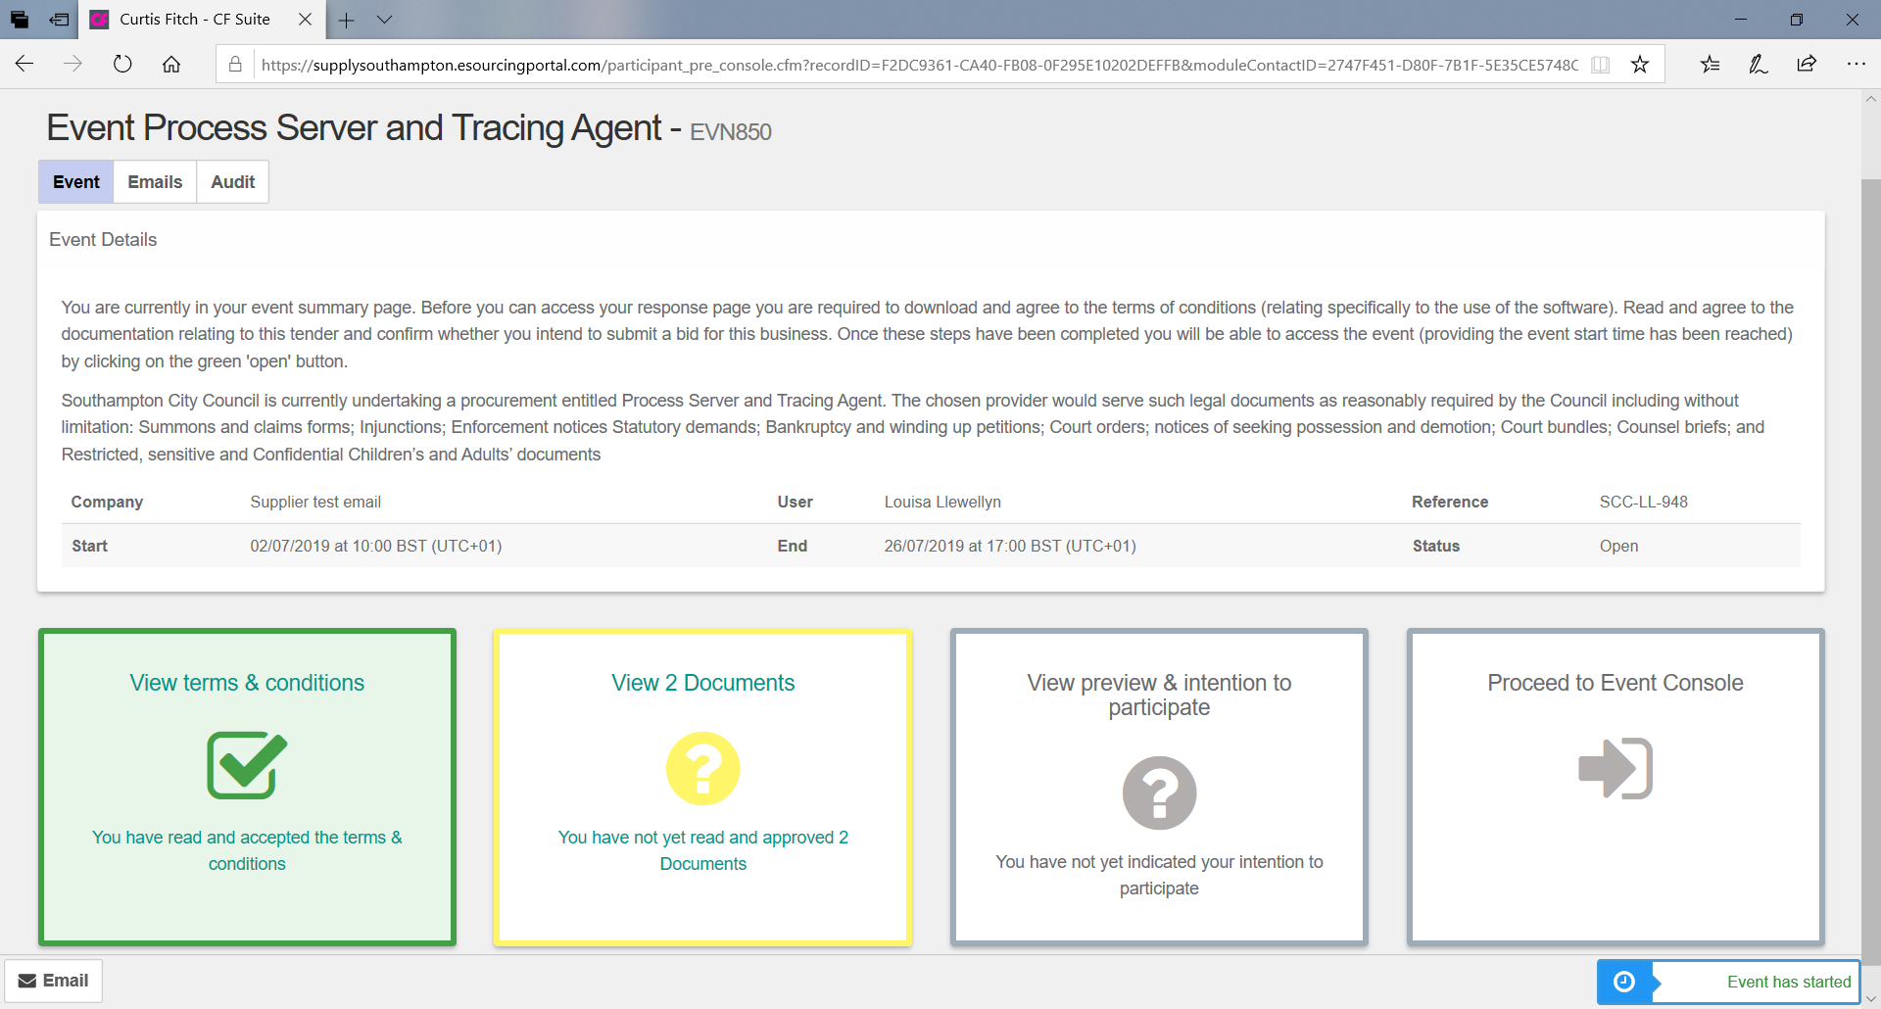

Slide 13
If you require assistance please call the Curtis Fitch Helpline on
01242 530900

