Slide 1
Event Participation guidance for Suppliers - Transport for London
October 2022

Slide 2
Event participation for suppliers
TfL’s e-sourcing tool is SAP Ariba- digitising and managing our sourcing and supplier collaboration via SAP Ariba.
Supplier benefits of e-sourcing
There are multiple benefits for our suppliers, such as:
Online collaboration
Opportunity to bid on TfL business
Transparent bidding process with clear requirements
Structured, recognisable format
Faster evaluation and feedback
Improved certificate, contract (incl. electronic signatures) and audit management

Slide 3
Collaboration with TfL
To collaborate with TfL on SAP Ariba you must be registered on the platform, and your profile and data must be up-to-date. The following pages detail how to register on Ariba Business Network.
To Participate in events complete the following steps
Register Interest for the event by contacting the Commercial contact listed on Find a Tender/ Contract Finder posting
If you have never done business before with TfL and are not a known supplier complete the request form at the following link . This will create the contact within Ariba to enable invite participation.
Create your Ariba Business Network account (see steps in subsequent pages)

Slide 4
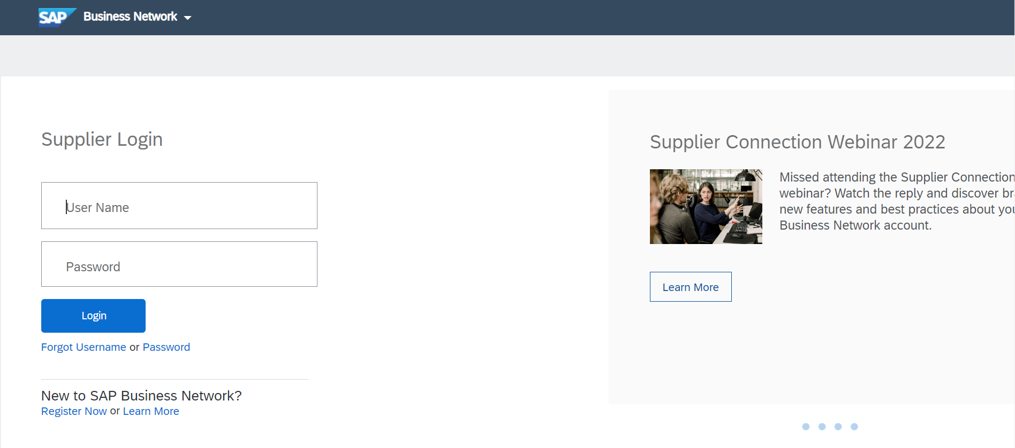
Create an Ariba Business Network account
Visit URL
Select ‘Register Now’
Note: there are two types of accounts. Standard and Enterprise. TfL only requires the use of standard account. This is a fee free account.
SF | PendingReview | 14,282 | Ferrytoll Park and Ride,Inverkeithing | Fife Council | 2 to 5 mins from Strategic Road (A90 - Busynon-strategic) | Would be an M90 hub

Slide 5
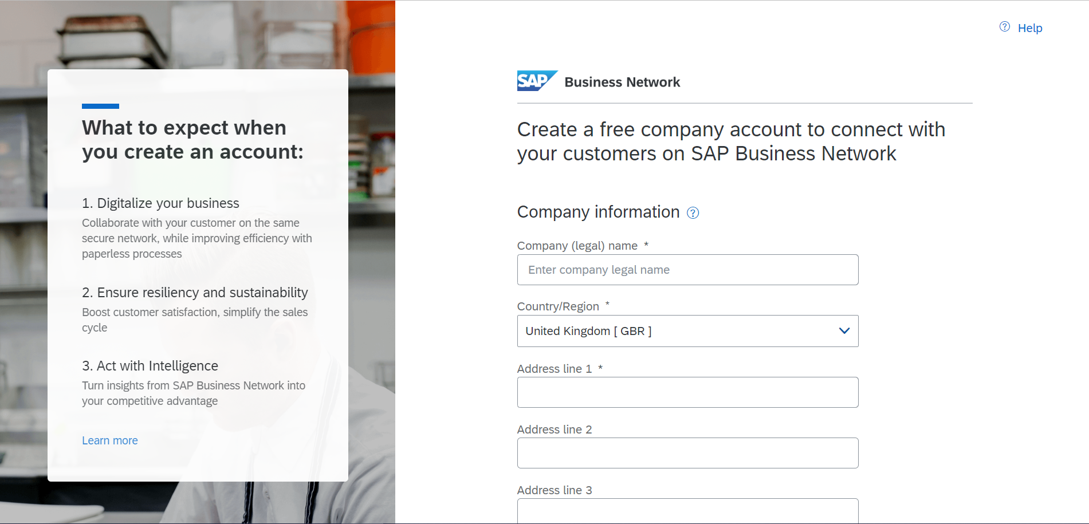
Create an Ariba Account
Fill out company information, such as company name, address, etc.

Slide 6
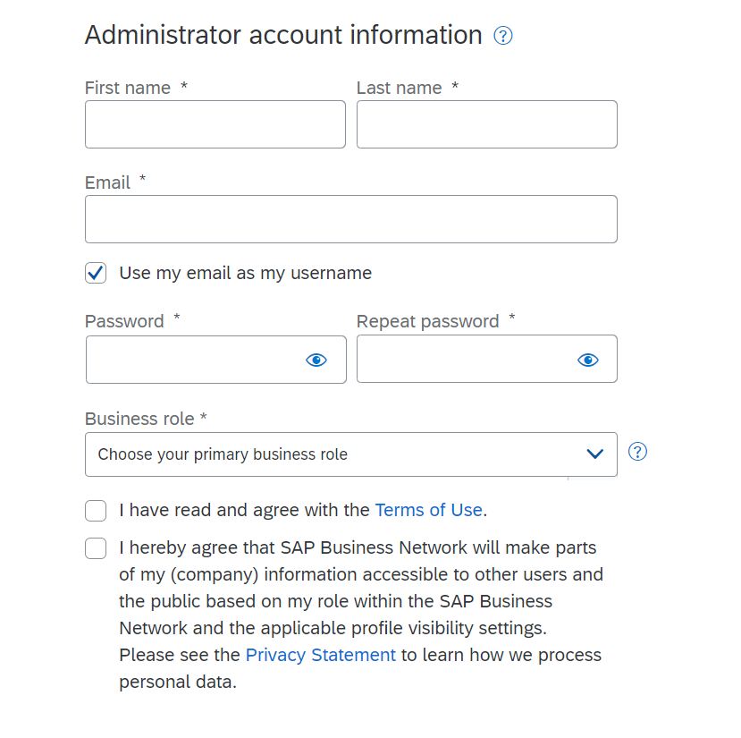
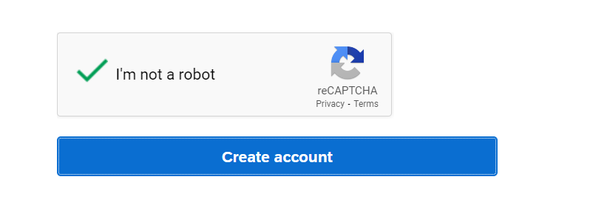
Create an Ariba Account
Fill out user account information, such as name, email, password, etc.
This will be the administrator account details

Slide 7
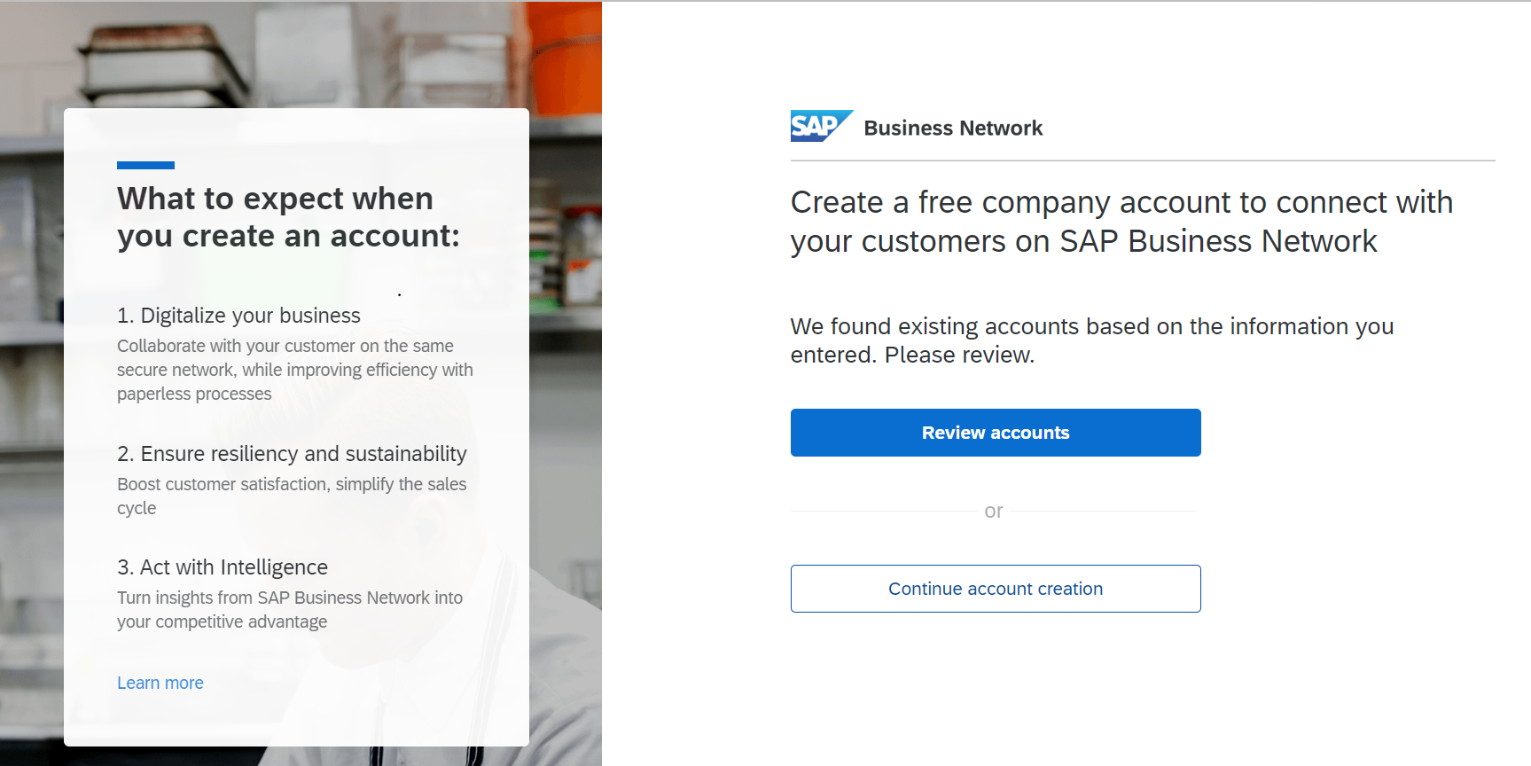
Check for Duplicates
You may get a warning about suspected duplicate accounts for your company.
Please check to ensure your legal entity does not already have an Ariba Account.
Click Review accounts to see the accounts your company or email address already have

Slide 8
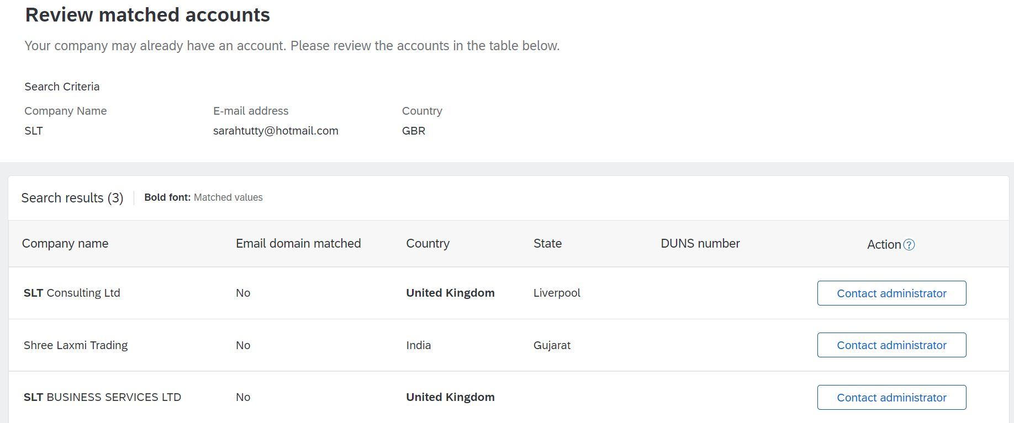
Check for Duplicates
The accounts that are a match to the information you have entered on the first screen will be displayed.
Click contact administrator

Slide 9
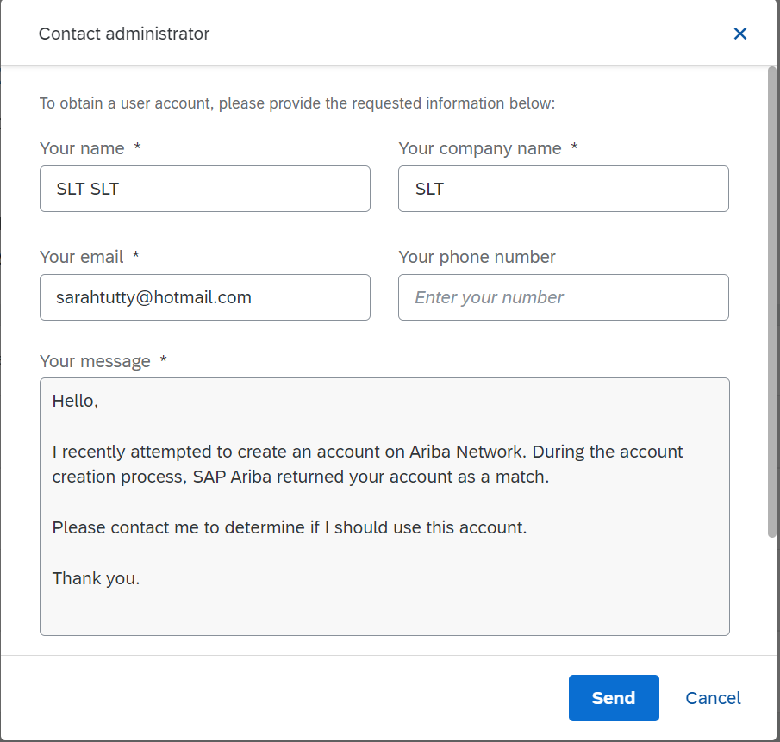
Check for Duplicates
You can send a request to the administrator to gain access to the username and password.
Note: Ariba accounts can be used across multiple customers.
If you require one account for access to TfL events then please select ‘ cancel’ and select ‘continue account creation’ on the previous page

Slide 10
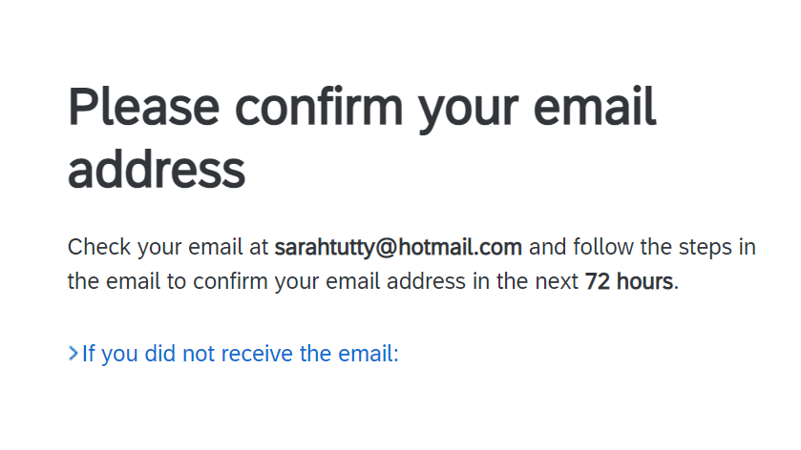
Email Confirmation
You may get a warning about suspected duplicate accounts for your company.
Please check to ensure your legal entity does not already have an Ariba Account.
Click Review accounts to see the accounts your company or email address already have

Slide 11
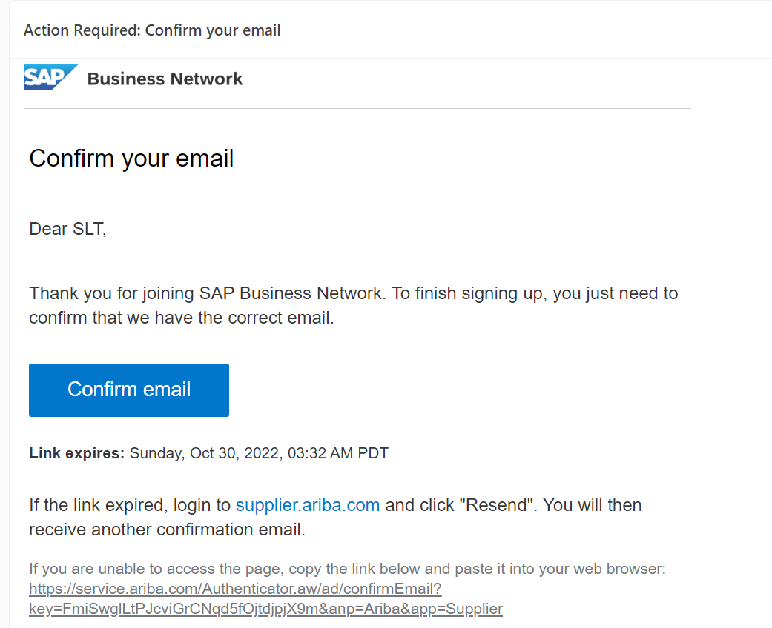
Email Confirmation
To complete the account creation go to the inbox of the email you stated in account creation– click ‘Confirm Email’

Slide 12
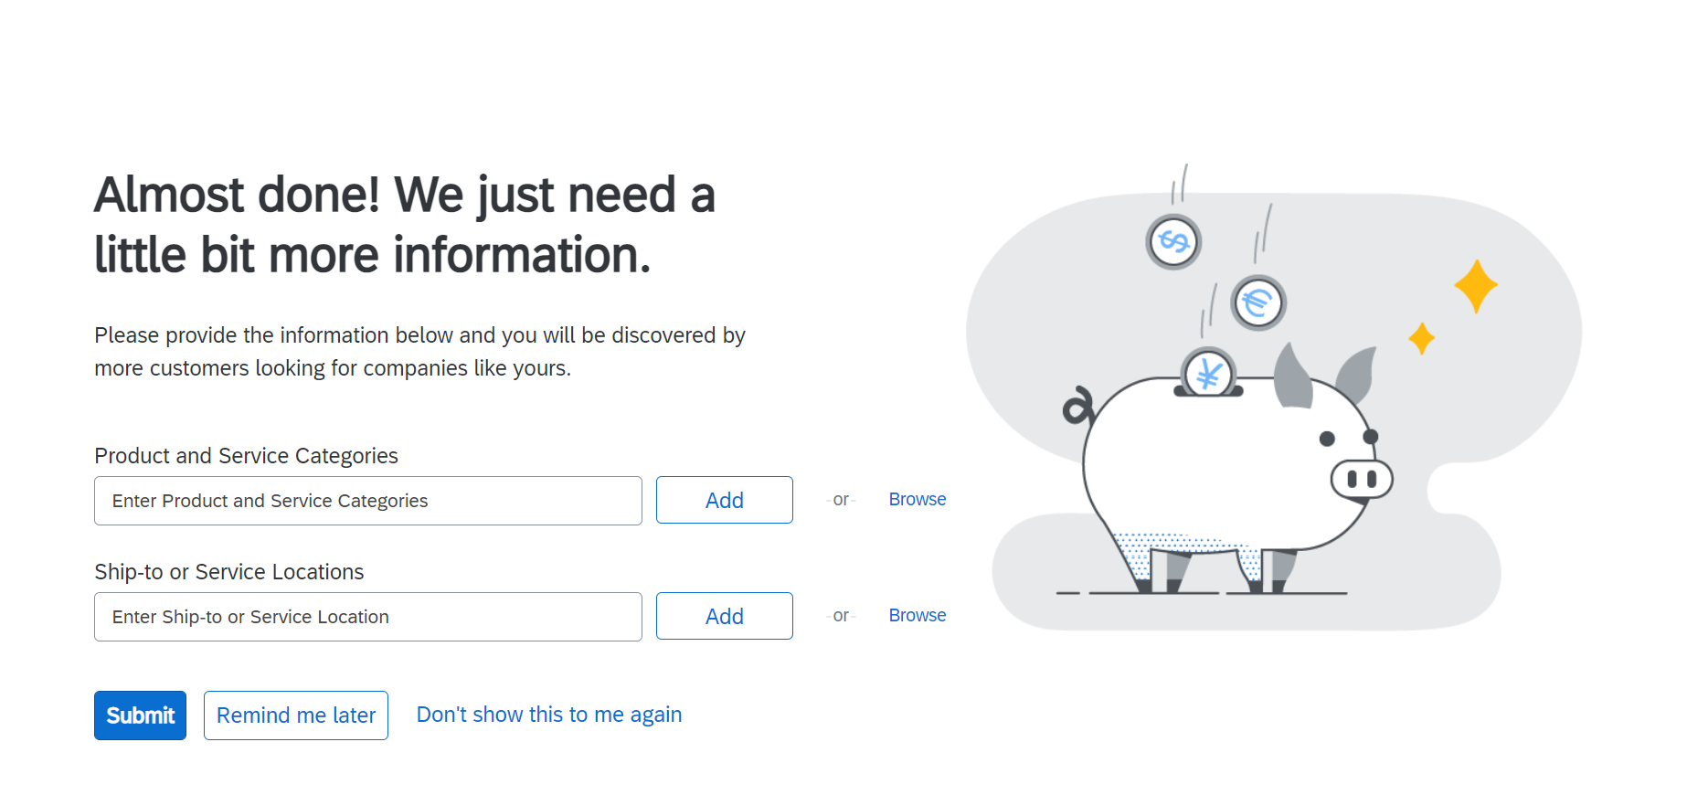
Email Confirmation
Non mandatory step : Confirm with Ariba the type of goods / services you supply

Slide 13
How will I receive the event details?

Slide 14
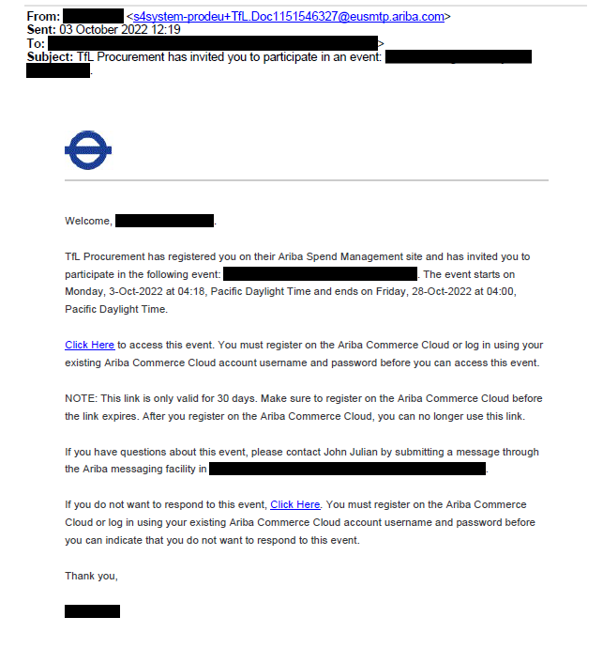
Event Participation
Once the event has been launched you will receive an email requesting you to participate
The email will be received from the TfL commercial contact with sender email address s4system-prodeu+TfL.Doc1151546327@eusmtp.ariba.com
(please add this to your safe senders list)
The invitation contains the event information. To view this, click on the link and enter your username and password previously created. Note: if you have not managed to complete the account set up you will be prompted to do this upon receiving the invite. ,
Note: You will not be able to be invited unless you have registered interest (via email to TfL commercial team) and have a supplier contact held within TfL’s Ariba system.

Slide 15
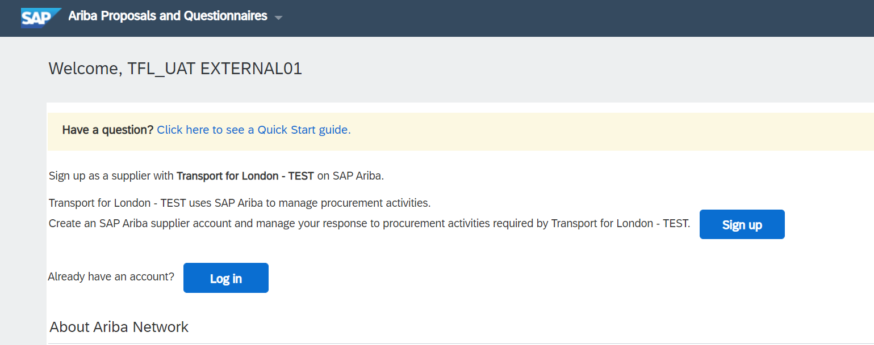
Accessing the event
Log on to the Ariba Business Network account previously created. If you are still to create an account you do so from this page using the ‘sign up’ link

Slide 16
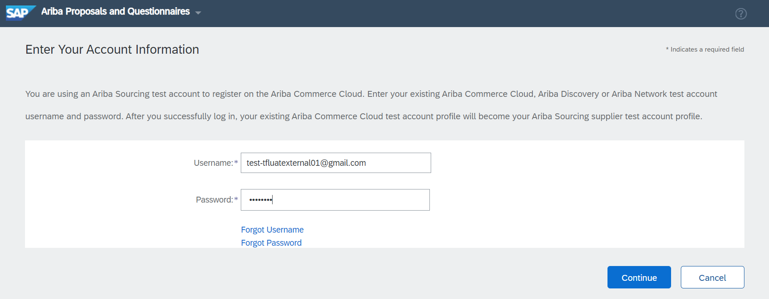
Ariba Business Network
Use the forgotten Username / Password link – a reset email will be sent to contact email address used in the account creation

Slide 17
Viewing the event details
View the event on the Ariba Proposal and Questionnaires page
To access the event click on event title

Slide 18
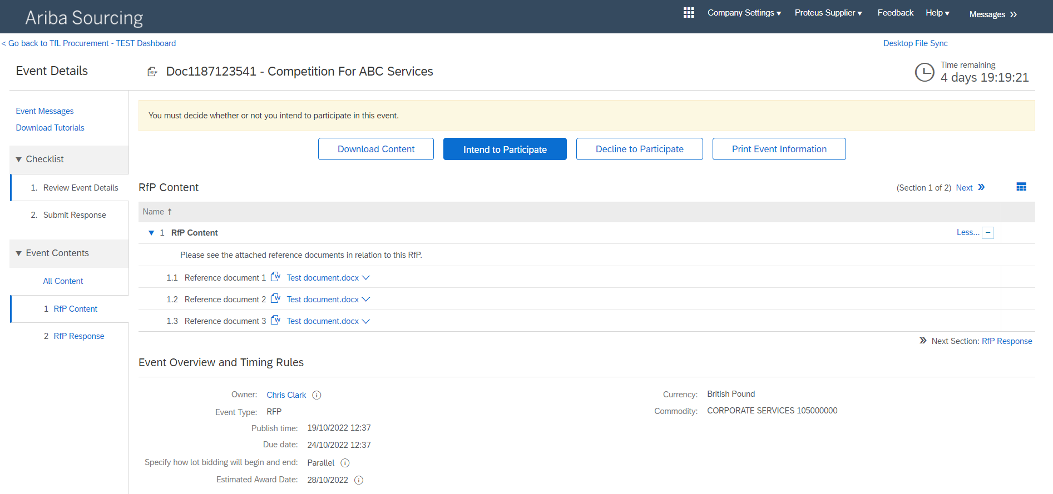
Participation
Click Intend to Participate
Number of days left tp participate
Click on ‘Intend to Participate’ to inform the TfL lead of your intention. Note – it is important that you click intend to participate to ensure you receive all event relevant communications
Click on ‘Intend to Participate’ to inform the TfL lead of your intention

Slide 19
Message functionality
You can view sent by TfL or compose messages to request information or ask questions of the TfL contact

Slide 20
Messages – Ariba Business Network & Email
You will receive notification of a response to your message via email as well as in portal

Slide 21
Questions
If you have any queries regarding your registration, please email: Ariba_Supplier_Enablement@tfl.gov.uk

