Slide 1
Evaluating the health and wellbeing impact of outdoor interventions
Insights from a scoping exercise to understand the capabilities and requirements of stakeholders
John Illingworth
Health Research and Evaluation
Specialist
4 May 2023

Slide 2
Research questions
To understand:
The needs of stakeholders currently evaluating the health and wellbeing impact of outdoor interventions.
The evidence requirements of stakeholders who use the findings from evaluations to influence planning, policy development, and the design and implementation of interventions.

Slide 3
Stakeholder groups
Decision-makers including in local authorities, government departments, NHS, public health, parks and green space management.
Delivery bodies made of up groups responsible for delivering outdoor interventions on the ground.
Expert bodies including academics/think tanks/non-profits with expertise in evaluation and/or nature and health.

Slide 4
Research approach
Survey
Open from 9-25 Nov 2022.
Consisted of 16 open and closed questions.
Total of 236 responses.
Interviews and group discussions
Carried out Nov–Dec 2022.
Interviews with 17 people representing 12 organisations or government departments.
Consultation event attended by 18 people.
Reporting
Findings brought together into a report to the steering group.
Dissemination event.

Slide 5
Topics explored
Evaluation activity
Existing approaches
Confidence & capabilities
Resources & support
Barriers & enablers
Data
collection
Evidence for decision-making
What’s working well
Opportunities for improvement

Slide 6
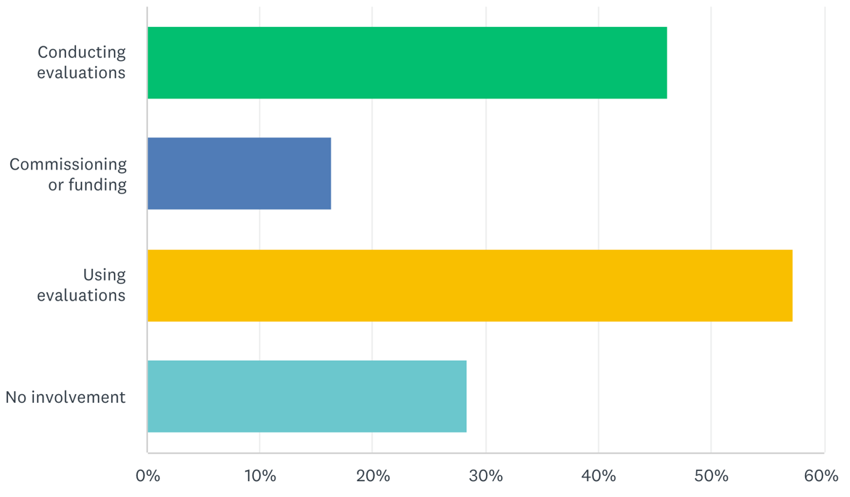
Profile of survey respondents
Area of work | Responses
Charity or non-profit | 112
Provider of outdoor interventions | 44
Local authority | 38
NHS | 38
Government or national body | 30
Other¹ | 16
Academica or consultancy | 13
Public health | 10
Total responses (and options selected)² | 236 (301)
Current/likely involvement with evaluations of outdoor interventions (proportion of responses)
1 Examples of work areas listed under Other include housing association, trustee, freelance and volunteer.
2 Respondents could select more than one option, therefore the total number of options selected is included alongside the total number of responses.

Slide 7
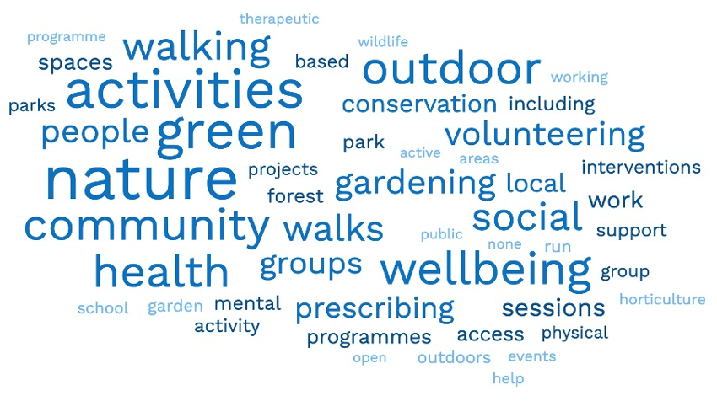
Outdoor interventions to improve health

Slide 8
Main findings

Slide 9
1. Evaluation activity varies significantly
Evaluations are not always or routinely conducted by delivery bodies.
The decision on whether, and what, to evaluate is typically influenced by a) funder requirements and b) a desire to cite impact in future funding bids.
Evaluations typically focus on process measures (e.g. activity, performance) to provide justification for money spent – particularly when part of larger programmes.
Academic or expert bodies were better equipped to conduct more rigorous evaluations, or use advanced methods (e.g. calculating Social Return on Investment).
"Evaluation doesn't take place, not in a formal way. We evaluate at the end of the project for the funder to be satisfied with how the money's been spent… [but] we're two people that are out there doing our funding and moving from place to place… there's no back up team to actually evaluate."
"It's really, really varied and more often than not, it's driven by the requirements of that fund."

Slide 10
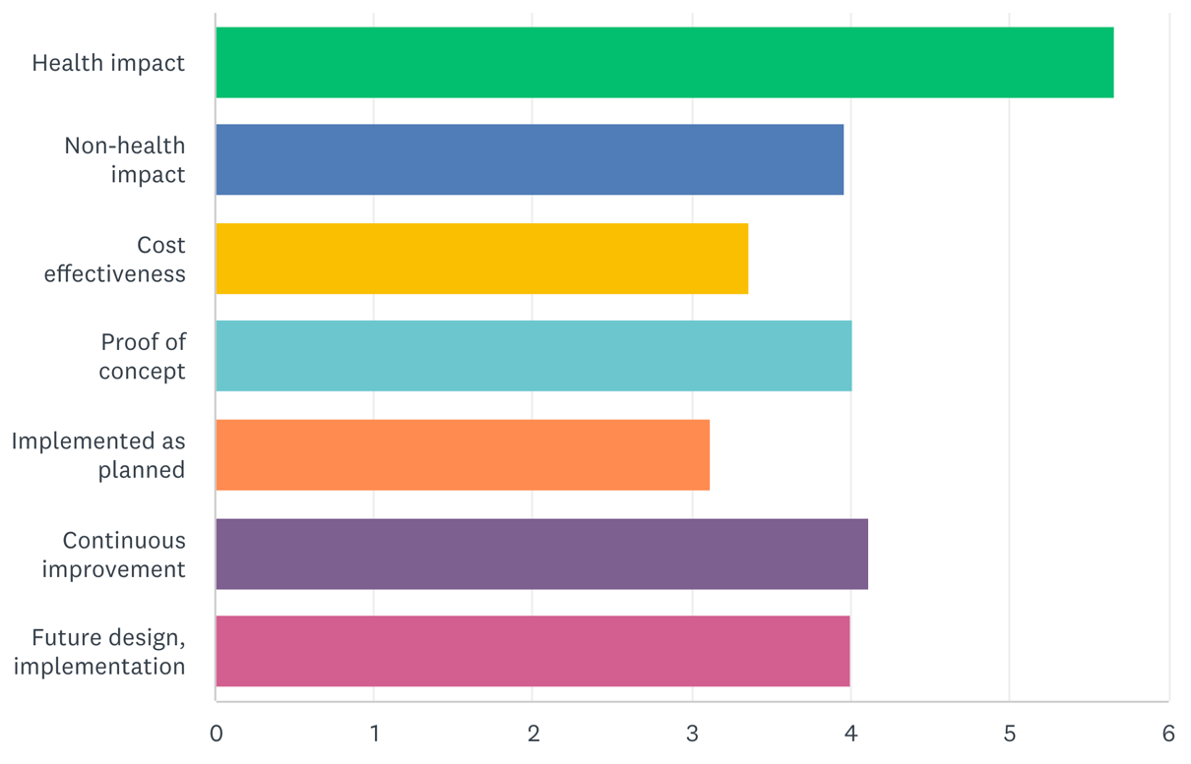
1. Evaluation activity varies significantly 2/2
58% of survey respondents ranked Understanding the impact on health and wellbeing or health disparity as their primary aim – see chart.
Enthusiasm for giving greater attention to evaluation was expressed by delivery bodies, resource permitting.
What evaluations of outdoor interventions typically aim to achieve (weighted score, based on ranking for importance)

Slide 11
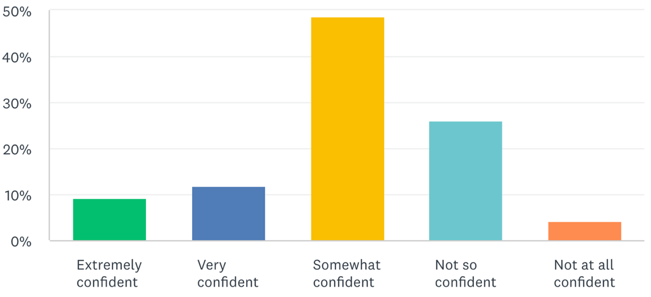
2. Confidence in the data is limited
74% of survey respondents stated they Always or Usually collect health or wellbeing outcome data.
But 75% reported feeling only Somewhat confident or Not so confident in the data – see chart.
Explanations for the lack of data confidence included the challenge of small sample sizes, inconsistent data collection methods, and only capturing ‘snapshot’ data.
Data collection activities varied e.g. counting participants, observing behaviour, calculating QALYs.
Confidence in the demographic, health and wellbeing data collected through evaluations (proportion of respondents)

Slide 12
2. Confidence in the data is limited 2/2
Mental health and wellbeing measures were more commonly reported than physical health and activity measures – this may reflect the respondent profile.
ONS4 and WEMWBS were the most commonly reported health outcome measures in use.
Qualitative data, and keeping data collections simple, were considered helpful in influencing decision-makers.
"I certainly think some of our most impactful evaluations are not about 'we've worked with this many people, and this has been the statistical improvement in wellbeing'. It's more 'we've worked with so many people and these are ten examples of beneficiaries and how they've individually benefited’.”
“In a real-world evaluation with limited resources it can be difficult to ensure that there is a representative sample and that the data collected isn’t biased.”
"Something straightforward, that allows non experts to gather some data is better than a failed complex project… so we use simple, single item measures.”

Slide 13
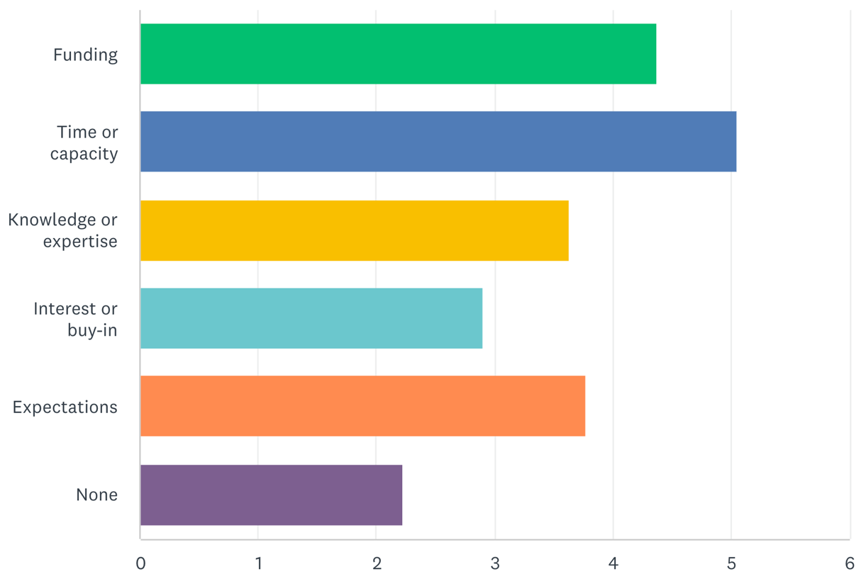
3. Several barriers and enablers to evaluation exist
Insufficient time and capacity, followed by funding, were the main barriers to conducting good evaluations – see chart.
Interventions were often delivered by volunteer-led, hyper-local organisations with little spare capacity for evaluation.
Fieldworkers reported feeling uncomfortable asking standard health survey questions
Barriers that get in the way of achieving evaluation aims (weighted score, based on ranking for importance)
"... if I look at our programmes, there's probably 20 to 30 different projects we deliver each year across the four sites. And we probably have maybe 10% of those that have an external evaluator linked to them, because they're part of a bigger programme. [For] the others... we might have £5,000 to work a day a week on a specific site. And it just doesn't lend itself to be able to engage with a lead evaluator on that and look at how we assess the impact."

Slide 14
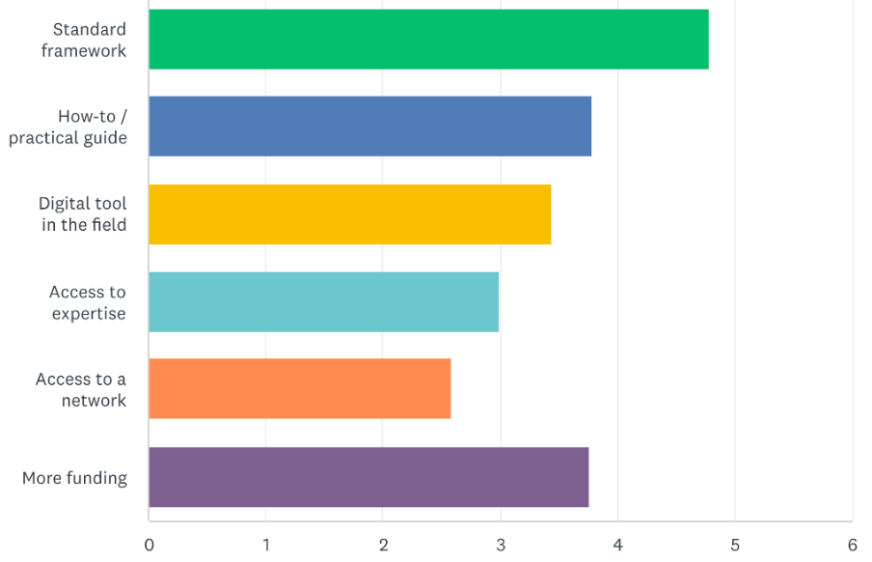
3. Several barriers and enablers to evaluation exist 2/2
Half of survey respondents stated that a standard evaluation framework would be the most helpful enabler to good evaluation – see chart.
But this would be insufficient without specialist support and training.
Some participants expressed enthusiasm for a network or community of practice to coordinate activity, share learning, or demonstrate impact across the sector.
What would help to deliver evaluations in future (weighted score, ranked based on importance)?
"I think training for the staff who would implement the tools would be really useful.... done in [a way] where it's not just [our] staff coming together, it's people from across the sector coming together...

Slide 15
4. Collecting ‘core’ data was considered important
Data considered most valuable was that which demonstrated impact on health states or on the use of NHS services.
But there was recognition of the challenges in collecting this data, and in attributing changes to a single intervention.
Enthusiasm was expressed for developing ‘golden threads’ of core data that should be collected for any evaluation – to demonstrate collective benefit or enable benchmarking.
An array of demographic and other health outcome metrics were suggested as being important – but there was no broad consensus in either area.
“It would be good if there were a standard set of questions or evaluation metrics that we were trying to gain across the sector.”
"You [Funders] would learn more about the success of your funding if you were gathering all that data with some common threads, so that you can say 'all of the funding that we did that involved people working in groups seemed to have better results than those where people were working individually, for example..."

Slide 16
4. Collecting ‘core’ data was considered important 2/2
Other suggestions for further work or the focus of evaluations included understanding:
  Which sections of the population are under-served or aren’t being reached through green space interventions.
  How green space interventions work to better support their replication
  Whether any benefits, both to people and to nature, are sustained.
"What we don't know is the opportunity to reach those people that we don't already reach it. And that's the bigger opportunity to help people get out and understand the benefits of being outside in nature.”
"There are some examples [of evaluation] where the development has been studied, they have indicators, they have the data, but they don't work out why those things happened… and I think you can't have one without the other… that formative learning".

Slide 17
5. Broad support for greater ‘consistency’
Interviewees expressed support for greater consistency in evaluation approaches and the type of data collected.
Considered helpful for this to be co-designed, and informed by the needs of commissioners and funders, particularly the NHS.
Caution expressed about too much prescriptiveness or standardisation.
Participants were keen to retain the nuance of individual projects, or to use a ‘simplified’ framework for small-scale interventions.
Nearly a third of survey respondents reported being aware of work underway to develop a framework or guidance – more work required to follow this up.
"...the biggest thing [that would help] is for a standardised tool or approach to the data that we collect, that can be applied across any projects and ideally something that has been developed with the sorts of organisations that we are trying to get funding from. So, the NHS is a prime example... whether it’s... a local NHS Trust, CCG or ICS...”
"Standardise is not the best word…I like to use the word consistency. And the certainty that can come from a single, authoritative source.”

Slide 18
5. Broad support for greater ‘consistency’ 2/2
Other suggestions included:
  A decision-tree, to guide selection of validated measures according to the intervention, context etc.
  A commitment to using agreed demographic data categories
  A data ‘portal’ provided by funders, to standardise project-level data and enable analysis of the characteristics of effective interventions.
"I think there needs to be more rigour, and we need to understand more, so maybe it’s not necessarily about a fixed or rigid framework, maybe it’s about a menu, standardising things within a menu. ...it’s about being able to understand stories from across the piece, rather than having an evidence base that's completely fragmented because everyone's doing things in different ways.”
"…I do sometimes wonder, if they're [funders] giving out money to do evaluation in a piecemeal way, why don't they spend that money on developing an evaluation portal, so that every project funded by an organisation… they collect all the data in the same format, and then they'll have a nice big dataset to work with.”

Slide 19
Thank you
john.illingworth14@imperial.ac.uk
07986 289822
John Illingworth
Health Research and Evaluation
Specialist

