Slide 1
Atamis –
Supplier Guidance
https://health-family.force.com/s/Welcome
Atamis Helpdesk:
Phone: 0800 9956035
E-mail: support-health@atamis.co.uk

Slide 2
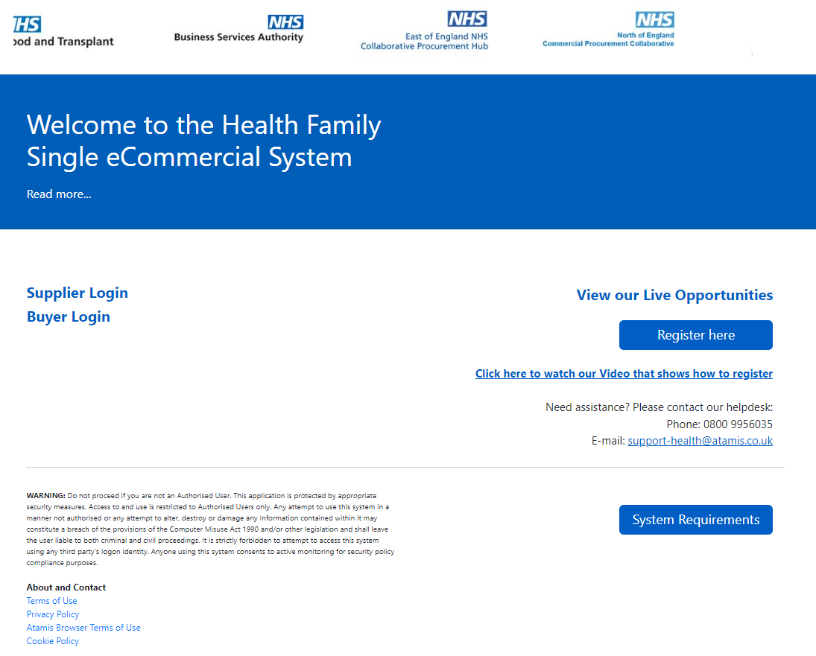
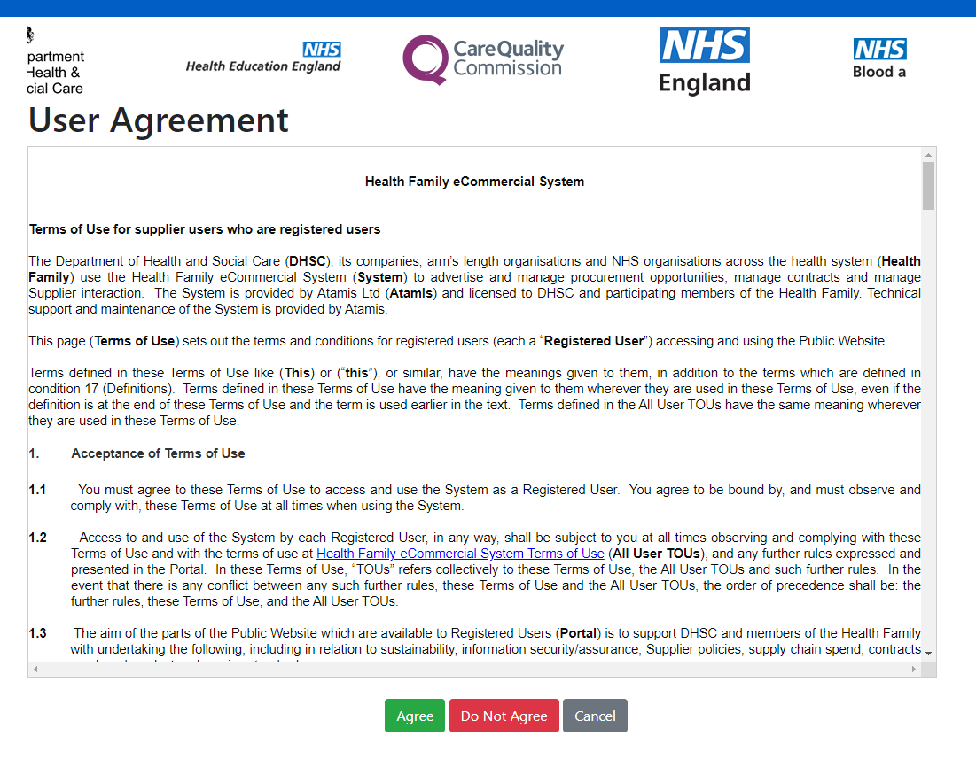
Registering for Atamis
1. Select ‘Register here’ on home page
2. Read User Agreement
N.B You may need to accept cookies as part of your browser settings to register and/or view opportunities.

Slide 3
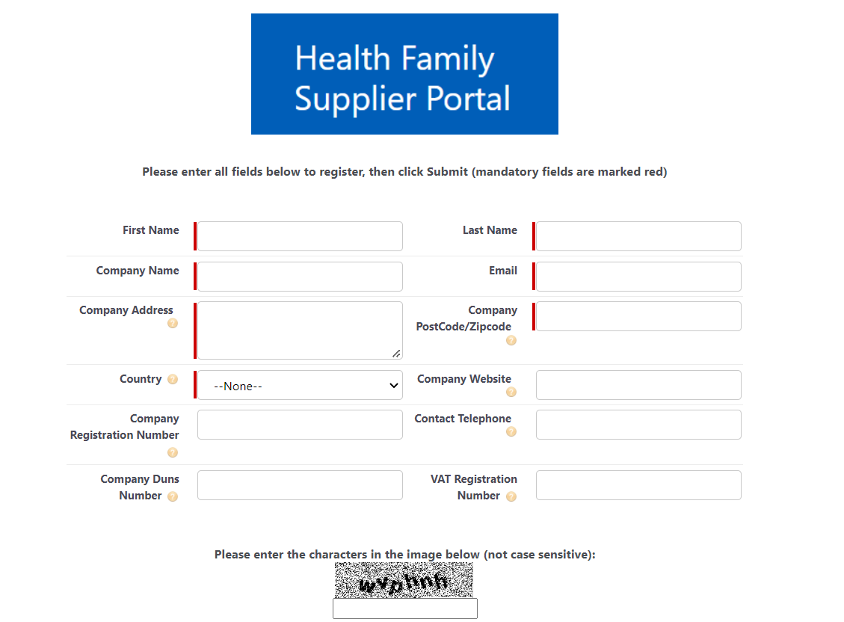
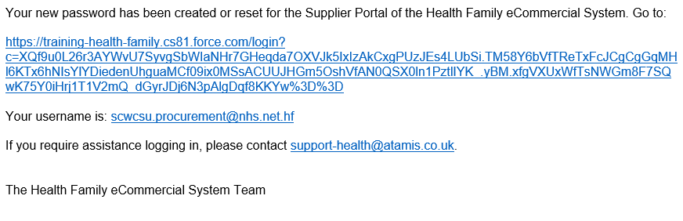
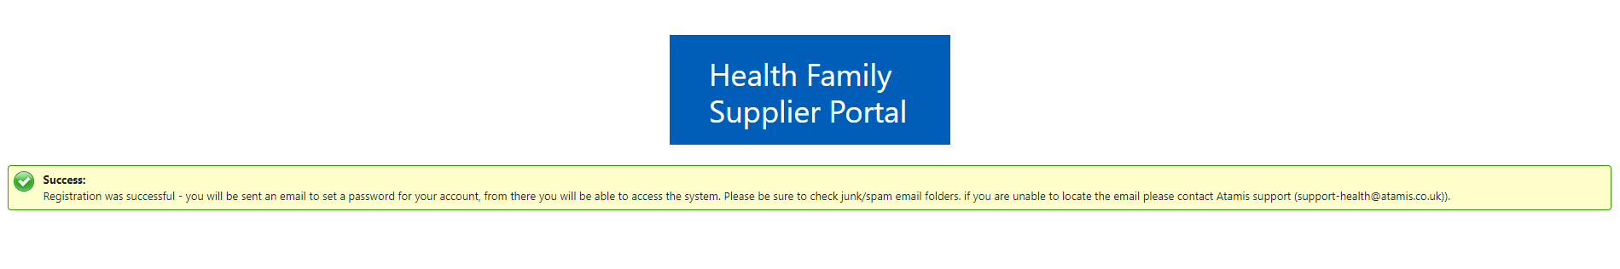
Registering for Atamis
3. Complete fields (Mandatory in red) enter characters as directed and click submit
4. If all necessary fields are completed the following success message will be shown
5. The email address entered will receive an email from support-health@atamis.co.uk (check Junk/Spam folders if necessary)
Click the link in the email to create a password using the username detailed

Slide 4
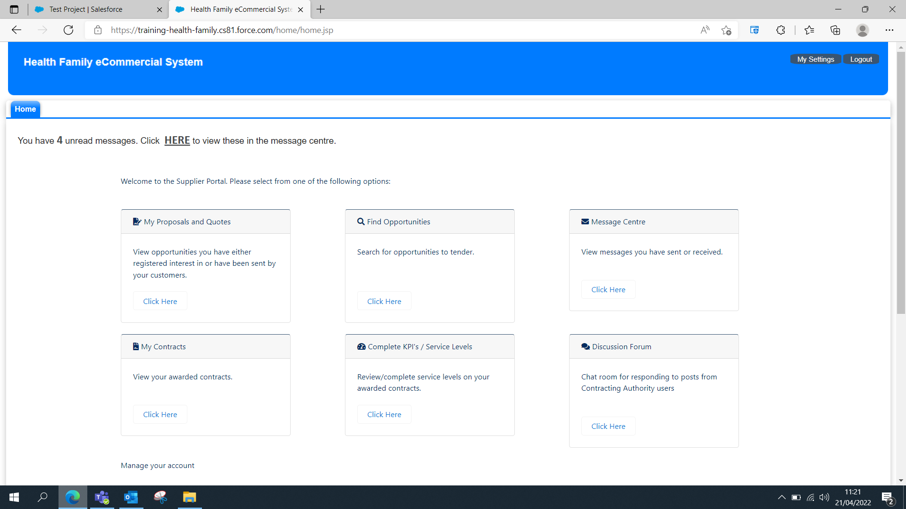
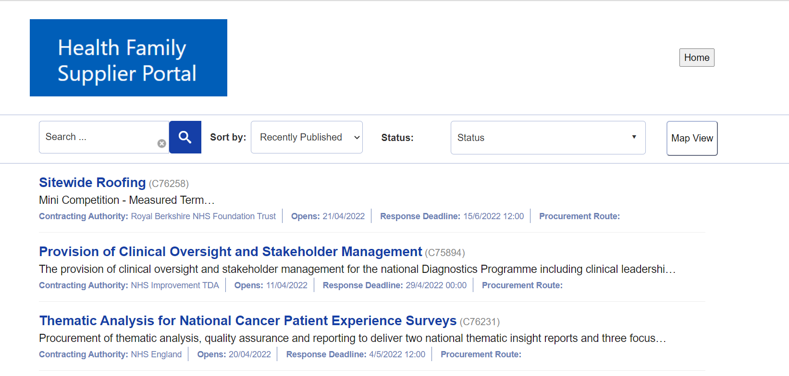
Accessing and submitting Bids within Atamis
1. Log in to Atamis, search for live opportunities by clicking the ‘Click Here’ link in the find opportunities box
2. Use the search bar to find the opportunity by entering the title or reference.

Slide 5
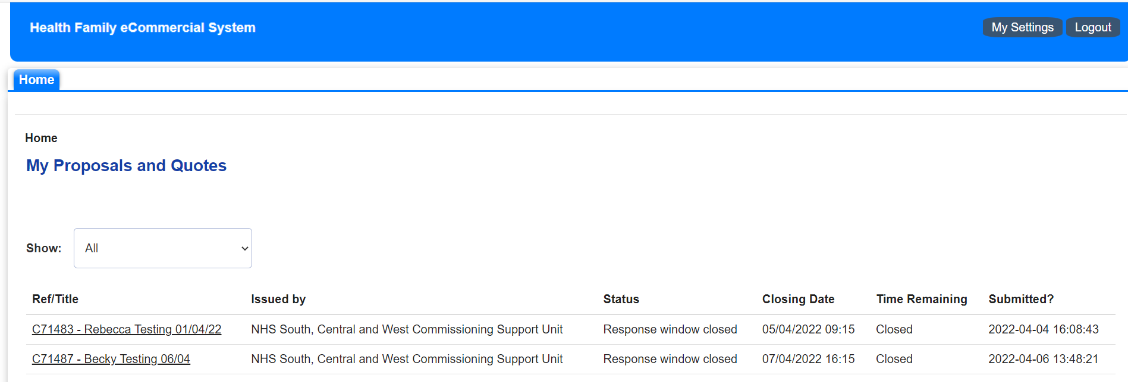
Accessing and submitting Bids within Atamis
3. If you have been sent an opportunity through invitation only, or to view those you have registered interest for, click the ‘Click Here’ link in the My Proposals and Quotes box
4. My Proposals and Quotes view - access the opportunity by clicking the Ref/Title link

Slide 6
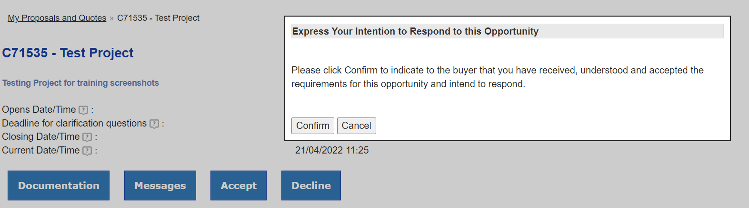
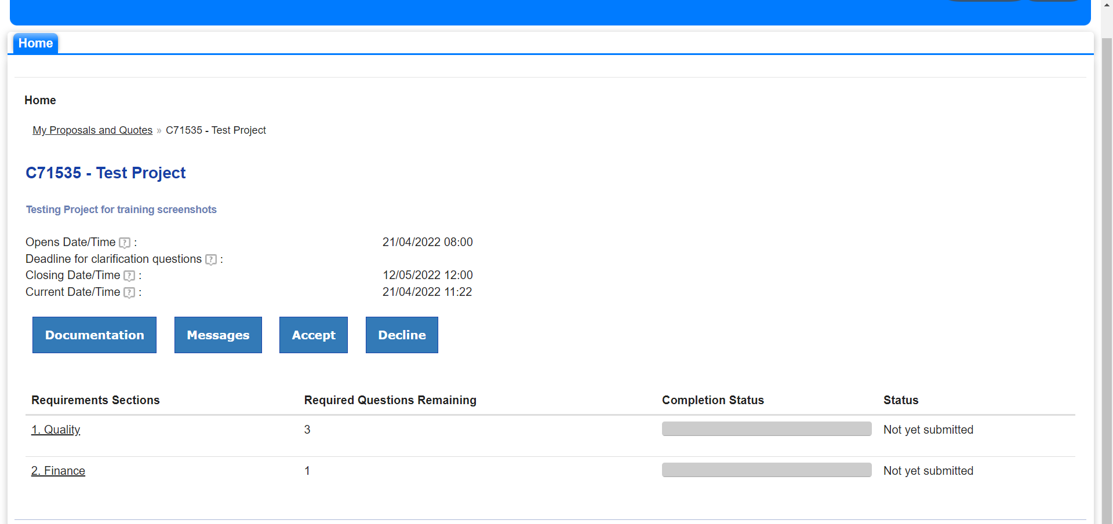
Accessing and submitting Bids within Atamis
5. Once in the opportunity you can accept/decline the opportunity, access the documentation, send messages and access the question set
6. You must accept the opportunity to be able to answer the question set

Slide 7
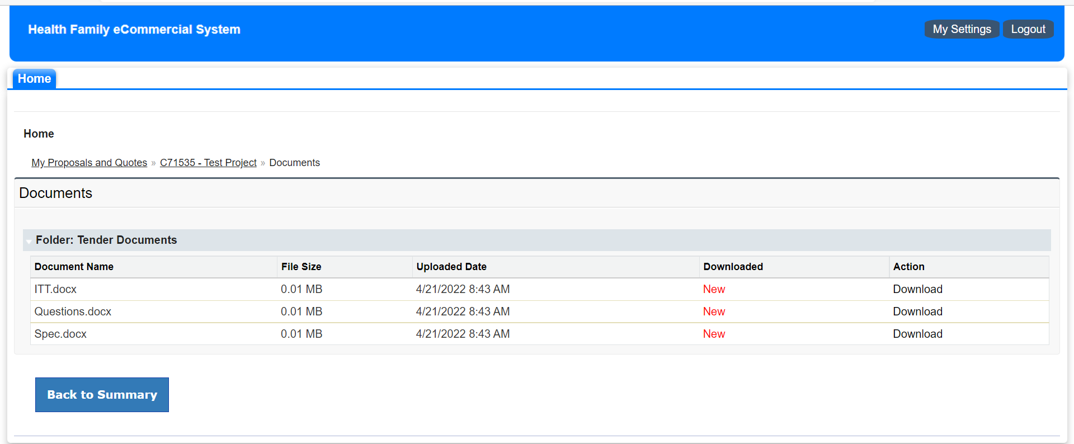
Accessing and submitting Bids within Atamis
7. Documentation view – Click the ‘Documentation’ button
8. Download documents by clicking the ‘Download’ link on the right of the page

Slide 8
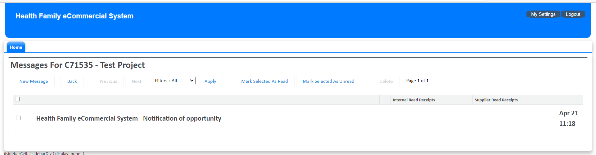
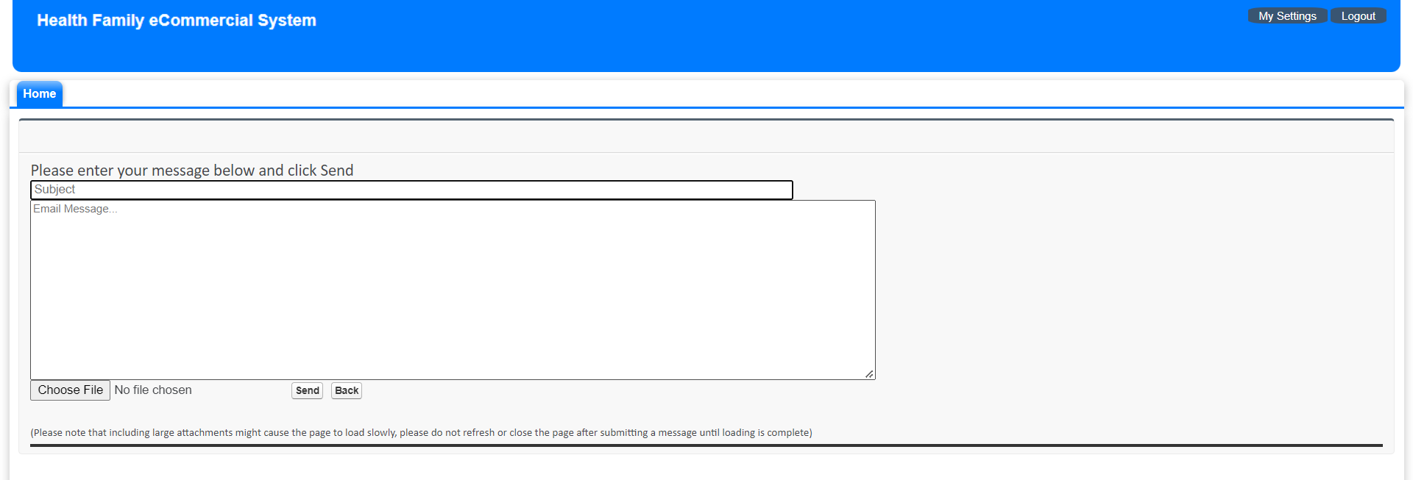
Accessing and submitting Bids within Atamis
9. Messages view – click the ‘messages’ button
10. View messages or send a ‘New Message’
11. Type your subject and message, upload a document if necessary and click ‘send’

Slide 9
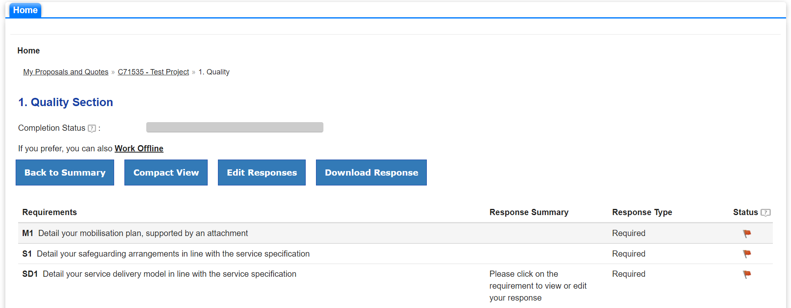
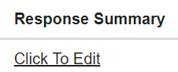

Accessing and submitting Bids within Atamis
12. To access the questions (requirements), click on the relevant requirement section link on the left of the page
13. Click the ‘Edit Responses’ button and then ‘Click to Edit’ on each relevant question to type your response.
Please note that if a question matches one answered by the supplier previously, Atamis will pull through those answers from the previous procurement and auto populate them into the current one. It is advised that you review any auto -populated responses before submission to ensure that they are relevant to the current procurement.

Slide 10
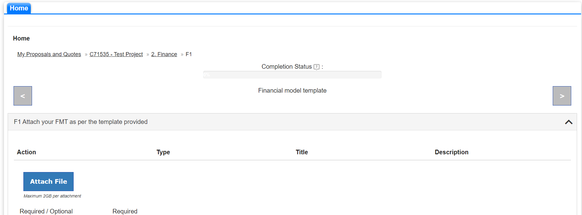
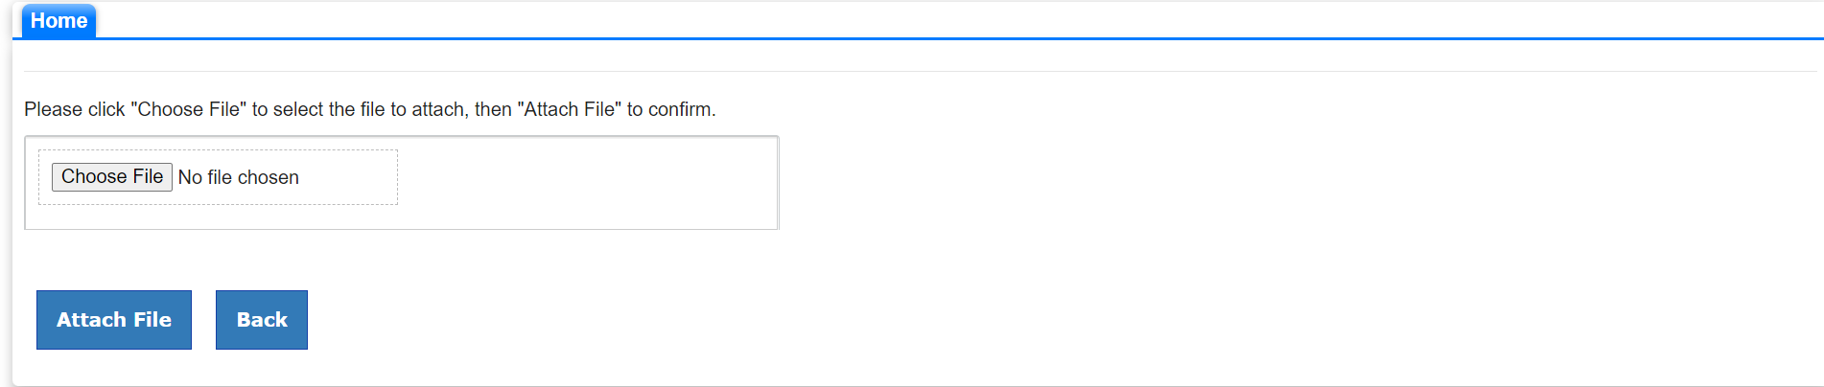
Accessing and submitting Bids within Atamis
14. For questions that require an attachment, click the response summary link
15. Click ‘Attach file’
16. Choose the file you want to upload and click ‘Attach File’

Slide 11
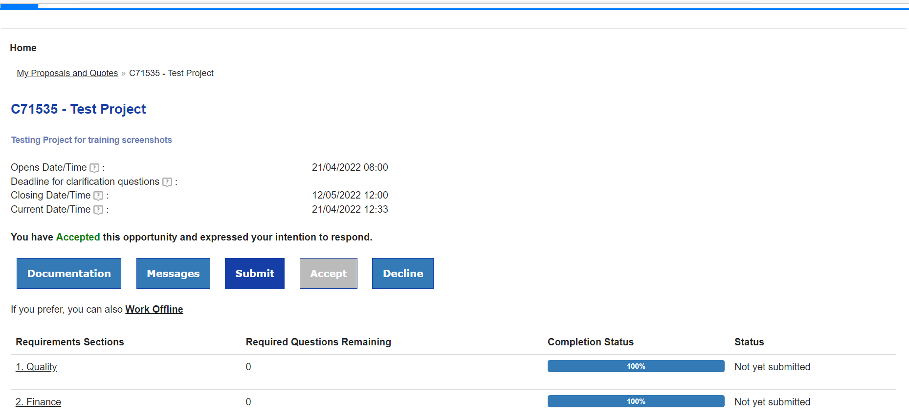
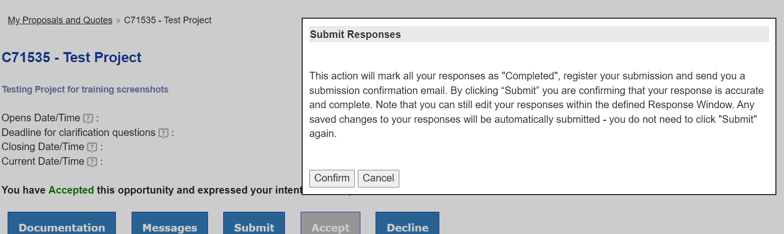
Accessing and submitting Bids within Atamis
17. Ensure all required sections have been completed before submitting your response. Progress can be viewed in the ‘Completion Status’ column
15. Once complete click ‘submit’
16. Submission confirmation view – click ‘Confirm’
Ensure you allow sufficient time to answer, upload and submit responses to all sections ahead of the deadline. We recommend uploading at least 24 hours before the deadline, allowing time for you to address any technical issues and/or raise them with the CSU and Atamis who will do their best to assist where possible.

