Slide 1


Last Updated: 25 | UK OFFICIAL SENSITIVE NAVY Develop Concept Card |  |  |  |  |  |  | Planned ISD:
[Project Title] |  |  | SoSA Level: [Sense, Decide, Effect, Connect, Host, Enable/Cross Cutting] |  | DCH Level: [Level 0-6, refer to slide 3] | Concept Origin: [UCR, RtL, Directed, Emergent, DI Threat, Industry] |  | Sponsoring CPG: [AWB, UWB, MAvn, CF-LitS, Digital, Support, FDev, DCTO, Healthcare, People]
Strategic Context: [High-level background information detailing the need for the project, referencing one or multiple of the following: Supporting strategic objectives, including references. DCAR or CCAR risk reference NATO capability objective (NATO blue book)] |  |  | NATO Capability Code: [As defined in Link] |  | Capability Target: [NATO blue book] M 1501 N; M 3201 N; M 7204 N; A 3104 N; A 3201 N; A 4303 N; A 5208 N; A 6205 N | CC Name: |  | POC:
Capability Description: [Outline the top-level requirements, likely to become Key Requirements, e.g. speed or range etc. Include project scope of what it will/ won’t include. E.g. Sensor Decider or Effector. This should align with dependencies. In addition - Pre-CONEMP. A very brief description on how the capability could be used – Potential useability/applications.]
Project Benefits: [Measurable improvement resulting from an outcome perceived as an advantage by one of more stakeholder, contributing to organisational objective. E.g. industrial strategy, international collaboration or improved lethality] |  | Risks: [Key Delivery Risks] |  | Current ROM Costings over 10: [VROM, ROM, ILR, FCR etc – also specify predicted Yr1 spend] |  |  | Workforce Required: [Total in number and Roles – Mil and Civ]

Slide 2
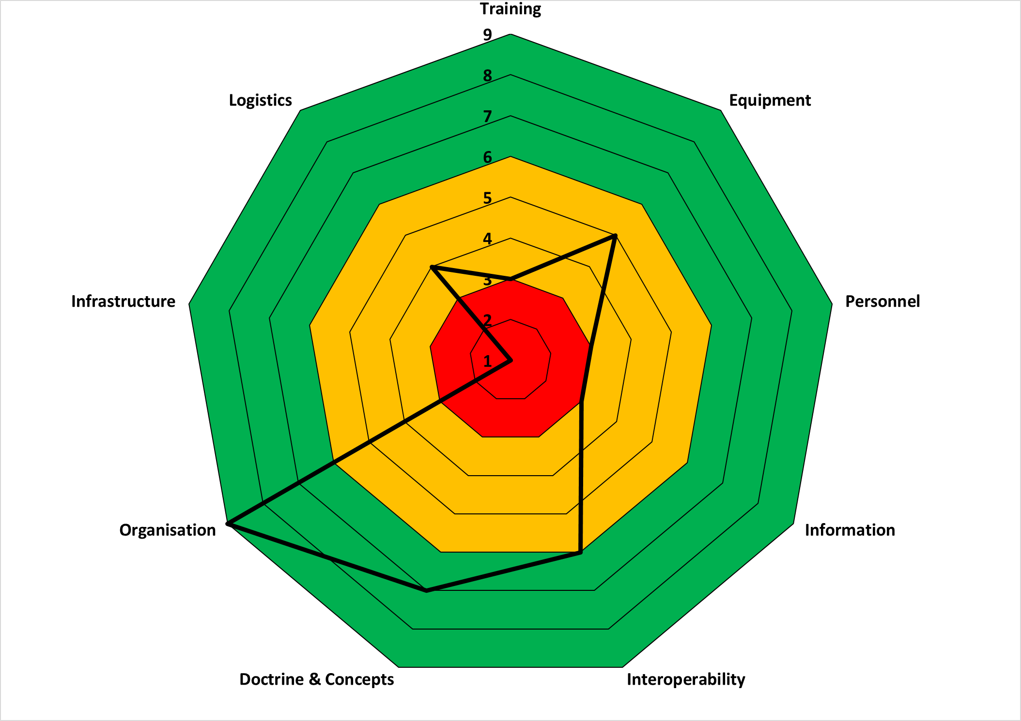
UK OFFICIAL SENSITIVE COMMERCIAL (when complete) NAVY Develop Concept Card
DLOD Implications: [DLOD capability readiness levels are given in slide 4 and the link can be used to create a radar graph of readiness levels as shown below.] | Key Enablers and Assumptions: Must include but not be limited to: Safety: Climate change and Sustainability Considerations: Regulation and certification: Test and evaluation: Commercial: Finance: Digital (including Autonomy and, Data and AI): Infrastructure: Other:
 | Dependencies: [Where the capability is reliant on an area outside of its control, this should be described within the dependencies.]

Slide 3
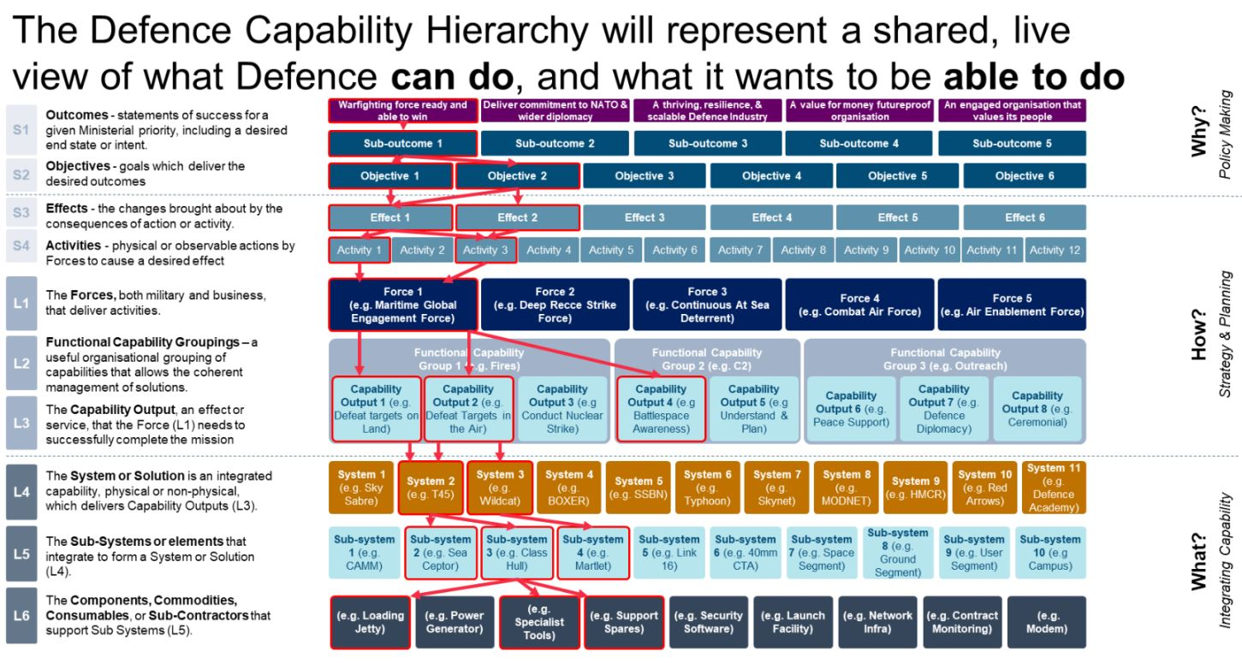
Notes:
Definitions of Defence Hierarchy Levels:
Level 0
The Missions or activities a campaign requires to be undertaken.
Level 1
The Forces designed to undertake a mission or activity (L1).
Level 2
The Functional Capability Groupings used to organise capability outputs (L3). This includes coherently managing existing capabilities, and developing future ones.
Level 3
The Capability Outputs that the Force (L1) needs to successfully complete the mission or activity.
Level 4
The Systems or System Solutions which deliver capability outputs (L3), representing the integration of separate sub-systems and incorporating appropriate DLODs.
Level 5
The Sub-Systems which integrate to form a system or system solution (L4). They cannot deliver a capability output (L3) on their own.
Level 6
The Components, Commodities, Consumables, or Sub-contractors that support sub-systems (L5). Usually, each one may focus on a particular DLOD.

Slide 4
Capability Readiness Levels by DLOD
Level | T | E | P | I | I | D | O | I | L
 | Training | Equipment | Personnel | Information | Interoperability | Doctrine & Concepts | Organisation | Infrastructure | Logistics
9 | No change required to existing training facilities or methods. | Actual technology qualified through successful mission operations | Could be fulfilled within current workforce planning assumptions. | Data and context is understood and established, requires minimal change. | Standalone solution. Some interoperability with other capabilities through existing routes. | No or minimal change required to accepted doctrine or concepts. | Fits within existing organisational structure. | No change to current infrastructure required. | No change required to existing logistics requirements and assumptions.
8 |  | Actual technology completed and qualified through test and demonstration
7 |  | Technology prototype demonstration in an operational environment
6 | Some change required to existing training facilities or methods. Not novel methods or bespoke facilities. | Technology model or prototype demonstration in a relevant environment | Some changes to workforce planning assumptions. | Limits in understanding of supporting data and context, requires some development. | Some interoperability with other capabilities required with minor changes. Minimal operability requirements requiring some change. | Some change required, but not novel. | Requires some operational and/ or non-operational organisational change. | Some modification of existing infrastructure. Some new infrastructure required, but within existing footprints. | Some change required to existing logistics requirements and assumptions.
5 |  | Technology basic validation in a relevant environment
4 |  | Technology basic validation in a laboratory environment
3 | Significant change required to existing training facilities or methods Development of novel training methods or bespoke facilities required. | Analytical and experimental critical function and/or characteristic proof of concept | Significant changes to workforce planning assumptions required. | Minimal understanding of data or context. | Significant interoperability requirements, requiring change. | Novel. | Requires significant operational and/ or non-operational organisational change. | Significant modification of existing infrastructure. New infrastructure required. | Significant change required to existing logistics requirements and assumptions.
2 |  | Technology concept and/or application formulated
1 |  | Basic principles observed and reported

Slide 5
Last Updated: 26 Mar 25 | UK OFFICIAL SENSITIVE Industry/Academia Concept Card |  |  |  |  |  |  | Planned ISD:
[Project Title] |  |  | SoSA Level: [Sense, Decide, Effect, Connect, Host, Enable/Cross Cutting] |  | DCH Level: [Level 0-6, refer to slide 3] | Concept Origin: [UCR, RtL, Directed, Emergent, DI Threat, Industry] |  | Sponsoring CPG:
Strategic Context: [High-level background information detailing the need for the project, referencing one or multiple of the following: Supporting strategic objectives, including references. DCAR or CCAR risk reference NATO capability objective (NATO blue book)] |  |  | NATO Capability Code: [As defined in Link] |  | Capability Target: [NATO blue book] M 1501 N; M 3201 N; M 7204 N; A 3104 N; A 3201 N; A 4303 N; A 5208 N; A 6205 N | CC Name: |  | POC:
Capability Description: [Outline the top-level requirements, likely to become Key Requirements, e.g. speed or range etc. Include project scope of what it will/ won’t include. E.g. Sensor Decider or Effector. This should align with dependencies. In addition - Pre-CONEMP. A very brief description on how the capability could be used – Potential useability/applications.]
Project Benefits: [Measurable improvement resulting from an outcome perceived as an advantage by one of more stakeholder, contributing to organisational objective. E.g. industrial strategy, international collaboration or improved lethality] |  | Risks: [Key Delivery Risks] |  | Current ROM Costings over 10: [VROM, ROM, ILR, FCR etc – also specify predicted Yr1 spend] |  |  | Resource Required: [Total in number and Roles – Mil and Civ]

Slide 6
UK OFFICIAL SENSITIVE COMMERCIAL (when complete) Industry/Academia Concept Card
DLOD Implications: [DLOD capability readiness levels are given in slide 4 and the link can be used to create a radar graph of readiness levels as shown below.] | Key Enablers and Assumptions: Must include but not be limited to: Safety: Climate change and Sustainability Considerations: Regulation and certification: Test and evaluation: Commercial: Finance: Digital (including Autonomy and, Data and AI): Infrastructure: Other:
 | Dependencies: [Where the capability is reliant on an area outside of its control, this should be described within the dependencies.]

