Slide 1
Primary Care – Extended Access

Slide 2
Aims for Today
Welcome and Introductions
Background to Extended Access Requirements
Summary of South Tyneside Practices Workload Review
Draft Model
Workshop to develop the model
Summary and Next Steps

Slide 3
Extended Access Primary Care Service Model
Extended access core requirements 17/18
Timing of appointments:
commission weekday provision of access to pre-bookable and same day appointments to general practice services in evenings (after 6:30pm) – to provide an additional minimum 1.5 hours a day;
commission weekend provision of access to pre-bookable and same day appointments on both Saturdays and Sundays to meet local population needs;
provide robust evidence, based on utilisation rates, for the proposed disposition of services throughout the week; and
appointments can be provided on a hub basis with practices working at scale.

Slide 4
Extended Access Primary Care Service Model
The specific criteria for South Tyneside being:
Providing at least 30 minutes per 1000 population rising to 45 minutes additional time to be provided, above and beyond the current in-hours capacity, and services procured through the existing DES on extended hours.
This equates for South Tyneside to an additional 78 hours per week initially, rising to 117 hours.
South Tyneside needs to ensure ease of access for patients including:
all practice receptionists able to direct patients to the service and offer appointments to extended hours service on the same basis as appointments to non-extended hours services
patients should be offered a choice of evening or weekend appointments on an equal footing to core hours appointments.

Slide 5
Extended Access Primary Care Service Model
In order to ensure the service model can be developed and implemented effectively:
appointments/support should be for routine primary care issues (urgent needs are addressed via the Urgent Care Hub at STFT);
services must be integrated (between sites and services) as well as utilise full range of staff skills across sites/settings;
the episode of care must be completed otherwise it requires further unnecessary contacts;
Patients will be referred onwards if necessary, with follow up support to be provided by patients registered GP;
the service must be supported by an IT infrastructure which enables real time and timely flows of data to provide continuity of care - regardless of where patients present.

Slide 6
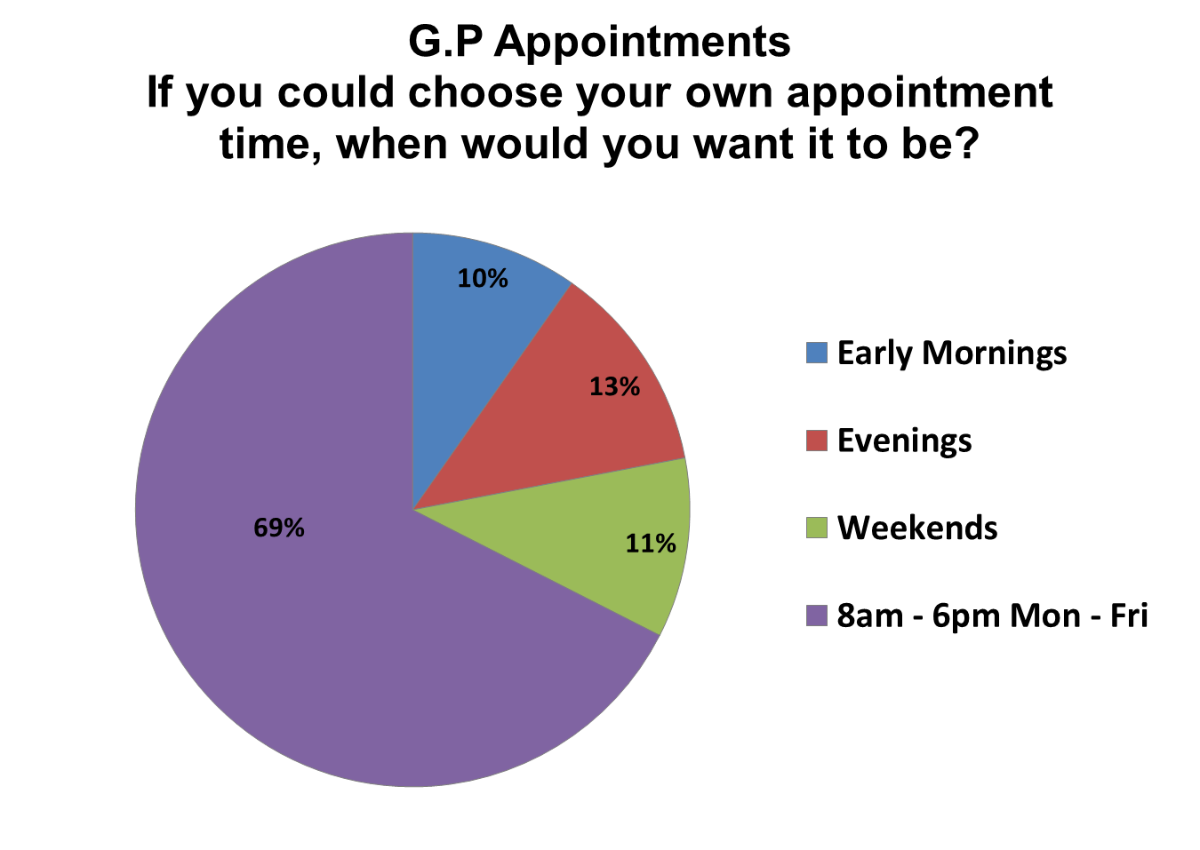
Extended Access Primary Care Service Model
From Previous Workload Analysis, where patients expressed a preference, we know:

Slide 7
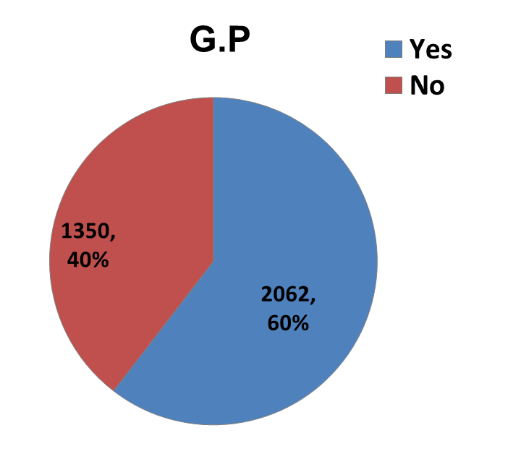
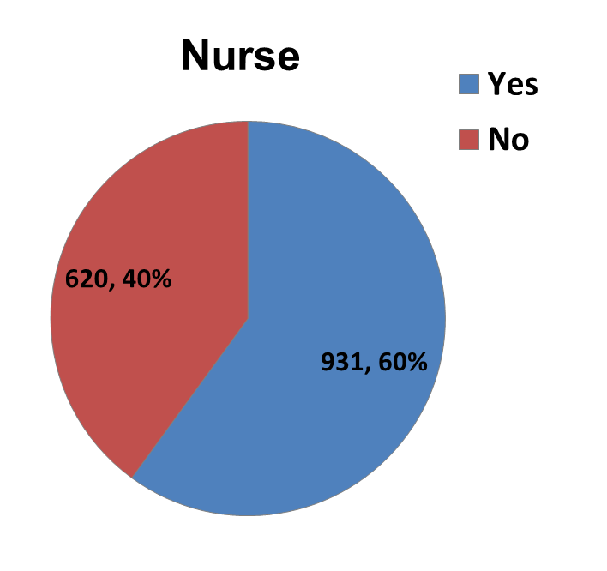
Extended Access Primary Care Service Model
From the Workload Analysis – Patients, who expressed a preference, are happy to receive telephone consultations:

Slide 8
Extended Access Primary Care Service Model
Workload analysis also indicated that many patients did not need to see a GP:
45% of patients seen by GPs (from the sample week workload analysis) could have been dealt with by another professional or by self care (i.e. did not need to be seen at all).

Slide 9
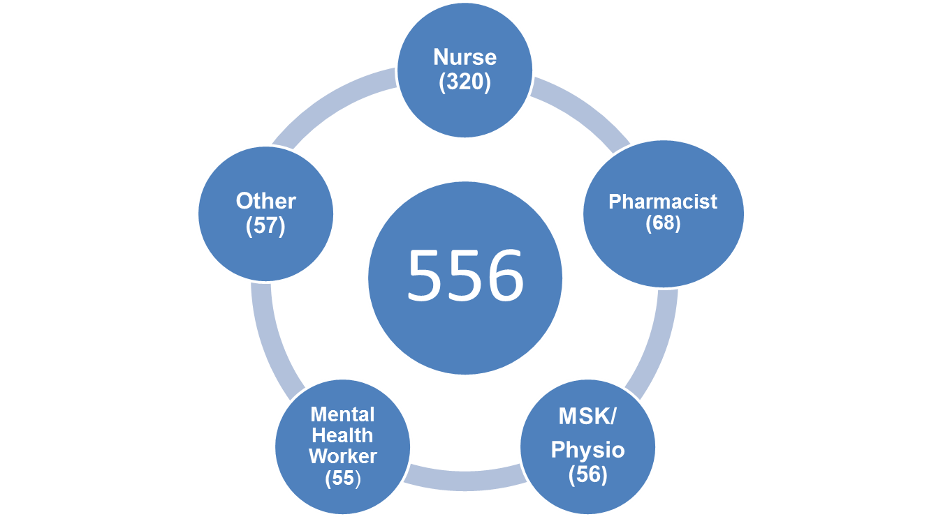
Extended Access Primary Care Service Model

Slide 10
Extended Access Primary Care Service Model
The service model for South Tyneside will be based upon the following principles:
integration with current local services,
planned appointment times in localities based on perceived need (activity flows),
equity of access,
in-line with current local and national guidance,
an extension of in-hours primary care, including skill-mixed professionals to provide the right care, right time in the right place.
and to be sustainable with the ability to expand the service if required in the future.

Slide 11
Extended Access Primary Care Service Model
The proposed model, to summarise:
The service needs to be based from local ‘hubs’ in South Tyneside.
The service must be primary care led – with a good skill mix.
The service is an extended access service to provide South Tyneside patients with choice and equity of access to primary care.
The service must provide 78 hours extra from September 2017.
The following two slides show two examples of how the service could operate (from two hubs) and provides an example of the clinical skill-mix for the service.

Slide 12
Extended Access Primary Care Service Model
Potential Model (which would provide 80 clinical hours):
 | Hub 1 |  |  | Hub 2
Weekday - Session One
GPs Available | 07:00 | 08:00 | 0 | 07:00 | 08:00 | 0
Practice Nurses Available | 07:00 | 08:00 | 0 | 07:00 | 08:00 | 0
Pharmacist Available | 18:30 | 22:00 | 0 | 18:30 | 22:00 | 0
Receptionist Available | 07:00 | 08:00 | 0 | 07:00 | 08:00 | 0
Weekday - Session Two
GPs Available | 18:30 | 20:30 | 1 | 18:30 | 20:30 | 1
Practice Nurses Available | 18:30 | 20:30 | 1 | 18:30 | 20:30 | 1
Pharmacist Available | 18:30 | 20:30 | 1 | 18:30 | 20:30 | 0
Receptionist Available | 18:30 | 20:30 | 1 | 18:30 | 20:30 | 1
Saturday - Session One
GPs Available | 11:00 | 14:00 | 1 | 11:00 | 14:00 | 1
Practice Nurses Available | 11:00 | 14:00 | 1 | 11:00 | 14:00 | 1
Pharmacist Available | 11:00 | 14:00 | 0 | 11:00 | 14:00 | 0
Receptionist Available | 11:00 | 14:00 | 1 | 11:00 | 14:00 | 1
Saturday - Session Two
GPs Available | 14:00 | 17:00 | 2 | 14:00 | 17:00 | 2
Practice Nurses Available | 14:00 | 17:00 | 1 | 14:00 | 17:00 | 1
Pharmacist Available | 14:00 | 17:00 | 0 | 14:00 | 17:00 | 0
Receptionist Available | 14:00 | 17:00 | 1 | 14:00 | 17:00 | 1

Slide 13
Extended Access Primary Care Service Model
Potential Model (which would provide 78 clinical hours):
 | Hub 1 |  |  | Hub 2
Weekday - Session One
GPs Available | 07:00 | 08:00 | 1 | 07:00 | 08:00 | 1
Practice Nurses Available | 07:00 | 08:00 | 1 | 07:00 | 08:00 | 1
Pharmacist Available | 18:30 | 22:00 | 0 | 18:30 | 22:00 | 0
Receptionist Available | 07:00 | 08:00 | 1 | 07:00 | 08:00 | 1
Weekday - Session Two
GPs Available | 18:30 | 20:30 | 1 | 18:30 | 20:30 | 1
Practice Nurses Available | 18:30 | 20:30 | 1 | 18:30 | 20:30 | 1
Pharmacist Available | 18:30 | 20:30 | 0 | 18:30 | 20:30 | 0
Receptionist Available | 18:30 | 20:30 | 1 | 18:30 | 20:30 | 1
Saturday - Session One
GPs Available | 11:00 | 14:00 | 1 | 11:00 | 14:00 | 1
Practice Nurses Available | 11:00 | 14:00 | 0 | 11:00 | 14:00 | 0
Pharmacist Available | 11:00 | 14:00 | 0 | 11:00 | 14:00 | 0
Receptionist Available | 11:00 | 14:00 | 1 | 11:00 | 14:00 | 1
Saturday - Session Two
GPs Available | 14:00 | 17:00 | 2 | 14:00 | 17:00 | 2
Practice Nurses Available | 14:00 | 17:00 | 0 | 14:00 | 17:00 | 0
Pharmacist Available | 14:00 | 17:00 | 0 | 14:00 | 17:00 | 0
Receptionist Available | 14:00 | 17:00 | 1 | 14:00 | 17:00 | 1

Slide 14
Extended Access Primary Care Service Model
Workshop:
Delivery of Service and Recruitment
Delivery of service would require new sessions, posts or roles outside of usual practice hours – ideas and issues bearing in mind workforce challenges – sessional/employed workforce etc.?

Slide 15
Extended Access Primary Care Service Model
2. Clinical Ways of Working
Avoid handbacks to in-hours services – how could this be achieved? Does the service need to limit patient groups it can treat?
Staff in the service are seeing and treating your patients – how do you want that to work? How can care be kept consistent across South Tyneside?

Slide 16
Extended Access Primary Care Service Model
3. Access Arrangement
What times do you feel the service should operate? Early morning, late evenings, Saturdays and/or Sundays?
How many hubs – 2/3/4?
How would you use the appointments?
How can it help in-hours GP’s?
What issues can you see?

Slide 17
Extended Access Primary Care Service Model
Summary and Next Steps
Service to commence in September 2017.
All ideas/issues from today will be reviewed by the Project Group and circulated as part of the model development.
Final model to be taken to the CCG Clinical Executive at end of April 2017.

Slide 18
Extended Access Primary Care Service Model
Should the decision be made to procure the service, the tender process will be managed through an E-Tendering System (PROACTIS)
https://www.proactisplaza.com/SupplierPortal/?CID=NECS

