Slide 1
Supplier guide to registering on the Attain eProcurement Portal
Jaggaer / Bravo Solutions
April 2022

Slide 2
Getting started
All procurements being run by Attain will be implemented on the Attain eProcurement Portal: https://attain.bravosolution.co.uk
Where a Contract Finder Notice and / or a Contract Notice is issued on the Find a Tender Service it will direct you to register at the above portal to obtain the tender documents for the relevant procurement. You must register your organisation if not already registered.
Typical types of tender issued in the eProcurement Portal include:
Selection Questionnaire (SQ) (including for Market Engagement Events and appointment to a Framework Agreement or Dynamic Purchasing System)
  Usually contains a Qualification Envelope and potentially a Technical Envelope
Open or ‘One-Stage’ Invitation to Tender (ITT)
  Usually contains a Qualification Envelope, a Technical Envelope and a Commercial Envelope
Restricted or ‘Two-Stage’ Invitation to Tender (ITT)
  Contains an SQ Stage (Qualification and potentially Technical Envelopes)
  Contains an ITT Stage (Technical Envelope and Commercial Envelope)

Slide 3


Registration
Go to the eProcurement Portal: https://attain.bravosolution.co.uk and click ‘Register’
The eProcurement Portal is transitioning from Bravo Solutions to Jaggaer One, following an acquisition. The ‘Bravo’ URL will be updated in due course by Jaggaer, when they update globally.

Slide 4
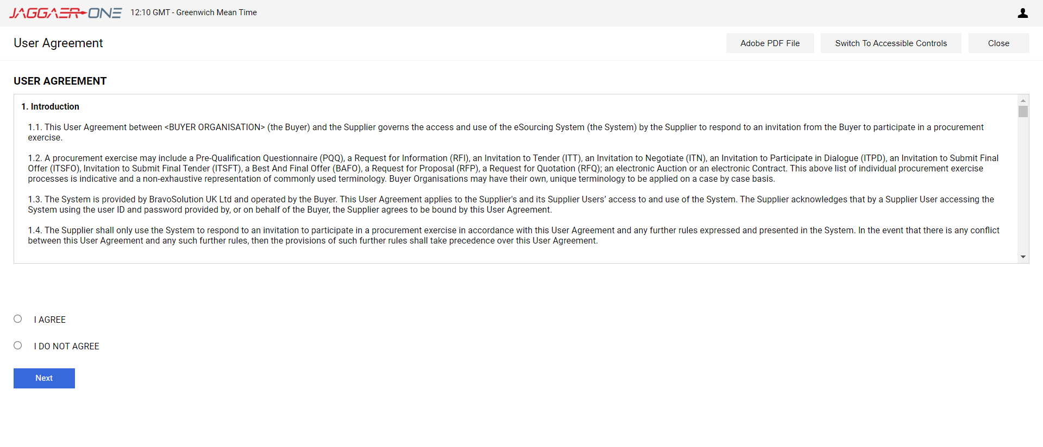
Registration
Scroll through and then accept the Terms and Conditions of the User Agreement then click ‘Next’

Slide 5
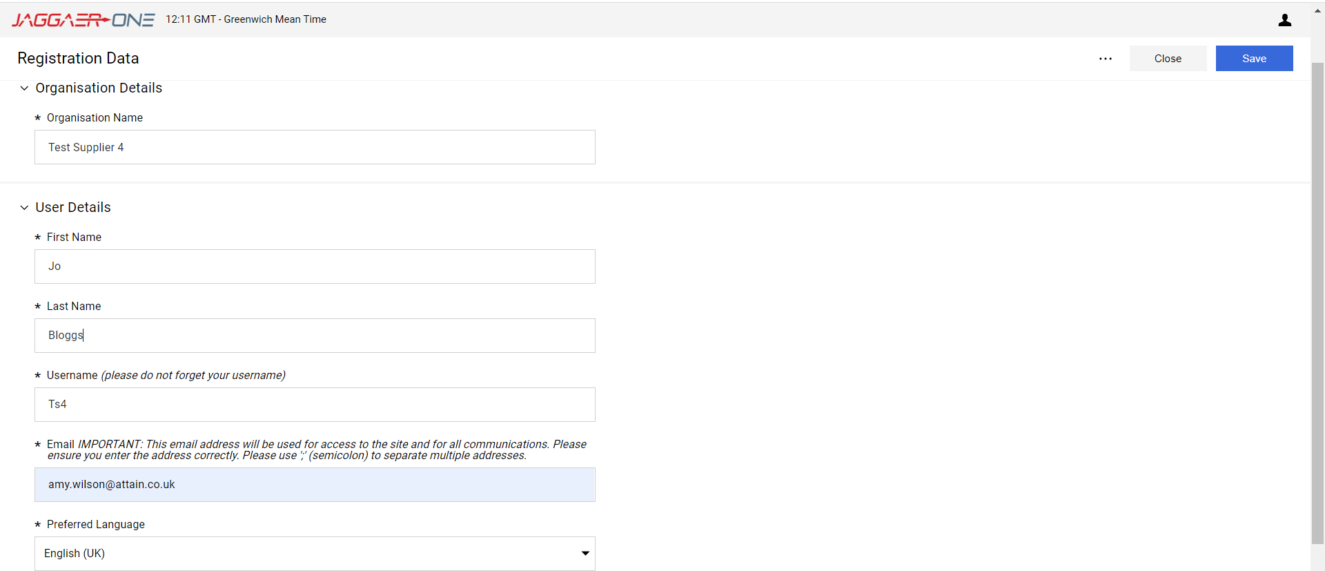
Registration
Complete the basic details for your organisation then click ‘Save’

Slide 6
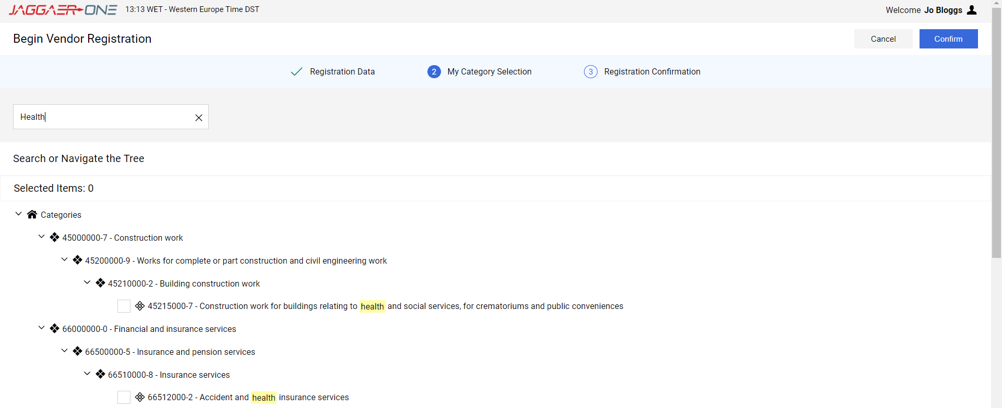
Registration
Search for and select the most appropriate category representing your business / organisation and then click ‘Confirm’

Slide 7
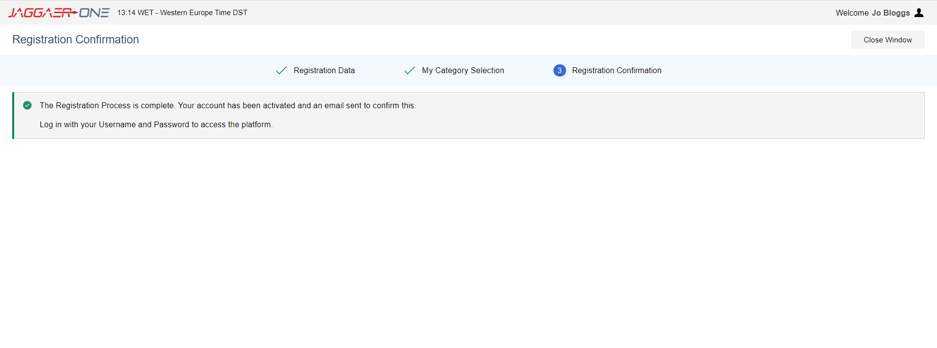
Registration
The registration process is now complete and your account is activated. You will receive an email with a temporary password to use to log in. The system will direct you to choose a new password the first time you log – in.
If for any reason you cannot access your account, for example, you lose your password, there is a link under the log-in details on the Home Screen. Click ‘I cannot access my account’ and follow the onscreen instructions.
In order to prevent eProcurement Portal emails from being quarantined by your organisation fire wall or spam filter, you are advised to instruct your IT team to accept all emails from a ".bravosolution.com"; ".bravosolution.co.uk" and ".jaggaer.com" address. Please also review the Junk Email settings of your email client software to avoid accidental message deletion.

Slide 8
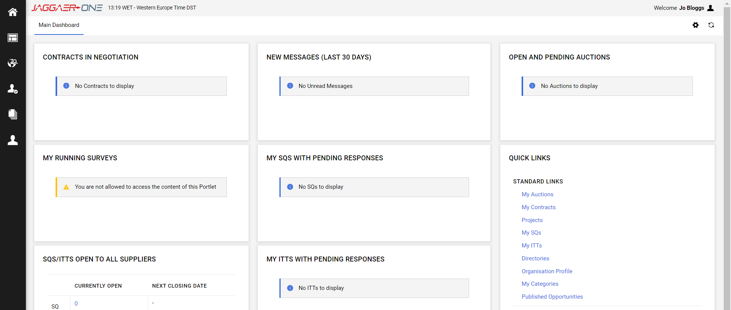
Home screen
Once logged in, you will see your Home Screen, where you can access all the SQs and ITTs that you have been invited to or have registered interest in. Return here using the ‘Home’ icon

Slide 9
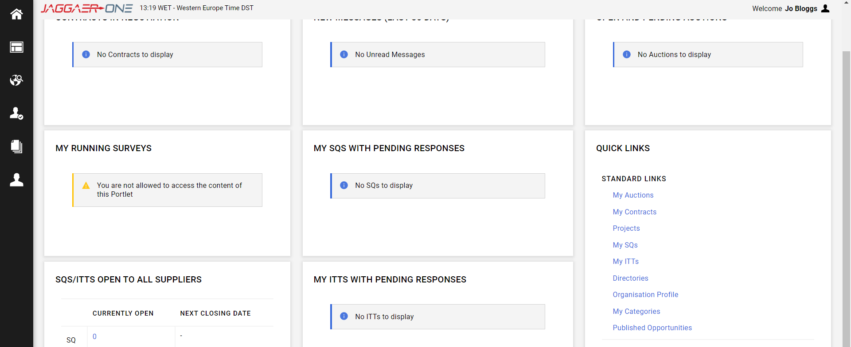
Accessing SQs and ITTs
To access tenders, navigate to SQs / ITTs that are Open to All Suppliers, using Published Opportunities. Once you have expressed interest in a tender or started a response to one, you will also see it appear in your ‘MY SQs’ or ‘My ITTs’ on your main dashboard, for easy future access.

Slide 10
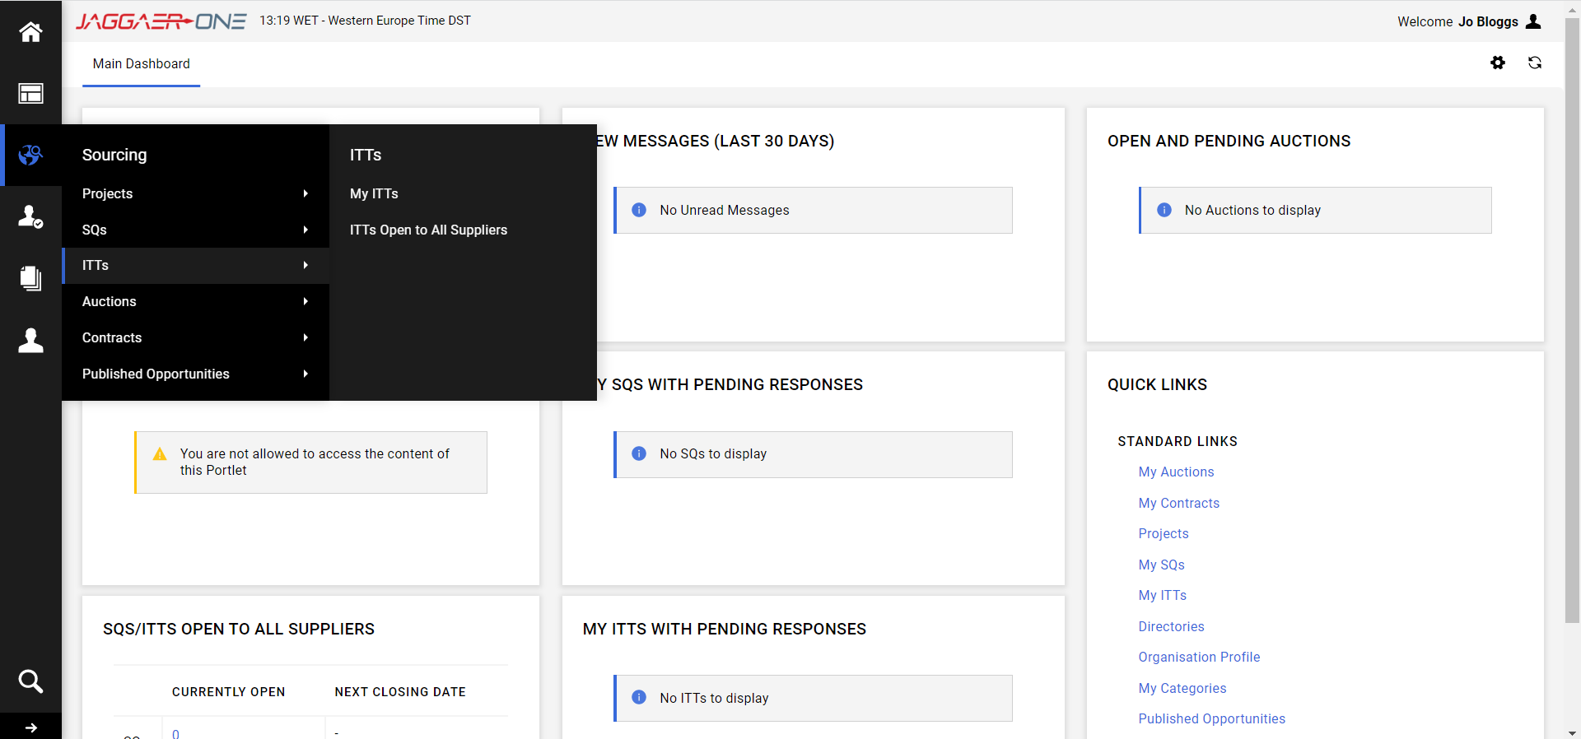
Accessing SQs and ITTs
You can also navigate to SQs and ITT’s by clicking on the ‘Globe’ icon as below

Slide 11
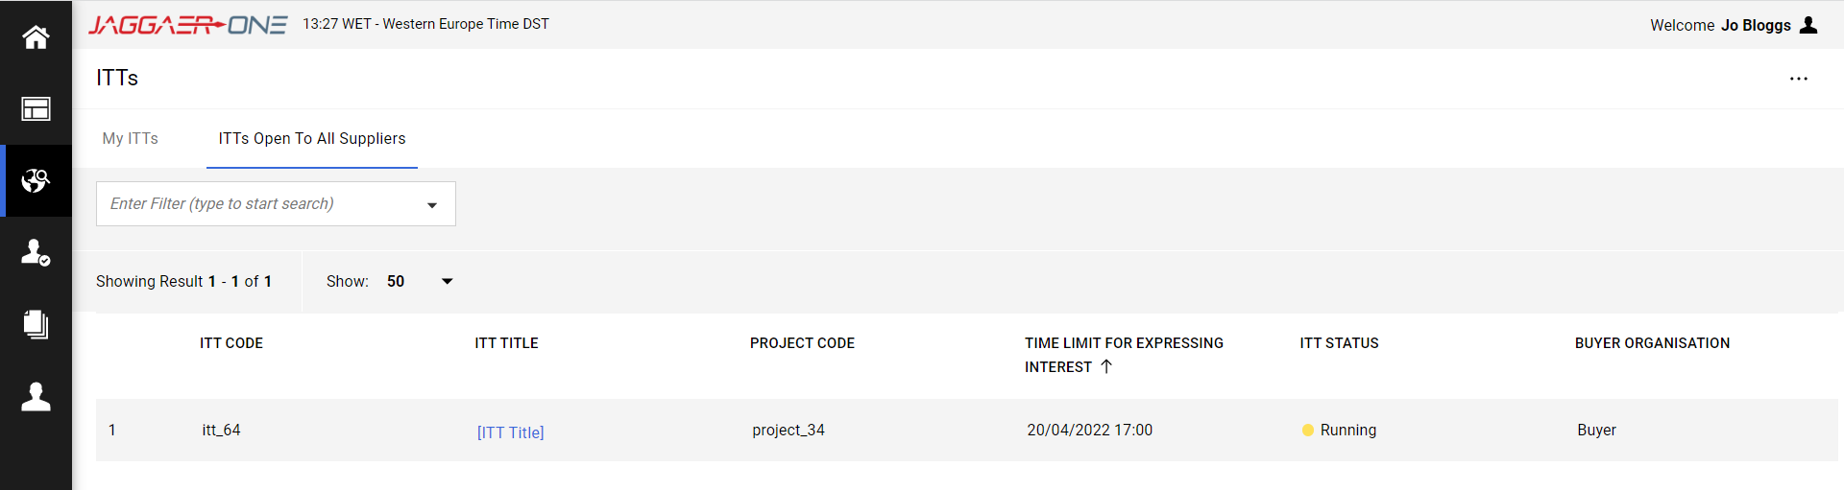

Expressing and Interest in a tender
To Express Interest in a tender, click on the name of the tender you wish to access in the list
10. On the next screen you will see the details of the SQ or ITT. Click on
11. You may see a pop up notification. Click ‘OK’

Slide 12
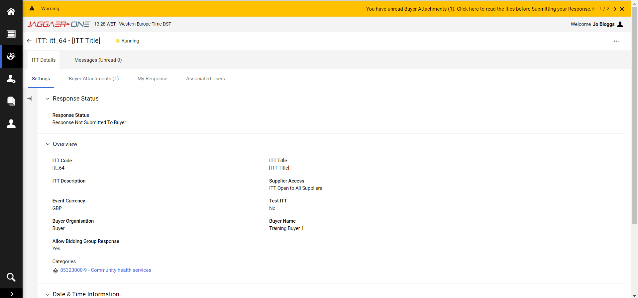
Accessing Buyer Attachments
You can access Buyer Attachments by clicking on the ‘Buyer Attachment’ tab, or on the link in the warning at the top of the page.

Slide 13
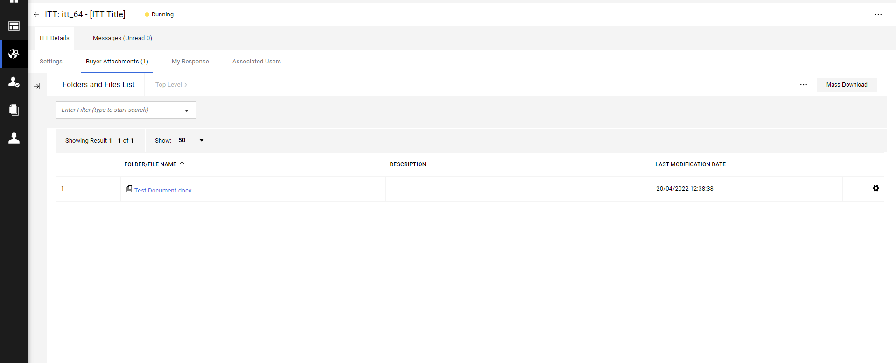
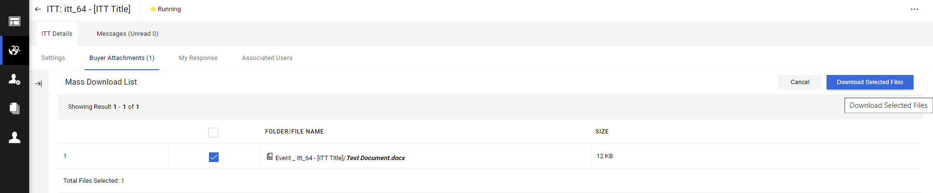
Mass Download Buyer Attachments
Click on ‘Mass Download’ and on the next screen select the file(s) you wish to download and click ‘Download Selected Files’
Your files will download into a .zip file that you need to double click to open.

Slide 14
Expressing an interest in a tender
In order to express an interest in bidding, from the SQ/ITT ‘Details’ tab, select ‘My Response’

Slide 15
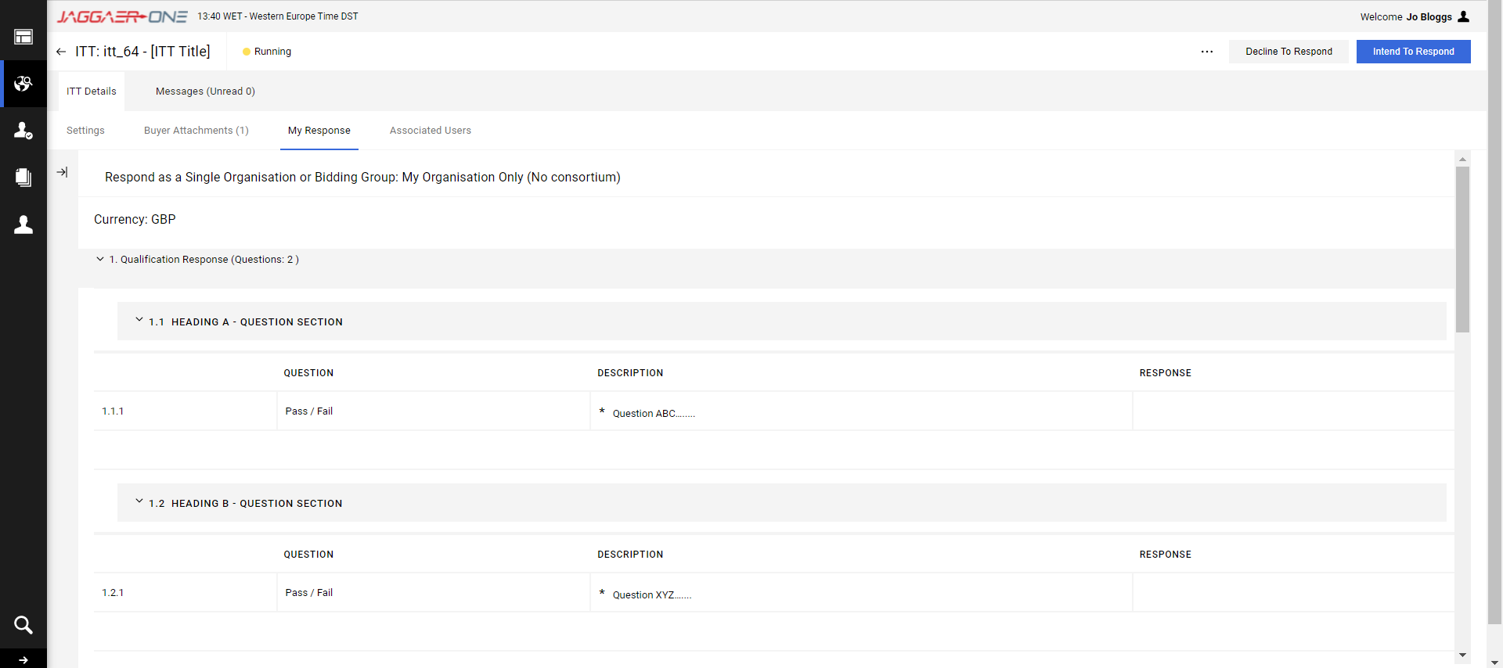
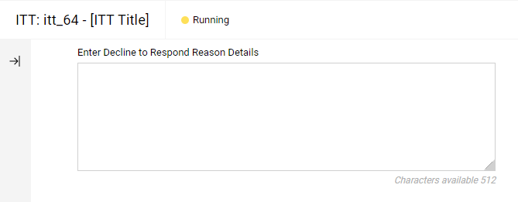
Decline to Respond
You can choose to click on either ‘Decline to Respond’ or ‘Intend to Respond’ using the buttons in the top right hand corner.
If you Decline, you will be asked to give a reason and then click ‘Decline to Respond’ again.

Slide 16
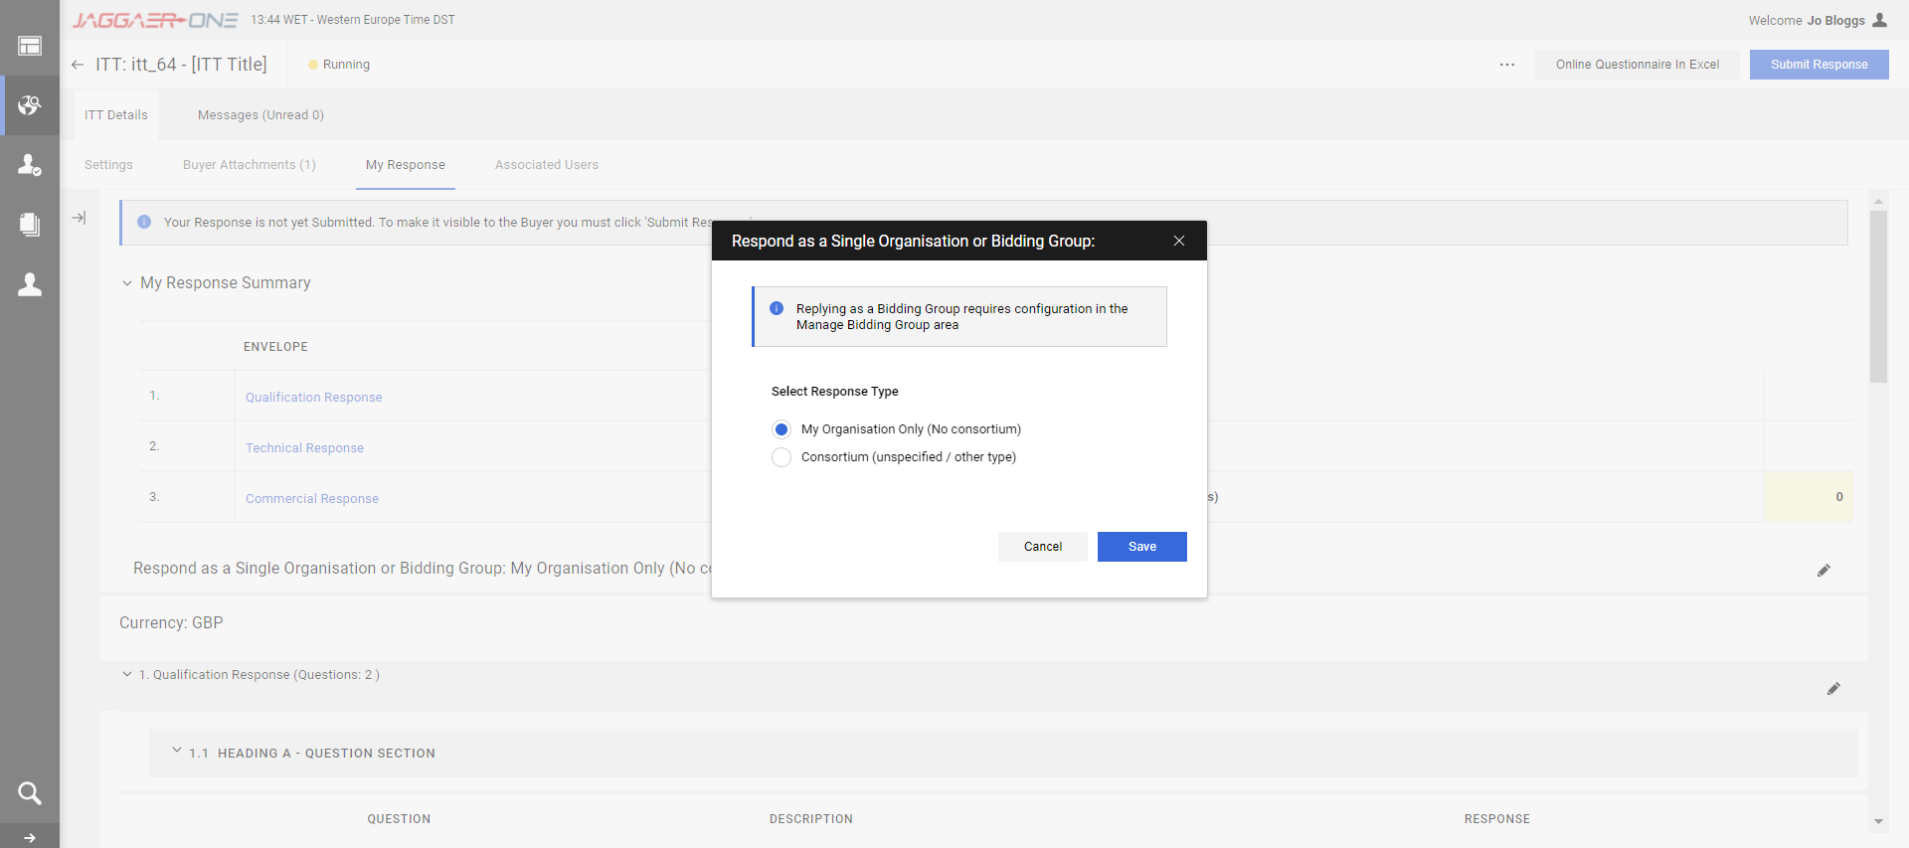
Intend to Respond
After clicking ‘Intend to Respond’ a pop up message will appear to ask if you are bidding as a Single Organisation or in a Bidding Group. Tick the relevant response and click ‘Save’.

Slide 17
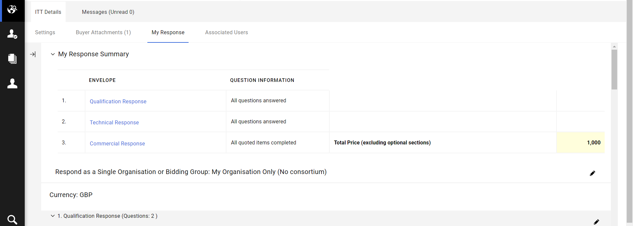
Accessing the envelopes
You can access each envelope within the SQ/ITT that you are bidding for by clicking on each of the links below (Qualification, Technical, Commercial) from the SQ/ITT ‘Details’ Tab.

Slide 18
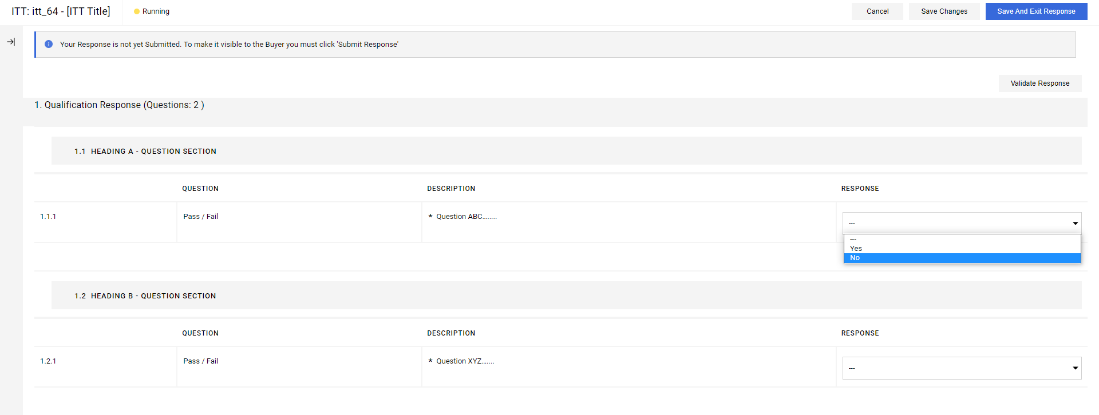
Responding to the questions (1)
Once you have clicked into an envelope, you will be able to respond to the questions contained. As demonstrated below, some will be single choice options, some may be free text response type, some may require a numerical figure, and some may require an attachment.
Complete your responses for each question in each envelope and click ‘Save and exit Response’ when finished.

Slide 19
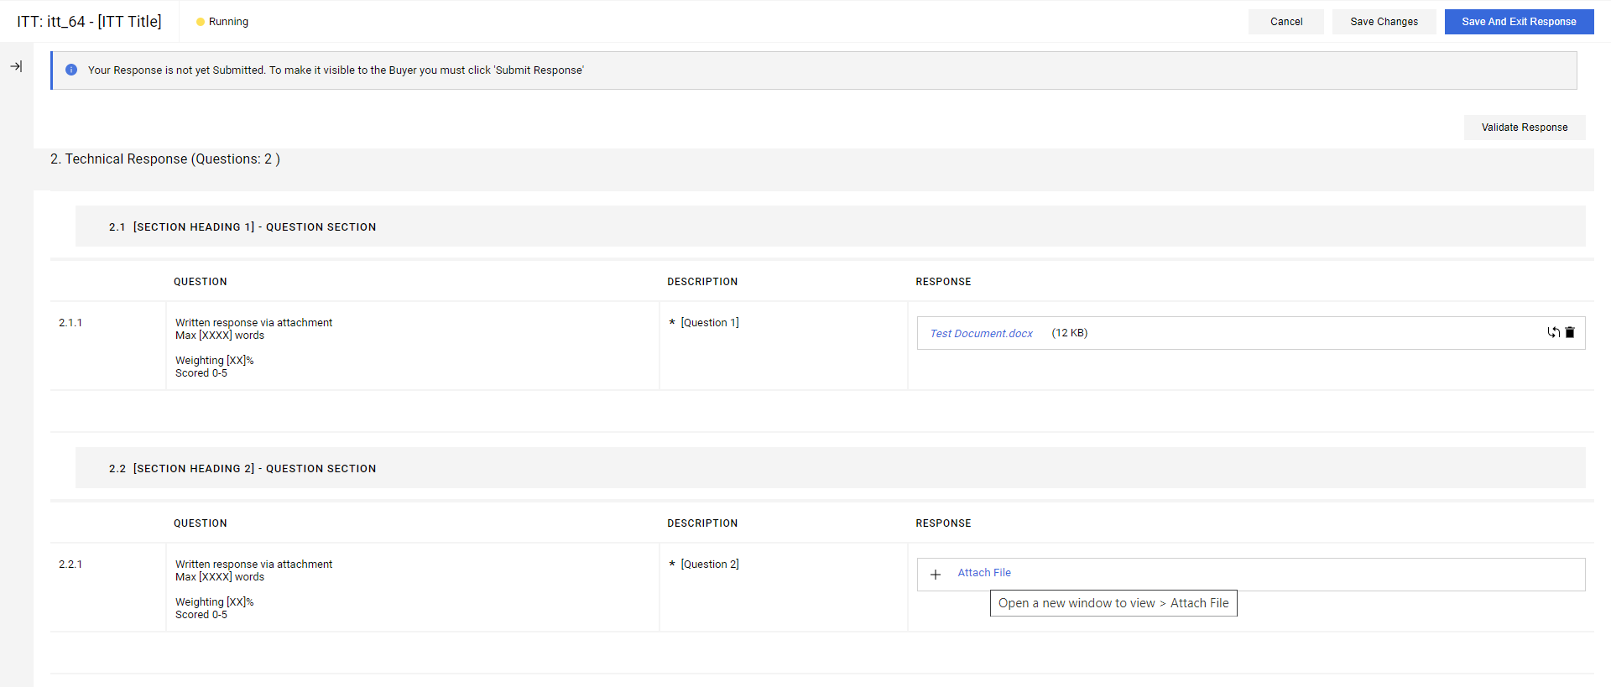
Responding to the questions (2)
To attach a file, click on the ‘+ Attach File’ icon next to each question. A pop up screen will appear allowing you to search for your file, and or drag and drop it in the relevant zone. Then click ‘Confirm.’ You can attach multiple documents to a single attachment question using a .zip file.

Slide 20
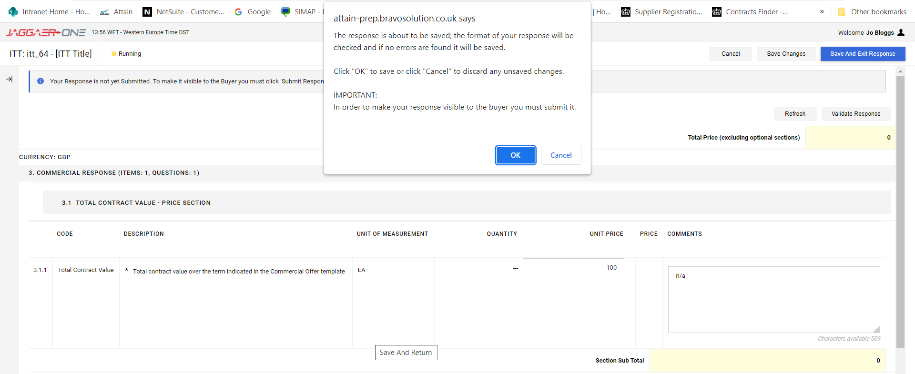
Responding to the questions (3)
After Saving and Exiting each Envelope there will be a pop up message. Click ‘OK’ to proceed.

Slide 21
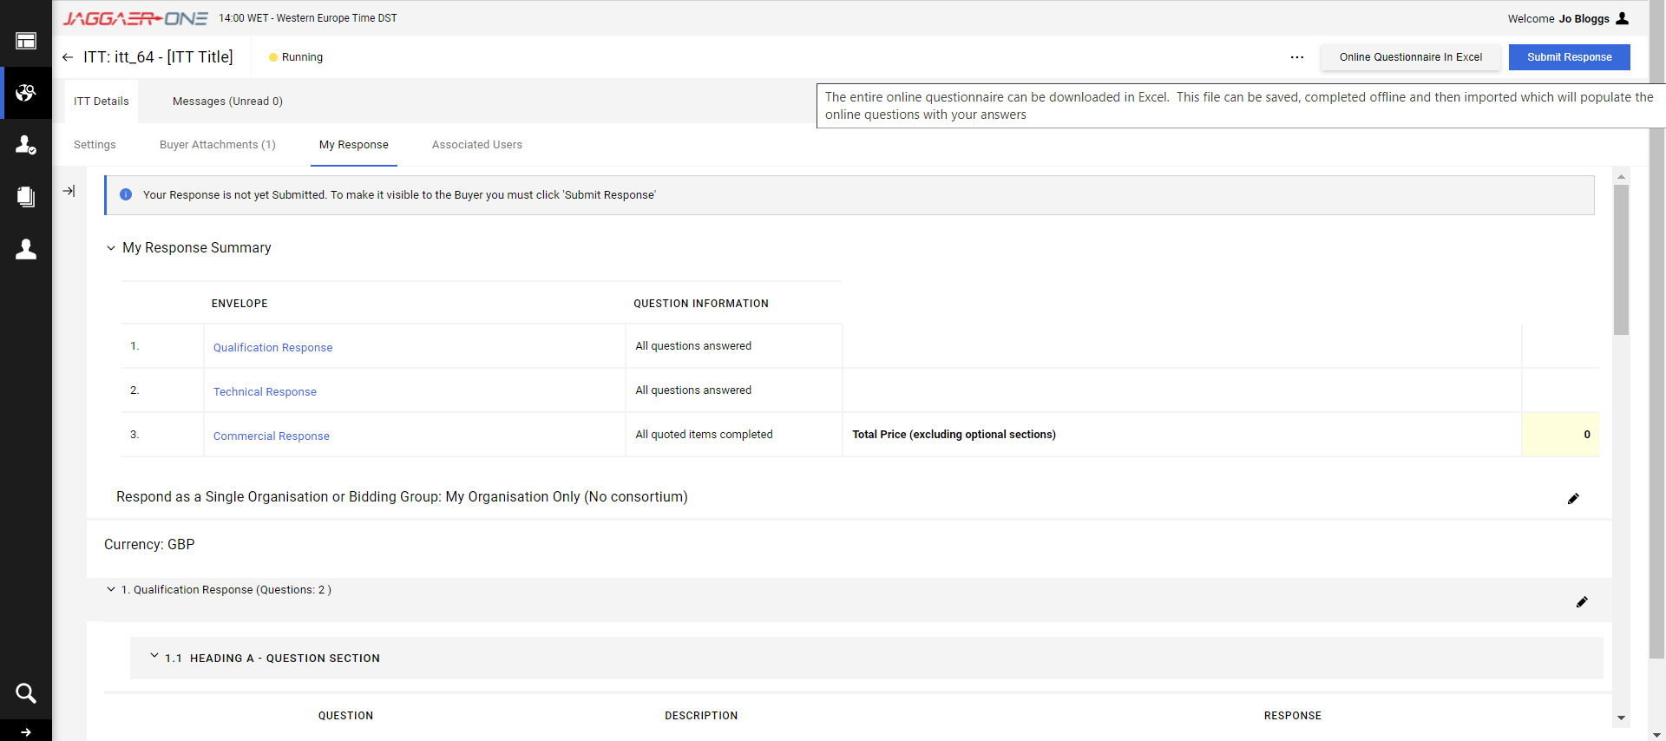
Responding to the questions (4)
It is also possible to download the SQ or ITT into Excel by clicking ‘Online Questionnaire in Excel’ icon.

Slide 22
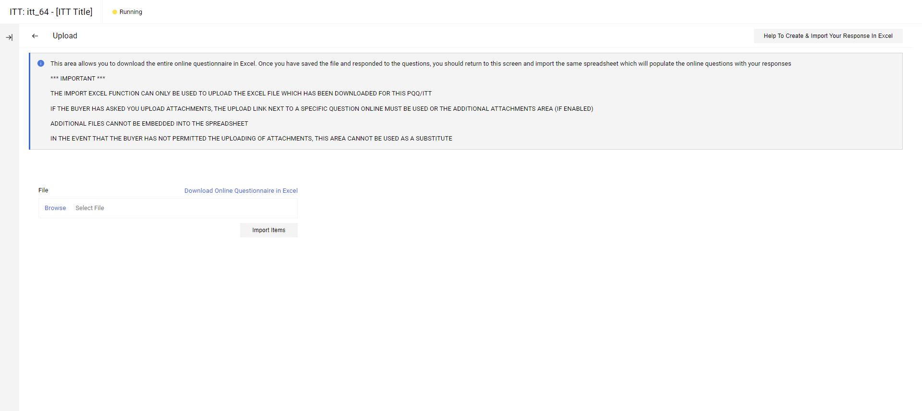
Responding to the questions (5)
Click on ‘Download Online Questionnaire in Excel
See next slide for an example of a Response Questionnaire / Form.

Slide 23
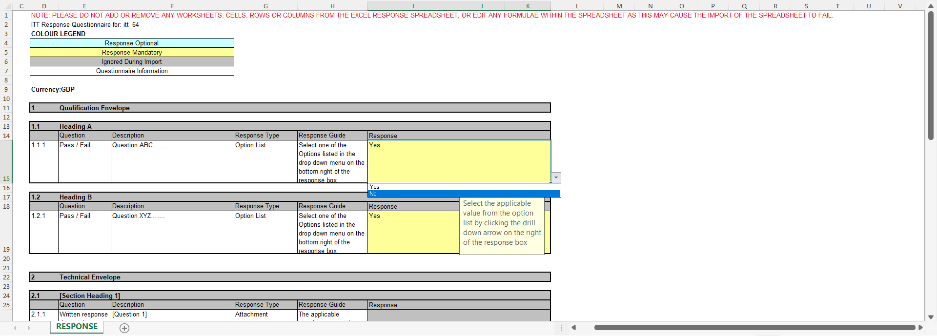
Responding to the questions (5)
The Excel Questionnaire should mirror what is in the eProcurement Portal exactly.
Do not add or remove any worksheets, cells, rows or columns from the response form or edit any formulae within the spreadsheet as this will cause the spreadsheet to fail to upload back into the Portal.
Complete all the blue / yellow boxes accordingly.
Complete your responses offline in the Excel file and save it somewhere on your computer hard drive / shared drive.
You can respond to text based questions and multiple choice questions by clicking the drop down menu available for each ‘option’.
Please note that there are only 2000 characters available in a text based response. If a Buyer requires >2000 characters within a response, it should be an ‘attachment’ type question instead. Please raise this as a clarification, if you are concerned.
Where a question requires an attachment you will need to attach the file manually to the relevant question within the Portal.

Slide 24

Responding to the questions (6)
When you are ready to upload your responses, Click ‘Browse’ and search for your saved file.
Then click ‘Import Item’ and all of your responses (with exception to attachments) will be uploaded in one go into the System.
If you need further help, click ‘Help to Create & Import Your Response in Excel’

Slide 25
Messages (1)
You can navigate to the ‘Messages’ tab to review any messages from the commissioner, including the Clarification Log updates.
You should use the Message functionality to raise any clarifications, whilst you are working on your tender response.
There should be no contact with the Commissioner outside of the eProcurement Portal.

Slide 26
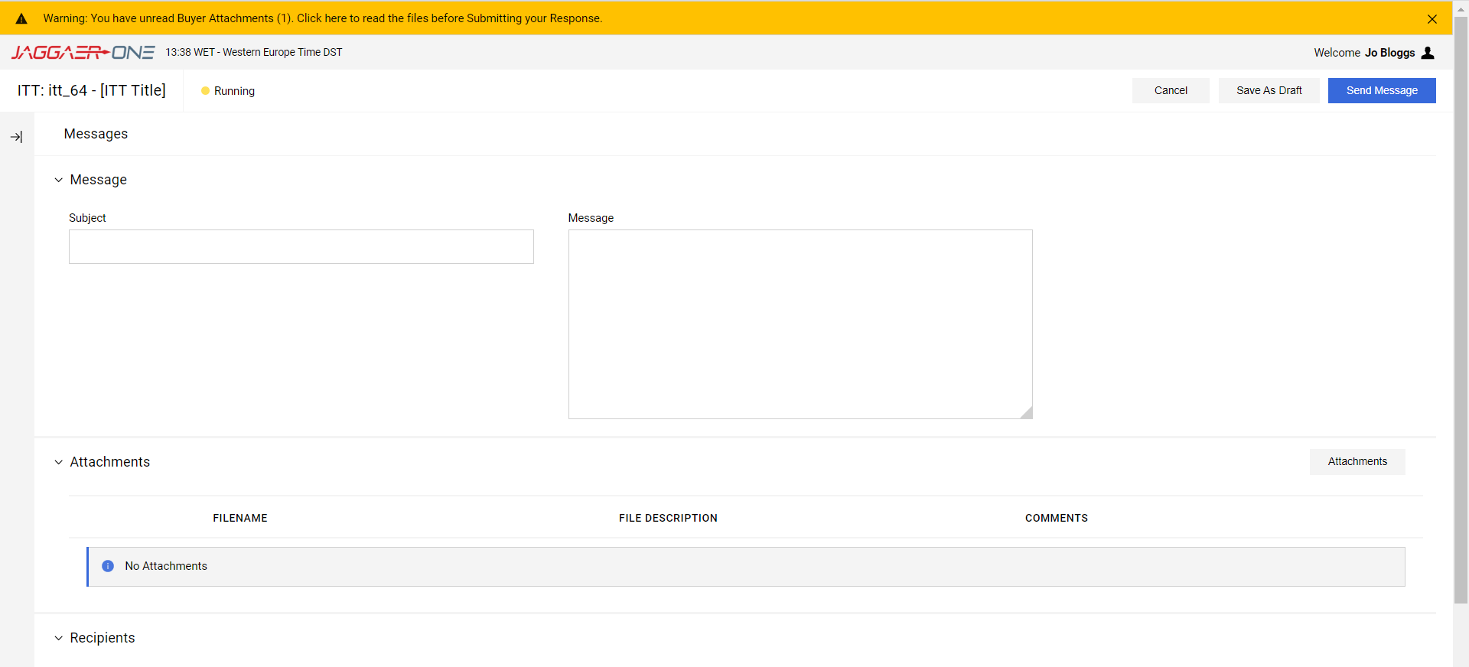
Messages (2)
Create you message to the Commissioner, attach any files requested and click ‘Send Message.’

Slide 27

Submitting your tender
You will see under ‘My Response Summary’ whether you have successfully responded to all questions in all envelopes. When ready, click ‘Submit Response.’
You can submit your response as many times as required for updates/amendments up until the published tender deadline. Thereafter no further edits are permissible.

Slide 28
Attain eProcurement portal helpdesk
Phone:
0800 069 8630
+44 203 608 4013
E-mail:
help_UK@jaggaer.com
Call me back!

Slide 29
2-4 Packhorse Road
Gerrards Cross
Buckinghamshire
SL9 7QE
0203 435 6590
contacts@attain.co.uk

