Slide 1
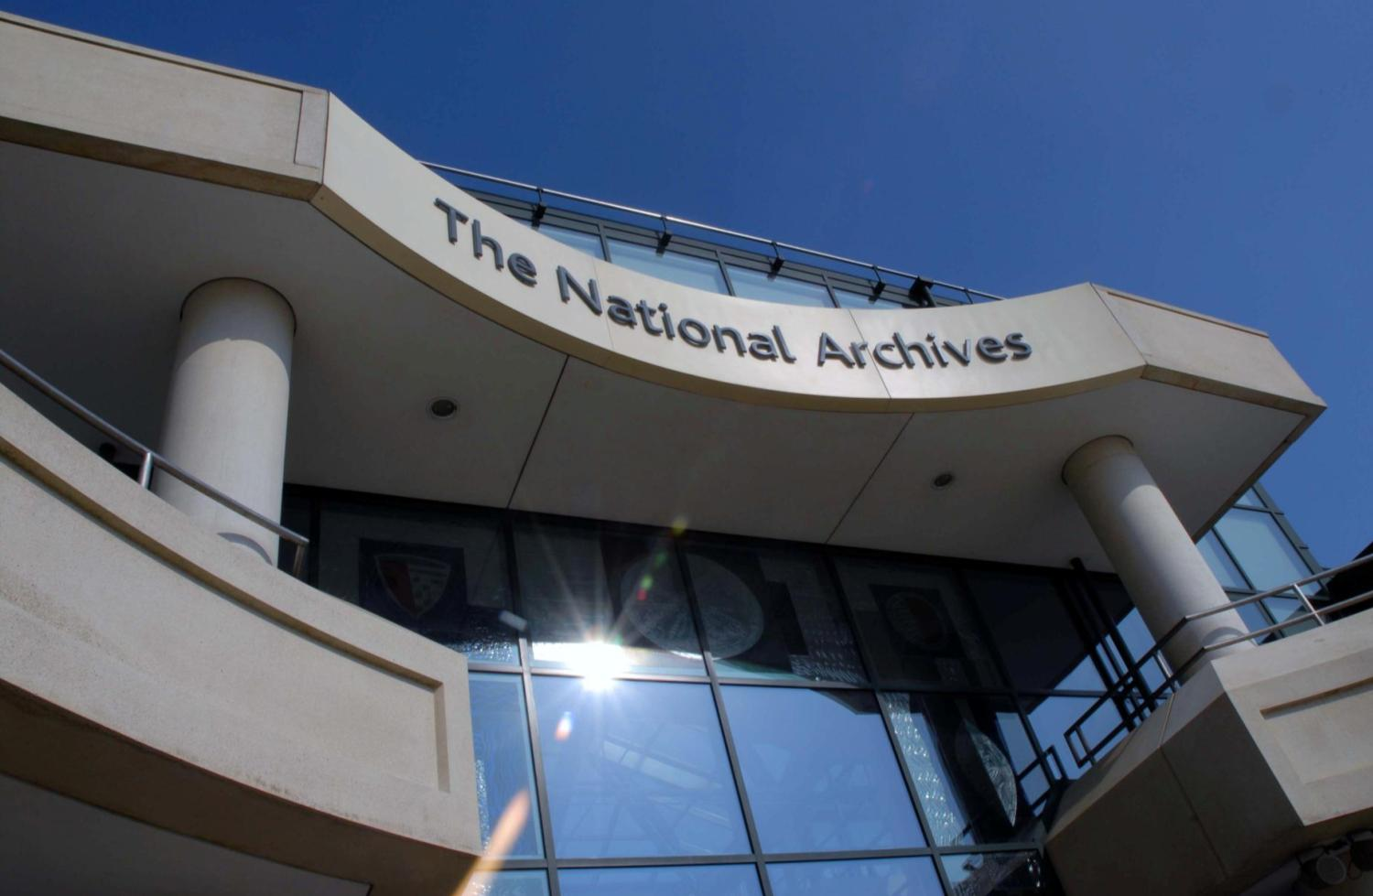
Public Space Programme
Please note: the following gives an indication of the organisation’s masterplan. It is provisional and subject to funding.

Slide 2

Archives Inspire the public
“We will inspire the public with new ways of using and experiencing our collection”
Goals
Grow our audience by connecting with new users
Provide a joined-up experience on site and online and use technology to make our routine services more efficient
Develop new and exciting public programmes and services which rival those of other pre-eminent institution
Inspire curiosity about The National Archives and the hidden gems in our collection
Re-imagine and reconfigure our Kew site to be a vibrant and welcoming learning environment

Slide 3
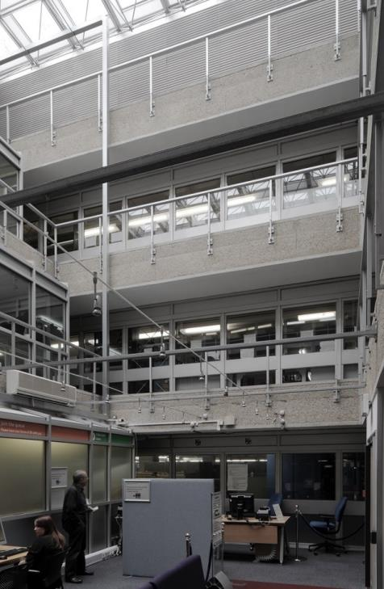
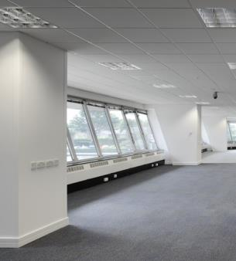
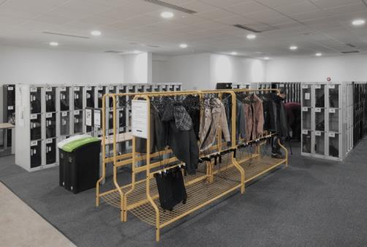
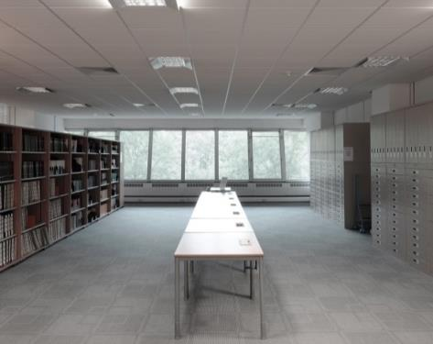
Our building ripe for transformation
Our ambitious plans mean that the building no longer meets our needs.
We require a space that will enable our traditional users
to engage in research, while
casual visitors can enjoy
events, exhibitions and
learning, in a welcoming and
vibrant social environment.

Slide 4
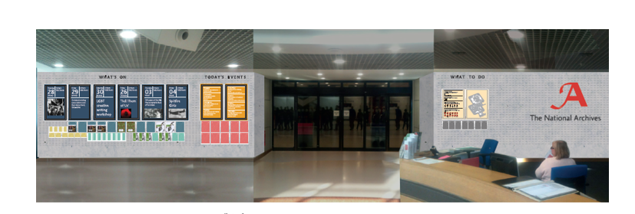
Our master plan so far a better welcome

Slide 5
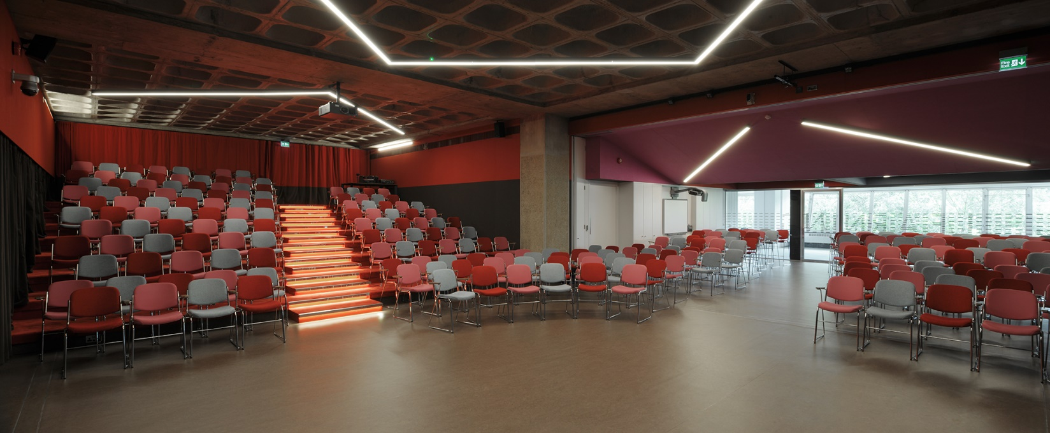
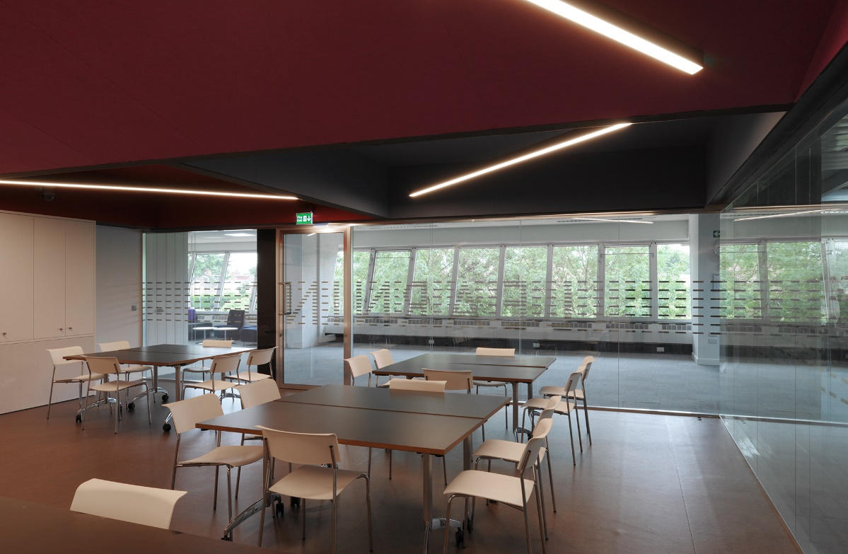
Our master plan so far flexible, multi purpose events and learning space

Slide 6
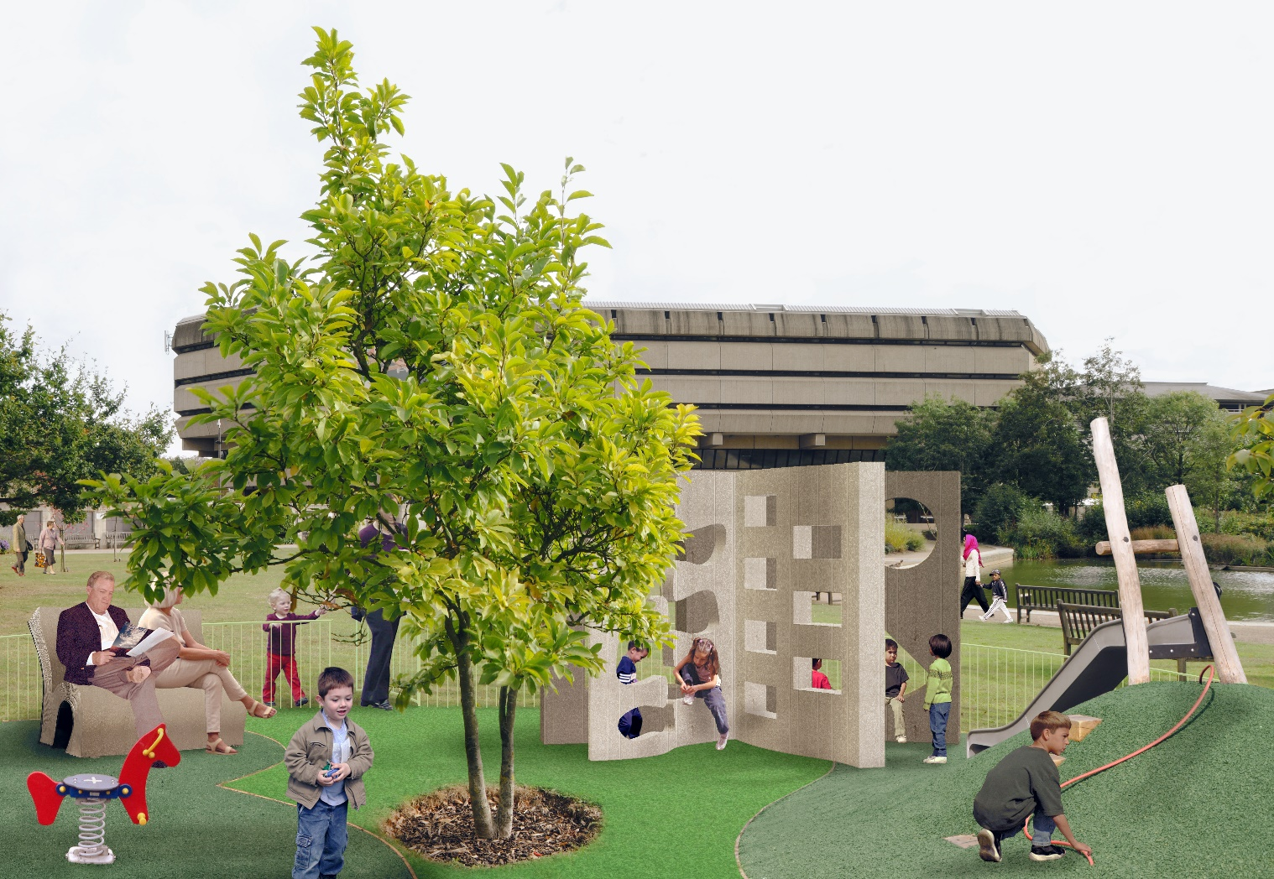
Our master plan - external children’s play area
Visible indications that children are welcome, and a sense of activity.

Slide 7
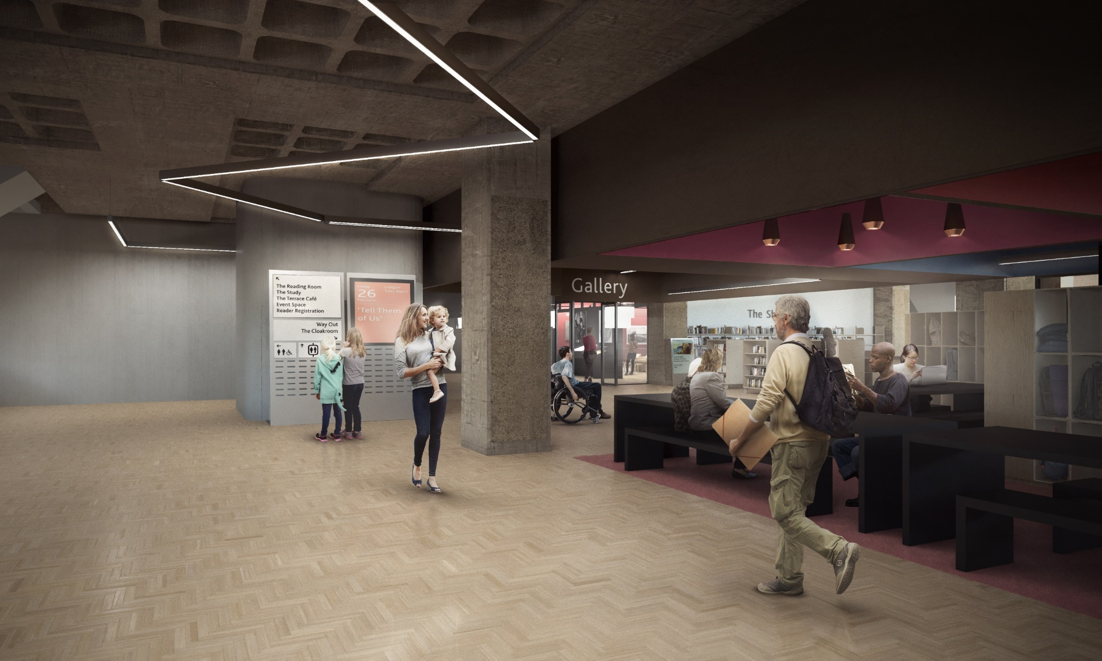
Our master plan – ground floor athe front room
Visitors will walk from our lobby into the Front Room, a new open plan space that brings together our cloakroom and secure storage lockers with a new-look shop designed to help visitors feel more welcome

Slide 8
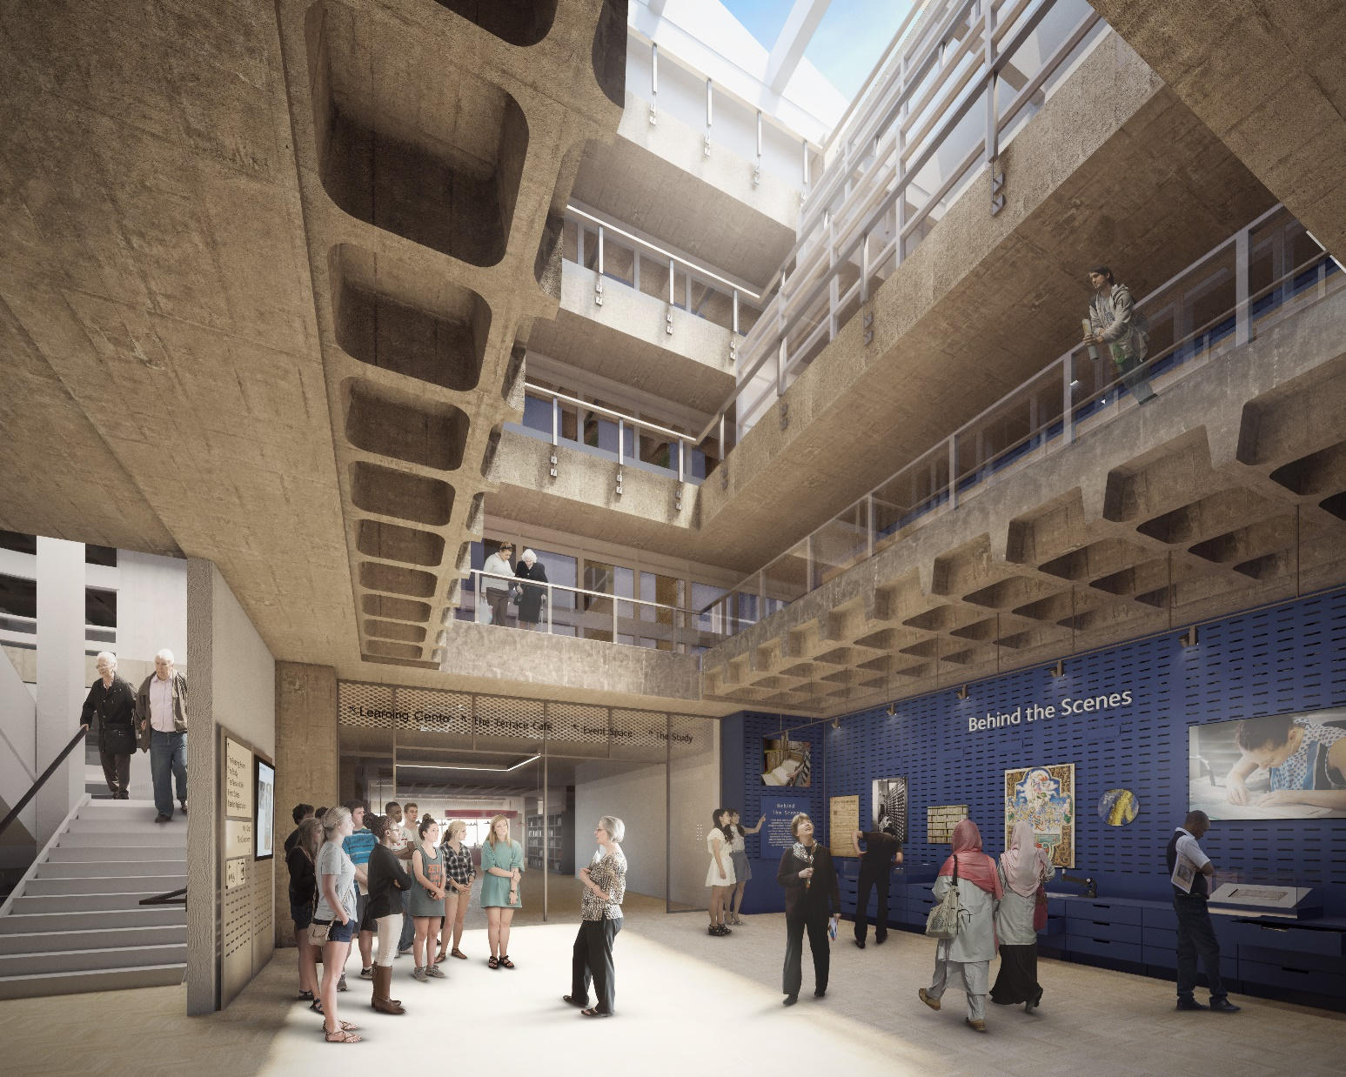
Our master plan – first floor the hall of archives
The Hall of Archives will be the dazzling new centrepiece of our public area.
By repurposing and exposing the incredible existing structure, we will develop a space that astonishes and inspires visitors.

Slide 9
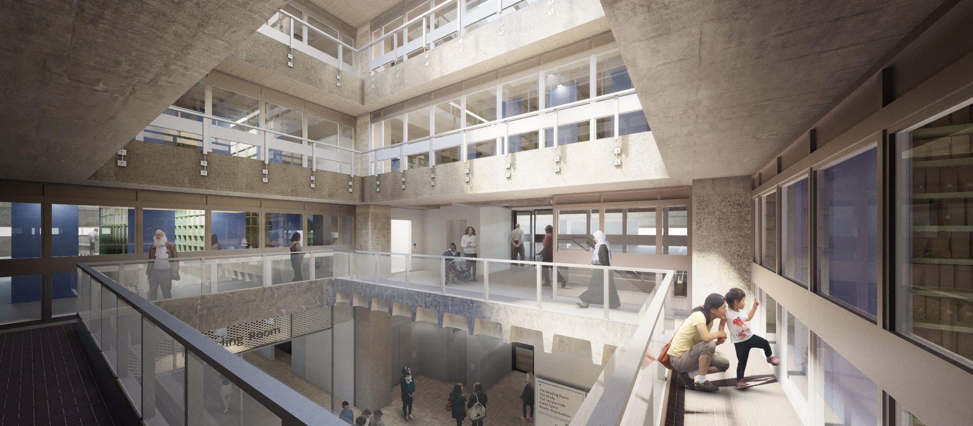
Our master plan – above the first floor the hall of archives mezzanine

Slide 10
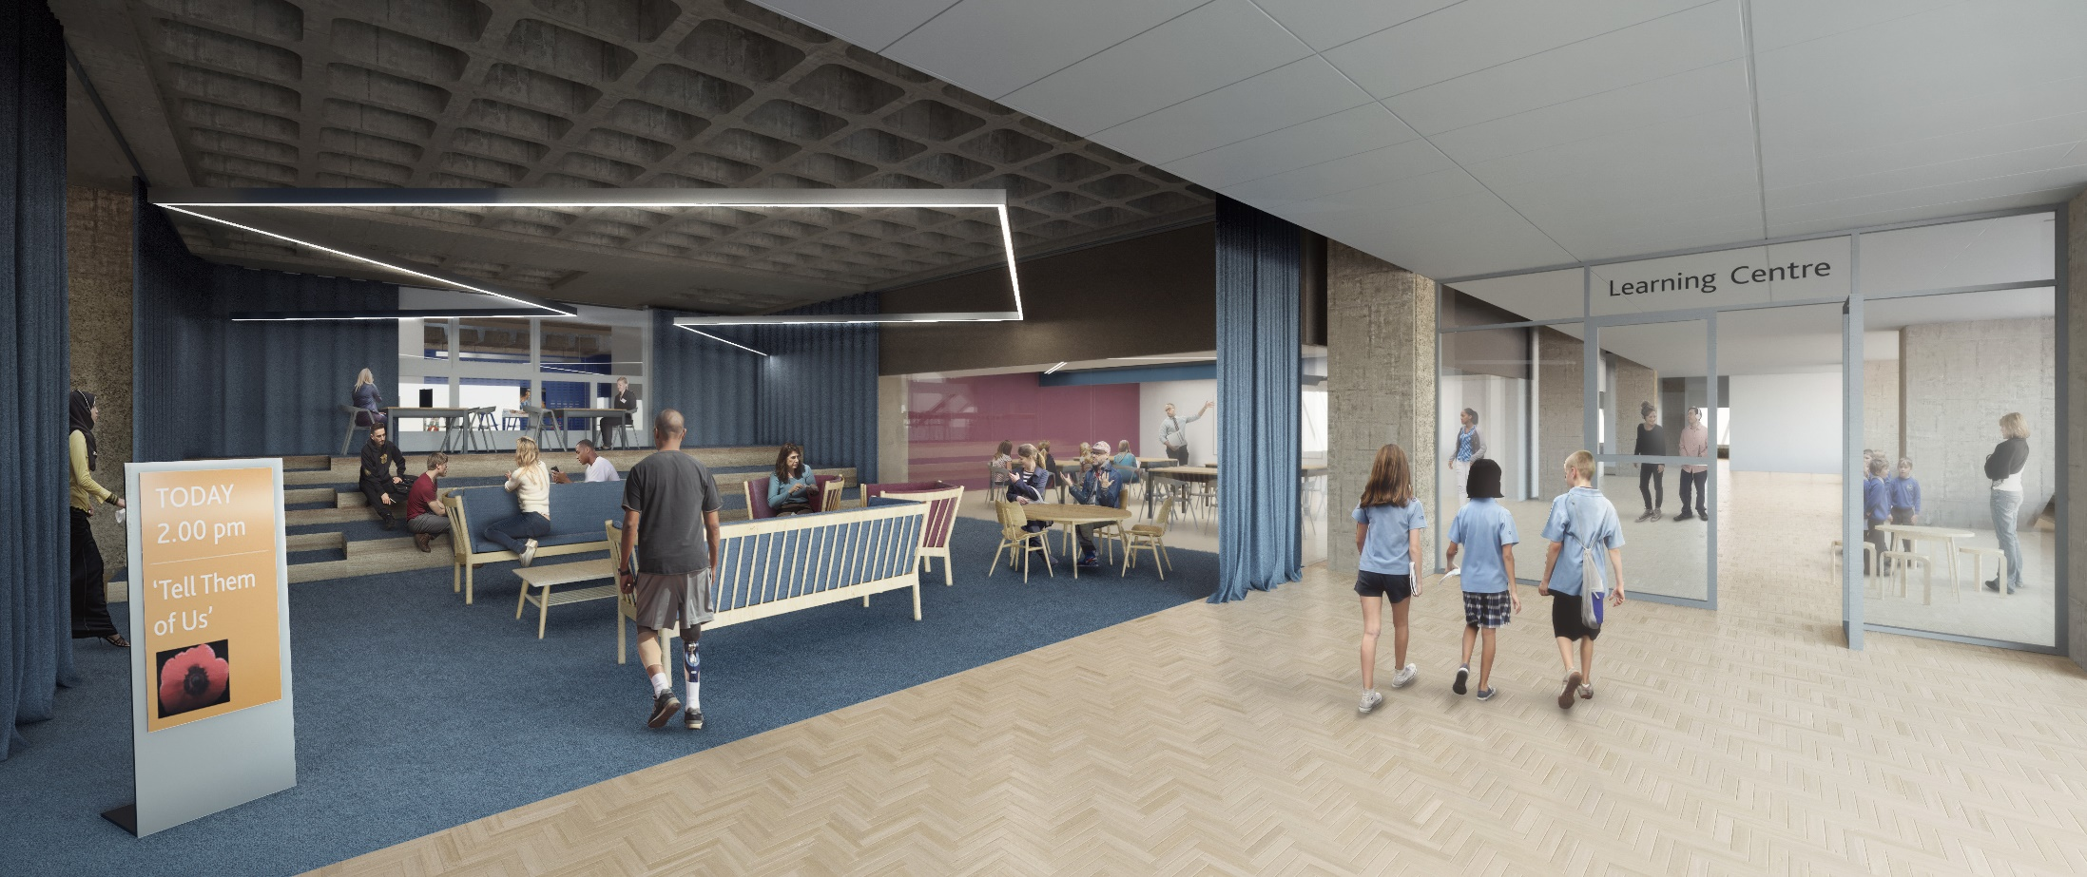
Our master plan – first floor
Liliving room and learning centre

Slide 11
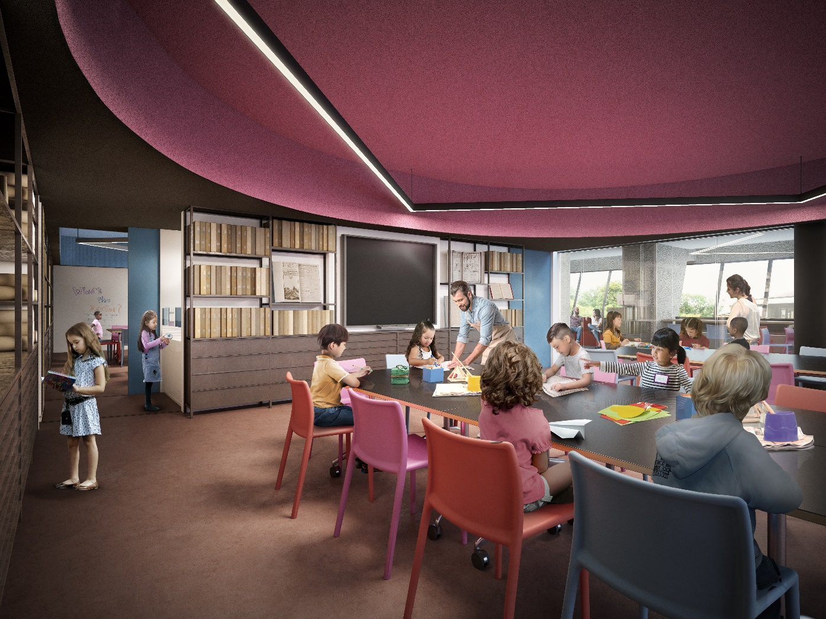
Our master plan – first floor inside a classroom

