Slide 1
Supplier Marketplace Event
Policing apps

Slide 2
Agenda
Background
The College
Membership Services
Options for future delivery
Commercial approach
One to one sessions
Close

Slide 3
The College
The College of Policing was established in 2012 as the professional body for everyone who works for the police service in England and Wales. The purpose of the College is to provide those working in policing with the skills and knowledge necessary to prevent crime, protect the public, and secure public trust.
We have three complementary functions:
Knowledge – we develop the research and infrastructure for improving evidence of 'what works'.
Education – we support the development of individual members of the profession and set educational requirements to assure the public of the quality and consistency of policing
Standards – we draw on the best available evidence of 'what works' to set standards in policing for forces and individuals.

Slide 4
Membership services
Membership Services supports the College of Policing vision to be ‘a world-class professional body, equipping our members with the skills and knowledge to prevent crime, protect the public and secure public trust.’
We:
enable members to take ownership of their own career development through providing greater individual choice and opportunities
support and embody practical ‘what works’ information and best practice in individual career development and continuing professional development
facilitate networking and exchange of information and knowledge
support professionalism across the whole of the Policing Community

Slide 5
Where are we now?
Launched Members’ Hub on POLKA on April 27th 2015
Launched Jobs Board on POLKA on 15th April 2015
Established Members’ Committee on June 30th 2015
Launched membership platform to College staff on 31st May 2016
Launched membership platform to all eligible officers and staff by the end of December 2016
Now c 17,500 members and growing every day

Slide 6
What members want from their College
 | %
Engage with, involve and recognise us at all roles and levels, help us to network, to build the evidence base and develop our careers | 33
Deliver national standards and resources to reduce duplication and help collaboration | 24
Inspire us through innovation and high quality education, review the use of e-learning | 19
Speak out as the authoritative independent public voice of the profession - with status commensurate to others and a clear sense of purpose | 16
Collect and share good practice, engage with academics, build the evidence base | 16
Develop a clear framework for continuing professional development and career pathways | 16
Provide professional body accreditation and transferable qualifications | 12
Be a font of practical knowledge, information, advice and support (everything from Athens access to legal knowledge) | 7
Notes:
We asked our members’ one question on POLKA Members’ Hub : ‘If the College could do one thing for you, what would that be?’
College already provides most of these things – membership will facilitate easier access and greater awareness of what College offers
We welcome our members’ feedback – we want to work with them to develop and grow our services.
We have asked our pre-registered members a question: If the College could do one thing for you, what would that be? (we have been collating and analysing the feedback – please let us know if you’d like to find out more)

Slide 7
What does membership provide?
Standard membership – providing the skills, knowledge and tools to do the job:
Continue to enjoy free access to products and services (e.g. Legal Digest)
Facility to browse training, events and workshops delivered by the College
Be connected to other policing professionals, experts and specialists
Be the voice of the profession and help shape its future
Careers information, advice and guidance online, plus mentoring
Additional services – to be charged for on a ‘pay as you use basis’
Coaching
More to be developed (such as National Police Library enhanced services)
Notes:
Free of charge products and services:
College newsletters and publications (e.g. Police Gazette, National Police library standard services, POLKA, our online e-learning portal, a bespoke College newsletter to members etc – please note this is not an exhaustive list)
Online bookings for College training, events & workshops – these will still need to be approved by an individual’s force – membership will increase awareness of them.
Currently connected to other members through Members Hub on POLKA - in the future this function will migrate to the membership website.
We seek members’ feedback in relation to what they want from their membership, we will involve them in consultations and workshops.
For example, we engage with members through Hot Seats with the 4 community chairs – where members can pose questions and get instant responses.
Careers information, advice and guidance online (and by appointment with a Membership Development Advisor) .
Mentoring – membership will provide details of prospective mentors in order for members to contact them directly. ** We are launching recruitment for our mentor database – please highlight this opportunity to get involved as a mentor and help us to shape this new free membership service – this applies to the relevant audience only (UK policing professionals: officers and staff)**
Chargeable products and services
Additional premium benefits are available to members on a pay-as-you-use basis, which will be facilitated by the ability to pay online via the new membership website:
Coaching (personal, professional and executive coaching) will be available to all members on a private, paid-for basis using our highly qualified coaches. This service will be available on request, following a discussion with a Development Advisor so we can ensure that it will be the right investment for the individual.
Also, the following products are being considered for future provision:
360-degree feedback. A valuable development tool for anyone seeking an understanding of how they are seen by others (e.g. peers, direct reports and customers). This service may be available to individuals via their force on a corporate basis (for details on whether this applies to them, the Beyond 360 team should be able to provide a list of client forces). In future, it may be provided directly to members for a fee. This will be available at a later stage depending on demand.
National Police Library enhanced services. These will be additional to the existing free library services and may include delivery of books (however, please note that this has not been agreed yet)
Lifestyle benefits – discounts and offers related to our profession (however, please note that this has not been agreed yet)
Personalised updates (e.g. training available)
** Services provided through membership will evolve over time and will be developed in response to member need. **

Slide 8
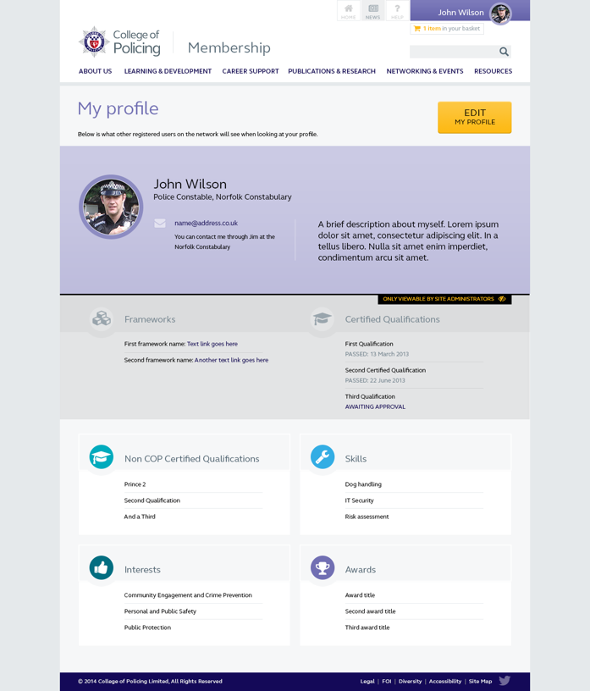

Membership website
Phase 1 membership website will include:
Profile builder (for qualifications, skills and interests)
Easy access to College’s products and services
Notes:
*An example screenshot of the membership website*
Membership website will provide one central access point to all College products and services.
**Services provided through the new website will evolve over time and will be developed in response to member need.**

Slide 9
Options for future delivery
Any options taken forward would mirror a public procurement / tendering exercise to comply with Public Procurement Regulations.
Timelines for any exercise to be decided – dependant on the outcome of this event.
The intention will be to arrange a formal engagement with full terms and conditions of being listed on the webpage.

Slide 10
Commercial approach
To comply with the rules of transparency, notes from todays events will be taken and shared on Contracts Finder.
This will include anonymised responses to questions discussed in the One to One sessions and also slides and any other topics of conversation covered throughout the day.
Please highlight to us if anything is Commercially Sensitive and we will redact accordingly.

Slide 11
What’s in it for them?
Listed on the College Membership Webpage.
The opportunity to engage with an established and growing target audience.

Slide 12

Firearms tactical adviser – 8 years service
Keen to improve the force and policing so more research focused and keen to learn from experiences in other forces
Most relevant services – Collaboration features, access to experts, mentorship and Research/CoP library

Slide 13

24/7 Sergeant – 5 years service
Keen to advance as far as possible within/beyond Policing. They are more likely to spend to support career ambitions and commit to personal study
Most relevant services – Active career management tools, mentoring and national vacancies. Access to Research/CoP library useful for study

Slide 14

PIP level 2 Investigator – 10 years service
They would like to look at options to move on from current roles, but are not focused on long-term career management
Most relevant services – Access to mentoring, national vacancies, information on career options and access to training and development

Slide 15

Dog Handler – 25 years service
They want to do a good day-to-day job within their current role and are not actively planning beyond this. They rely on personal networks for support
Most relevant services – Assisting with careers after policing. Access to guides and collaborative tools has potential, but benefits need to be sold

