Slide 1
Teaching and Leadership Innovation Fund (TLIF) Supplier Information Event
November 2017
NB this represents policy thinking as at November 2017. It is NOT the full prospectus which will be published in 2018.

Slide 2
Introduction and Overview of the Teaching and Leadership Innovation Fund (TLIF)

Slide 3
Introduction
In October 2016, the Secretary of State announced a three-year investment in a Teaching and Leadership Innovation Fund worth up to £75 million, which will support the delivery of high quality professional development to teachers and school leaders in areas of the country that need it most: https://www.gov.uk/government/news/social-mobility-package-unveiled-by-education-secretary.

Slide 4
Introduction
The need for better professional development of teachers and leaders (particularly in schools and areas that are facing challenges) is not new.
Evidence shows that the most successful education systems in the world are characterised by strong systems of professional development.
This fund will enable providers to bid for funding to improve the quality of teaching and leadership in the areas of the country and the schools that need it the most, with the aim of improving the outcomes of children and young people through professional development for teachers and leaders.

Slide 5
TLIF Aims
Improve the provision of teachers’ continuing professional development (CPD) and leadership development in areas and schools that are facing challenges.
Stimulate the demand for provision of teachers’ CPD and leadership development in areas and schools that are facing challenges.
Support the development of a sustainable market in CPD and leadership development that will be capable of becoming self-funding in the future.

Slide 6
TLIF outcomes
TLIF Round 2 will focus on implementing proven evidence-based projects where appropriate, whilst also supporting the development of new innovative ideas where needed.
The outcomes we are seeking are:
Improving the quality of teachers and effective teaching in classrooms.
Improving the quality of leaders at all levels.
Improving the career progression of teachers and leaders.
Improving the retention of high-quality teachers and leaders.
A professional development and leadership development offer that meets the needs of schools.

Slide 7
The evidence
The proportion of secondary schools rated as good or outstanding by Ofsted for quality of teaching is 23 percentage points lower in the most deprived areas compared to the most affluent ones; and schools serving deprived communities are less likely to be judged by Ofsted to be ‘Good’ or ‘Outstanding’ for their leadership and management than those with least deprivation.
Recent research suggests that time is a barrier to take up of professional development. For example, a recent Education Policy Institute (EPI) report based on Teaching and Learning International Survey (TALIS 2013¹) data said:
Of the 36 jurisdictions in the dataset, England ranked 30th in terms of the average number of days spent in a year on certain types of professional development.
Teachers in England spent only an average of 4 days on these CPD opportunities (including courses, observational visits, seminars and in-service training), compared with an average of 10.5 days. Teachers in the Netherlands complete 196 hours per year, while teachers in Sweden must complete 104 hours per year.
Workload represents a significant barrier to accessing professional development according to 60 per cent of teachers in England.

Slide 8
Insight from schools
We talked to many teachers including those in underperforming schools and Opportunity Areas.
They told us about the barriers:
They said good CPD is:
Teachers in schools in challenging circumstances have many demands on their time.
Cover for off-site CPD may not be available or not available at a quality which would enable the teacher to be released.
CPD may not be regarded as a priority.
External CPD is often limited or rationed and often only used for ‘technical’ updates – i.e. curriculum training.
Bespoke - teachers need to choose things that suit their personal style and/or targets their own personal weaknesses.
Flexible - it has to be adaptable for a variety of different contexts (location, equipment, ability level, Special Educational Needs and Disability).
Incremental - so that teachers can change gradually and consistently, rather than having to constantly reinvent everything they do.
Proven - to work in their particular context.
Incentivised - as teachers have so many other pressures on their time.
Good CPD should meet the Standard for Teachers’ Professional Development (published July 2016)'

Slide 9
TLIF Round 2: Policy Themes
The DfE is looking for proposals that focus on specific policy themes identified as priority.
These policy themes are:
Early Years language/literacy
Supporting newly qualified teachers/teachers in their early career
Specialist CPD (SEND, Alternative Provision, Mental Health)
Leadership CPD (Equality and diversity, headteachers, middle leadership (High Potential Middle Leaders programme)
Behaviour
Curriculum
Workload
Year 7 catch up

Slide 10
Early Years - Language/Literacy
Five-year-old children who struggle with language are six times less likely to reach the expected standard in English at age 11 than children who have had good language skills at five, and ten times less likely to achieve the expected level in maths.
This theme covers how to narrow the word gap that exists between disadvantaged children and their peers - these activities should be linked with readiness for Key Stage 1 and preparing children for a more structured environment.
We are likely to suggest the following as areas that bids in this policy theme might want to focus on/include:
Training for school leaders (for example, headteachers) to better understand and support reception teaching.
How to deploy early phonics teaching to create a foundation for KS1 teaching.
Building a good understanding of the development early language and literacy of children at this age, and tools and techniques to support this.
Training teachers or teaching assistants to support the development of spoken language and literacy skills with small, targeted groups or on an individual basis, including how to particularly target and support those children who are at risk of falling behind.
Evidence suggests provision should engage a range of approaches to developing these early communication and language skills, so bids that provide a toolkit rather than training on a singular approach are encouraged.

Slide 11
Newly Qualified Teachers (NQTs) and early career teachers
More newly qualified Teachers leave teaching in the first five years of their career than at any other point of their career, so we think investing in CPD for people at this stage of their career can only be a positive thing.
We know that early career teachers are more likely to leave the profession than more experienced teachers. This is also a crucial period in which to develop teaching practice. We are likely to suggest the following as areas that bids in this policy theme might want to focus on/include:
Supporting new teachers to continue to improve the quality of their teaching, building on what they learnt in Initial Teacher Training. Particular knowledge and professional skills that may be appropriate to focus on building during these years could include:
Use of evidence to inform teaching practice.
Behaviour management.
Subject and curriculum knowledge.
Use and understanding of assessment.
Personal resilience and wellbeing.
Supporting pupils with SEND.

Slide 12
Specialist CPD
Special Educational Needs and Disability (SEND)
Alternative Provision (AP)
Mental Health

Slide 13
Special Educational Needs and Disability (SEND)
All teachers are teachers of SEND and need to prioritise meeting the diverse needs of these pupils. Currently 14.4% of pupils have an identified SEND which is 4-5 children in the average class of 30.
We are likely to suggest the following as areas that bids in this policy theme might want to focus on/include:
Supporting teachers to:
Apply the graduated approach (‘Assess, Plan, Do, Review’).
Identify SEND and effective support.
Ensure those with SEND are included in activities outside of formal lessons and extracurricular activities.
Work with parents and carers of those with SEND to support children, parents and young people to participate in decisions about their support.
Ensure children and young people with SEND achieve the Preparing for Adulthood life outcomes. In all phases of education.
Implement effective interventions for speech, language and communication needs (SLCN) from nursery to the end of key stage one.
Supporting leaders to:
Effectively deploy SENCOs and upskill leaders and SENCOs in the use of notional SEND budgets and the deployment of teaching assistants.
Work with their SENCO and become more effective in collaboration with health and social services in line with the vision of a more joined up offer for children and young people.
Effectively deploy staff across special (including residential) and mainstream provision to drive improvement, develop career ladders for teachers who wish to specialise in SEND and use the expertise of special school teachers to build the skills of mainstream teachers.

Slide 14
Specialist CPD: Alternative Provision (AP)
Alternative Provision is the education arranged for children of compulsory school age who would not otherwise receive suitable education, because of illness, exclusion or for any other reason.
Children in AP have a range of needs with varying levels of complexity, and the educational outcomes of these children are considerably worse than their peers. 40.8% of children in PRUs, AP academies and free schools are eligible for and claiming free school meals, compared to 14.0% in all state funded schools. 77.1% of children in these AP settings have a SEN or disability. In 2016/17, 4.4% of pupils in AP achieved passes in English and Maths GCSEs, compared to 63.3% for all state-funded schools.
In addition to welcoming bids from alternative providers across the policy themes, we are also welcoming bids for AP-specific CPD which can be made by both alternative and other providers. We are likely to suggest the following as areas that bids in this policy theme might want to focus on/include:
Supporting development of a clear structure to improve and strengthen the quality of teachers in AP, by having a focus on effectively deploying staff across AP and mainstream provision to drive improvement, continuous development and retention of staff, so that it provides stability and consistency for pupils.
Improving cross fertilisation of teaching and learning between AP and mainstream whilst sharing knowledge and best practice with their peers.
Recognising that one size does not fit all and can be tailored / adapted to support teachers with the right tools and techniques to address the diverse needs of pupils with SEN, mental health, behavioural issues so that they can improve children and young people’s outcomes and life skills.
Successful projects will need to demonstrate how the improvements will be measured and evaluated in terms of teacher quality, retention and improved outcomes of pupils.
15

Slide 15
Specialist CPD: Mental Health
Our recent provision survey indicated that schools and colleges are already carrying out a range of activity and training on mental health. Around half of school and colleges have a designated mental health lead. However many are not clear about how to access high quality training and evidence-based activities to promote mental well being and deal with emerging issues.
We are planning to publish a green paper on children and young people’s mental health before the end of the year which will include proposals to support schools in this area.
To align with this we are likely to suggest the following as areas that bids in this policy theme might want to focus on:
Developing the role of mental health leads - including
Techniques to promote mental well-being and awareness-raising of mental health issues across the school or college.
Co-ordinating the whole school/college mental health approach for staff and pupils – including teaching about mental health, behaviour and safeguarding policies and engagement with parents.
Supporting school and college staff with identifying and responding to emerging issues and making effective links to external specialist support.

Slide 16
Leadership CPD
Equality and Diversity
High Potential Middle Leaders
Headteachers

Slide 17
Leadership CPD: Equality and Diversity
Women and ethnic minorities are underrepresented at senior levels, compared with the wider teaching workforce, across all phases.
We are likely to suggest the following as areas that bids in this policy theme might want to focus on/include:
Building participants’ confidence and motivation in applying for leadership positions.
Offering participants a deeper understanding on school leadership and leadership styles.
Providing participants with access to a wider network to support their learning and development (e.g. mentoring, coaching, peer review groups).
Supporting and encouraging participants to take on leadership responsibilities.
Sharing of best practice by schools modelling a positive approach to diversity and inclusion and its role in wider school improvement – this may include:
The building of school networks.
A presence in leadership/learning.
Development of forums and sharing of CPD materials and resources.

Slide 18
Leadership CPD: High Potential Middle Leaders
The DfE is looking to procure one national contract for a single programme targeting high potential participants from primary and secondary priority schools. The DfE will invite provision for innovative models based on the following high level design principles. The new HPML programme should:
Target high potential middle leaders with the commitment and capability to work in priority schools for a minimum of two years during the programme.
Drive educational excellence in priority areas – disproportionately targeting schools that perform least well in the most challenging circumstances in specific geographical areas. To a lesser extent targeting schools in greatest need of support outside these areas.
Enable sector-led content design, building on best practice – so that we can be assured that a new HPML programme responds to the changing nature of school leadership.
Encourage innovation – setting the right balance between the parameters we set for an effective leadership development programme and enabling market-led solutions.
Provide excellent value for money – we will be seeking to maximise quality and impact that make savings over the life of the contract whilst ensuring a quality provision.

Slide 19
Leadership CPD: Headteachers
Evidence suggests that effective school leadership is a key factor in improving; teaching quality, effective delivery of the curriculum, pupil attainment and teacher retention.
We are likely to suggest the following areas bids in this policy theme might want to focus on/include:
Initiatives that enable high quality knowledge exchange and networking, particularly through collaboration with other schools to benefit from external expertise, observation and feedback.
Coaching that supports the implementation of theoretical learning to address real challenges, reflecting and identifying areas for improvement.
Prolonged or extended CPD rather than short term/one off interventions; follow up activities that build momentum and rhythm; courses that build a sense of purpose and a consistency between the CPD environment and the actual educational context (an example would be a practical and specific school improvement case study or project); high quality of coaches/mentors.
Building more robust support networks for headteachers, form formal induction processes, practical support that builds confidence and resilience and access to peer support.
Building capability and confidence in strategic and business planning, particularly the use of financial management, budgeting and workforce allocation.

Slide 20
Behaviour
All schools should be safe and disciplined environments within which pupils are able to learn and can fulfil their potential. Data published in 2015/16 shows the rate of exclusions has increased. Persistent disruptive behaviour remains the most common reason for permanent exclusions accounting for 2,310 (34.6%) of all permanent exclusions and 94,025 (27.7%) fixed period exclusions, up from 26.3% in 2014/15. This is equivalent to around 119 fixed period exclusions per 10,000 pupils.
We are likely to suggest the following as areas that bids in this policy theme might want to focus on/include:
Opportunities to develop practical skills – observation of excellent practice, practice of strategies and skills in an environment as close to the classroom conditions as possible or within a live classroom with pupils, review of these demonstrations to deliberate and assisted reflection in collaboration with expert’s coaches and mentors.
Designing a school culture that provides a clear idea of the behaviour they want to achieve and the methods they will achieve to do them, including strategies for identifying and addressing the causes of poor behaviour as well as rewards and sanctions for this behaviour.
Supporting schools to develop well-established and clearly understood systems/routines/school rules for behaviour, such as classroom expectations, sanctions, consequences.
Effective communication of the culture in school and the wider community.
Teacher training including front-loading staff training by ensuring all staff are trained in behaviour management at the time of their induction.
21

Slide 21
Curriculum
Confidence in teaching the curriculum varies considerably across subjects with around 80% of teachers confident of teaching English to just 40% feeling confident about teaching Computing. Across all subjects, the primary reason stated for teachers not feeling confident is lack of training.
We are likely to suggest the following as areas that bids in this policy theme might want to focus on/include:
Improving delivery of the curriculum and teaching literacy and English.
Improving delivery of the curriculum and teaching of mathematics at all ages, from the Early Years Foundation Stage (EYFS) to post-16.
The spread of mastery pedagogy, including progression to level 3 mathematics, including core maths qualifications, considering the challenges raised in Professor Sir Adrian Smith’s Review of Post-16 Mathematics.
Improving teaching of English Baccalaureate subjects, which includes computing and MFL pedagogy.
Building subject knowledge and confidence.
Supporting effective curriculum design and mapping.
Promoting and building capacity in effective subject-specific pedagogy.
Promoting and building capacity in knowledge-rich curriculum or pedagogical approaches.

Slide 22
Workload
Excessive and unnecessarily burdensome teacher workload is the main reason cited by teachers for leaving the profession, and it impacts negatively on the time teachers have to focus on their own professional development and career progression.
We are likely to suggest the following as areas that bids in this policy theme might want to focus on/include:
How schools can review and streamline practice to remove unnecessary burdens which do not help improve pupil outcomes using the three independent workload reports on marking, planning and data management.
Support for teachers in the early stages of their career to manage their workload, including the transition from initial teacher training to induction, effective time management and helping embed effective and efficient practice which focuses on pupil outcomes.
Developing existing middle leaders’ capacity to manage the range of tasks and activity relevant to their roles and ensure that their teams focus their practice on pupil outcomes.
How technology can support workload reduction across the school whilst maintaining standards.

Slide 23
Year 7 Catch up
In 2017 29% of Y7 pupils had not reached the expected standard in reading; for maths it was 25%.
The government is committed to help schools in providing literacy and numeracy catch-up support for year 7 pupils who have failed to reach the expected level in reading and/or mathematics – the two most important skills for life.
We are likely to suggest the following as areas that bids in this policy theme might want to focus on/include:
Providing training to teachers on how to deliver effective Y7 intervention programmes in numeracy and/or literacy.
Scaling up Y7 catch-up literacy and numeracy programmes that have shown early promise but would benefit from further wide-spread trials.
Promoting whole-class teaching as a successful approach to helping struggling Y7 pupils catch-up.

Slide 24
Priority areas and schools
TLIF seeks to improve pupil outcomes through improving the quality of teaching and leadership by funding high-quality professional development for teachers and school leaders in the areas of the country and the schools that need it most
We are expecting to define priority areas as category 5 and 6 areas, which includes the 12 Opportunity areas (see next slide for map).
We are still finalising the definition we will use for priority schools, but expect it to build on that used round 1, schools rated by Ofsted as category 3 or 4.

Slide 25
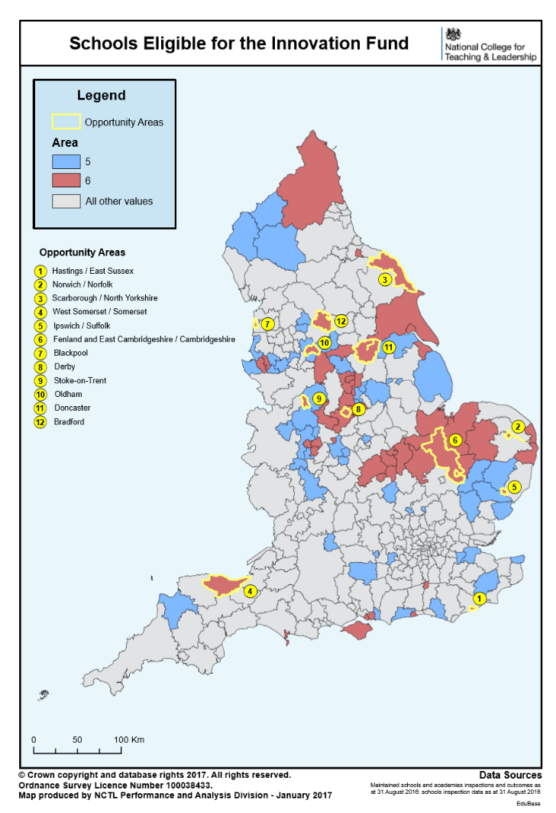
Map of the Opportunity Areas and category 5 and 6 areas

Slide 26
How We Will Award The Funds
It is anticipated that the TLIF funds will be used by the appointed contractors for the following:
Start-up/local roll out/running costs - where organisations can guarantee the 70% reach as set out above – including content development / refinement.
Free places for teachers and leaders.
Programme delivery activities, including but not limited to, payment of staffing and Facilitators, venues and other direct spend.
Quality assurance / evaluation support.
Administration, Governance and Programme/ Project Management.
A proportionate contribution to organisational overheads and running costs.
TLIF funds will not be used for capital.

Slide 27
Evaluating the provision
The Department will be working with Education Endowment Fund (EFF) and an external contractor to evaluate the effectiveness of all projects funded through the TLIF against six long term outcomes looking at quality, progression, and retention of teachers and leaders, and improving the evidence base and market for CPD.
The evaluation will involve process, impact and economic evaluations for all proposals whether evidenced based or innovative as well as the fund overall. Data will be collected on recruitment and retention, geographical spread, intermediate outcomes, and longer term impact beyond the life of the fund.
All programmes will be evaluated. In some cases, where a programme is suitable, EEF will seek to do this through a Randomised Control Trial.

Slide 28
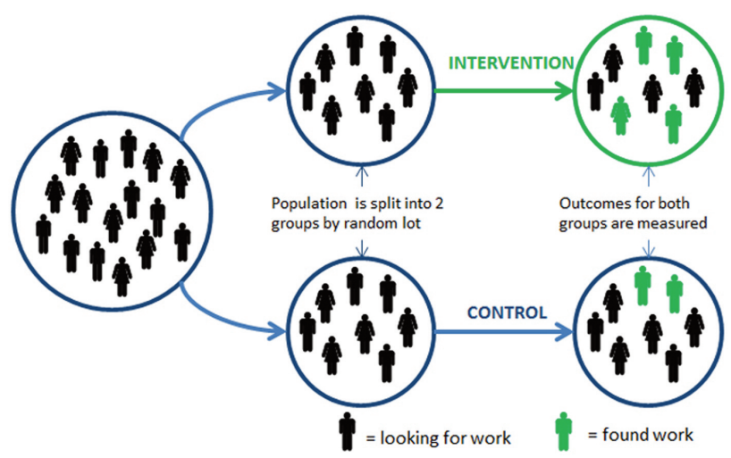
Evaluating the provision: Using Randomised Controlled Trials
No effect seen
Effect seen
RCTs – if large and well-designed remove bias and control for external factors (e.g. KS2 tests changing).
Image adapted from Test, Learn, Adapt - Laura Haynes, Owain Service, Ben Goldacre & David Torgerson (2012).

Slide 29
Key elements of high quality education RCTs
Large intervention group needed, to have good chance of finding an impact.
Double the number of schools should be recruited to the trial – have to be happy with either intervention or control group.
Schools must stay in their allocated group for the course of the trial – control schools cannot begin doing the intervention.
Data collection and consent procedures must be undertaken with recruited schools before randomisation.
Programme should be relatively consistent across the intervention schools – in terms of timing, intensity etc.
Outcomes would be measured for a pre-defined cohort (e.g. can’t have some schools focusing on Year 3 and some on Year 5).
For EEF to be interested, there would need to be a clear measurable attainment outcome.
RCTs are a challenge, but a rewarding one. EEF and evaluators will work with you to ensure it is achievable.

Slide 30
Commercial Process and Timeline

Slide 31
Stages of the Bidding Process
Stage 1
2. Bidders submit SSQ
3. Desktop evaluation of bidders’ SSQ
4. Bidders selected to participate to ITT stage
Stage 2
2. Desktop evaluation of bidders’ written responses, including moderation & clarification
3. Final moderation
Notification of results and feedback
1. Bidders notified
3. Contract award
Commencement of Contract
1. SSQ open for Bidders to express an interest
1. Shortlisted bidders submit ITT response/proposal including costings
2. 10 day standstill period

Slide 32
Standard Supplier Questionnaire (SSQ)
A Standard Supplier Questionnaire asks potential suppliers to initially self-declare their status against the exclusion grounds and selection questions.
The SSQ is structured in 4 separate parts:
Part 1 - of the SSQ covers the basic information about the supplier: e.g. contact details, trade memberships, details of parent companies, group bidding etc.
Part 2 - covers a self-declaration whether or not any exclusion grounds apply e.g. insurance cover must be the minimum level required as stated in the SSQ etc.
Part 3 - covers a self-declaration regarding whether or not the company meets the selection criteria in respect of their financial standing and technical capacity.
Part 4 - covers mandatory questions to enable an outline of proposed solution / capability / capacity and ability to deliver the contract.

Slide 33
Invitation to Tender (ITT)
Initiating step of a competitive tendering process in which qualified suppliers are invited to submit sealed bids for the supply of specific and clearly defined services during a specified timeframe.
Bidders will be selected to participate in the ITT stage following shortlisting from Standard Supplier Questionnaire stage.
Pre-defined scoring criteria will determine the outcome and number of contracts that will be awarded.
Scoring criteria will be based on “most economically advantageous tender” (“MEAT”), an evaluation methodology based on a balance of Technical (Quality) and Price.

Slide 34
Contract Award
DfE will be carrying out a desktop evaluation of bids at Stage 2 to determine whether or not bidders will be eligible for a contract award.
Notice of intent to award.
A mandatory standstill period of 10 days will take place.
Contract Award.

Slide 35
The Teaching and Leadership Innovation Fund: Round Two
We anticipate that Stage 1 for Round Two will open in January 2018 and Stage 2 ‘the bidding stage’ will open in March 2018.
We are seeking proposals for teachers’ CPD and/or leadership development across 8 priority policy areas, primarily which have a clear rationale rooted in evidence. We would also be open to proposals which similarly show a strong rationale but which exhibit new and innovative ideas for the delivery of services.
Proposals should be ready to deliver to participants from September 2018.

Slide 36
Specific requirements for Round Two
Specific requirements for Round Two include:
Capacity to deliver in the required timeframe, scheduled for delivery to commence from September 2018.
Evidence of impact - which can be validated and can demonstrate how this will improve the quality of teaching and/or leadership, which enables social mobility and improves outcomes for children.
Bids must set out the reach and how the programmes will be delivered and targeted towards priority areas and schools.
Proposals that are distinct from existing programmes which are contracted by Government for teachers and school leaders.

Slide 37
Approximate timeframe
Date | Activity*
November 2017 | Market engagement events
January 2018 | Stage 1 - SSQ opens for 30 days, Bidders to express an interest
March 2018 | Stage 2 - Tender bidding round for 30 days
End April-beginning of June 2018 | Assessment of bids
June 2018 | Standstill period/contract development
June 2018 | Contracts awarded
September 2018 | Delivery to commence
*All activity is also subject to funding being available and proposals meeting the required standards.

Slide 38
Due Diligence & Financial Checks
Checks will be carried out to ensure that potential bidders to not expose the DfE to unacceptable levels of financial risk.
Potential bidders will be asked to submit full sets of company accounts (for the latest two financial years). Accounts should clearly state the company number and registered name.
A review of the Balance Sheet (net assets, current assets / liquidity), Income Statement / Profit & Loss (cash-flow & profitability) and credit score will be undertaken at Stage 1.
Potential bidders will be expected to provide indicative costs for each outline solution at Stage 1; costs must not exceed more than 50% of the yearly turnover.
At Stage 2, bidders will be asked to complete a cost matrix which will provide a transparent breakdown of all costs and profit. This will then be used to assess the bids Value for Money.

Slide 39
Procurement

Slide 40
Advice
Before you can access anything on the DfE e-tendering portal you will need to register.
This registration takes a matter of minutes
You start by accessing https://education.bravosolution.co.uk
This takes you to the following screen

Slide 41
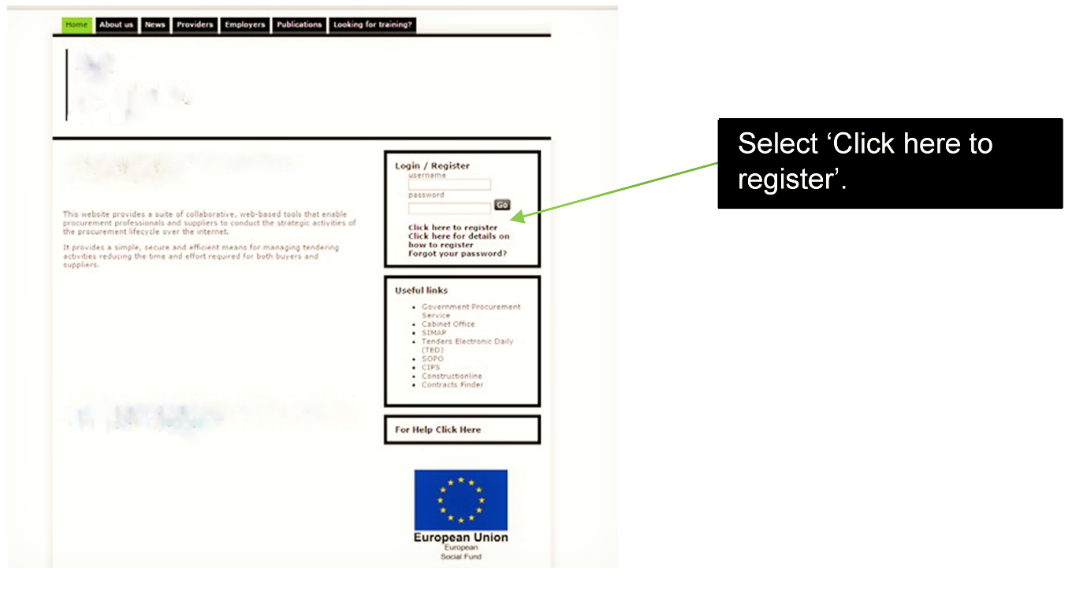
Bravo registration screen

Slide 42
What organisations are expected to do
Read any Read Me First & Instructions document FIRST.
Answer all questions posed online or as directed offline then upload your response to the correct area.
Complete all other required attachments and upload to the correct area.
Read, understand and accept any Terms and Conditions attached to the procurement and complete the online declaration of acceptance.
Complete all other online Declarations.

Slide 43
What organisations must not do
Canvas help, assistance or opinion on the SSQ/ITT or the procurement process in general from any DfE employee or other Government Department, Agency or NDPB other than through the e-Tendering portal message board.
Publish a partially completed SSQ/ITT as this will not be evaluated.
Publish after the closing date and time. Any SSQ/ITT published after the deadline will not be considered.

Slide 44
TLIF Round 2 online survey
https://www.smartsurvey.co.uk/s/TLIFround2/

Slide 45
Further Information and Contact Details
Further information is available on our website (including a link to Contracts Finder and a section where you can register your interest to be kept up to date on developments and application round dates): www.gov.uk/guidance/teaching-and-leadership-innovation-fund
We have set up a space on Slack (www.slack.com) called TLIF Providers which you are welcome to use to continue to network after today. If you would like to join this group please send your email address and a request to join to Mailbox.TLIF@education.gov.uk.

