Slide 1
CLINICAL REVIEWERS FRAMEWORK MARKET ENGAGEMENT INFORMATION PACK

Slide 2
Content Page
Background
Clinical reviews and clinical reviewers
Lotting and finance
Procurement
Bid preparation
Next steps

Slide 3
Market engagement process
NHS England (London region) - the Authority – is requesting market feedback to inform the upcoming re-procurement of Clinical Reviewers Framework (CRF) for deaths in custody services ahead of the expiry of the existing contracts in December 2024.
In order to assist the Authority with testing its assumptions and proposed service requirements, your responses to the online questionnaire will explore the following areas (not exhaustive):
- the draft Service Specification
- the proposed procurement lotting structure options
- timescales for procurement and mobilisation of the new contract/s (if required)
- proposed contract duration and financial model
- proposed social value criteria.
We ask that interested organisations submit responses to the market engagement questionnaire using the MS Forms template provided (link below) by 12.00 (noon) on Friday 05 April 2023.
For clarity, no submission via the tender portal is required at this stage.

Slide 4
1. Background

Slide 5



NHS England (London) is procuring a framework of clinical review providers
A framework agreement is, at its simplest, a list of clinical review providers that NHSE/I (London) can call upon on when needed
Clinical review providers – clinical reviewers – conduct clinical reviews into deaths of people detained in custody in London
Detail can be found in information pack

Slide 6
Clinical reviewers are commissioned by the Health & Justice team, part of NHSE London’s Direct Commissioning division
£91m
Prison and Immigration Removal Centre (IRC) healthcare provision is our biggest area of work.
Typical services include:
of services commissioned per annum from:
NHS
Voluntary sector
Independent providers
Primary care
Urgent care
Inpatient units
Primary and secondary mental health care
Pharmacy
Substance misuse
*plus an increasing range of services normally delivered in community health or acute hospital settings
Detail can be found in information pack

Slide 7
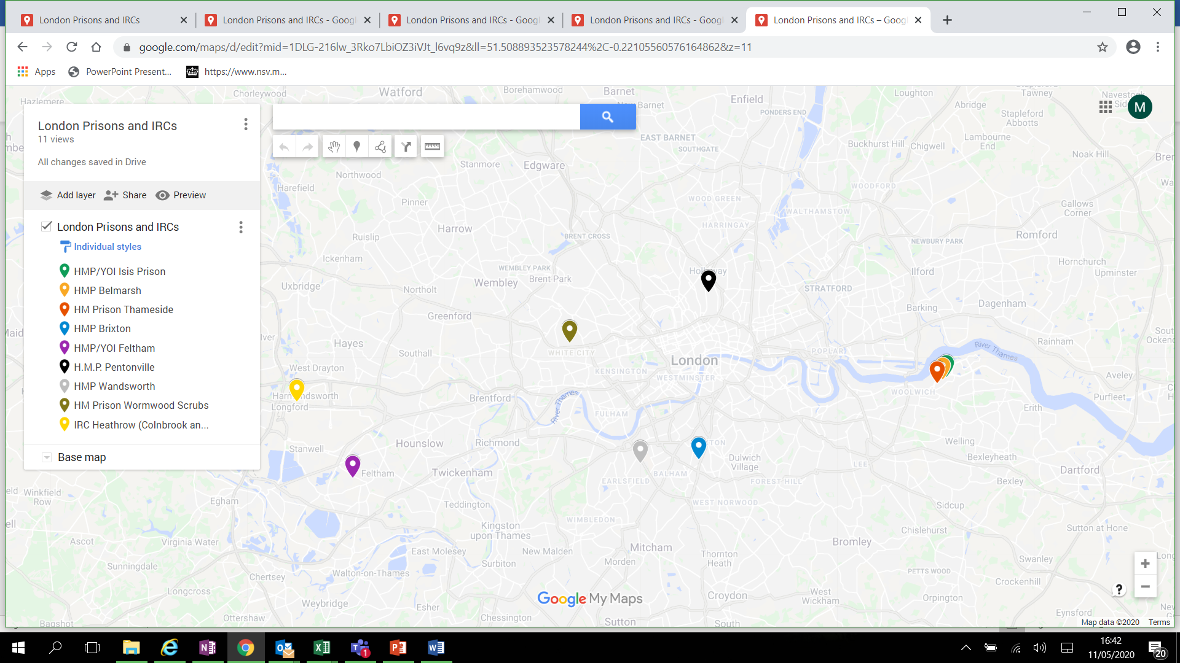
Our work spans prisons, IRCs and youth offending institutes in London

Slide 8
H&J Services: Prison, YOI & IRC Healthcare
GP & Primary Care
Emergency Response & Urgent Care (Minor Injuries)
Pathology & Diagnostics
Mental Health Primary Care
Mental Health Secondary Care
Access to Secure Mental Health Services
Public Health: Substance Misuse
Public Health: Sexual Health
Public Health: Screening and Immunisations
Prison Inpatient Units
Social Care*
Triage & Risk Mgt (reception screening)
Care Planning & Coordination
Managing External Health Appts
Release Planning and Continuity of Care

Slide 9
The team commissioned clinical reviewers in response to 43 deaths in custody between 2021 and 2023
 | 2021 | 2022 | 2023
Deaths in Custody | 26 | 6 | 11
Total | 26 | 6 | 11
Detail can be found in information pack

Slide 10
2. Clinical reviews and clinical reviewers

Slide 11
Levels of clinical reviews
There are 3 levels of clinical reviews:
 | Level 1 | Level 2 | Level 3
Desk based review of records | ✓ | ✓ | ✓
Interviews conducted | ✗ | ✓ | ✓
Number of reviewers | 1 | 1 or multiple with lead reviewer | Multiple with lead reviewer
Typically type of death investigated | Natural | Self-inflicted or have an other non-natural cause | Self-inflicted or have an other non-natural cause

Slide 12
Each clinical review wider Prison & Probation Ombudsman (PPO) investigations
Clinical reviews do this by:
establishing the circumstances and events surrounding the death
examining relevant health issues and assessing the clinical care
examining whether changes in operational methods, policy, and practice or management would help prevent a recurrence
identifying any root causes that inform wider learning opportunities
making SMART recommendations for providers, commissioners and the wider health and custodial community
providing explanations and insight for bereaved relatives; and
identifying any good practice to support improvement work across the criminal justice system.

Slide 13
Each review must meet PPO expectations
Some examples of what the PPO look for include:
Events are clearly and concisely stated
Plain English is used
Interviews are fully referenced and quoted verbatim
Interpretation of another’s verbal comments is avoided
The report is impartial, objective and based on fact not opinion
The clinical reviewer’s professional opinion is clearly identified and supported by evidence
When referred to, clinical guidance is referenced in full

Slide 14
Clinical reviewers are clinicians capable of carrying out robust and challenging reviews into clinical services
What are we looking for:
Relevant experience in clinical practice;
Current professional registration
Professional indemnity cover
Both individuals and teams
People with a broad range of experience
People who can focus on the learning and scope for development

Slide 15
Clinical reviewers must be independent
To ensure objectivity and protect the independence of the PPO, clinical reviewers must:
Be impartial, having no pre-conceived opinions
Not be working in or directly involved with the establishment under review
Have no conflicting line management responsibilities
Be able to complete the review within PPO timescales
Have detailed knowledge of care delivered within a custodial environment

Slide 16
Their role is to determine whether care received in custody was commensurate to the care one would expect to receive in the community
Clinical reviewers are responsible for:
Examining the clinical care pertinent to the death of the deceased; and
Determining if the care received was equivalent, in accordance with national guidance, standards and local policy, to the care that one could expect to receive in the community
The approach is to determine how and why events took place, not to apportion blame or provide an expert witness opinion

Slide 17
Reviewers compile reviews using multiple sources of evidence
SystemOne records
Liaison and Diversion Records
Person Escort Record
HMPPS offender Personality Disorder Records
Hospital records
Ambulance records
All community records
Secondary care notes
Interviews
Out of Hours phone and visit records
CCTV footage
How are clinical records stored?
System 1
Prison paper work for some information – i.e. ACCTs and Prisoner Escort Records
Prison Healthcare is linked to the Summary Care Record via the PDS

Slide 18
3. Lotting and Finance

Slide 19
TYPES OF CLINICAL REVIEWERS
There are two types of clinical reviewers:
Lot 1 - Lead reviewer
Lead author of each clinical review
Responsible for coordination of the review
Carry out all administration in relation to the review
Lot 2 - Subject matter expert reviewer (SME)
Brought into Level 2 or Level 3 reviews
Support the lead reviewer with specific subject matter expertise
May be drawn from the lead reviewer’s own team as an in house SME
May be drawn from the pool of SMEs we are seeking to develop

Slide 20
Providers can bid for Lot 1 and / or Lot 2
Review | Lot 1 – Lead reviewer | Lot 1 – In house SME | Lot 2 – Pool SME
Level 1 | ✓ | ✗ | ✗
Level 2 | ✓ | ✓ | ✓
Level 3 | ✓ | ✓ | ✓
We are seeking SME's who have one or more expertise in the following areas:
Primary Care
Long Term Condition Management
Mental Health
Substance Misuse
Palliative/ End of Life Care
Urgent Care
Detail can be found in information pack
Notes:
Lot 1 is where you and your colleagues can bid to be listed as a Lead Reviewer
Lead Reviewers should be capable of completing all three levels of review
For a Level 1 review, the Lead Reviewer will work alone
For a Level 2 and 3 review, the Lead Reviewer will be supported by SMEs
If you would like to work with an SME from your own organisation, you can also include them in your bid for Lot 1 as an in house SME
Lot 2 creates a pool of SME reviewers to draw on. This means that even if you do not have expertise in all of these suggested areas you can still bid to be a Lot 1 – Lead Reviewer. Any additional requirements for SMEs – commissioners will support the provider by arranging a Lot 2 SME Pool reviewer to join the review team.

Slide 21
I’m an individual clinician. What does the lotting structure mean for me?
For Lot 1, you may wish to bid to be a Lead Reviewer
As you are applying as an individual, there is no need to list in house SME Reviewers in Lot 1
For Lot 2, you may also wish to bid to join the SME pool. This will allow you to support other Lead Reviewers from other organisations
You can list multiple subject matter expertise when bidding for Lot 2

Slide 22
We’re a large organisation or a small group with multiple clinical reviewers. What does the lotting structure mean for us?
For Lot 1, you should detail all your clinicians capable of leading Reviews as Lead Reviewers
Also for Lot 1, you should list all your supporting SME Reviewers. This will allow you to complete some Reviews with your own team
You can list someone as both a Lead Reviewer and as an SME Reviewer, and you can list multiple subject matter expertise for an individual
For Lot 2, list all your SME Reviewers again. This will allow them to join the SME pool and support Lead Reviewers from other organisations

Slide 23
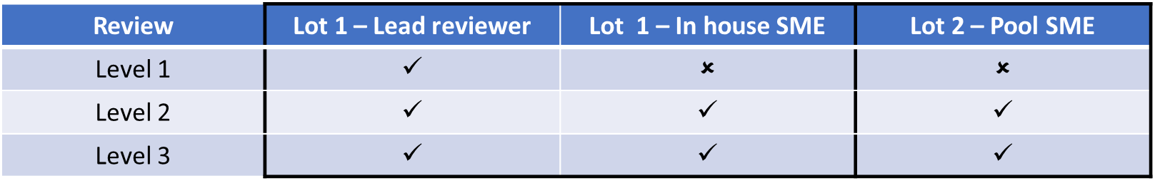
Contracts will be awarded in one or two ways
Award by rotation or direct award
Direct award in consultation with Lead reviewer and in an equitable manner
Notes:
Lot 1 is where you and your colleagues can bid to be listed as a Lead Reviewer
Lead Reviewers should be capable of completing all three levels of review
For a Level 1 review, the Lead Reviewer will work alone
For a Level 2 and 3 review, the Lead Reviewer will be supported by SMEs
If you would like to work with an SME from your own organisation, you can also include them in your bid for Lot 1 as an in house SME
Lot 2 creates a pool of SME reviewers to draw on. This means that even if you do not have expertise in all of these suggested areas you can still bid to be a Lot 1 – Lead Reviewer. Any additional requirements for SMEs – commissioners will support the provider by arranging a Lot 2 SME Pool reviewer to join the review team.

Slide 24
Successful providers could expect approximately £20,000 of income under this framework
Volumes of work are not guaranteed under a framework agreement but we are proposing limiting the number of suppliers in Lot 1 to a maximum of five providers. This will mean each successful provider could expect approximately £20,000 p.a. of income under this framework
There will be no cap on the number of subject matter experts who can qualify to be on Lot 2
Currently the average cost of a clinical review in London is £6400 inclusive of all expenses
Payment will reflect the actual time spent completing the clinical review but does not include time spent by the provider participating in:
Internal and external quality assurance processes
Coroner’s hearings
Payment will be made in two parts – an advance payment agreed with commissioners to represent 50% of the projected cost of the review and a final payment made upon completion of the final review and internal and external quality assurance processes for the balance

Slide 25
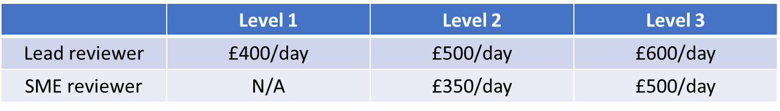
Potential providers are invited to propose their own day rate
Day rates exclusive of expenses and overheads should be proposed for each level of review
We have capped day rates for each type of review as follows:
Expenses and overheads should be given as a fixed cost for each full review
Where a review changes in complexity commissioners will agree with the provider a change in level

Slide 26
4. Procurement

Slide 27
Regulation and Compliance
This procurement process complies with:
Provider Selection Regime (PSR)
This procurement is a competitive process.
We will ensure the process is open, fair and transparent;
Value for money for taxpayers.
Notes:
LTF – As it is a clinical service it gives of flexibility in terms of running the procurement process
Ky to amend

Slide 28





Procurement Process Open Procedure
Tender adverts Published
(CF/FT)
Bidders to complete and return online questionnaires
Mobilisation
Service Commencement
Evaluation and Moderation stage
Bidder Presentations
Outcome Notification and Standstill
Due Diligence and Contract Award
Pre-Procurement (Including Market Engagement)
Result/ Award Recommendation Report
Start
End
NHS London Commercial Hub

Slide 29
Procurement Timetable
Key Events | Dates
Market Engagement Live / Publish MS forms | Monday 25 March 2024
MS forms deadline | Friday 12 April 2024
Invitation to Tender Issued | Monday 10 June 2024
Deadline for receipt of ITT clarification questions | Friday 28 June 2024
Deadline for receipt of ITT submissions | Friday 05 July 2024
ITT Evaluation | Monday 08 July 2024 - Friday 26 July 2024
ITT Moderation | Monday 05 August 2024 - Friday 23 August 2024
Award Report Approval | Monday 23 September - Friday 27 September 2024
Inform bidders of outcome and observe standstill period | Monday 14 October 2024
Last day of standstill | Tuesday 22 October 2024
Contract award | Wednesday 23 October 2024
Mobilisation | Thursday 24 October 2024 - Tuesday 31st December 2024
framework commencement | Wednesday 01 January 2025
* Dates are subject to change

Slide 30
Procurement components
The procurement documents as a whole will comprise the following:
Invitation to Tender Guidance document (information only)
Invitation to Tender Questionnaire(s), including lot specific questionnaire
Selection Questionnaire
Financial Model Template
Service Specification (information only)
Any additional documents will also be on the Atamis Portal once the Procurement is live

Slide 31
Procurement Imperatives
Post-publication, read all of the procurement documentation;
Submit Clarification Questions as early as possible in the procurement phase (via the Atamis portal) and note the deadline for receipt;
Submit your ITT response by the stated deadline and in alignment with the ITT Guidance;
You should use the available time prior to ITT publication to register on Atamis and access the guidance available from the Help centre.

Slide 32
Social value
The Public Service (Social value) Act came into force on 31 January 2023. The Social Value model is applied to all new procurements from 01 January 2012.
A minimum of 10% will be allocated to social value question(s) in the Invitation to Tender Questionnaire.
Social Value will be evaluated based on qualitative responses from bidders, and not on volumes.

Slide 33
Social value
What is the Social Value Model?
The Social Value Model (‘the Model’) sets out government’s social value priorities for procurement. There are 5 themes and 8 policy outcomes:
Themes |  | Policy outcomes
Theme 1 | COVID-19 recovery | Help local communities to manage and recover from the impact of COVID-19
Theme 2 | Tackling economic inequality | Create new businesses, new jobs and new skills Increase supply chain resilience and capacity
Theme 3 | Fighting climate change | Effective stewardship of the environment
Theme 4 | Equal opportunity | Reduce the disability employment gap Tackle workforce inequality
Theme 5 | Wellbeing | Improve health and wellbeing Improve community cohesion

Slide 34
5. Bid preparation

Slide 35
Bid preparation
Post-publication, read all of the procurement documentation;
Submit Clarification Questions as early as possible in the procurement phase (via atamis ) and note the deadline for receipt; and
Submit your ITT response by the stated deadline and in alignment with the ITT Guidance;

Slide 36
Key Points (1 of 2)
Make note of instructions, word limits and the ITT submission format - Be compliant;
Try to understand what each question is asking and why it is being asked - Answer the Question;
Note the scoring / weighting of criteria - Allocate time / effort on your response accordingly;
If in need of clarification, contact the Procurement Team (but be aware that any question you ask will be notified to other bidders);
Double check your response / second pair of eyes;
Ensure you complete and submit all the documents required. Many bids have failed because people have forgotten to upload all the correct documentation and;
Make careful note of the deadline and make sure you submit well in advance - Avoid last minute submissions

Slide 37
Key Points (2 of 2)
Do not assume that the evaluators will have prior knowledge of your organisation or past experience;
Do not cross reference an answer with another answer: e.g. “Please see question xx for more information ….” Evaluators may not see all of your response;
Examples are powerful tools for illustrating your answers. The difference between an average answer and a good answer, often lies in the level of supporting evidence;
Use of bid writers – Ensure no conflicts exist;
One application per organisation;
Plagiarism and collusion – Take precautions to ensure your bid is unique.

Slide 38
6. Next Steps

Slide 39
Next steps
Please complete the MS forms questionnaire
Please If you have not yet registered on Atamis, please do this as soon as possible. You can register here: https://health-family.force.com/s/Welcome (https://health-family.force.com/s/Welcome) The process is straightforward, but if you find you do need advice or support in registering please contact the Atamis helpdesk using the following details:
Phone: 0800 9956035 E-mail: support-health@atamis.co.uk (mailto:support-health@atamis.co.uk)

