Slide 1
In service pilot of the T1135 operational decision-making tool: Assessing performance and customer impact
Supplier engagement meeting
18 March 2019
0203 142 5510,,368794#
Notes:
Version 1.1

Slide 2
Agenda
Welcome and introductions
Overview of the research
  Background
  Project structure
  Aims and objectives
  Scope
  Timescales and deliverables
Questions

Slide 3
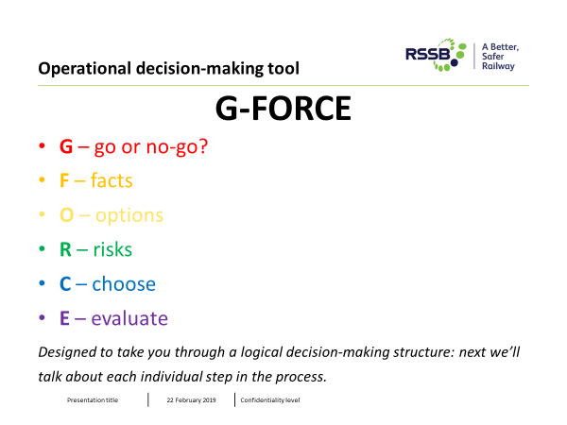
Background
Operational decision making has become undervalued in recent years
RSSB research T1135 Development of an operational decision-making model for abnormal working delivered:
  Decision making model
  Training package
IMP-T1135 In service pilot of the T1135 operational decision making tool, will assess the benefits and impact of the tool.
IMP-T1135 will assess whether the tool / training empowers staff to make more effective decisions during abnormal situations to keep people and trains moving safety
The trial will be undertaken on the Midland main line, with East Midlands Trains (EMT) and Network Rail London North East (LNE) Route

Slide 4
Project structure
Work Package 1 (WP1): Project scoping and development - undertaken by RSSB.
Work Package 2 (WP2): Embedding the decisional making tool within company culture - undertaken by RSSB
Work Package 3 (WP3): Assessing staff impact and use - undertaken by RSSB
Work Package 4 (WP4): Assessing performance and customer impact – this ITT

Slide 5
Aims and objectives – WP4 only
Aim
Apply an experimental design to assess the performance, service disruption and customer benefits and impact of the IMP-T1135 trial
Objectives
Define the measures required to analyse the performance, service disruption and customer benefits and impact of the trial
Develop a robust method to undertake the data collection and analysis
Analyse data to assess the impact and benefits of the trial of the tool
Identify factors that may have led to any impacts identified
Provide recommendations on the implications and transferability of the findings to the wider industry

Slide 6
Scope
In scope | Out of scope
Work collaboratively with RSSB, EMT and LNE throughout the trial Process map the operational workflows to identify scenarios where the tool may be used and benefits and impact measured Identify the data sources required to measure the benefits and impact of the tool on performance, service disruption and customer impact Define a robust method to undertake the analysis Receive data from EMT and LNE to analyse: Historical / baseline data prior staff training of the decision-making tool Data from the Midland main line (treatment group) and comparative line (control group) Where required clean raw data to undertake the analysis Identify significant patterns, trends, relationships, key themes that indicate the benefits and impact of the decision-making tool Test the hypotheses of WP4 Identify any differences where the tool has / has not been used Identify any underlining factors that led influenced the changes in benefits or impact of the tool use Identify any implications the findings may have on the IMP-T1135 trial Provide recommendations on the transferability of the findings to the wider industry should another operator/NR Route adopt the tool | Schedule 4 and 8 industry payments Measuring staff experience, confidence and impact of the tool

Slide 7
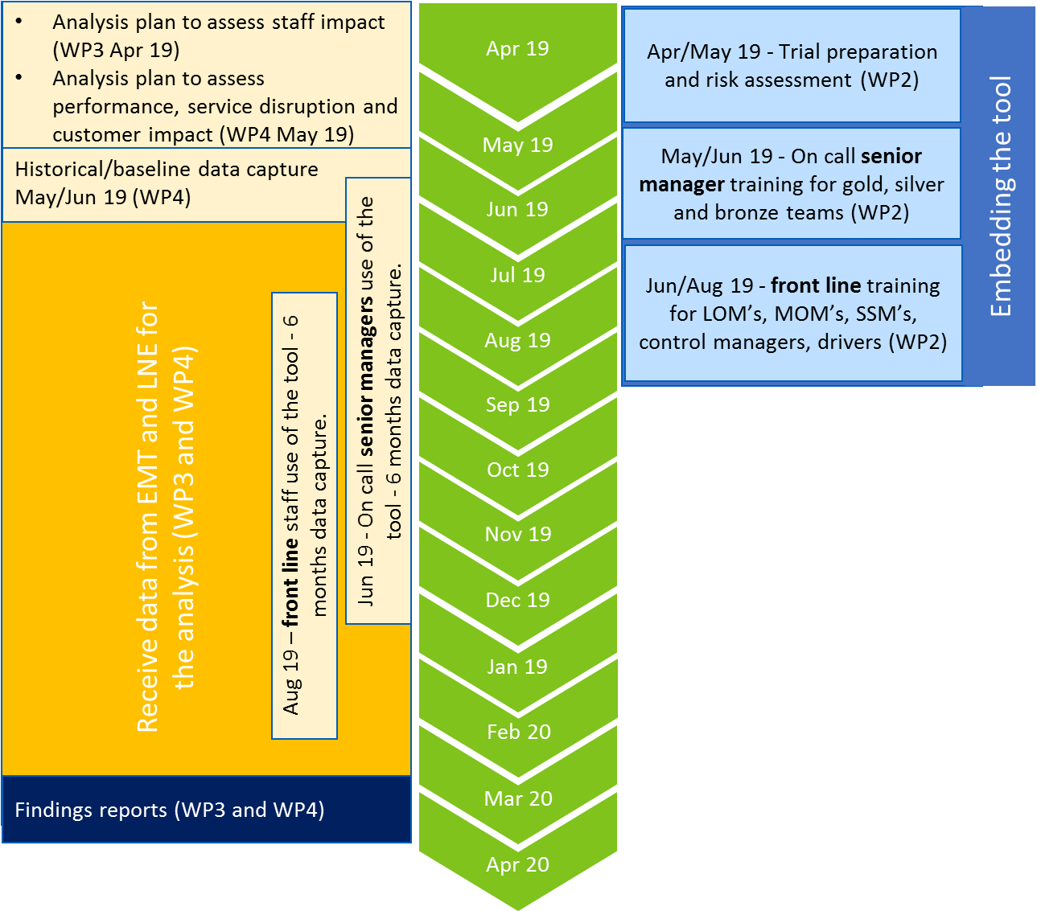
Timescales & Deliverables (D)
D
D
D

Slide 8
Questions (1 of 2)
A list of proposed measures is provided below – what measures do suppliers see as essential, missing, or unnecessary to this work?
Operational performance
Average minutes lateness
Total delay minutes, primary and reactionary delay minutes
PPM / PPM failures, ‘right time’ and ‘on time’ metrics
Changes in PPM attrition
CaSL metric, including full and part cancellations
Delay per incident
Excludable and void days (PPM and delay minutes)
Changes across the TRUST delay attribution profile (categorised delays)
Service disruption threshold
Number of Customer Service Level 2 escalations
Number of incident notifications, company holding and core messages
Number of contingency / recovery plans implemented
Number of operational changes, such as employees mobilised, uplift in capacity delivered (how close to planned capacity did contingent operations run)
Travel warnings and other external passenger communications
Number of incidents of serious disruption (>1,000 delay minutes)
Number of calls, including GSM-R, phone calls to control and senior managers
Customer experience
Average passenger lateness
Average passengers affected
Existing passenger satisfaction surveys gathered by EMT / LNE, and Transport Focus National Rail Passenger Survey
Frequency and type of passenger complaints, compensation claims
Data mining passenger impact from social media feeds

Slide 9
Questions (2 of 2)
What data and information would be required to provide best possible estimates of the performance, service disruption and customer benefits and impact?
What are the challenges and barriers to delivering this work? What enablers would support successful delivery of the project?
What is the suppliers estimate of effort required to deliver the project?

Slide 10
Thank you

Slide 11
Hypotheses
H1: The tool will support staff to manage abnormal situations effectively by keeping people and trains moving safely, resulting in:
  Fewer delay minutes
  Fewer incidents
  Fewer incidents breaching disruption thresholds
  Improved capacity utilisation during contingent operations
  Improved recovery time following service disruption
  Less overall attributed delays
  Changes to the delay attribution profile, where some categories may increase and others decrease (e.g. less attributed delay for one incident type may increase sub-threshold reactionary delay)
H2: The tool will improve staff confidence to make more operational decisions during abnormal situations, resulting in less escalated decisions (e.g. to control, on-call structure), reducing other operational workflows, effort and time when managing and recovering from incidents
H3: Staff using the tool are more likely maintain or improve operational performance
H4: The impact from improving performance, managing abnormal situations and disruption, will indirectly improve the customer experience

