Slide 1

Mulbarton Play Areas
Presented by
Mulbarton Parish Council

Slide 2
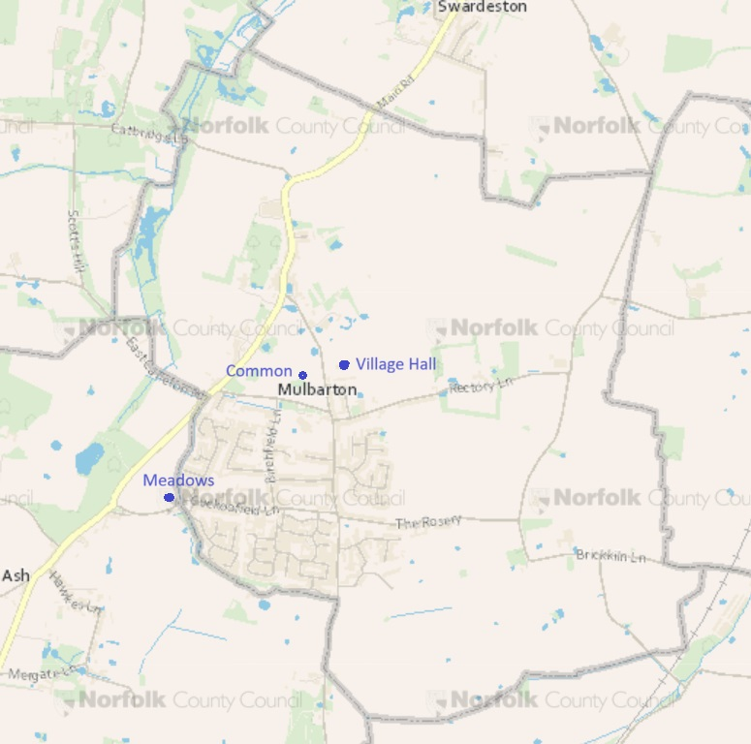
Introduction
Mulbarton has 4 areas with play equipment
The Parish Council is responsible for 3 of them at The Meadows, Common and Village Hall
There is also a play area at Oakley Park South
The play equipment is suitable for ages up to 12 years

Slide 3
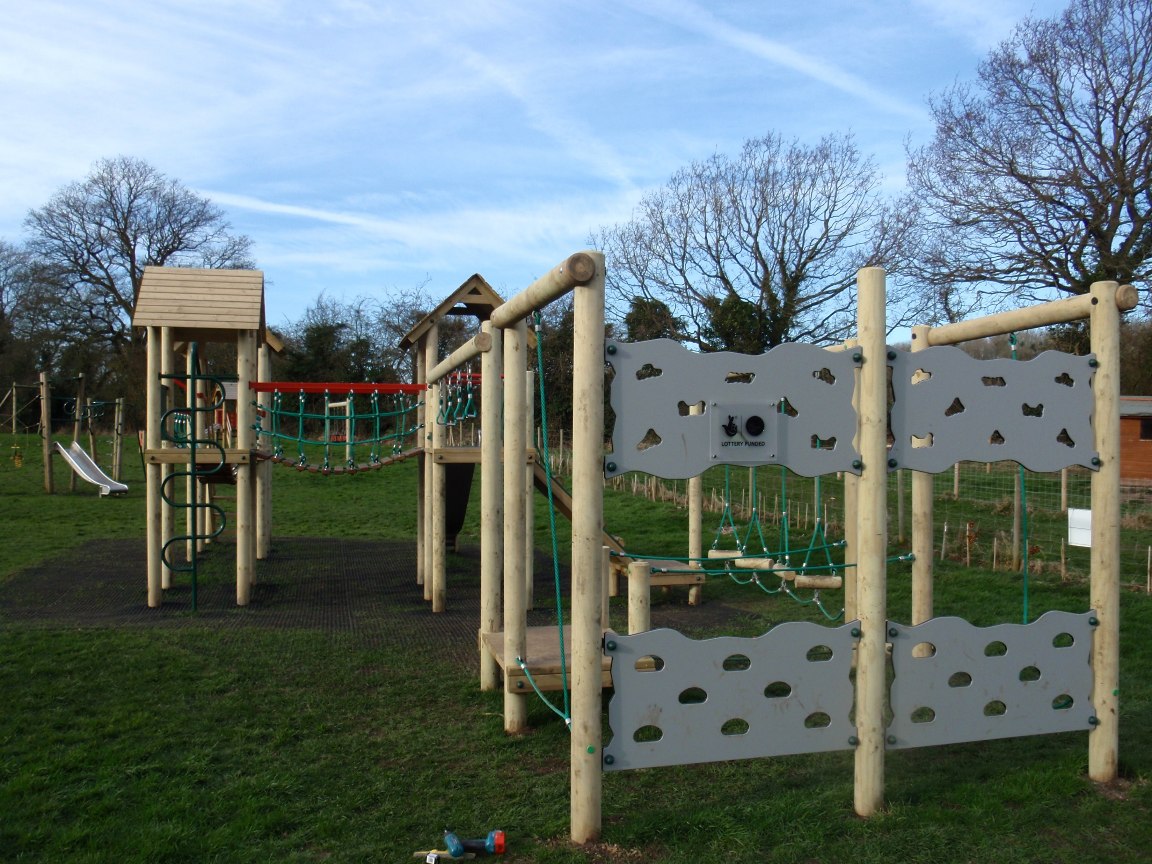
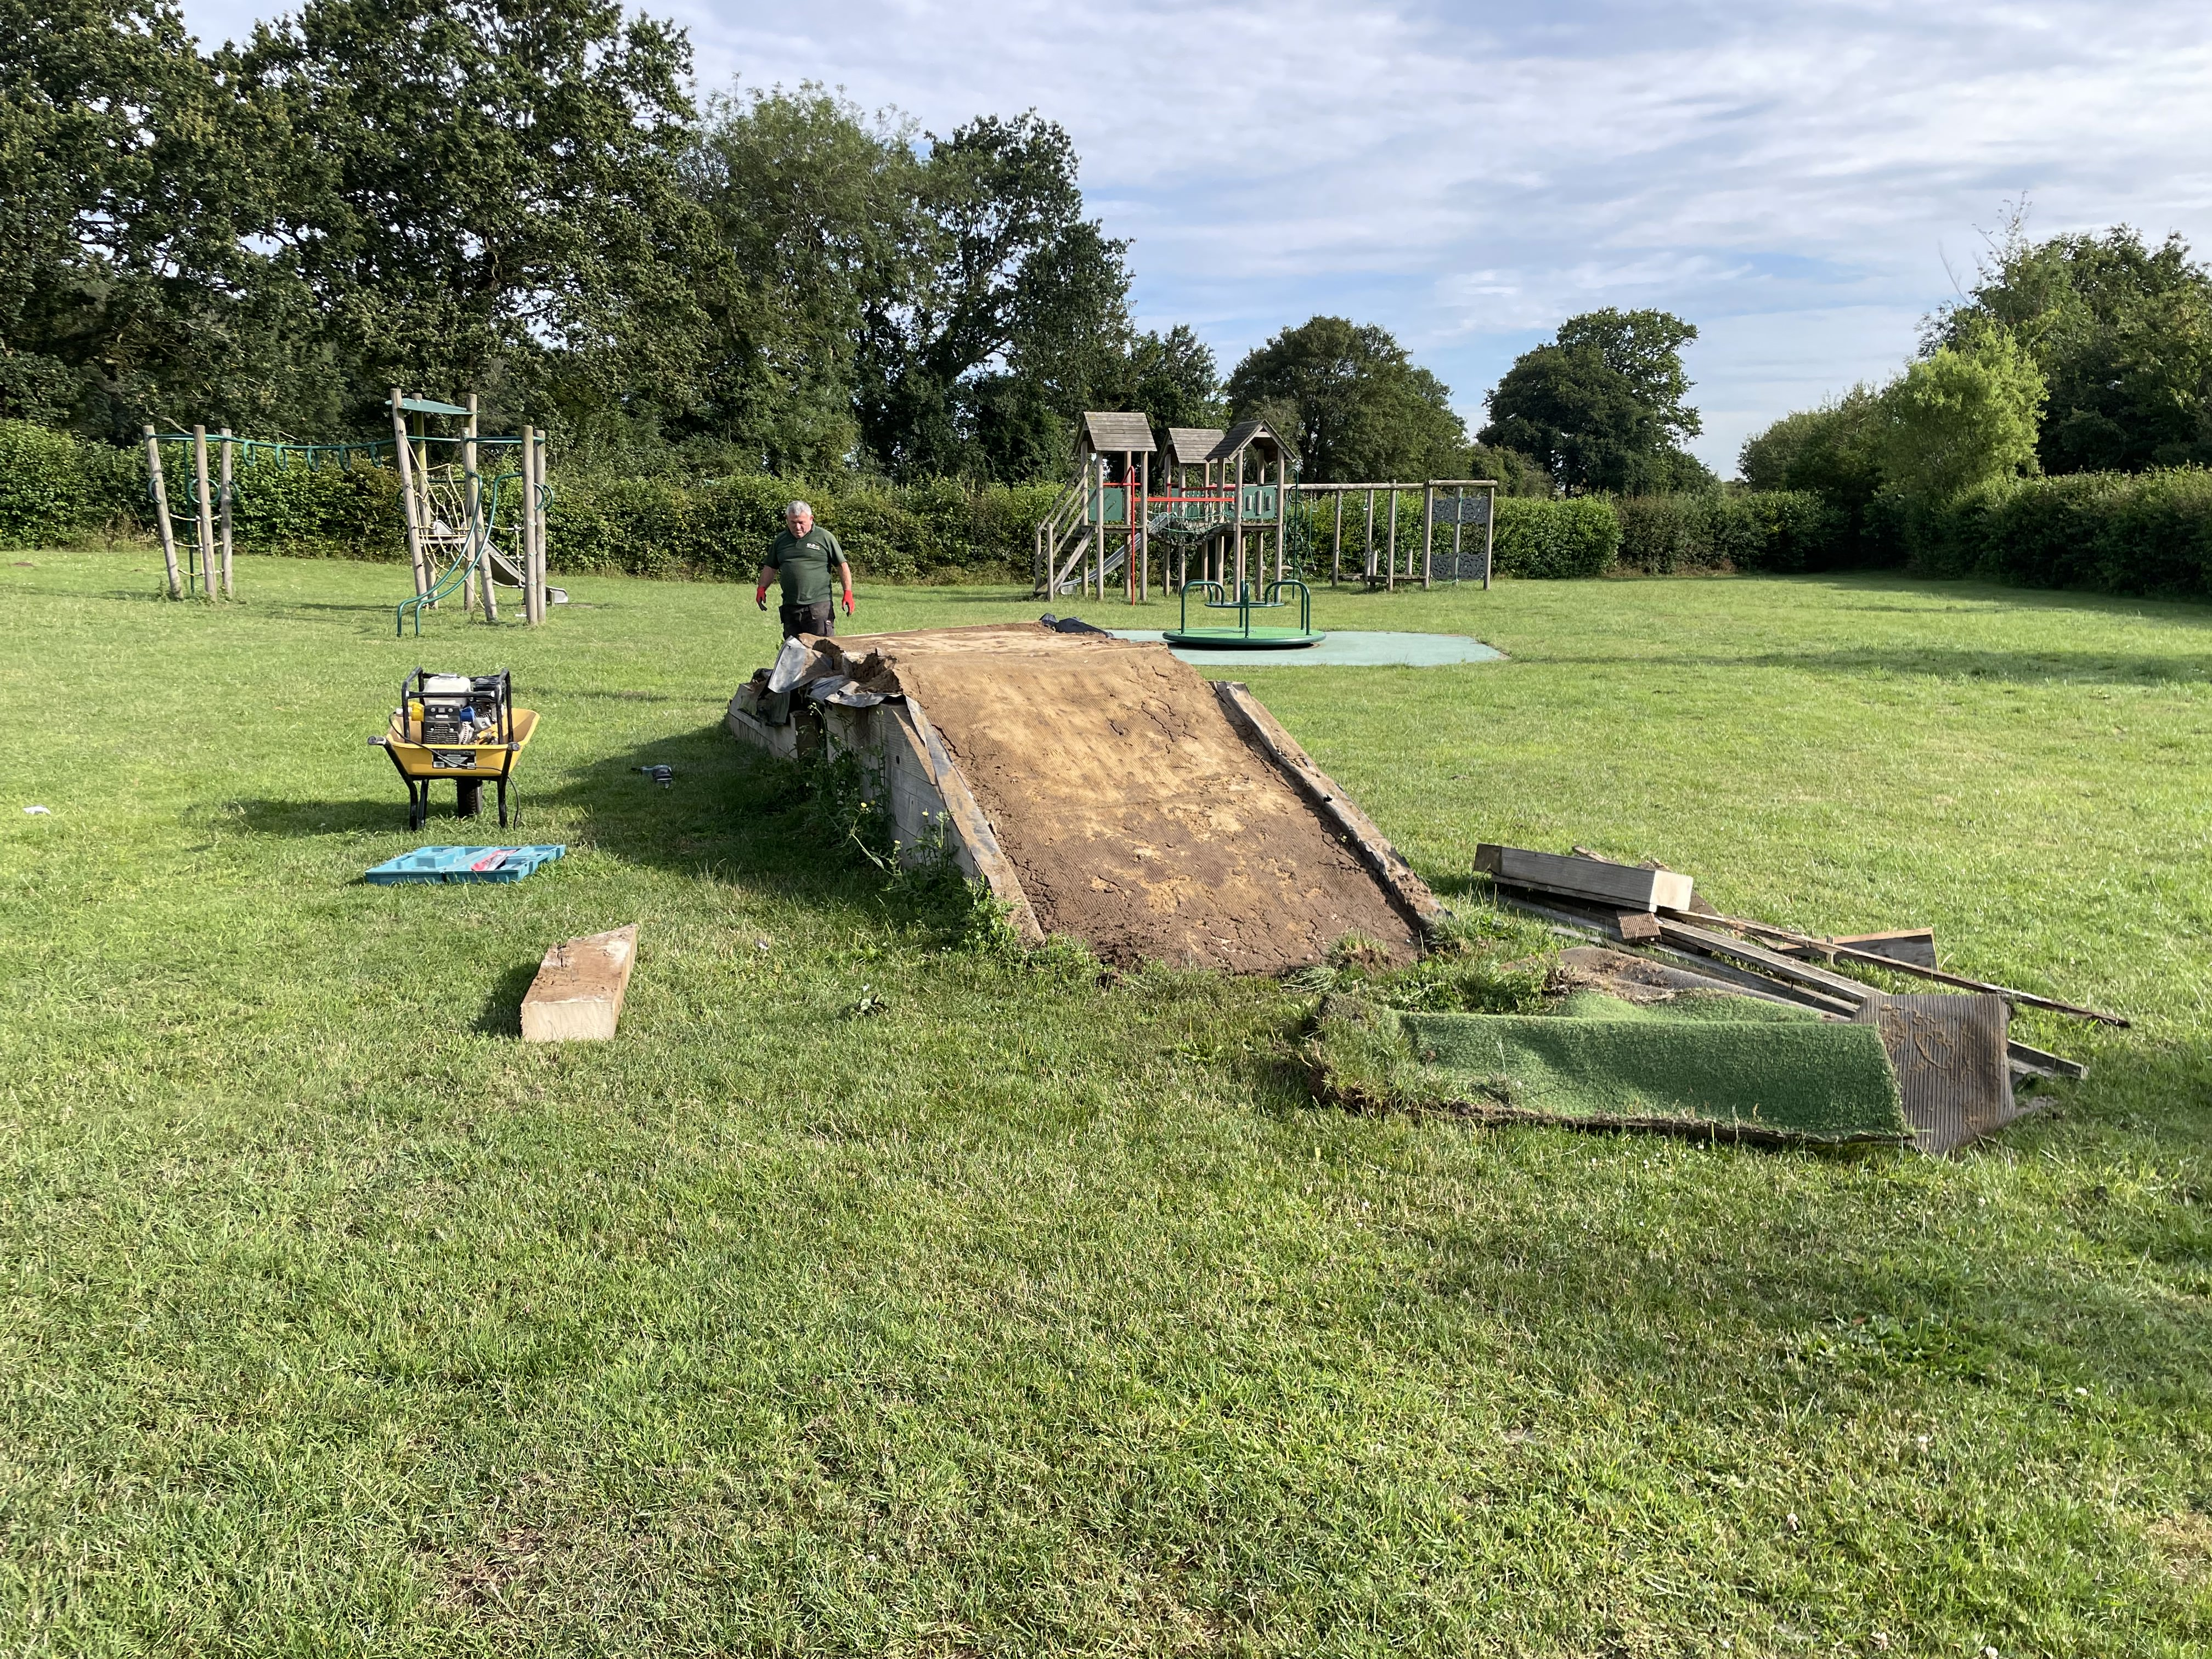
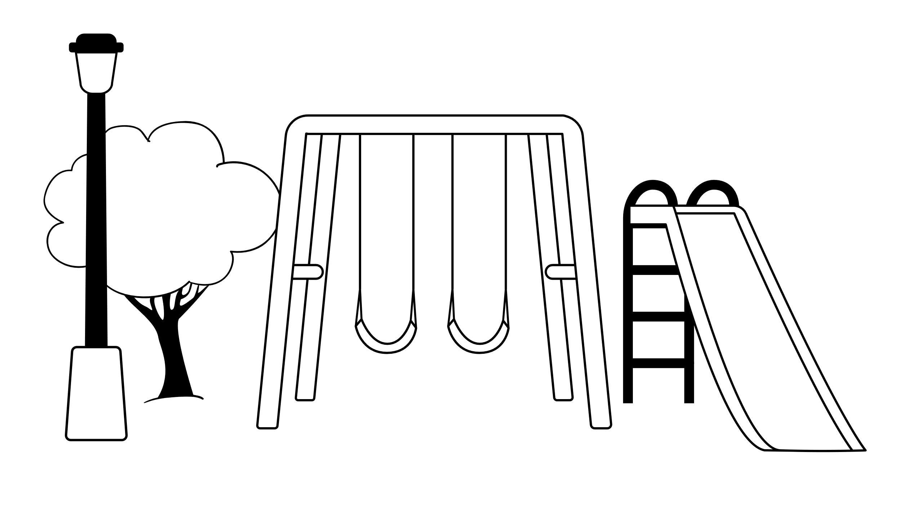
The Meadows
The original play equipment was installed in 2012/13
Some of this has reached the end of the life and been removed
We need new play equipment and your ideas!

Slide 4
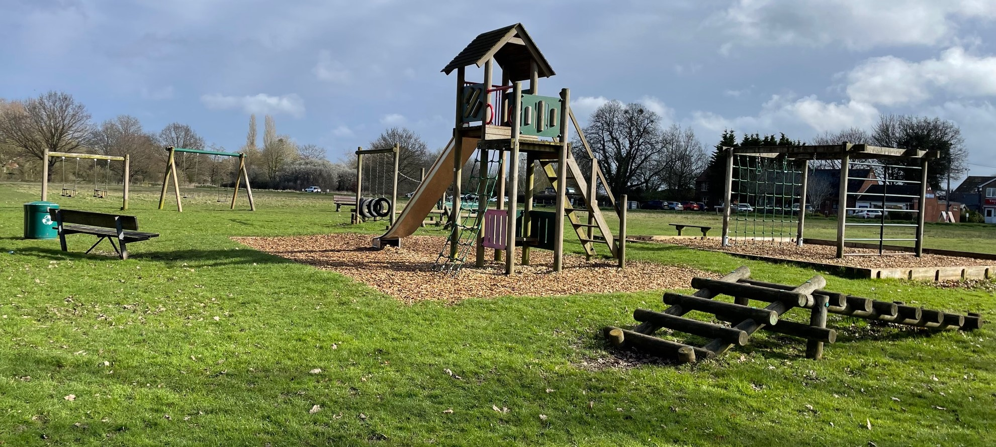
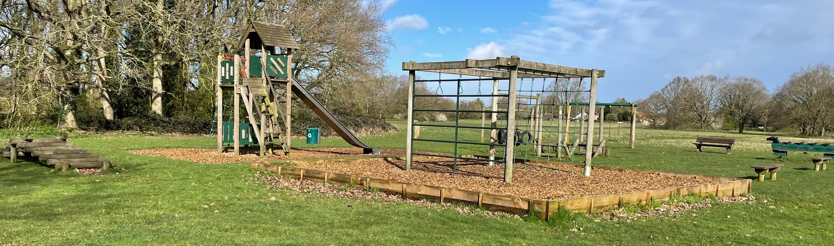
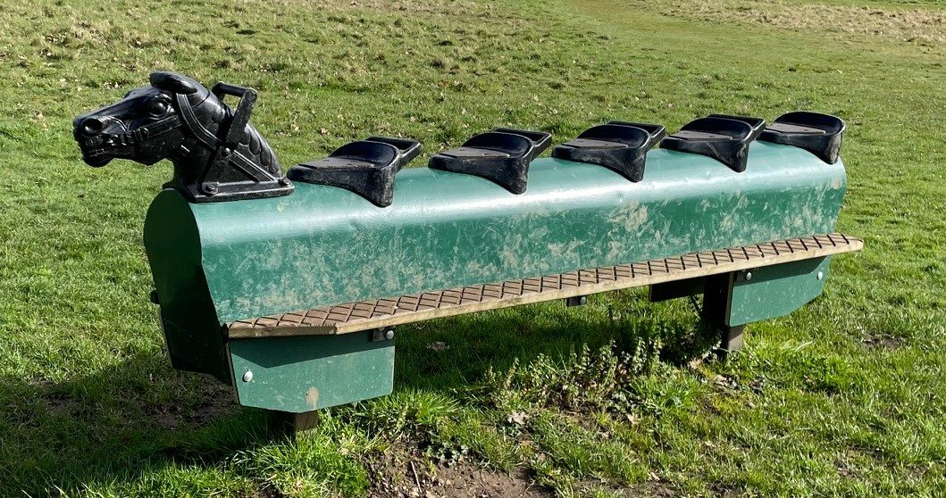
The Common
Play equipment suitable for ages up to 12 years old
Includes
Swings
Climbing frame
Slide
Rocking horse

Slide 5
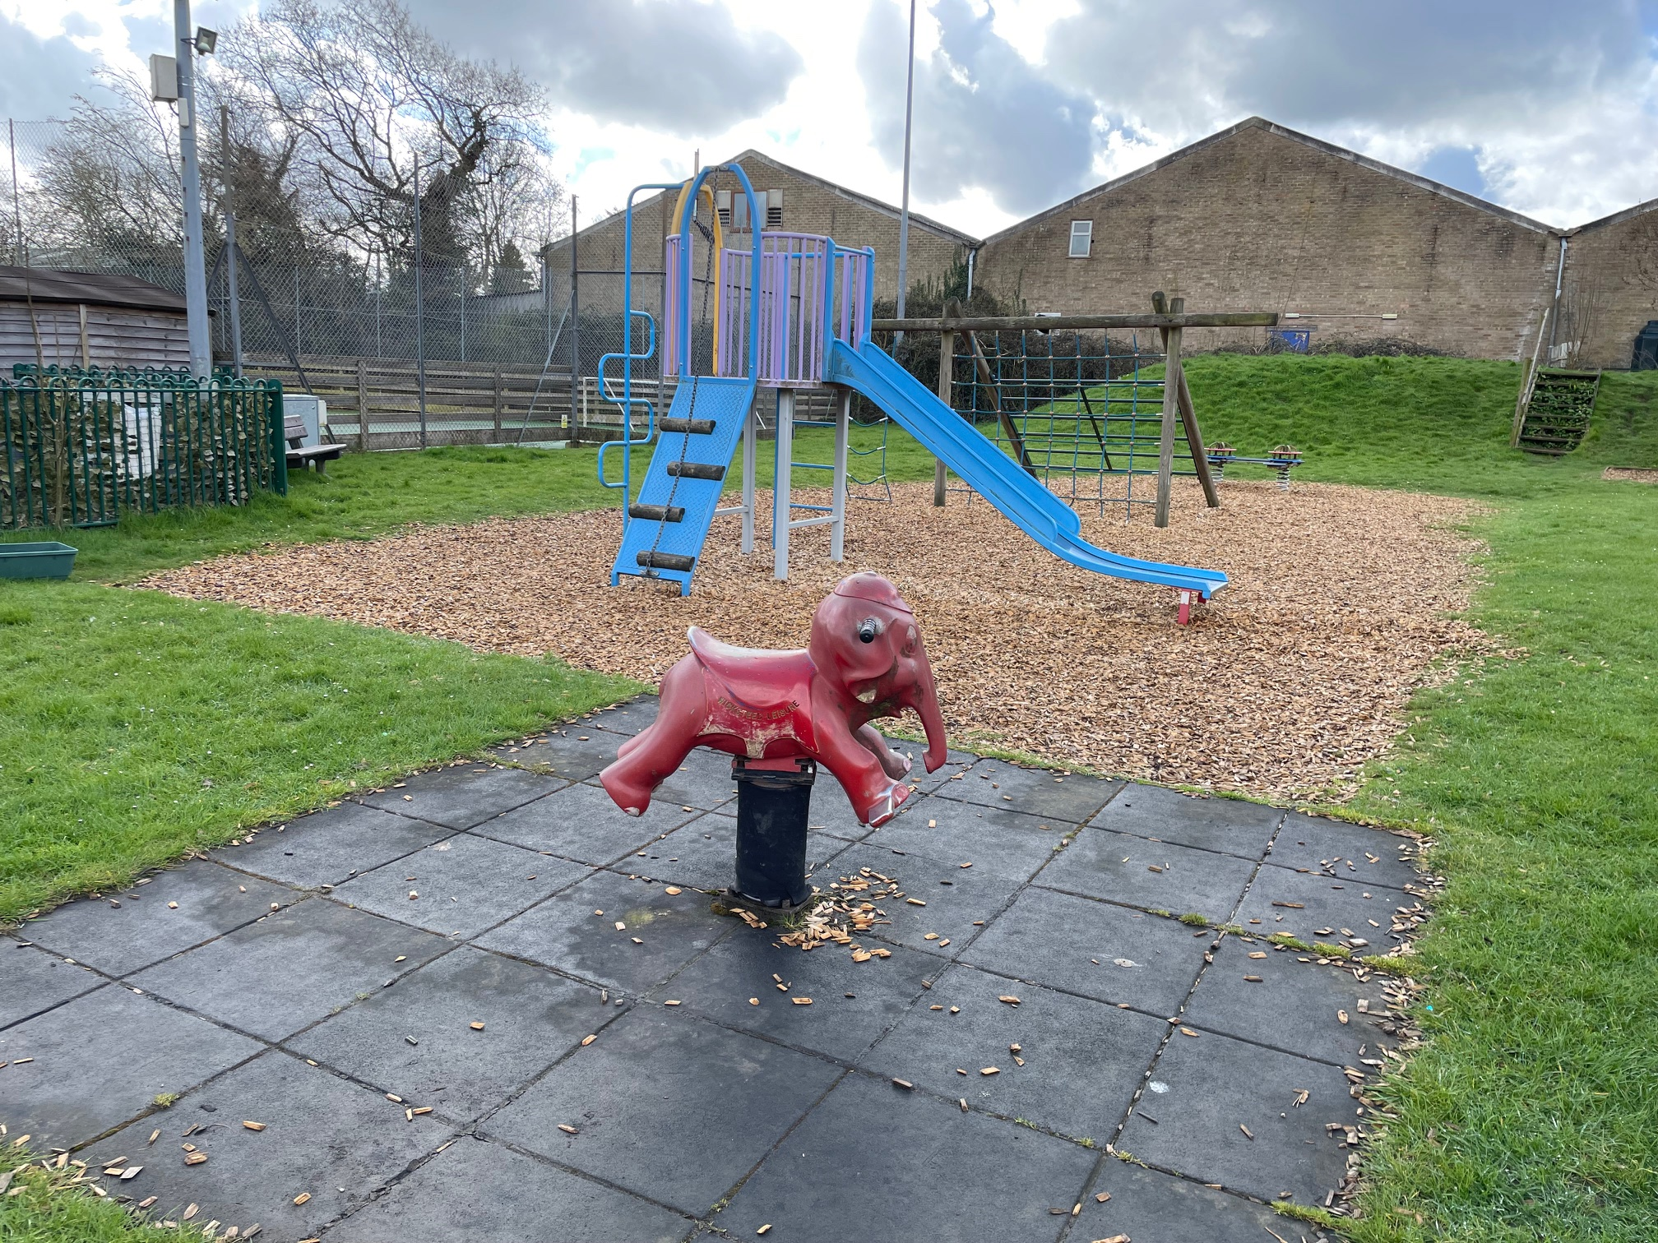
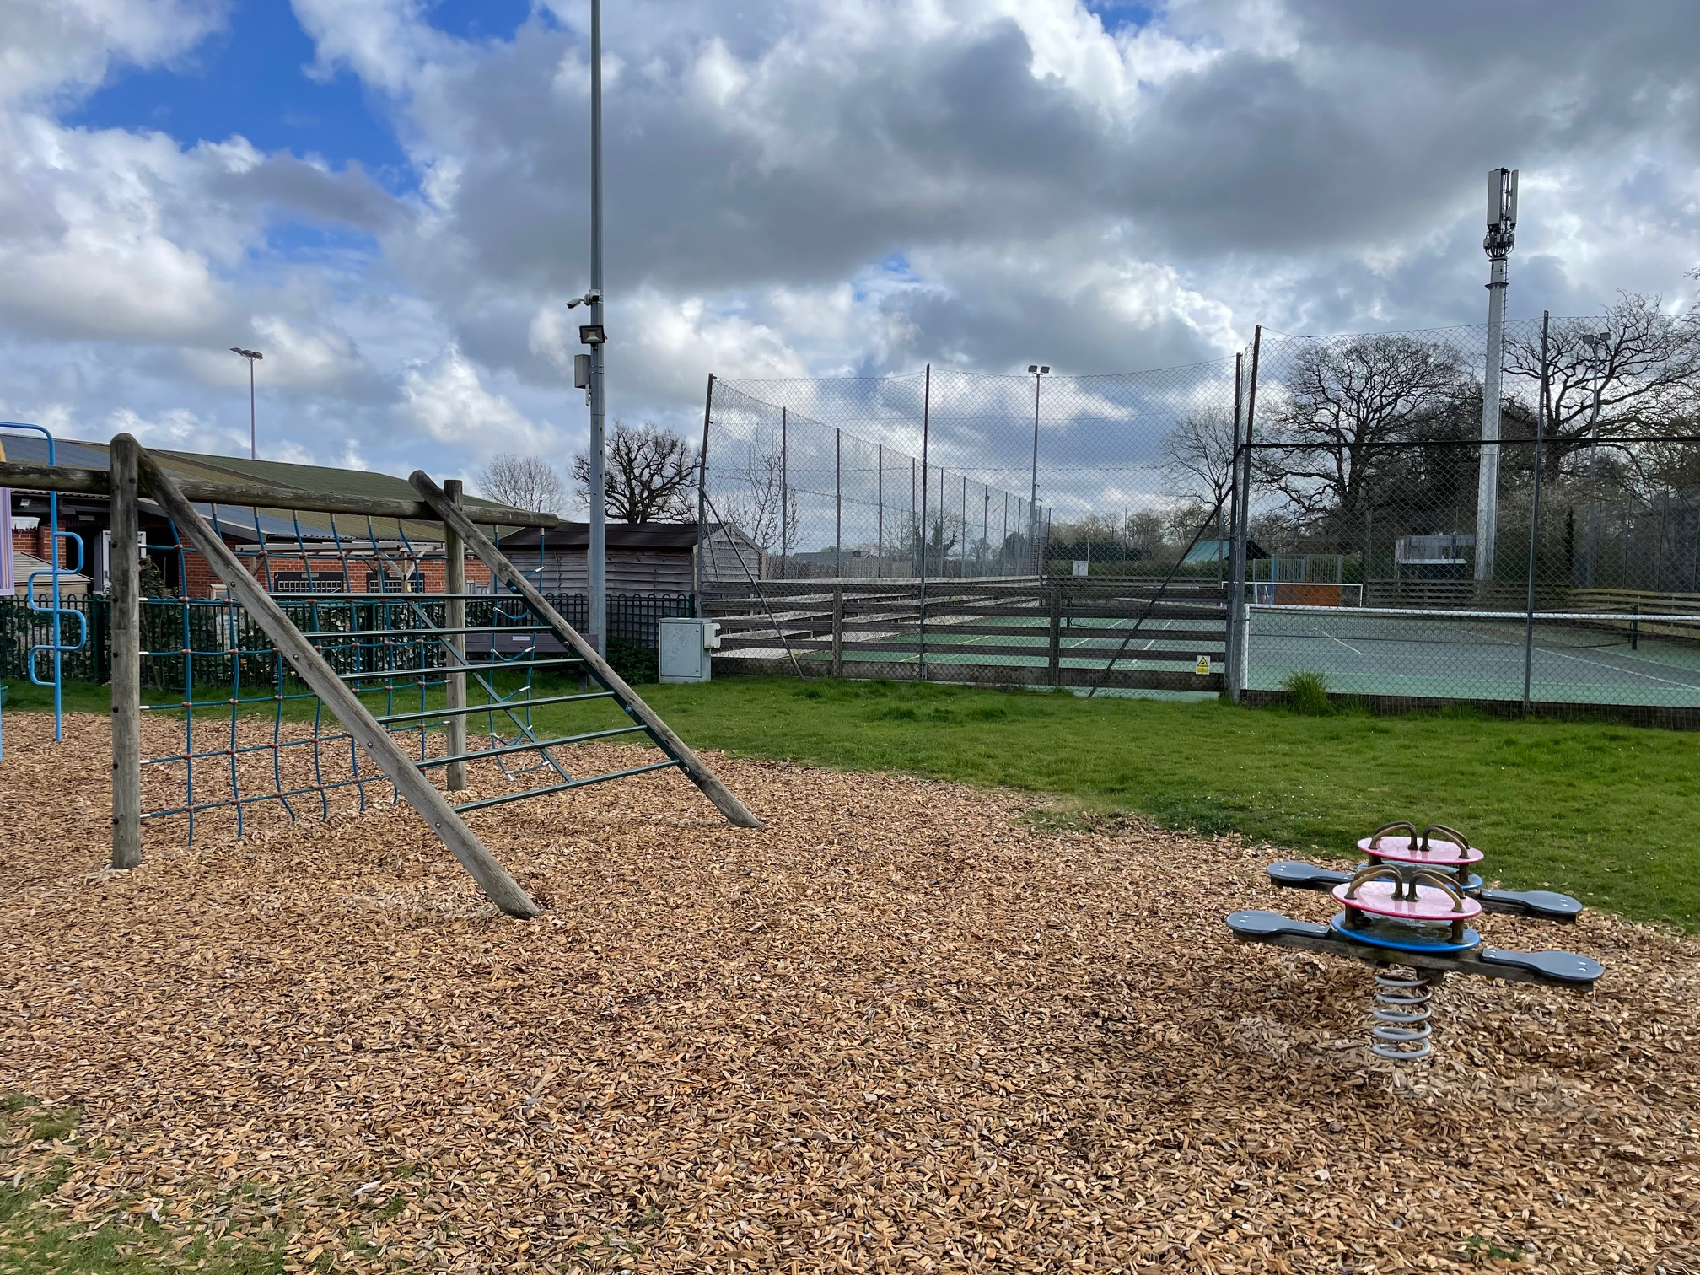
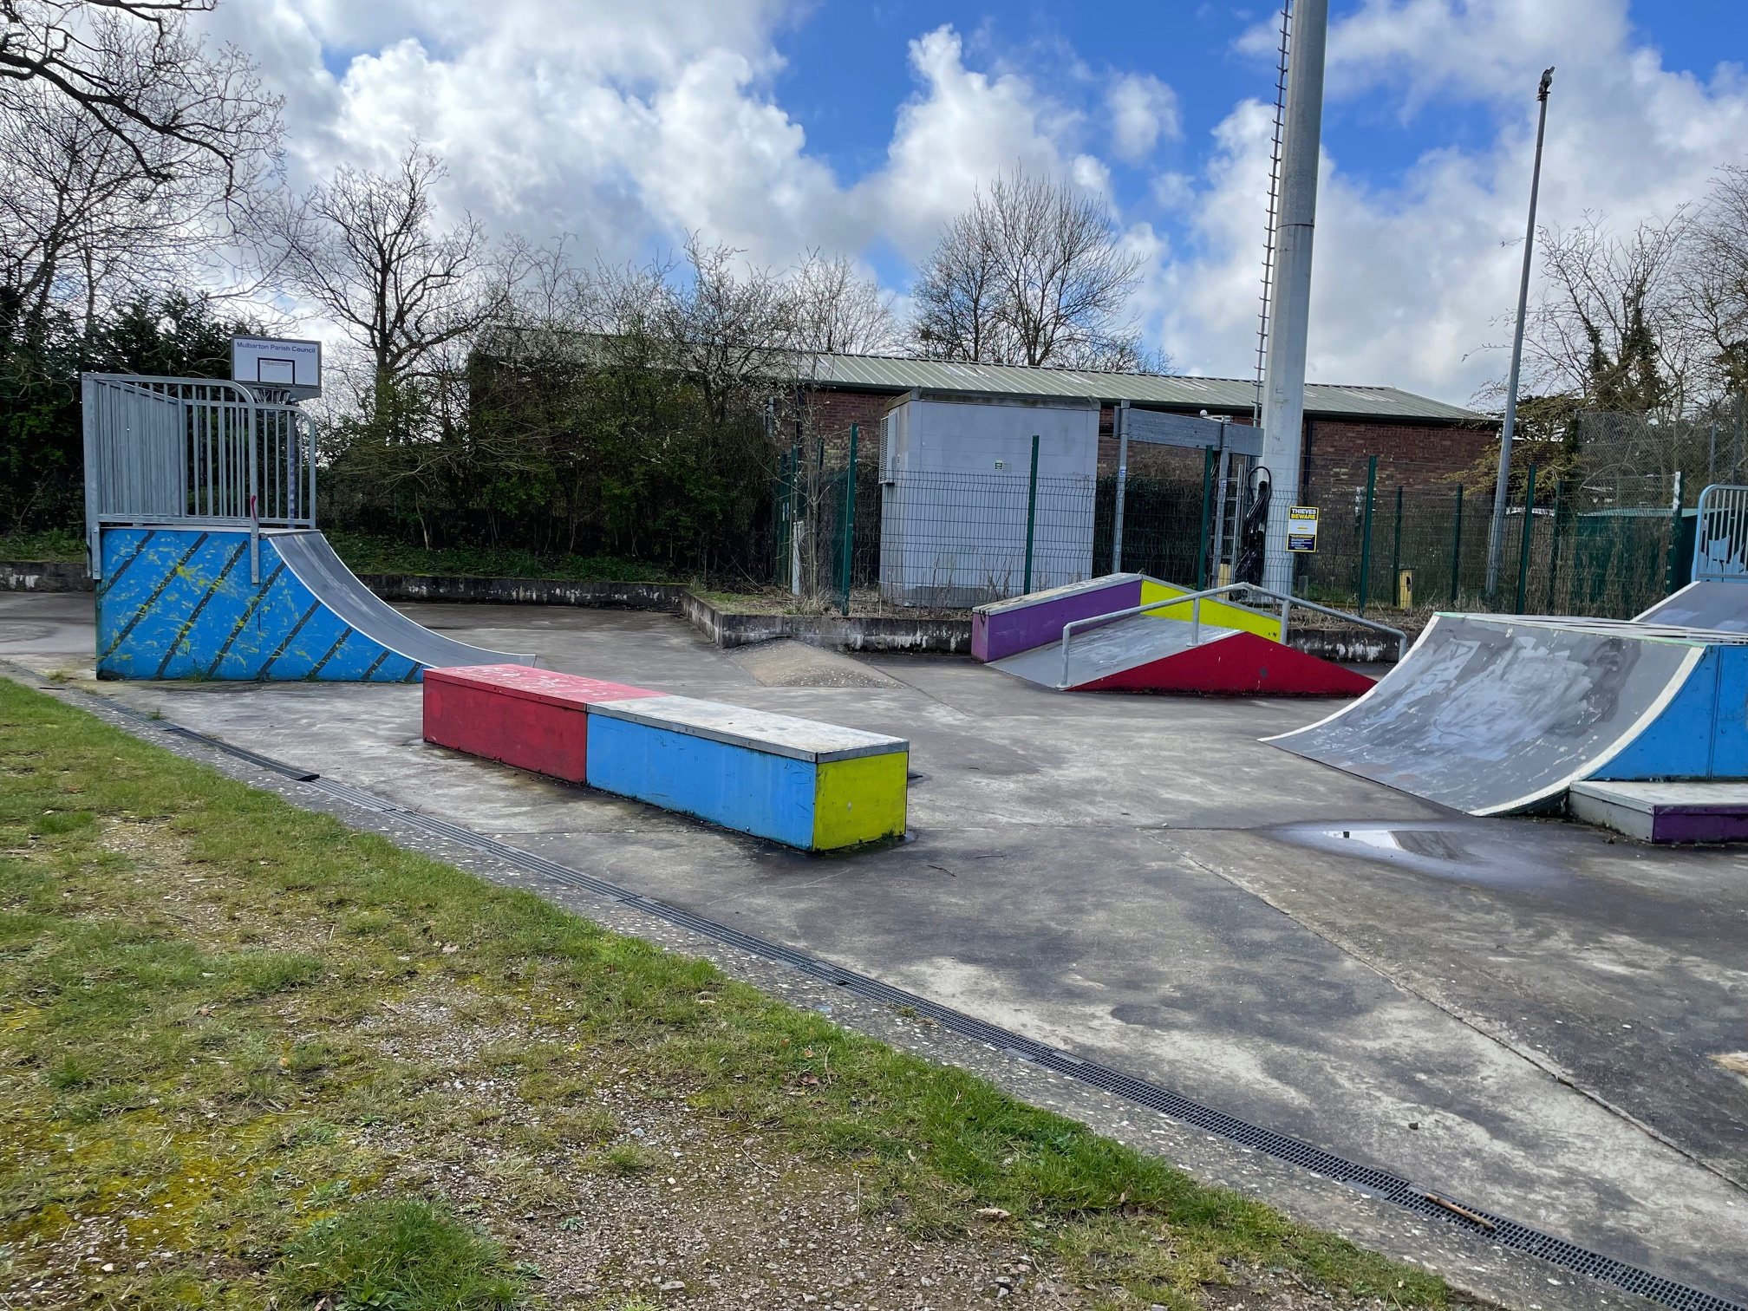
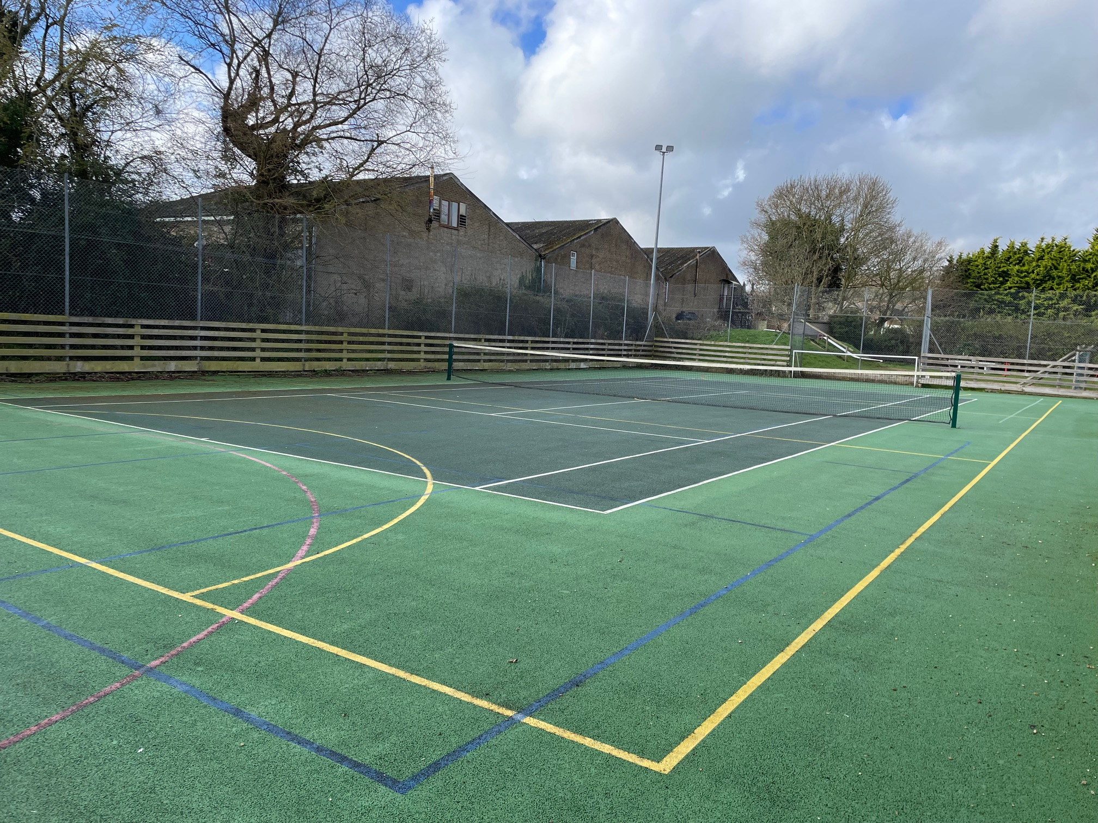
Village Hall
Located behind the village hall
Play area equipment suitable for age ranges up to 10 years
Includes
Swings
Slides
Climbing frames
Skatepark & MUGA* is available at the village hall
*Multi Use Games Area is chargeable

Slide 6
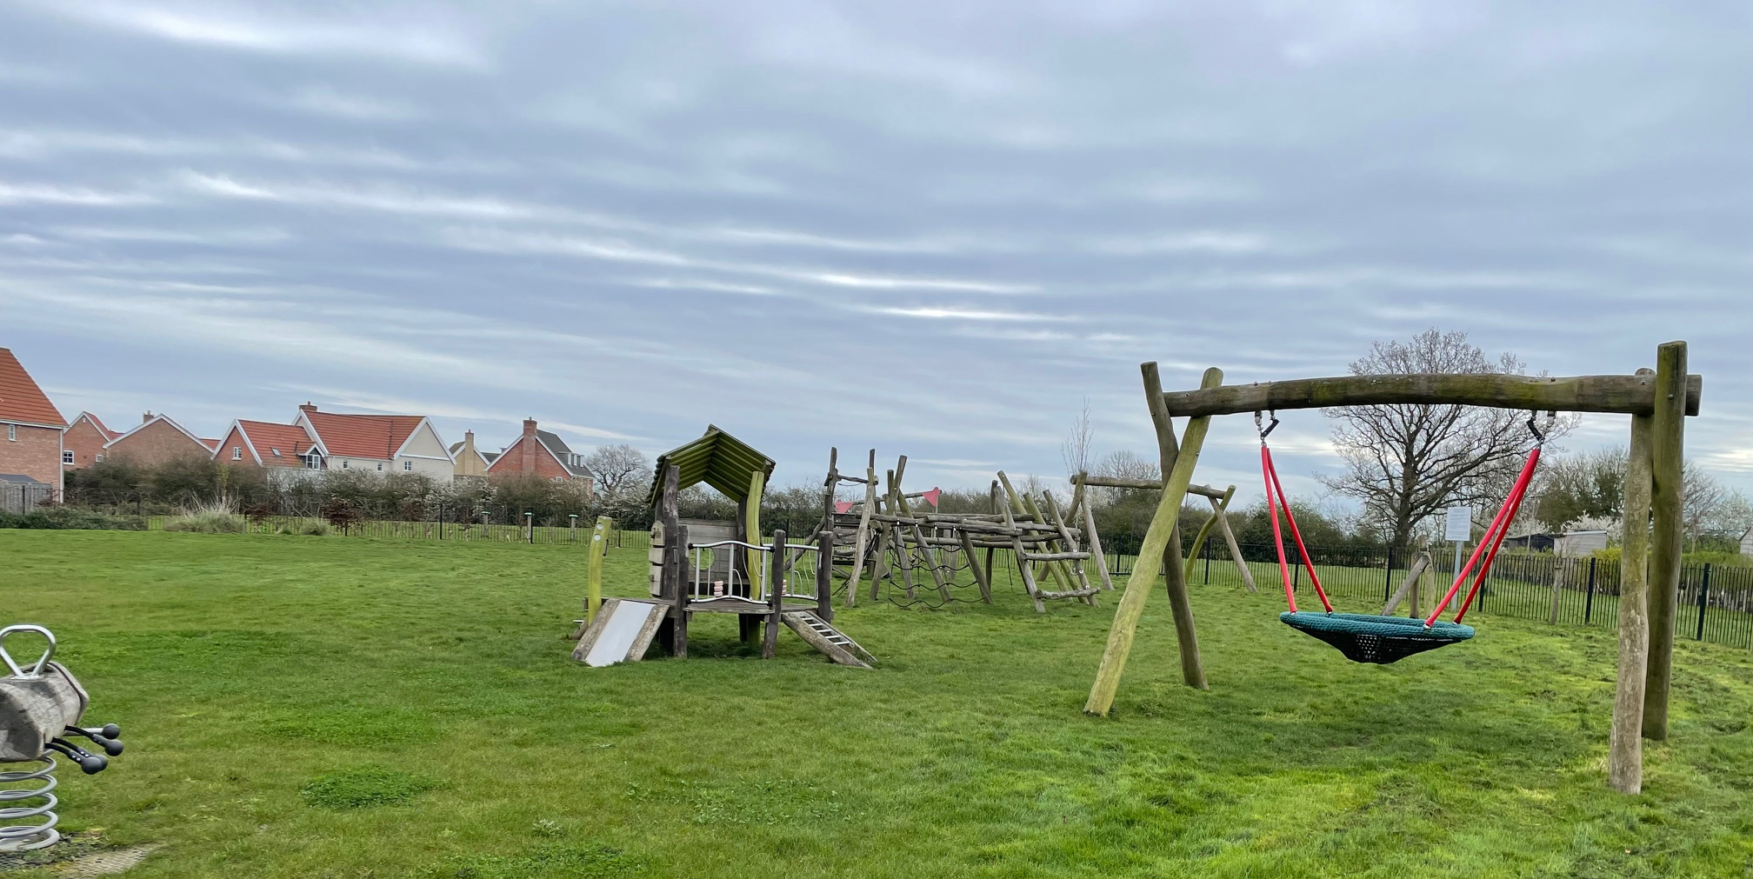
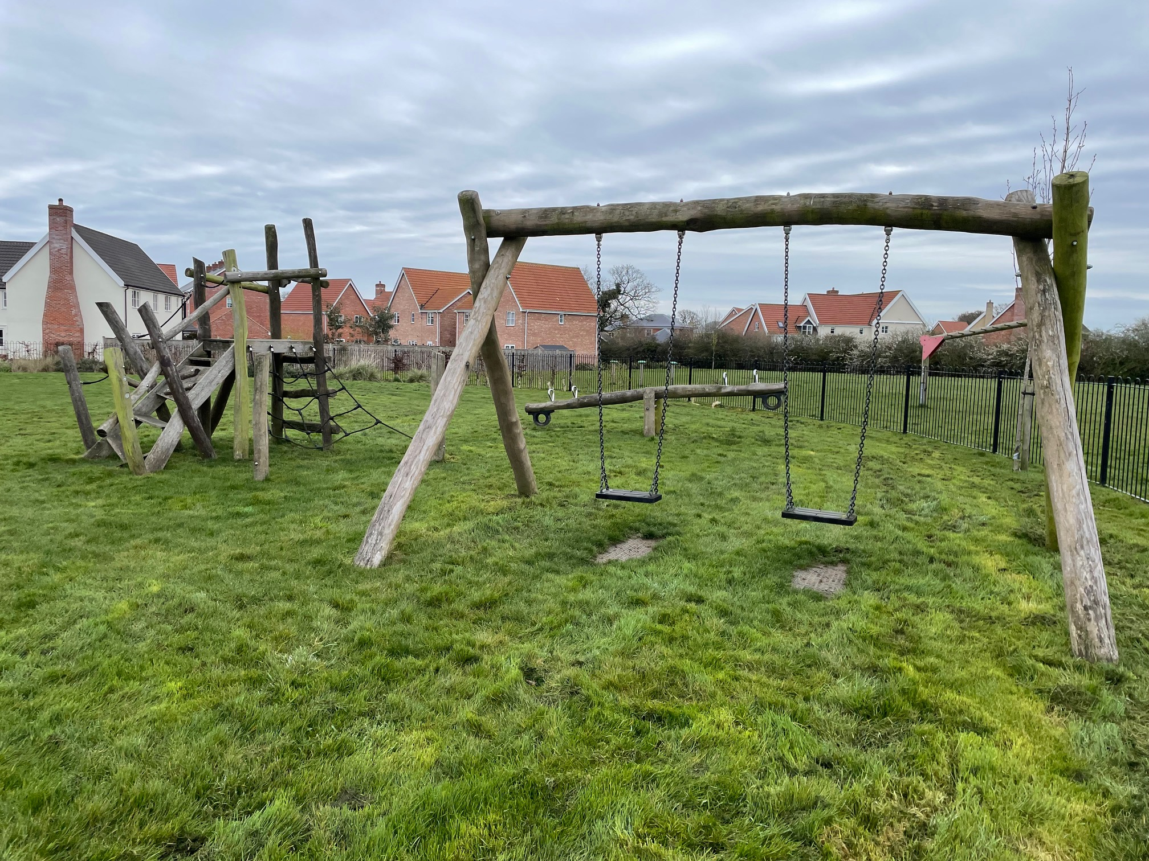
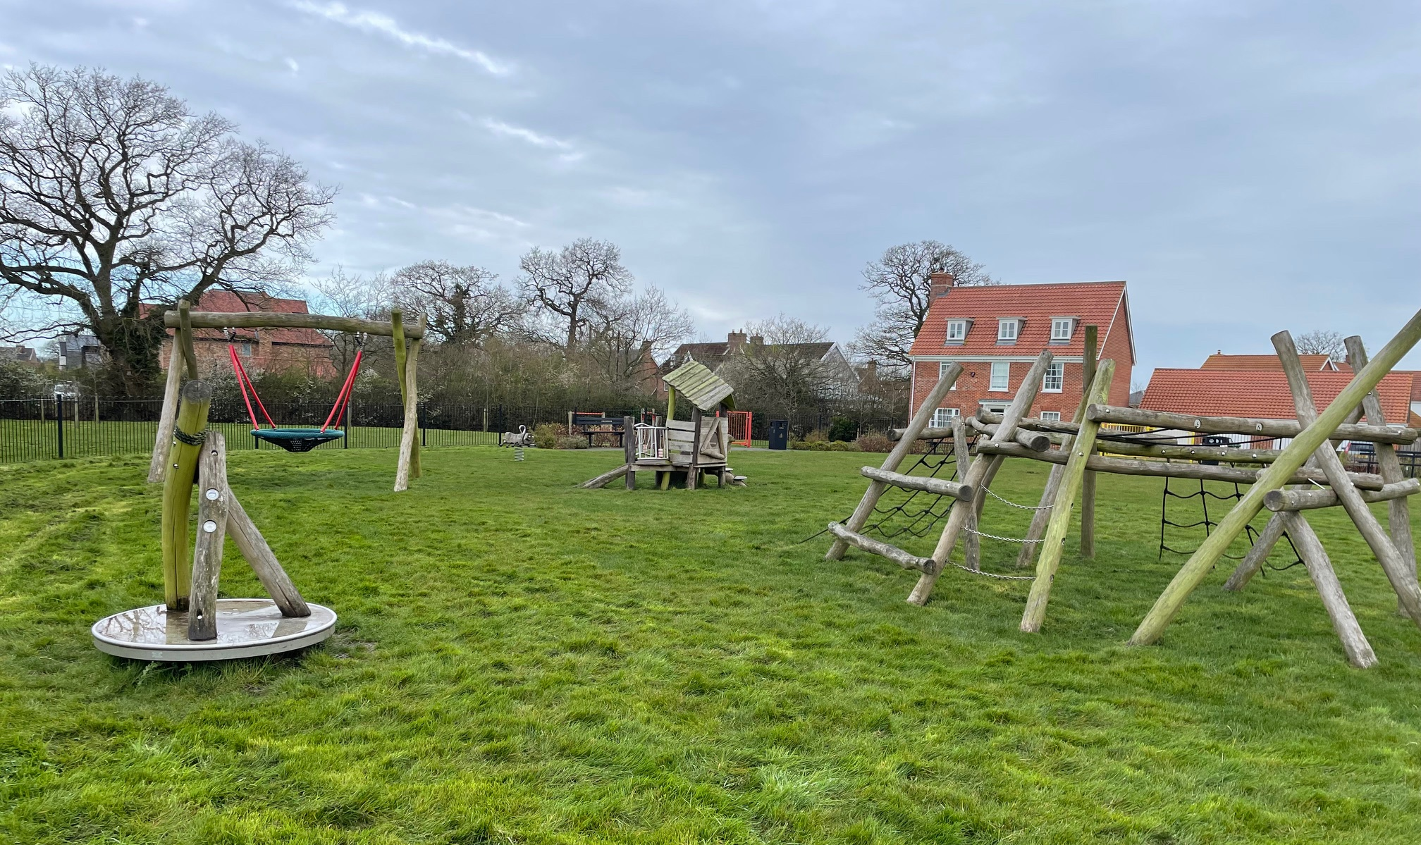
Oakley Park South
Play equipment suitable for ages from 2 to 7 years
Managed by EWS
Includes
Swings
Climbing frame
Slide

Slide 7
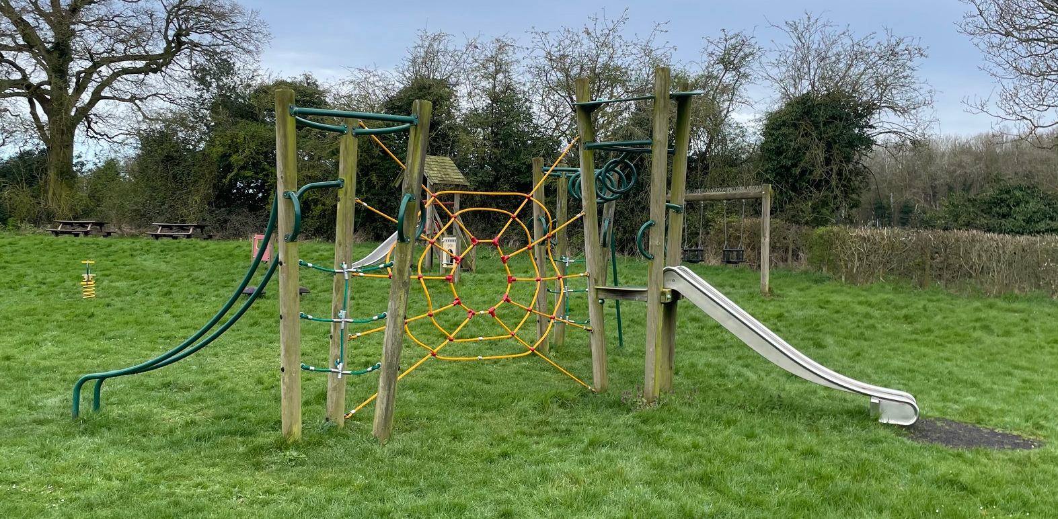
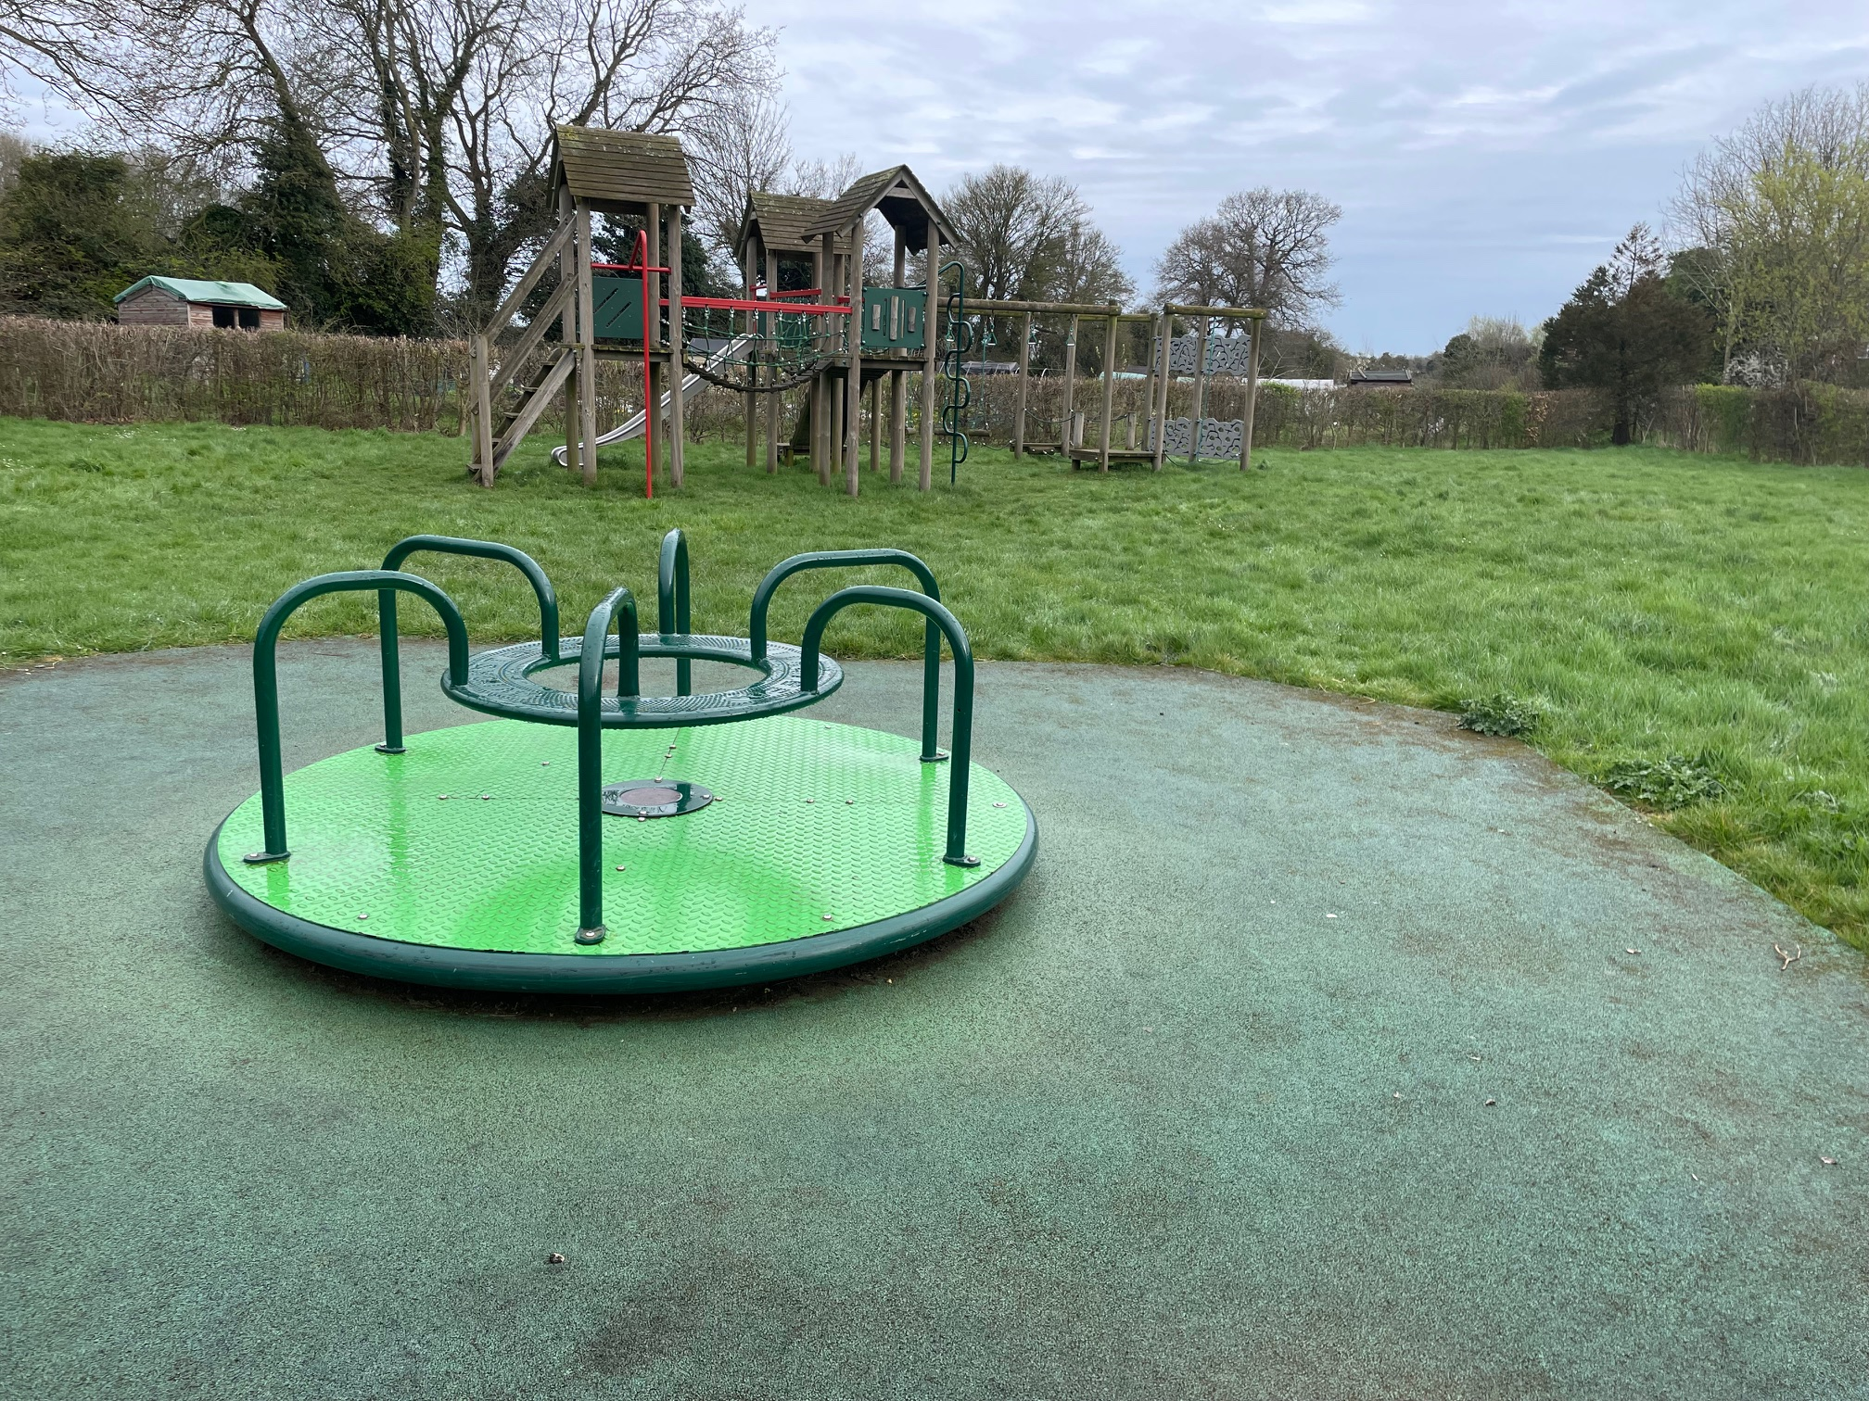
The Meadows
Off Cuckoofield Lane, opposite Catmere Herne is in Bracon Ash
Play equipment suitable for age ranges up to 12 years old
Includes
Swings
Zipwire
Climbing frames
Roundabout

Slide 8
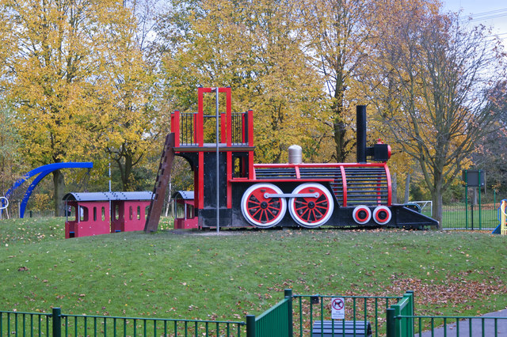


New play equipment at The Meadows
The Parish Council want your views
We have set aside some funds but will need to win some grant funding too
The following slides show some examples of what equipment COULD be added to the Meadows play area
Tell us what YOU think
This Photo by Unknown Author is licensed under CC BY-SA

Slide 9
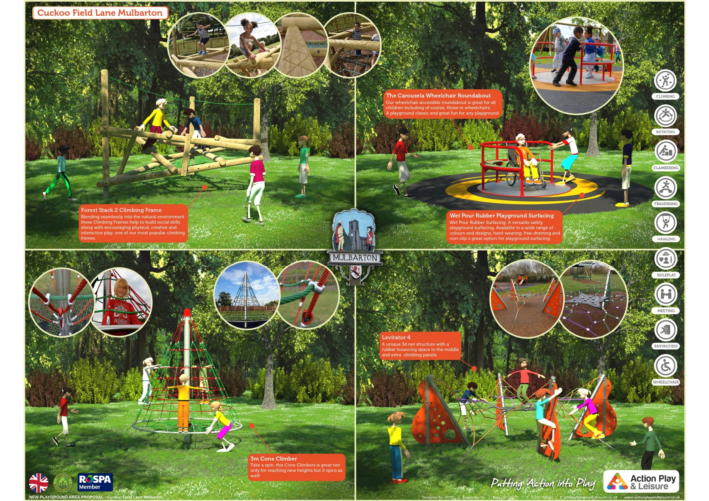
Idea 1
Notes:
Example objectives
At the end of this lesson, you will be able to:
Save files to the team Web server.
Move files to different locations on the team Web server.
Share files on the team Web server.

Slide 10
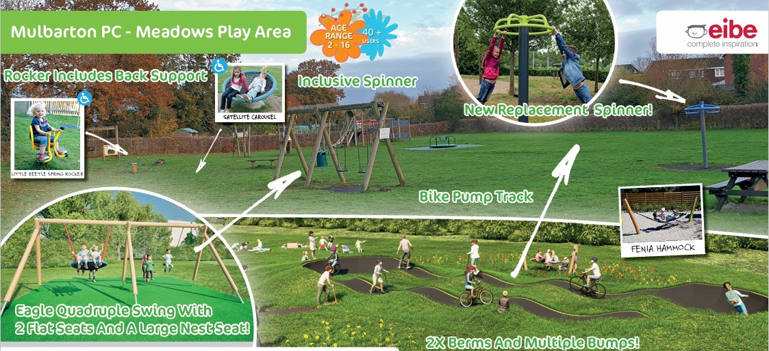
Idea 2
Notes:
Example objectives
At the end of this lesson, you will be able to:
Save files to the team Web server.
Move files to different locations on the team Web server.
Share files on the team Web server.

Slide 11
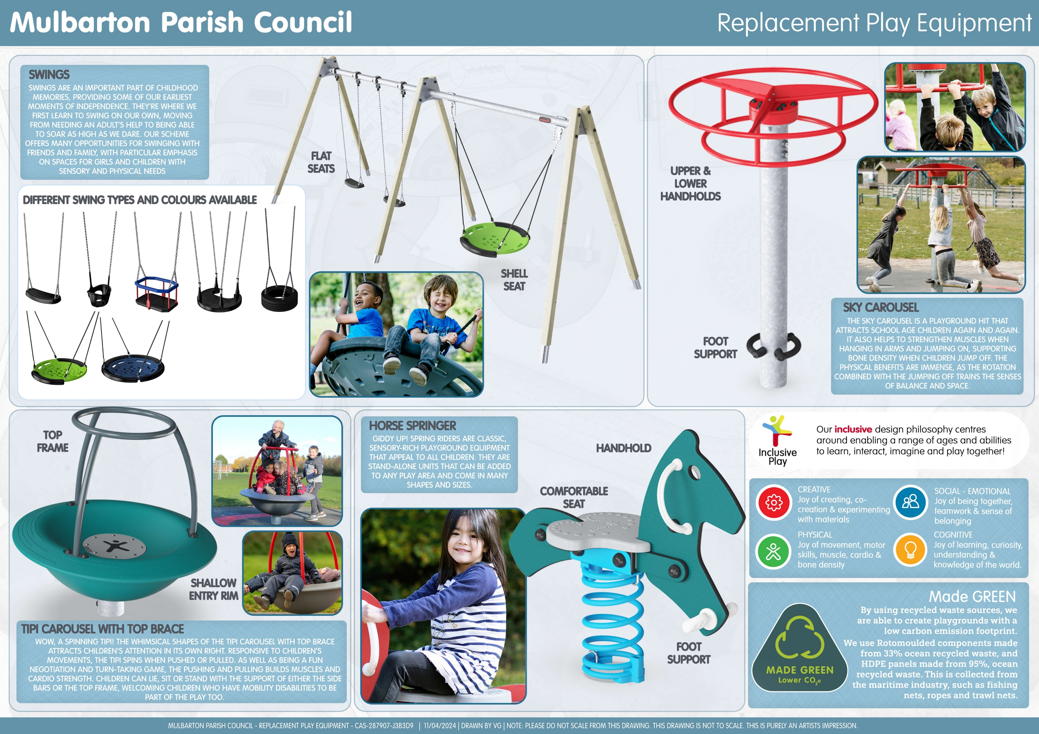
Idea 3
Notes:
Lesson descriptions should be brief.

Slide 12
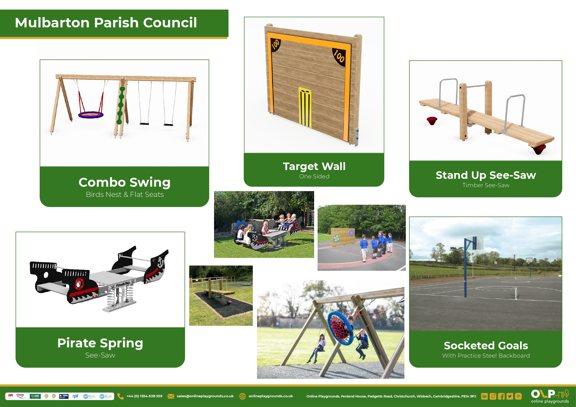
Idea 4
Notes:
Lesson descriptions should be brief.

Slide 13
What do you think?
Tell us what equipment you like – and don’t like!
Tell us your favourite play area – inside and outside the village
Tell us if there is a piece of play equipment you would at The Meadows
Tell us your favourite piece of play equipment
Tell us if you like any of our ideas
Help us to help you

Slide 14
Find out more & get in touch
To find out more
Visit our website https://www.mulbartonpcinfo.com/
Follow our Facebook page
Get in touch
Email clerk@mulbarton-pc.gov.uk
Come to our monthly council meetings

