Slide 1
Future model for an Integrated Musculoskeletal service
December 2021

Slide 2
Background
Croydon MSK service was commissioned following a competitive tendering process and began to operate in December 2018. The service is currently provided by Connect Health.
We have been working with the local system partners within the Croydon ICS system to co-design a new clinical model for MSK. This work has been completed. The model is in line with the principles set out in the ‘BestMSK High impact strategy’ by NHSEI which has been produced in collaboration with GIRFT and BestMSKHealth Collaborative, published in July 2021.
To support the Integrated clinical model, it has been proposed that the Croydon Health Services NHS Trust (CHS) to lead the MSK pathway in Croydon and provide the triage and CATS element of the service.
For the community element of the MSK service, the CCG and CHS intends to run a procurement process to select the provider for a 3 year contract with an optional 2 year extension. The service provider will work closely with the CHS Trust and the Croydon GP Collaborative (CGPC) in delivering the service from a number of GP practices.
The following set of slides (3-6) lays out the proposed clinical model for an Integrated MSK Service in Croydon.

Slide 3
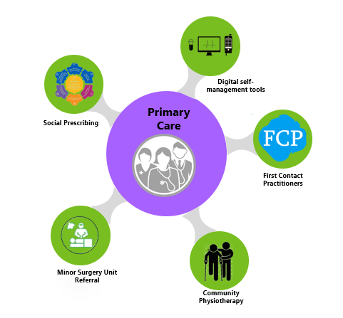
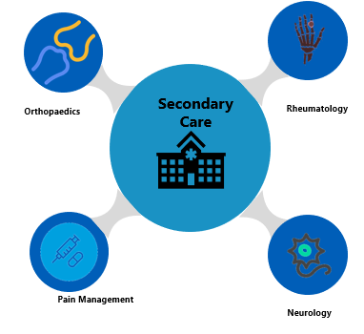
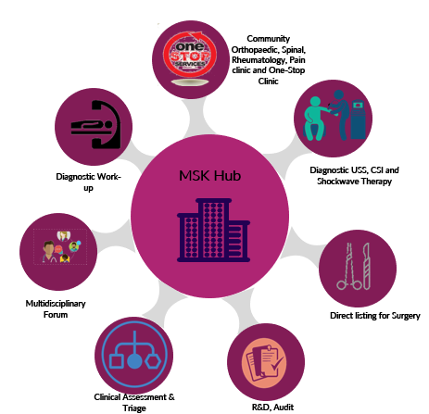
Integrated MSK Service Model-key Components

Slide 4
Integrated MSK Service - Key Functions
First Contact Practitioner
Commissioned by Croydon PCN
First point of contact for patients presenting with MSK conditions in primary care
Provide
  expert MSK assessment
  diagnosis (inc. screening for serious pathology)
  first-line treatment
  self-care advice
  if required, appropriate onward referral
Regulated
  currently most FCPs are advanced physiotherapists
  podiatrists, osteopaths, occupational therapists could also meet the capabilities set out in the MSK Core Capabilities Framework
Location
  based in PCN sites
Access
  GP referral not needed to access the FCP
  reception staff - vital in directing patients appropriately
IT system – EMIS Web
Community Physiotherapy
Skill
  Based on AfC banding – Band 5 (junior physiotherapist → Band 7 Specialist Physiotherapist)
Provide
  Clinical assessment
  1:1 Treatment via face to face and virtual consultation
  Group exercise session
  Group educational session
  Hydrotherapy
Location
  GP practice sites
  Community health sites
Access
  GP or FCP referral
  Referral from CATS
  Referral from Consultant-led services
IT system
  Proposed that the service will utilise community EMIS Community to record patient notes.
MSK Hub
Offers a range of treatments for patients with musculoskeletal (MSK) conditions.
Link closely with the Croydon GPs, Community Physiotherapy and FCP services to enable appropriate and timely management where required.
Provide
  Assessment and advice
  CATS and Community Orthopaedic, Rheumatology and Pain clinics.
  Advanced diagnostic imaging or blood tests where required with follow-up.
  Injection therapy - joint and soft tissue.
  Onward referral where required to community or secondary care such as orthopaedics, rheumatology, neurosurgery or pain clinics.
  Direct listing for surgery
  One-stop clinic
  Location
  ICN+ Hub sites – proposed 6 sites in Croydon.
  Access
  GP. FCP or physiotherapy referral
  Referral ED and VFC
IT system
  Proposed that the service will utilise Cerner Millennium.
First Contact Practitioner Service
MSK Hub
Community Physiotherapy

Slide 5



Integrated MSK Service (Proposed future model)
PRIMARY CARE: GP/ FCP
Holistic assessment
Investigations
ED discharge via:
Signposting and/ or refer
Fracture clinic/ VFC/ Soft tissue clinic
GP
Refer to community physiotherapy
Refer to Minor Surgery Unit
Social Prescribers
Physiotherapy service
Domiciliary Physiotherapy
Podiatry
In-patient physiotherapy team
Paediatric Physiotherapy
Neurophysiotherapy
Hand Therapy
IAPT
Clinical Assessment
Self-management tools
1:1 Treatment
Group exercise sessions
Hydrotherapy
Signpost to social prescribers
DC back to GP/ refer to tertiary care
Link up with other therapy services
Group educational sessions –Pain, OA
Signpost to voluntary sector – CVA, LA
MSK Hub
Secondary Care Services
Clinical Assessment
Diagnostic work-up
MDT forum with Consultants/ GPs
Orthopaedics
Rheumatology
Diagnostics including Neurophysiology
One-Stop Clinic
Diagnostic USS and Shockwave Therapy
USS guided CSI
Neurology
Pain management
Direct listing for surgery
R&D, clinical audits
Pain management

Slide 6
Sample clinical pathway
Primary Care Led
Secondary Care Led
EMIS
START
Diagnosis of OA by FCP/ GP
Virtual appt with GP/ FCP
Refer to MSK Hub.
E-RS
Clinical Assessment and Triage Service (CATS)
FCP/ GP
(no clinical contraindications)
Provide information
Lifestyle advice
Diagnostics – if indicated (x-ray, bloods, USS)
Community Physiotherapy
Provide information
Individual exercise programme
Group exercise class
EMIS
EMIS
Clinical Assessment
Diagnostic work-up
MDT forum with Consultants/ GPs
One-Stop Clinic
Diagnostic USS and Shockwave Therapy
USS guided CSI
Direct listing for surgery
R&D, clinical audits
Cerner
PIFU
Improved?
Social Prescribing
Prescribe analgesics
Domiciliary Physiotherapy
Podiatry
In-patient physiotherapy team
Paediatric Physiotherapy
Neurophysiotherapy
Hand Therapy
No
Yes
No
Improved?
Yes
END
Discharge/ Patient continues following advice.

Slide 7
Activity planning
Methodology
Analysed activity level for 2019/20 and 2020/21.
2020/21 activity highly skewed due to the impact of the pandemic hence disregarded for activity planning.
2019/20 referral activity used for activity forecast. The service received 32,683 referrals in 2019/20 FY.
Forecast activity
Activity type | Forecast 2022/23
All Referrals Received - Action/Non Actioned | 36000
New Referrals accepted for 1:1 Physiotherapy | 25200
Referrals to CATS (MSK Hub) | 9000
All Referrals Rejected back to GP/ FCP/ Physio. | 1800
Follow up activity | 37800
Telephone consultations | 9450
Group sessions | 18900
1:1 FU Physio | 9450
Assumptions
10% increase in demand for 2022/23
New patient activity
  Referrals for 1:1 Physio – 70%
  Referrals to CATS – 25%
  Referrals rejected back to GP – 5%
Follow-up activity – NP:FU ratio = 1:1.5
  FU Telephone consultations – 25%
  Group sessions – 50%
  1:1 FU Physio – 25%

Slide 8
Budget
The proposed annual budget for the Community Physiotherapy service is between £1.2m-£1.3m.
Additionally, the CCG is considering reserving a right to expand the scope and value of the contract during its term, to facilitate access to this community based capacity, by local NHS Trusts, as may be assessed as required by the South West London integrated care system.

Slide 9
Quality assurance (Proposed)
No | Quality Requirement | Threshold | Method of Measurement
1 | Percentage of Service Users who indicate that they have been actively involved in developing their Action Plan (including goal setting, preferences and treatment). | 80% | Measured each month via provider submission
2 | Percentage of Service Users who indicate that they have been given self-care and self-management advice and guidance | 80% | Measured each month via provider submission
3 | Percentage of Service Users offered a priority first appointment (i.e. Clinically triaged as urgent by the service) slot that is within 10 operational days of successful contact with the service user | 95% | Measured each month via provider submission
4 | Percentage of Service Users offered a routine first appointment slot that is within 20 operational days of successful contact with the service user | 95% | Measured each month via provider submission
5 | Percentage of Service Users identified as requiring IAPT or other well-being services who indicate that they have been offered mental health support (referral to IAPT, assessment or wellness services) | To be baselined in by Q1 21/22 and a monthly trajectory. | Measured each month via provider submission
6 | Percentage of Service Users who had their appointment cancelled by the provider for non-clinical reasons | 3% | Measured each month via provider submission
7 | The number of locations of service where face-to-face services are provided | 21 (TBC) | Measured each quarter via provider submission
8 | Percentage of Service Users completing the clinical outcome measure (EQ5D5L) at the start and end of their care pathway | 70% | Measured each month via provider submission
9 | Percentage of Service Users reporting an improvement in their condition via the validated clinical outcome measure agreed by the Commissioner (EQ5D5L) at the end of their care pathway compared to the start | 80% (of completed outcome measures showing improvement) | Reported as a rolling year average submitted each month via provider submission
10 | Percentage of Service Users receiving a face-to-face service answering “Extremely Likely” or “Likely” to recommend the Service to a friend or family member via the Service User Survey | 85% for the first 6 months then up to 90% | Measured each quarter via submission of the quarterly quality report
11 | Percentage of Service Users receiving a non-face-to-face service answering “Extremely Likely” or “Likely” to recommend the Service to a friend or family member via the Service User Survey | 70% | Measured each month via provider submission
12 | Percentage of Service Users completing the Service User Survey | 30% | Measured each quarter via submission of the quarterly quality report

Slide 10
Quality assurance (Proposed)
No | Quality Requirement | Threshold | Method of Measurement
13 | Percentage of CATS referrals triaged within 2 operational days of administrative registration | 95% | Measured each month via provider submission
14 | Percentage of Physio referrals with attempt to contact within 2 operational days of decision to offer Physio | 95% | Measured each month via provider submission
15 | Percentage of Action Plans (detailing the assessment, diagnostic tests, treatment plan, medication and investigations) sent electronically to the referring clinician within 5 operational days of a Service User’s discharge | 95% | Measured each month via provider submission
16 | Percentage of staff compliant with Mandatory Training requirements | 90% | Measured each quarter via submission of the quarterly quality report
17 | Percentage of Service Users directed back to their GP: From Admin triage From Clinical Triage | 5% each | Measured each month via provider submission Includes referrals to all providers
18 | Percentage of Service Users referred to Secondary Care (Orthopaedics, Pain Management and Rheumatology) | 10% for each specialty | Measured each month via provider submission Includes referrals to all providers Excludes Red Flag / 2ww referrals
19 | Percentage of Service Users referred to Secondary Care Orthopaedics who subsequently had a procedure | 70% | Measured each quarter via audit / CCG SUS Review (TBC) and reported via provider submission Includes procedures within all providers

