Slide 1


Supplier Day Presentation Renewing and updating the Futures Procurement Framework (2023-26) 01 December 2022
Vision and Objectives
Notes:
Charlie – 5 mins to wait for stragglers

Slide 2





Housekeeping
Please mute your microphone and switch off your video camera (when you’re not speaking!)
We will have Q&A at the end of the presentation; please Raise Your Hand then if you wish to ask a question
If your question is not answered during the Q&A, please make sure it is recorded in the Teams Chat. We will follow up after the event with a Q&A document.
This session will be recorded
Vision and Objectives
Notes:
Thank you for joining BEIS for the Pre-Market Engagement Event.
Please keep your mics or speaker phones on mute, to cut down on background noise or interference.
Please note there is a direct link to the meeting and a dial In option via your calendar invite if required.
Please ask any questions via the MS Teams chat box as we take you through today’s session. The question’s will be answered at the end of the slide pack where we will endeavour to answer your question’s.
Any questions we can not answer on the day, we will revert back to “all” with a response to the questions answered in this session.

Slide 3
Introduction to the Team
GO-Science Futures Team (Policy Lead):
Charlie Warwick – Head of Futures Advice
Kelsy Dyer – Programme Manager
Jack Snape – Head of Foresight Projects
Richard Thistlethwaite – representing EmTech & TSI
UKSBS Framework Manager (Administration Lead):
Vicki Clewer – UKSBS Lead (management by the wider Professional Services team)
BEIS Commercial Team:
Darrin Hook & Gabriella Lesca – Commercial Leads
Vision and Objectives
Notes:
Intros – the policy customers (plus others from departments who have commissioned and/or want to commission via the framework)

Slide 4
Why we are holding the Supplier session
…a two way conversation
1
Introduce our new framework requirements and scope
2
Elicit your feedback, questions and suggestions to fine-tune requirements and scope
3
Provide practical guidance on next steps
Vision and Objectives
Notes:
Charlie
The objectives of this session are threefold:
To give prospective suppliers an understanding of the scope and requirements of a new framework before it goes to market
To elicit feedback, questions and suggestions from suppliers so we, as government customers and framework managers, can optimise the scope and requirements of the framework this time around. We’re interested in hearing about existing suppliers’ experiences and suggestions of the current framework, as well as thoughts from those who might be new to it.
To give practical information on the process and what we need from you, by when, for evaluation and award phases

Slide 5





The Futures Procurement Framework
Background
Plugged a ‘Futures Gap’ as demand within govt was rising
BEIS-hosted
UKSBS-managed
GOS-led
Essential part of HMG foresight system
Rapid / streamlined commissioning (esp for <£50k)
£3m max spend over 3 yrs…
Find out more HERE
Vision and Objectives
Notes:
Charlie
For those who are less familiar with this framework, it was established to fill a gap that had been identified in government procurement. Via Crown Commercial Services, government officials and teams could access consultancy on a number of things, from finances to organisational change, citizen research and behavioural insights… but no clear route to accessing futures and foresight consultancy, and no obvious supplier base to call upon.
It was the future-facing part of GO-Science that led the development of the specs, and proposed the idea to our home department, BEIS – which is why BEIS Commercial still own the framework. Recently, UKSBS (shared business services) have taken over the administration of several BEIS systems, including the framework – so the wonderful Vicki & team help customers and suppliers through the commissioning process, and keep track of what’s being spent and delivered. It is GOS’ Futures team who work as marketeers and matchmakers, raising awareness of the framework across HMG and helping customers ask questions and craft commissions that suppliers can respond to effectively.
We like to think of it as an essential feature of the government foresight system. For those less familiar with futures in UK govt, I’d say about 2/3rds of departments, agencies and arms length bodies have dedicated horizon scanning, futures or foresight teams, but they have varying degrees of literacy and capacity. GOS functions as a hub connecting those teams, sharing best practice, resources and advice and building capability across govt. We do our own consulting on high priority, cross-cutting and sensitive longer-term work – but we cannot possibly support on every request we get. And often it’s actually more beneficial to the project or policy to have external perspectives and guidance, rather than ours.
So the intention was to feature a manageable number of quality-assured suppliers offering a range of futures-related services, making the landscape easier to navigate for govt customers less familiar with that world. The process was designed to make commissioning quick and easy, removing the need to go out to open tender then wading through proposals that didn’t meet a futures need. For projects worth less than £50k, the framework allows for a direct award, provided the customer has reviewed supplier specialisms and criteria. We intend to maintain this option in the refresh.
As with any government framework, spending is capped over its lifetime. £3m was the agreed maximum for 2019-2022, on the basis that there would be more than 10 chunky projects of £100k or more, and several more lower value projects. However, a number of factors, most notably the org pressures created by Covid, means that to date only XXX has been spent. This time around, we’re proposing the same cap, with the intention of better advertising the framework and in the knowledge that there is even greater demand for futures thinking from more places in and around govt. I’ll talk about the kinds of services in demand a little later

Slide 6
Proposal
Overview & Requirement
Refreshed procurement framework will commence in March 2023 and expire in March 2026, with the option to extend by a further year.
The max total spend via the framework will be £3m, and commissions under £50k will have the option to award directly, or run a mini competition between 3 suppliers rather than sending ITTs to full supplier list
UKSBS will manage communications between customers and suppliers, including guidance on completion of contracts for awards and payment, sharing commissions and proposals
GOS will grow an intelligent customer base and understand supplier offers more deeply, while suppliers will leverage GOS resources where possible and capture learnings and impact of work
Vision and Objectives
Notes:
Charlie
Life cycle
Budgets
Management
Collaboration (outside of supplier-customer transactions and discrete project delivery, we want our relationships to contribute to overall capability building and improve the quality of futures thinking done in govt. This means, understanding each others’ offers and needs, sharing learnings, capturing case studies of impact)

Slide 7
Proposal
Overview & Requirement
CUSTOMERS
Discover via the gov.uk page, or are directed to framework by GOS / other past customers
Note: Customers will need their own departments’ commercial approvals for spend
COMPETITION
Specification & weightings template, + briefing document to be completed by customer
>£50k ITTs to full supplier list
<£50k ITTs can go into a mini competition or even direct award
REPORTING
Quarterly MI reporting to UKSBS
Check ins with GOS and impact reporting
Vision and Objectives
Notes:
Charlie – in practical terms, when you’re actually on the framework…
Customers can discover services and prospectuses via gov.uk page – and then commission using standard template forms issues by UKSBS (with help from GOS to tailor their brief)
If over £50 value, ITTs go to entire framework, if under, they can go to whole framework or a mini comp (3), or – if strong enough business case for one supplier – can direct award (again all through UKSBS)
Each quarter UKSBS will reach out for reports of any work done, and the value of that work

Slide 8
Proposal
Overview & Requirement
Expertise / Service | 2019-2022 Description | 2023-2026 Evolved Description
1. Services for describing and explaining the characteristics of a policy area, including trend and driver analysis, and systems analysis | Identifying and characterising the structure and nature of a policy area and the key relevant indicators of what is happening and why. Identifying and communicating major opportunities and challenges, where they come from, and their related risks and uncertainties for action. This may include techniques such as horizon scanning, surveys, Delphi, driver and systems mapping and literature reviews to enable officials monitor and understand the nature of the change. This is likely to include: economic trends, societal trends, security trends and emerging technologies. | Identifying and characterising the structure and nature of a policy area or strategic issue […] + Data visualisation, knowledge management, dashboard development and web-based information dissemination may be part of this requirement.
2. Services for describing what the future might be like | Defining and exploring with officials different potential futures – whether they be possible, desirable, or adverse futures – what they mean and how we might get there. This may include using tools such as forecasting, scenario planning, visioning, and road mapping to help officials understand these futures and their implications. | + It also includes qualitative (creative, ethnographic, experiential) and quantitative (modelling, leading indicators) ways of enriching and visualising scenarios.
Vision and Objectives
Notes:
Charlie
In terms of the service requirements of the current framework
Recognition that govt needs to consider the long-term for complex and cross-cutting issues which have implications for multiple policy areas e.g. climate security. Greater demand for how to showcase scans and ‘make them live’ in dept’s central strategic functions
Appetite for more experimental / creative engagement techniques – and at the other end of the spectrum, ways to connect futures work more closely to budget forecasting or cost saving efforts

Slide 9
Proposal
Overview & Requirement
3. Services for developing and testing policies and strategies, and related decisions, particularly for their robustness and resilience | Developing and evaluating options for policy and strategy development and related decisions. This may include using policy workshops, stress-testing and personas to reveal insights into managing and making decisions in uncertainty and complexity. Understanding of the critical differences between public and corporate strategy and decision making, the policy making process, the business cycle of government departments and delivery bodies.
4. Services for developing Futures capability within the Civil Service, including skills related to the above activities | Developing and providing training and coaching on qualitative and quantitative Futures and systems methodologies, including skills related to the above activities and project management and communication skills. | Developing and providing training and coaching on qualitative and quantitative Futures and systems methodologies, leveraging existing government resources where relevant + Advising departments on establishing their own internal Futures / capability building functions and systems.
Notes:
4. Not to say you have to stick doggedly to our playbook, but we want to promote the use of e.g. the toolkit and other resources so when work is done across departments, there is a shared language and understanding of terms and techniques as much as possible

Slide 10
Proposal
Overview & Requirement
5. Services and expertise related to specific fields | Researching and reporting on insights into specific fields related to policies. This includes, but is not limited to, specific science and technology, social, environmental and economic fields. | + Science and technology assessment capabilities could include the application of statistics and data science to analyse technologies for policy purposes, economic appraisal and analysis of S&T ecosystem, and access to S&T research and commercialisation data via commercial providers.
6. Services for convening or engaging a diverse range of stakeholders (citizen and expert voices) in futures work |  | Designing and delivering processes which bring a diversity of perspectives into Futures and foresight work, to promote widespread benefits, break down siloes between organisations/sectors, and engage the public in Futures activity.
Notes:
5. Demand from TSI / EmTech – open floor to more info on needs?
6. By popular demand (recognition that we are all stakeholders in policy futures)

Slide 11
Evaluation criteria
Contractors are invited to submit tenders for inclusion on the framework, which will be evaluated by at least three BEIS staff.
BEIS will select the bidders that score highest against the criteria and weighting listed below:
0. [unweighted] Organisational profile & suitability
1. Futures skills and expertise
2. Flexibility and innovation in delivering horizon scanning, foresight and futures
3. Communication skills
4. Knowledge and experience of working with Government or a large/complex org
5. Project management
Vision and Objectives
Notes:
Charlie – so now to talk about how we might shortlist supplies for inclusion. draft eval criteria
(non weighted – mandatory) Org profile; we’d like to see a recent futures case study and testimonials
Futures Skills & Expertise: Experience in the use and application of horizon scanning and futures techniques, such as those in the Government’s Futures toolkit¹, including the impact achieved as a result. Example(s) of adaptation or combination of techniques to meet client needs and deliver services as listed
Flexibility and innovation: capacity to develop innovative approaches to meet needs, processes for keeping up to date with the latest / emerging approaches, be they creative, data-driven, participatory etc)
Communication skills: tailoring messages to specific and diverse audiences – effective ways to engage and influence senior leaders, including digital / multimedia forms of engagement, visualisation tools and graphics. Importantly, facilitation, training and knowledge sharing ability
Knowledge & experience of working with government or a large/complex organisation: understanding the differences between public and corporate strategy, how horizon scanning informs strategic thinking and adds value to policy making. Knowledge of business cycle and structure of departments (or evidence of working with other large complex orgs)
Project management: delivering in time and within budget, resources in place to support client challenges, manage project risks, clear milestones and realistic timescales, SMART objectives, ways to monitor and report progress, evidencing value for money, networks for accessing expertise or outsourcing/sub contracting where needed

Slide 12
Tender to be launched – mid December
Tender closes – end January
Tender Evaluation February
Contract award – end February 2023
Supplier Engagement Session – Dec 1st
Estimated Tender Timeframe
Vision and Objectives
Notes:
Vicki
Between now and launch we will take feedback/notes from this session and finalise the framework spec. Vicki and team will work on tender docs, which will be shared upon launch.

Slide 13
Final Points and Q&A
Your opportunity to ask questions! Any questions asked in the Chat bar which we don’t manage to answer during the session, we will capture and respond to in written form
Any questions you would like to ask after the session, please send to Victoria.clewer@uksbs.co.uk and professionalservices@uksbs.gov.uk no later than 7th December
All responses will be collated after the session and sent out to all suppliers
Please do not share any commercially sensitive information
Any commercial figures quoted should be indicative or freely available upon research
BEIS will publish an application form (contract notice) and ITT guidance once the competition opens. This will outline, in greater detail, many of the points from this presentation.
Vision and Objectives

Slide 14
Reporting & Performance Management
The provider will write at the end of each financial year to the Secretary of State at the Department of Business, Energy & Industrial Strategy (BEIS) setting out:
The provider’s assessment of their own performance against the KPIs over a 12-month period based on feedback from ADR bodies and key stakeholders alongside their own performance.
Provide an assessment of how the ADR landscape is performing for businesses and consumers, including information gathered from its landscape monitoring function.
Data on the number of ADR providers and the average number of days taken for the approval process to be completed.
A detailed financial breakdown of the income received and costs of running the service including an estimate of further income and costs.
In addition, BEIS will meet quarterly with the provider as part of its normal performance update meetings to monitor performance against the KPIs. Suppliers will be required to submit MI on a quarterly basis. Furthermore, the provider must refer any significant decision (e.g. removal of approval) to the Secretary of State for BEIS or where the Regulations leave a discretion to the ‘competent authority’.
Vision and Objectives
Notes:
Vicki / BEIS commercial

Slide 15
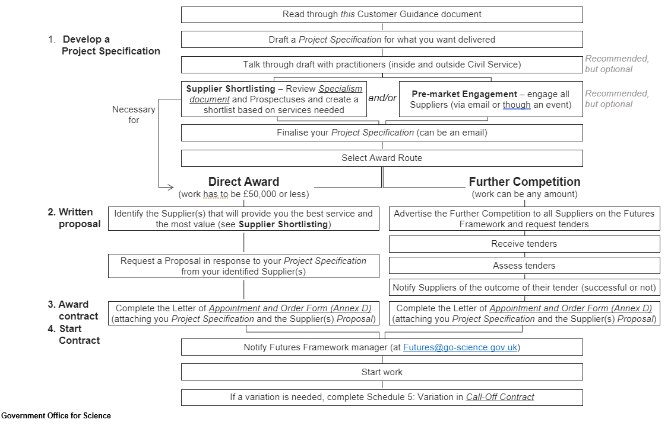
Proposal
Overview & Requirement
Would it be helpful to include a visual customer journey, to take suggestions on how we improve or adapt this?
@Kelsy – if yes, would you adapt this one from the current framework guidelines?
professionalservices@uksbs.co.uk
Vision and Objectives
Notes:
Charlie
For the more visual amongst you – the customer journey currently looks like this (happy to take comments and suggestions on how we might adapt this)

Slide 16
Consortia
Suppliers are allowed to submit bids as consortia, however the ‘Lead Supplier’ must be named. ​
Suppliers can submit bids individually as well as joining up and bidding as a consortium. Suppliers should clearly declare this information with both BEIS and the supplier(s) they have selected to join as a consortia.​
Suppliers should agree confidentiality arrangements between themselves and the consortia.
BEIS shall not be involved in any consortia arrangement.
Suppliers should note there is a general confidentiality clause within the Department's terms and conditions.​
Vision and Objectives
Notes:
Vicki / BEIS commercial

Slide 17
Vicki / Darrin / Gabriella –
Is this info correct / does it apply to us?
Procurement Process
Terms and Conditions:​
Suppliers should not amend the T&C’s or submit changes with their proposal. Any changes will be a non-compliant proposal and will result in the self-deselection;​
Any queries on the terms and conditions shall be dealt with before the procurement commences. (BEIS reserve the right to make amendments that benefit the procurement process).
The standard Mid Term CCS T&C’s will be published with the ITT
Vision and Objectives
Notes:
Paul

Slide 18
Functions & Responsibilities
Initial Application – The provider will assess initial applications to become approved from ADR providers in the non-regulated sectors. Both the steps for applying (Schedule 2) and the assessment criteria (Schedule 3) are outlined in the Regulations.
Biennial Review & Annual Activity Reports – The provider will carry out biennial functions on behalf of the Competent Authority to see if ADR bodies remain compliant with the assessment criteria. Furthermore, within a month of the first anniversary of being approved, and for each subsequent year, ADR providers must publish an annual activity report on their website.
Administrative Functions – The provider will work with the other ‘Competent Authorities’ to ensure consistency of approach and to highlight and share emerging issues. They will also inform the Secretary of State if a ADR body is no longer compliant with Schedule 3 and support both parties with the attempted rectification and/or removal of accreditation.
Single Point of Contact & Other Administrative Duties – The provider will support the Secretary of State in their role as a Single Point of contact for all ADR in the UK and internationally. This includes tasks such as publicising a list of accredited ADR bodies and other administrative duties such as supporting the Government on any ADR-relevant requests, answer relevant press/MP questions etc.
Quality Management – the provider will help set and drive quality standards amongst all accredited ADR bodies. The Regulations set the minimum standard and we expect the provider to help set, promote, and drive these standards further.
Vicki / Darrin / Gabriella –
Are there additional commercial or administrative considerations / functions we need to include?
Vision and Objectives
Notes:
Vicki / BEIS commercial

Slide 19
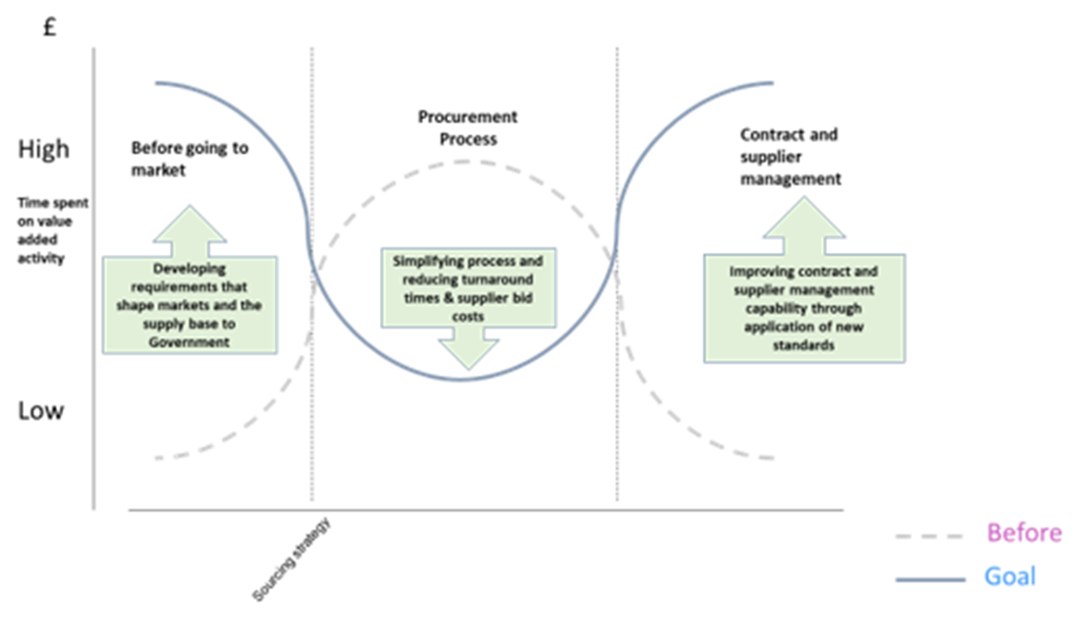
Procurement process
Darrin/vicki – is this worth including in our case? Would you speak to this slide?
Vision and Objectives
Notes:
Paul

