Slide 1


A Net Zero Society – Evidence and Analysis
This is early thinking and not the detail that will necessarily be included in the tender
Pre-market engagement event
EVENT WILL START SHORTLY
PLEASE DO NOT DIAL IN VIA TWO DEVICES

Slide 2
Please submit your questions and suggestions on Sli.do using the code #49992.
Note – we will try to answer as many questions as possible. We will consider suggestions/comments in drafting the tender but won’t respond to them here.
Questions and responses will also be published on contracts finder alongside the tender.

Slide 3
Outline
This is initial thinking and not the detail that will necessarily be launched in the tender
Aims of the event
Project background
Project objectives and research questions
Methodology
Timescales & deliverables
Questions

Slide 4

Aims of this pre-market engagement event
To get early views and comments on the project specification and scope
To ensure that we provide suppliers with sufficient level of detail / clarity within the ITT to develop bids
An opportunity for suppliers to ask clarification questions about the project specification
OFFICIAL – SENSITIVE

Slide 5

Project background
In June 2019 the UK Parliament passed legislation for Net Zero emissions by 2050
Significant societal change is required to meet these decarbonisation goals
  The CCC estimate that the majority (62%) of emission reductions will require some form of behaviour change.
Policy makers need to move away from thinking about discreet low-carbon behaviours but rather thinking about a system-wide approach
To achieve this shift, engagement with the citizens on the issues around climate change will be crucial.
Long-term behaviour change can be sustained when habits and routines are disrupted. The outbreak of Covid-19 has brought the largest behavioural shifts we have experienced for decades.

Slide 6
Project objectives
This is initial thinking and not the detail that will necessarily be launched in the tender
To holistically set out the implications of net zero for people (e.g. mapping out behaviours that could be required for net zero, how they interact with government policies and understanding their implications for lifestyles, homes etc).
To identify how different levels of societal change/responsiveness can affect the feasibility, costs and policies of transitioning to net zero.
To Identify how, and where, cross-cutting interventions could be implemented to support the societal change necessary for net zero.
Max budget: £120k
OFFICIAL – SENSITIVE

Slide 7
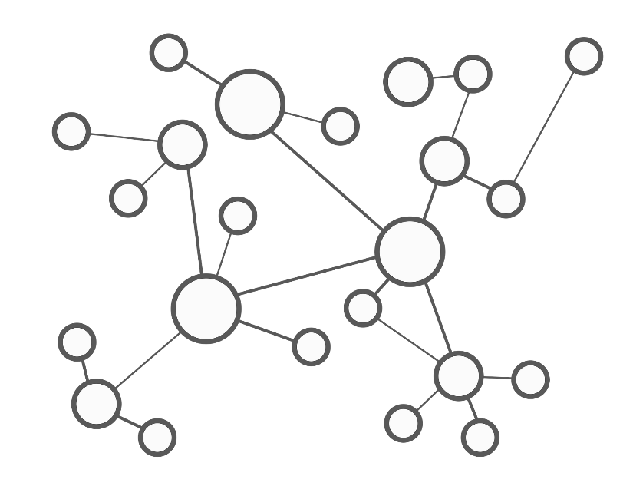
Project objectives and research questions
Objective one: To holistically set out the implications of net zero for people (e.g. mapping out behaviours that could be required for net zero, how they interact with government policies and understanding their implications for lifestyles, homes etc).
RQ1.1: What are the large and small behaviour/societal changes that could contribute towards (or hinder) reaching net zero?
RQ1.2: What evidence exists regarding the emission reduction potential associated with the behaviours identified in RQ1.1? Where are the evidence gaps?
RQ1.3: For the most significant/important behaviours identified in RQ1, what are all of the government policies that exist which may influence these behaviours?
RQ1.4: For the most significant/important behaviours identified in RQ1, what evidence exists regarding to the distributional impacts and considerations of changing these?
RQ1.5: For the behaviours identified in RQ1.1, which (potentially) have been affected by COVID-19?
OFFICIAL – SENSITIVE

Slide 8

Project objectives and research questions
Objective two: To identify and assess how different levels of societal change/responsiveness can affect the deliverability (e.g. costs/benefits and feasibility) of transitioning to net zero.
RQ2.1: How can (positive and negative) societal change affect the deliverability, costs and benefits of reaching net zero?
To achieve this it is envisaged that the following would, in turn, be addressed:
RQ2.2: What are the current methodological limitations and challenges in incorporating evidence on societal change into whole-system planning and modelling?
RQ2.3: What methodological frameworks/approaches could be adopted to better assess the impact that societal change could have on the deliverability/costs of net zero?
The remaining research questions would be dependent on the work picked up in work package 4 of the project, which would depend on a scoping study. For example, a research question may be:
RQ2.4: How might different future societal scenarios be associated with differing levels of shifts in behaviour, demand and technology adoption (and rates of technology adoption)?
OFFICIAL – SENSITIVE

Slide 9

Project objectives and research questions
Objective three: To Identify how, and where, cross-cutting interventions could be implemented to support the societal change necessary for net zero.
RQ3.1: What relevant climate change engagement, societal/behaviour change and public participation (e.g. co-production of policies, citizen assemblies) initiatives have been implemented in other countries? What evidence exists on the impact and success of these?
RQ3.2: What recommendations for interventions to support societal change can be inferred from the work to address all of the prior research questions?

Slide 10
Example methodology
We remain open to the methods that are proposed and used to address the research questions
A high-level example of a potential methodology:
Work package 1:
Behaviour Mapping
Work package 2:
International review of engagement, public participation & behavioural initiatives.
Work package 3:
Methodological scoping study (for addressing Objective 2)
Work package 4:
Scenario development and assessment

Slide 11
Example Methodology
Work Package 1: Behaviour mapping
Mapping/setting out all different behaviours implicit within possible pathways to net zero – then considering how these behaviours could be packaged or effectively ‘pieced together’.
For the most important behaviours, mapping (e.g. using a form systems thinking/mapping) out interactions with HMG policies
Mapping out how key behaviours may have been affected by COVID-19.
Possible review of the evidence around the abatement potential of different behaviours (possibly focusing on key behaviours and studies that already review a range of behaviours) and distributional considerations of key behaviours.
What would this tell us?
  Where there are key gaps, negative influences etc in policy coverage
  Where to prioritise interventions targeting behaviour change
  How we could effectively package behaviours and policies

Slide 12

Example Methodology
Work Package 2: International Evidence Review of Climate Engagement and Public Participation Initiatives
This review should provide evidence on other countries’ initiatives relating to:
Public engagement/climate change communications approaches,
Public participation in decision making (e.g. co-producing policies, citizen assemblies),
Packaging of climate policies to make them simpler / easier to access for the public, and;
Innovative initiatives to support low carbon societal/behavioural change.
This could also involve interviews with international policy makers and experts. Some (but not all) contacts can be provided by BEIS if interviews are incorporated.
What would this tell us?
Lessons and innovative ideas that we can learn from other countries

Slide 13

Example Methodology
Work Package 3: Methodological framework scoping study
A methodological scoping study for assessing impact of societal change on deliverability of net zero (objective 2):
Identify the existing issues/challenges with integrating different dimensions of societal change (e.g. behaviour change, welfare impacts, preferences…) into government modelling;
Reviewing different, potential approaches for addressing some of the above challenges:
  Identifying and recommending approaches for integrating societal change into current government modelling using different analytical techniques / frameworks
  Identifying alternate (to modelling) decision-making approaches (e.g. qualitative/descriptive assessment using ‘futures methods’, multi-criteria analysis…).
Synthesise methods and findings of existing evidence on the importance of societal change on deliverability and costs of achieving climate targets.
What would this tell us?
An evidence-based proposal for WP4 (subsequent slide)
Limitations of existing approaches used to model pathways to net zero in factoring in societal change
Methods (short-term & long-term) for improving incorporation of societal change into decision making
Initial, wider evidence with regards to objective 2

Slide 14

Example Methodology
Work Package 4: Scenario Development (these suggestions should be taken as examples – the main thing is to adopt a method to address objective 2)
Would take forward a recommended approach from the scoping study (WP3) that is achievable within the budget and time constraints of the contract. For example:
Developing future societal scenarios that could be use to quantitatively test the resilience of different potential net zero pathways and explore the impact of different societal futures on the costs/benefits of net zero (although it is not necessarily anticipated that the contractors would carry out this modelling). OR
Developing future societal scenarios and using these to qualitatively/descriptively assess how different future societal scenarios could affect costs/benefits and deliverability of net zero (e.g. using the scenarios as a lens through which to systematically assess different pathways to net zero).
What would this tell us?
- How different societal futures could affect the deliverability and costs of net zero.

Slide 15
Timescales and deliverables
Work package | Deliverable | Timings
Work Package 1: Behaviour Mapping | Behaviours mapping outputs (if applicable) Short accompanying report | End of September
Work Package 2: International review of relevant initiatives | Publishable report | End of December
Work Package 3: Methodological framework scoping study | Publishable report Evidence based proposals for WP4 | End of August
Work Package 4: Scenario development and assessment (subject to outputs from work package 3 and agreement to proceed at contract review point). | Tbc | Tbc - End of December

Slide 16





Ways of working
The project is owned by BEIS, but carried out in conjunction with a number of government departments
Bidders may need to form consortiums in order to address the range of skills and methodologies required to meet the project objectives

Slide 17

Was this information sufficiently clear? Are there any areas of clarity?
Is this the right level of detail to be able to develop your bids?
Any other areas of feedback or questions?
Questions ?
Notes:
Hopefully of interest. Also other proposals.

