Slide 1



Intermediate Care and Reablement Strategy
C H I L D R E N A N D A D U L T S
Market Event 26 November 2015

Slide 2
Objectives/draft agenda
Outline our Intermediate Care Strategy
Tell you about a potential procurement
Get your engagement in the process
Hear your ideas

Slide 3
Intermediate Care Services
Range of health and social care services offered on a short term basis to
Promote faster recovery from illness
Prevent unnecessary hospital admission
Prevent premature admission to long-term residential care
Support timely discharge from hospital
Maximise independent living

Slide 4
Context
Joint Strategy between Medway Council and Medway CCG
Intermediate Care and Reablement is one of 5 themes within the Medway Better Care Fund (others are self help and community resilience, community services redesign, Dementia and Carers)

Slide 5
Costs
Costs broadly covered within £17.6m Pooled Budget for Better Care Fund
Contributes to a sustainable health and Social Care economy
Makes Better use of existing resources
Improves outcomes
Approx 4m involved in Intermediate Care

Slide 6
Peoples’ views
People told us they wish to be supported at home
Extensive stakeholder consultation
Strategy is in line with national good practice

Slide 7
Better use of services
In Medway there is evidence there is an over reliance on institutional services
Inefficient use of residential care, nursing care, intermediate care beds and hospital beds – over half of the people do not need to be there at times
Strategy proposes changes to a group of health and social care services
Right care in Right place-at Right cost

Slide 8
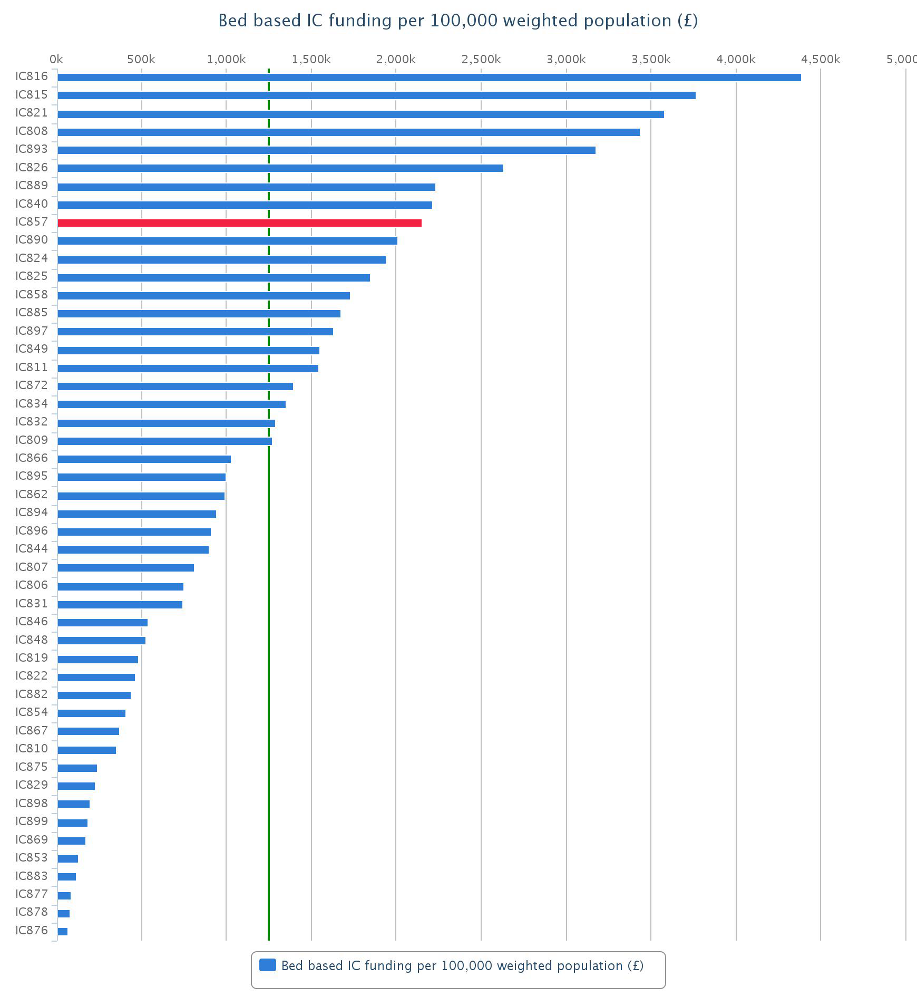

Slide 9
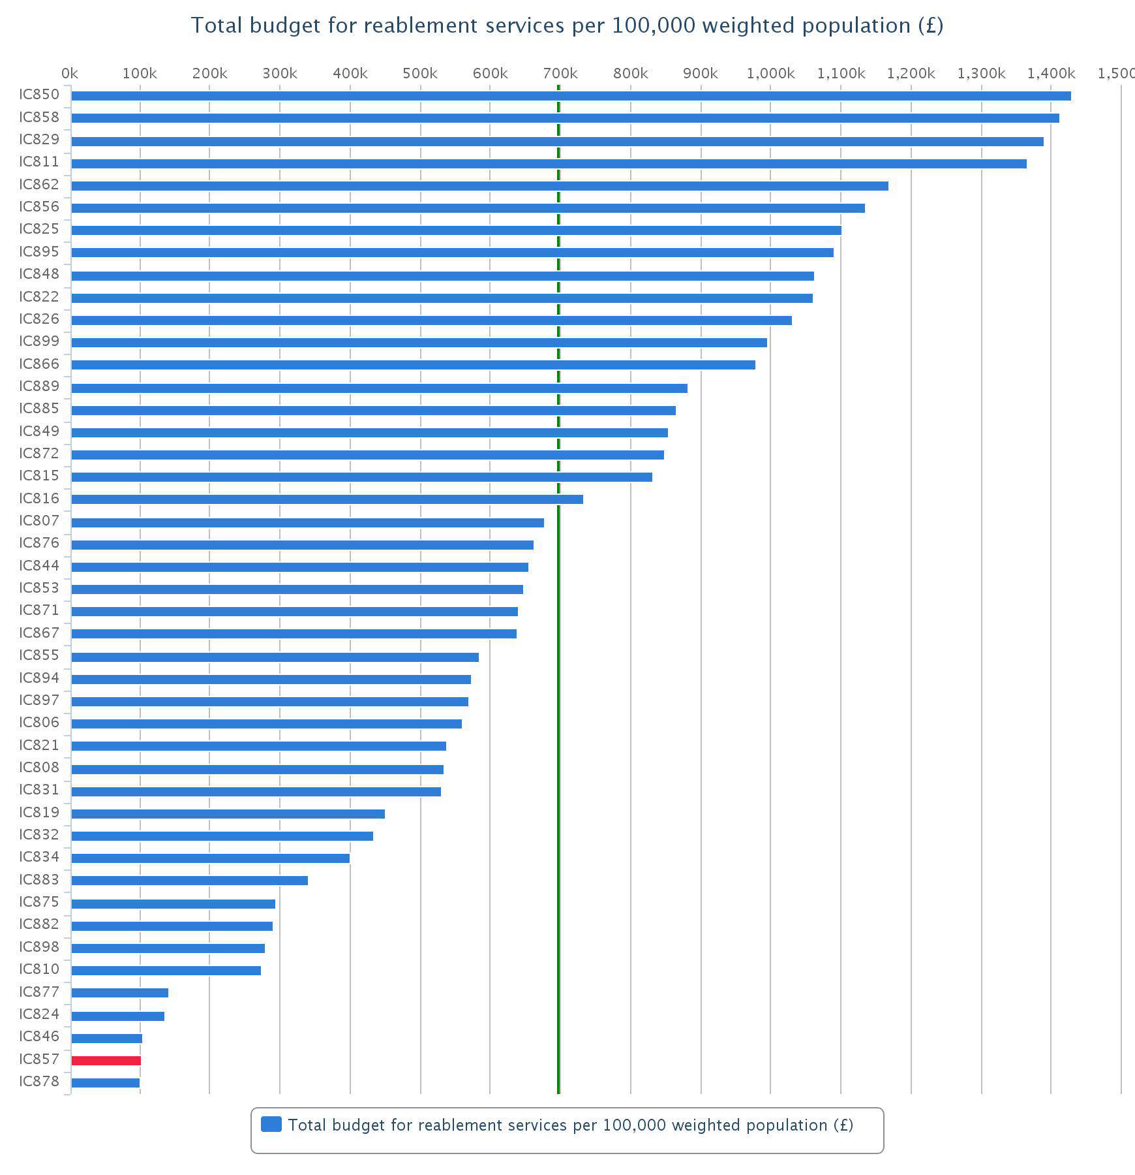

Slide 10
Now
Provider
Provider
Provider
Provider
Provider
Provider
Provider
Provider
Provider
Provider
Provider
Provider
Beds
Community services & home care
Reablement

Slide 11
What we want to get to
Prime Contractor and Provider Consortium
Beds
Reablement
Community Services

Slide 12
Procurement Process
The requirement is complex and needs development by interaction between the Council and Suppliers.
It is unlikely that traditional tender process such as the Open or Restricted procedure will allow sufficient flexibility to achieve the commisioning outcomes and service re-development required.

Slide 13
Procurement Process
Where the process is complex the Public Contracts Regulations 2015 allow for the use of the Competitive Dialogue process.
What does a competitive dialogue process look like?

Slide 14
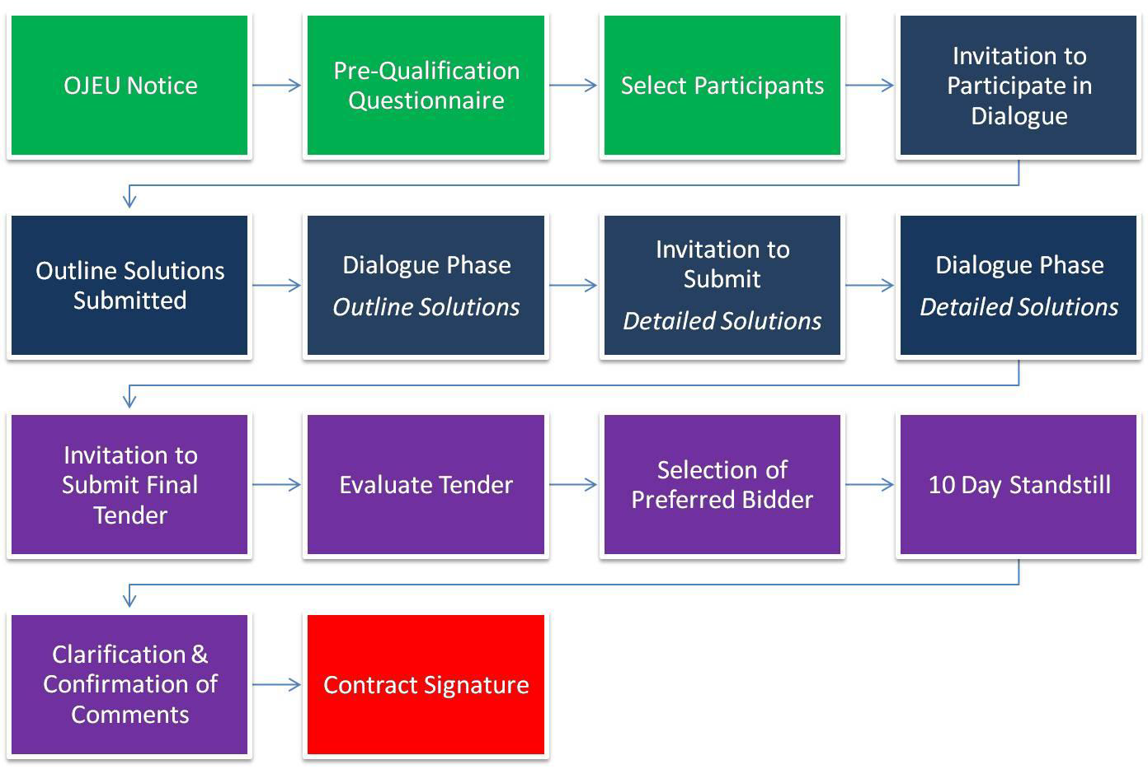
What Does a Competitive Dialogue Look Like?

Slide 15
Contract Term & Approach
Contract term is likely to be considerable to allow the development, reshaping and change required - 5 Years plus?
It is likely that a development contract approach will be taken to reflect the innovative, flexible and developmental focus required by the Council and appointed Supplier

Slide 16
Outline Timetable
Procurement Activity (Milestones) | Timeline
Market Event | 26 November 2015
OJEU Advert published | December 2015
PQQ Issued | December 2015
Competitive dialogue | February – March 2016
Invitation to Tender issued | May/June2016
Contract Award | July 2016
Mobilisation period | July-Sep 2016
Service Commencement | 30/09/2016

Slide 17
Actions
More use of Reablement services – piloting a more responsive service and developing a long term service
Develop a more responsive Community Equipment Service by April 2016
Make more use of Telecare services
Trial a Discharge Home to Assess Scheme
Work with market to change existing services

Slide 18
Group Work
What do you think will be the opportunities in delivering this service in Medway?
What do you think are the challenges in providing the service in Medway?

Slide 19
Further information
lance.douglas@medway.gov.uk
Medway Portal

