Slide 1
VCSE supplier market day
Tuesday 31 January 2017

Slide 2
Welcome and introductions
Penni Pollard – Commercial Manager
Mark Richardson – Commissioning Adviser TCA Team
Ginnie Odetayo – Researcher TCA Team
Stuart Hinde – Senior Supply Chain Specialist
Donna Peverley – Strategy and Engagement Specialist
Rebecca Patterson – FIS Team Leader
Rob Andrew – Head of Localism

Slide 3
Interventions
Ultimate goal
Outcomes
People are healthier, more capable, in control, and net contributors to their communities
Individuals are able and willing to do more for themselves and for others, within communities that are strong, thriving and self-reliant.
VCSE becomes more
asset-based, innovative,
focused on impact, prevention and early intervention
Public sector becomes more integrated, collaborative, and less fearful of change, with a more open approach to risk and reward
Community-led conversations
Rewards for people taking action
Outcomes-based commissioning
More strategic use of social value criteria
Collaborative/shared risk and reward
Cross-sector partnerships
Behaviours
Demand for services is reduced
Cornwall TCA Theory of Change
‘Focus on incentives, not risks’
‘Understand cultures and psychologies’
‘Change-ready people and processes’
Line of accountability

Slide 4
VCSE sector support engagement
1. VCSE sector support Task & Finish Group
Jul-Dec 2015
2. Independent survey of 205 VCSE orgs by Transform Research
3. Desktop research of 10 other LA VCSE approaches
6. Further VCSE stakeholder session Mar 2016
5. CEG paper by Ian Smith
Feb 2016
4. VCSE reps* Focus group: Dec 2015
7. Second CEG paper by IS
Apr 2016
8. VCSE Summit feedback April 2016
9. TCA Theory of Change co-design with VCSE reps
TCA Board discussion Nov 2016
12. Spec
re-issued Sept 2016
11. Supplier days: 25 May & 13 July
10. PIN / draft spec issued April 2016
Notes:
*Those involved Ian Smith, Peter Jefferson, Andrew Green, Richard Mckie, Oliver Baines, Emma Rowse, Pam Cole, Denbigh Cowley, Dave Hocking and DP as Facilitator

Slide 5
Key features and delivery of services

Slide 6
Time credits
Ginnie Odetayo
Researcher
TCA

Slide 7
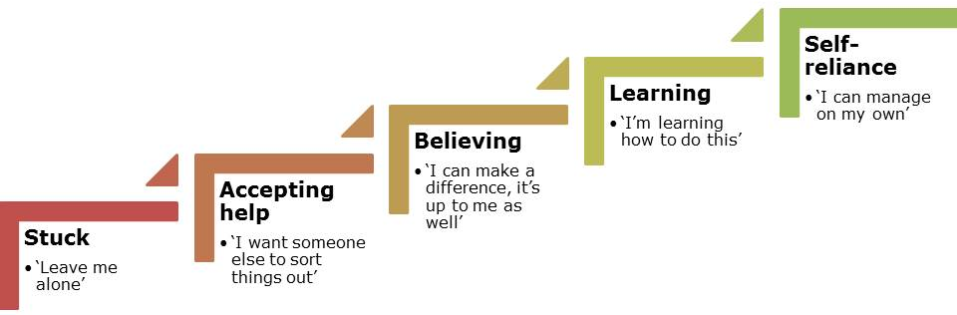
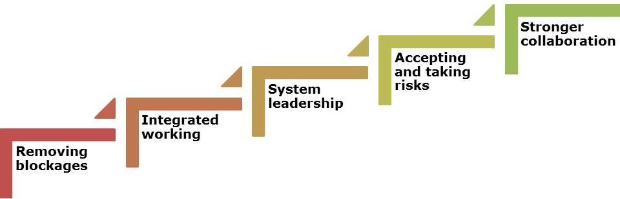
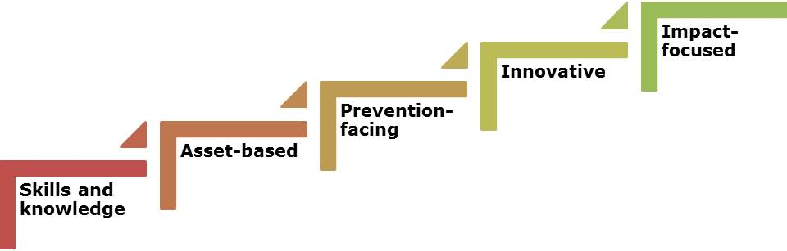
Empowering and mobilising people, communities and organisations for good
People
Public services
VCSE

Slide 8
Time credit overview
Time banking / time credits
Broadening the concept of ‘volunteering’, recognising the value in a spectrum of activity and contributions.
Based around ‘host’ organisation and ‘earn’ partners.
Non-subsidised spend network
Tool for change: asset-based approaches, co-production, culture shift.

Slide 9
Host organisations, spend partners, growth
Training
Theatre
Sport
School
Health & wellbeing
Family Outing
Time Credit Lead
Commissioner
Service Lead
Cinema
Supported Living
Day care Service
Music
DAT Provider
Events
Community
Sport

Slide 10
Components
Embedded co-ordinator: working with service lead and commissioned services (cohorts to be confirmed, progressive service outlook, capacity and will to try = crucial for first iteration).
External Development Partner: knowledge transfer, co-production and asset based training, spend network delivery, change management expertise, planning for exit.

Slide 11
Deliverables and outcomes
Set up and embedding of a time credit system within Council Commissioned services currently supporting vulnerable people.
Developing a non-subsidised spend network.
Bridging the gap between services and community activity.
People – skills and contributions valued and developed. Meaningful activity and purpose enhances prevention.
Public services – integrated working, taking risks, stronger collaboration, co-design. Prevention = cost reduction.
VSCE – commissioned services, asset-based approaches, co-design, spin-off community-led activity.
People – become ‘net contributors’ through spend network.

Slide 12
Money and timing
Two years plus option to extend for a third year – 100k per year.

Slide 13
Routes to market
Penni Pollard – Commercial Manager

Slide 14
Headline Procurement Timeline
Finalise Specifications, evaluation frameworks and performance indicators:
  Investment and Commercial Board: 7th Feb
TCA Board: 16th Feb
Launch tender opportunities: Late February/Early March
Submission Deadlines for Bids: Mid April
Supplier Presentations: Late April
Evaluation of bids for the 3 lots: Early May
Contract award and Standstill Period: Mid – Late May
Contract commencement - June
Notes:
Those involved Ian Smith, Peter Jefferson, Andrew Green, Richard Mckie, Oliver Baines, Emma Rowse, Pam Cole, Denbigh Cowley, Dave Hocking and DP as Facilitator

Slide 15
NEPRO – Procurement of Consultancy
Neutral Vendor solution for procurement of consultancy and professional services
Mandated as first choice option for procurement of consultancy across the Council
Likely to be used for procurement of Time Banking piece
Terms and Conditions (insurance levels etc.) varied for each commission according to risk

Slide 16
NEPRO – Procurement of Consultancy
How it works:
Online system for running mini competition
We choose shortlist or ask NEPRO to suggest suppliers
We score, contract with NEPRO who back to back with supplier
Payment against milestones
What to do:
Visit NEPRO website and start registration process
For assistance from the Council contact NEPRO@cornwall.gov.uk

Slide 17
Workshop Session

Slide 18
Outcomes
How do we measure success?

