Slide 1

Right Care Right Place
Purchasing Model

Slide 2
Scope of presentation
This presentation considers how costs are calculated within an outcome base service with each service user having their own individual personal budget and maximise the use of service user’s income to pay for day-to-day living costs.

Slide 3
Outcome Base Commissioning
Adult services undertake a holistic assessment to determine the persons eligible needs and the outcome;
Service user, provider and social care staff agree clear personal outcomes to be achieved within a specified timescale and at an agreed cost in a support plan;
Resource Allocation System (RAS) is used to ensure consistency across the service;
The provider designs a care plan to meet the outcomes specified in the support plan . The local authority staff agree the plan:
At the end of the agreed timescale the service user, provider and council staff member undertake a review of whether outcomes were achieved;
A new support plan is then agree for the next period with clear maintenance outcomes and cost.

Slide 4
Resource Allocation System
System is based upon:-
10 Care Act domains
For each domain the following are assessed:-
Is this an eligible need for social care support?
Is this need already being met?
Level of need
Indicative Cost Range

Slide 5
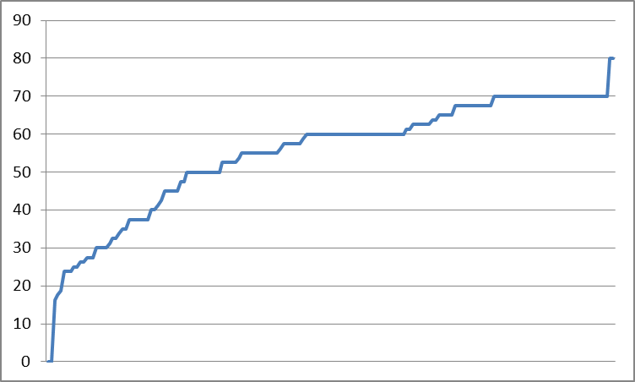
Resource Allocation System

Slide 6
Phase 1
New tenders commence in 2015/16 and run to 2020/21
Based upon core and flexi
Intention not to change these services

Slide 7
Care Drivers
Care Act
Individualised Personnel Budget based upon:-
An assessment of needs;
An agreed set of outcomes;
Taking account of the setting in which the services are delivered.
Allocation of Personnel Budget
Percentage retained for a managed service based upon clear justification.
Changes in Care
How are changes in care addressed.

Slide 8
Cost Drivers
1:1 Care
Background staff
Night staff
Property costs
Costs that should be met from Service Users
Council Issue
How we take the Purchasing Model back into the Resource Allocation System

Slide 9
Day-to-day Living Costs
Funding and charging models is different for Float Support and Supported Living than Residential Care. With the former the cost of day-to-day living cost should be meet by the Service User unless their income (including benefit) could not fund. The latter the service user contribution is based upon all income with the exception of a personnel allowance is collected.
Need to ensure purchasing model reflects this.

Slide 10
Floating Support
Definition – No permanent on site staff, support is provided at times agreed between the Service User and Service Provider.
Analysis of Current Service
Number of schemes – 5 schemes
Number of Service Users – 20 (including 1 CCG)
Level of Support – Low 6, Medium 8, High 5

Slide 11
Supported Living
Definition – Individual Service Users have their own tenancy/licence and are responsible for meeting all rent and service charges. In period where 1:1 care is not provided background staff are available. A level of night cover is provided.
Analysis of Current Service
Number of schemes – 6 schemes
Number of Service Users – 31 (including 1 CCG)
Level of Support – Low 6, Medium 13, 11 High

Slide 12
Residential
Definition – Individual Service Users require a residential setting as a more controlled setting or a higher level of care is required.
Analysis of Current Service
Number of schemes – 13 schemes
Number of Service Users – 60 (including 9 CCG and other LA)
Level of Support – Low 11, Medium 18, High 22

Slide 13
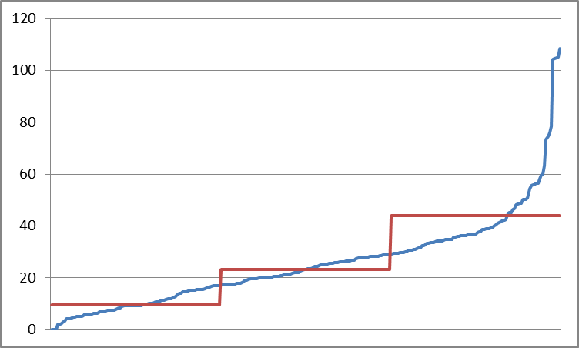
1:1 Care

Slide 14
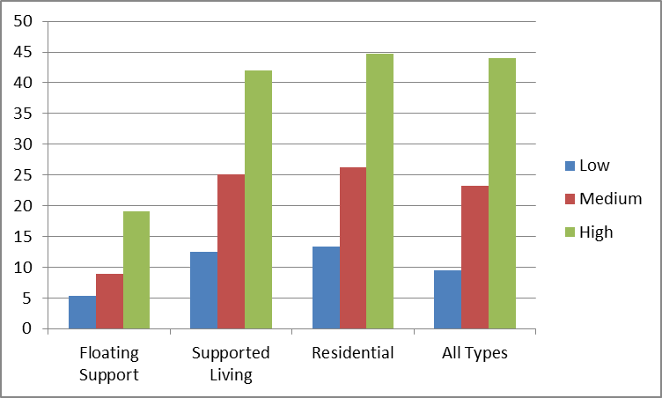
1:1 Care by Type

Slide 15
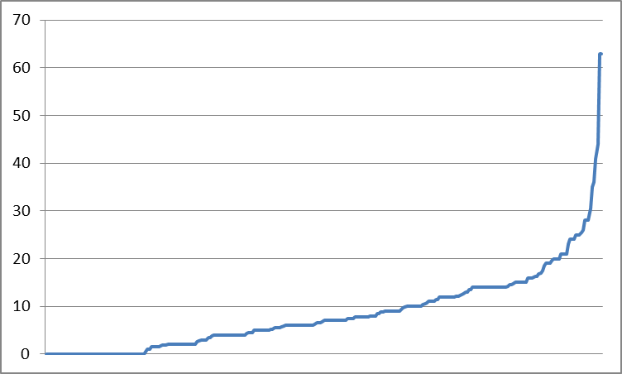
Community Activities

Slide 16
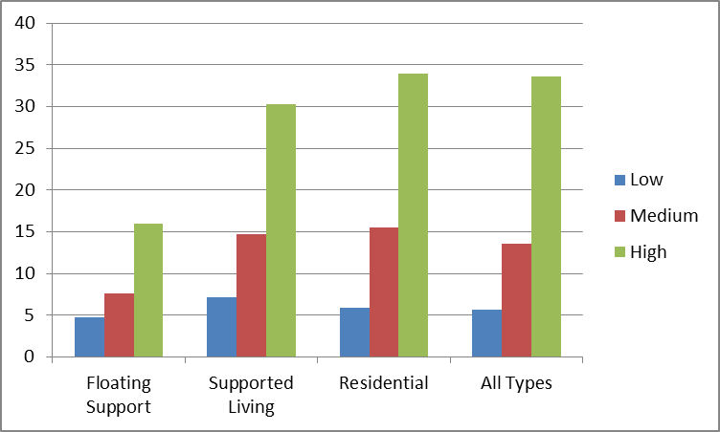
Variations

Slide 17
Background Staff
Definition – care staff providing direct care to Services Users not allocated to 1:1 care – excludes back office functions, shift overlaps, training and supervision, regional costs etc – allowance for these items will be included in cost calculations.
Allowance needs to take account:-
Size of scheme
General care level
Background Information
Staff Rota

Slide 18
Night Care
Level of night care varies
Benchmark
Float Support – none;
Supported Living – 1 sleep in night;
Residential – 1 waking night
Additional provision - examples
Demonstrate technology has been fully utilised;
Turning service users at night;
Incontinent management
Provision above agreed base – extra over payment automatically ceasing when no longer required.

Slide 19
Property Costs and Service Charges
Property costs and service charges vary with type of scheme and form of occupancy agreement.
Currently obtaining information from landlords.
Voids management and costs

Slide 20
Indicative Cost Components
 | Low | Medium | High
1:1 Care
Background
Night Care
Property Costs
Total Indicative budget

Slide 21
Care Variation (including Care Voids)
Permitted variations
Changes in RAS score by 10%;
Changes in outcomes;
Occupancy changes (voids)

Slide 22
Issues

Slide 23
Task for discussion group

