Slide 1
Holiday Activity and Food Programme 2021 Background information
Appendix 1.
Notes:
Anju
Thank you inviting Sharan and I, from Organisational Development, to talk about employee health and wellbeing. It’s true to say the health and wellbeing of BCC employees has been tested since the pandemic from March 2020 to today. Here are some of the examples that staff have shared in the health and wellbeing survey and through discussions with us.
I feel increased stress and anxiety from the fear of the unknown and catching the virus, who can I talk to?
If schools close, how am I supposed to work and care for my child?
I have caring responsibilities to my elderly parents, what happens if I am ill?
How financially stable are we if my partner is made redundant?
I am living alone and feel isolated, I really need someone to talk to?
I am struggling with the loss of my parent, I need bereavement support.
My manager is busy, and I am unsure of what is happening in my team because we do not communicate often?
I feel unsafe from working at home and being around my partner all the time.
Health and wellbeing is not a one size fits all, and many staff are feeling the benefits of working from home as well as riding the highs and lows that each day brings.
Today, Sharan and I will speak about the health and wellbeing survey results, sickness absence data, workforce plans, how yourselves as management teams can drive employee health and wellbeing, and how we can support Neighbourhoods management team to support employee’s health and wellbeing. ​
We are happy for questions as we go along, and we’ll ask a few as well, so please unmute and speak rather than putting your hand up.

Slide 2
Content | Slide
Census data | 3
Target Groups and localities | 4
HAF Summer 2021 Sufficiency/ Capacity across localities | 5- 6
Easter HAF 2021 | 7
Achievements of 2021 Summer | 8
Achievements of 2021 Winter | 9
Independent evaluation summary | 10- 13
Lessons Learnt from 2021 | 14
Challenges | 16

Slide 3
Census data
Birmingham is a growing city:
Between the census years of 2001 and 2011 the city’s population grew by 96,000 (9%) to 1,074,300.
The most recent population estimation (2019) shows an increase to 1,141,800 which is an increase of 91,700 (8.7%) since 2009.
Birmingham has a youthful age profile with 46% of its residents under 30 compared to the national average of 37%.
The most recent Joint Strategic Needs Assessment (JSNA) (2018) shows that Birmingham has more families and children in poverty than the national level however this is not shared equality across the city.

Slide 4
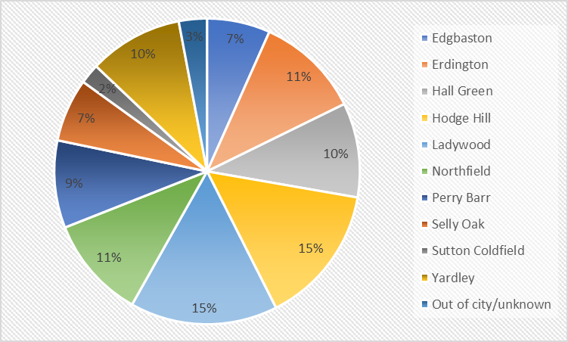
Target Groups and localities
At the end of 2020, approximately 62,000 children were eligible for free school meals; this increased to 74,443 by September 2021.
The pie chart opposite shows that the level of FSM eligibility is evenly distributed across the city, with the highest prevalence of FSM in Ladywood, Hodge Hill, Northfield and Erdington respectively.

Slide 5
HAF Summer 2021 Sufficiency/ Capacity across localities
 | Summer CYP Target | Summer CYP Actual
No. CYP | 18,299 | 32,240
Food Provision (No.) | 207,455 | 365,504

Slide 6
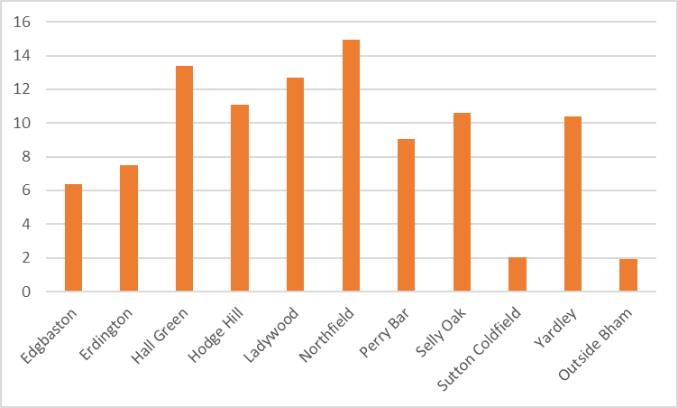
HAF Summer 2021 Sufficiency/ Capacity across localities
This chart shows that the level of attendance was evenly distributed across the city, with Ladywood, Northfield and Hall Green representing the highest proportion of attendances.
Erdington which had the 4th highest prevalence of FSM only represented 6% of the attendances.
Percentage of FSM attendance for each locality (sample size 10,360)

Slide 7
Previous HAF delivery- Easter HAF 2021
At Easter HAF activities mainly took place online due to the ongoing Covid 19 pandemic. The programme provided enrichment activities families could do at home.

Slide 8
Previous HAF delivery- Achievements of 2021 summer
Activities
Activities took place face to face with some Covid 19 restrictions in place around social distancing
243 Activity Providers delivered holiday clubs
32,000 children attended: 60% were on free school meals
477 holiday club leaders were trained on the programme
Food
Over 365,000 meals were served
70% of the meals was provided by activity providers
30% of were from the central supply which was made up of a commercial supplier and local community food suppliers

Slide 9
Previous HAF delivery- Achievements of 2021 Winter
Activities
Christmas activities took place face to face.
189 activity providers having delivered holiday clubs
15,252 young people attended: 72% were on FSM and 12% were classified as vulnerable
Over 100 holiday club leaders were trained on the programme.
Food
Over 30,500 meals were served
80% of the meals was provided by activity providers
20% of which came from the central supply of food

Slide 10
Independent evaluation findings
The Healthy Living Lab within Northumbria University was commissioned to identify benefits of the HAF programme delivered in Birmingham in the summer of 2021.
The following points are some of the key findings from the report.
The full report is available upon request.
The programme’s offer of enrichment and cultural activities were excellent overall.
Children attending for at least 4 days each week were more likely to engage in 60 minutes of moderate to vigorous physical activity across the summer holiday.

Slide 11
Independent evaluation findings on food
HAF programme needs to work towards ensuring all food adheres to School Food Standards.
Holiday club leader rated in-house food provision better than meals provided centrally.
Food wastage was low throughout the programme.
Access to food education and young people physically getting involved with preparing food on the programme needs to be improved. Where nutritional education was delivered, children reported high levels of enjoyment and learning.
Household food security was significantly better for households with children attending the programme compared to non-attendees.

Slide 12
Independent Evaluation:- Parent Feedback
Parents reported significantly less stress if young people attended activities.
80% parents perceived their children to be safer whilst attending the programme.
74% of parents thought that the HAF programme kept children from participating in anti-social behaviour.
76% thought that the HAF programme clubs supported children’s wellbeing and confidence.
63% felt the programme supported school readiness.
Overall parental satisfaction was high with 95% of parents reporting that they were very likely to send their children to the HAF programme in the future.

Slide 13
Independent Evaluation:- Parent Feedback
They [holiday clubs] have been fantastic. Haven't they? They are going to Bear Grylls tomorrow. So, yeah, cinemas...they've been to cinemas. They've been to skating, bowling’.
One of mine was having a bit of an issue and he [staff member] and he just took him under his wing and straight away he became confident, and you know they've been fine’.
‘We’ve got somewhere else to go, like that fact that it’s a ten minute walk from my house, I'm very grateful cos it’s something he can do, cos we're in a tower block, it’s more isolating, we don’t have a back garden, if it’s raining I can’t go to the park, so a centre's perfect for him an myself you know’.
‘It just makes you feel comfortable... to leave your child, you don't have to worry. You really don't, and that's what you want as a parent... for your children to be happy’.

Slide 14
Lessons Learnt from 2021
Overall lessons learnt:
To give providers more time to mobilise
To improve engagement with schools
To improve signposting to local support agencies
To use more volunteers
To increase provision in Erdington
Better targeting of children on FSM
To seek more match funding opportunities

Slide 15
Lessons Learnt from 2021
Food: It is noted that the food element of the programme needs to be developed further to include:
Engaging young people in interactive food activities
Nutritional advice
Parent food engagement
Meeting School Food Standards and food safety requirements
Develop the central food supply to including hot meals and breakfasts
Activities:
Clearer benchmarking on cost per head per day
Increasing engagement and provision for secondary age young people

Slide 16
Challenges
We have had a reduction in funding from £8.7m in 2021 to £8m in 2022.
Number of children in receipt of FSM increased from 60,000 in January 2021 to 74,000 by Autumn 2021 and sits at 70,000 currently as of January 2002 and continues to fluctuate due to the impacts of the COVID19 pandemic.
The funding now includes all young people in reception who are in receipt of benefit related FSM.
Developing the offer further for young people with special educational needs and disabilities.
HAF activities are for a minimum of 4 hours a day, 4 days per week, which may create challenges for working parents.
Developing hot food within the central supply for delivery across Birmingham.
Developing volunteering within the programme.
Seeking match-funding opportunities to the increase the scope and reach of the programme.
Ofsted registration of activity providers.
Ensuring all kitchens are registered with Environmental Health.

