Slide 1
Connected Train and Customer Communications: Development of Rail and Digital Industry Roadmap
T1138-02
Supplier Engagement Meeting

Slide 2
Meeting with Suppliers
Agenda
  Welcome and Introduction
  ITT T1138-02 scope presentation
  Supporting statements from the Project Steering Group
  Q&A

Slide 3
Background: Rail Communication Scenarios
High reliability
Low throughput
GSM-R – a single technology that serves ETCS data and voice call
GSM-R predicted obsolescence by 2030
A successor needed by 2025 (5 years migration)
  Shift2Rail - Adaptable communication system
  Future Rail Mobile Communication System – leading to 3GPP standard
Safety critical operational communication
Control
Positioning
(Operator, Emergency) Voice call
Safety related operational communication
A large set of (non) safety related services identified for railway operations
Many monitoring and maintenance operations are being automated
Real-time information to improve the operations
Monitoring
Non-safety related operational communication
Maintenance
Customer communication
Commercial cellular networks
Poor cellular QoS inside trains
Better broadband service for passengers/customers will lead to better economic productivity
Passenger broadband
Low reliability
High throughput

Slide 4

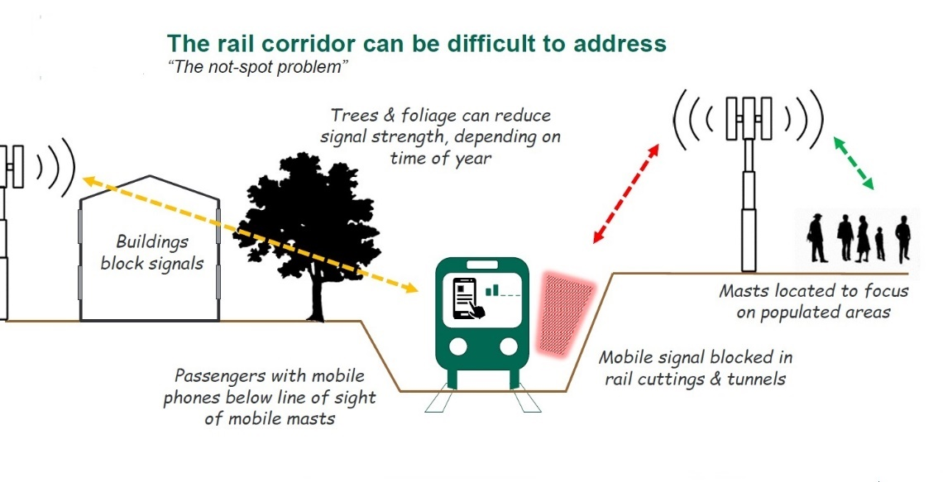
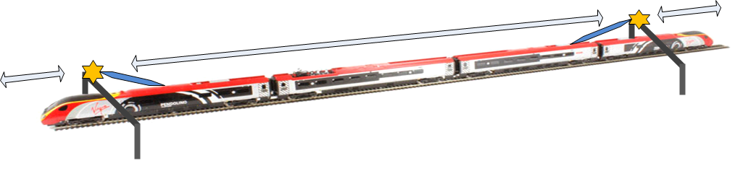

Background: Internet Connectivity on Rail Routes
Network Rail
Telecom Network
Railway Operational Communications
(e.g. movement authority,
train positioning, etc.)
(FTNx) Backbone
Passenger
Communication
Passenger
Communication
Commercial Mobile Networks
(2G/3G/4G/Wireless Mesh)
Source: Department for Transport
UK railway moves 4.5m people every day – growing at 4% /yr
More trains, high speed up to 400 kmph by 2030
1200 – 1500 passengers on a 12 coach train (mobile village!)
=> more than 10Gbps per train needed by 2030
18,500 km of fibre cabling along the tracks in the UK
Autonomous train operations
=> Massive safety critical communication
Poor internet connectivity / mobile coverage on GB rail routes
Lack of commercial models / incentives: ROI models? who owns? who runs?
Short franchise periods, limited competition between franchisees, and unclear passenger revenue opportunities

Slide 5
Background: Related Activities / Reports
NIC’s Connected Future report - one of the key recommendations is to improve internet connectivity on road and rail routes (plan on how to deliver this by end of 2017)
Shift2Rail TD2.1 Adaptable communication systems for railways – allowing smooth migration from GSM-R to a new technology for ETCS communication (Requirements specification available September 2017)
DfT’s survey of passenger requirements
Committed DfT Policy to deliver free Wi-Fi to majority of travelling passengers and trains by December 2018.
Transport Select Committee’s recommendations to DfT, Network Rail and RDG to work collaboratively to produce a strategic plan for the implementation of extensive and reliable Wi-Fi across the rail network (October 2016)
RDG’s ‘Customer Journey’ and ‘Customer of the Future’ development
RSSB’s research report T964 - Operational communications: Rail mobile communications requirements and its related previous work such as T817, T911 and T809
UIC’s Future Rail Mobile Communication System (FRMCS) project to prepare the necessary steps towards the introduction of a successor to GSM-R
3GPP’s study item on Future Rail Mobile Communication System (for Release 15)

Slide 6
T1138 – 02 Connected Train and Customer Communication- Development of Rail and Digital Industry Roadmap
A sprint activity for developing a limited (short-to-medium term) rail and digital industry roadmap towards improving internet connectivity across GB rail routes
Aim to identify/review and report GB rail communication scenarios (demands, requirements and barriers) and existing and (immediately) emerging technology landscape for current and projected 3-5 years deployment time, supported with the identification of innovative business models and opportunities that stimulate future investments
Output will clearly frame the commercial and technical options available for review and further development, to inform the rail and digital industries, and the Government, of potential investment opportunities to improve internet connectivity across the rail network
Funding £20-25k
Invitation to Tender available on:
https://www.contractsfinder.service.gov.uk/Notice/8fd44b3b-c43f-49c2-bb08-f3c3cf301d37
Tender closing date 25 August 2017
Estimated award notification date w/c 4 September 2017
Tentative project start date 11 September 2017

Slide 7
Methodology
A desk based requirements and technology landscape review
Scenarios description and validation through industry workshops
Interviews with key stakeholders to capture approaches and challenges pertinent to the commercial and technical options
Identification of innovative business models
Development of commercial and technical options (and questions) suitable/relevant for current and projected 3-5 years deployment for review and further development
Final report, research in brief and presentation of the findings

Slide 8
Deliverables (1 of 2)
Connected train and customer communications – Short-medium term industry roadmap & Business models - Report
  Overview of GB connected train and customer communications requirements: GB rail communication scenarios, demands and barriers
  Review of current and emerging technologies (including cost trends) suitable for current and projected 3-5 years deployment
  Review of related national and international developments, including lessons learnt.
  Short-medium roadmap and guidance for different deployment scenarios
  Identification of innovative business models that enable new business opportunities, facilitate best possible collaboration between the rail and digital industries and stimulate investments for delivering
The final report will be endorsed by the project steering group and FC&PS AG, and published by RSSB. The supplier must produce the above report in such a way that enables RSSB to publish as soon as the contract is complete

Slide 9
Deliverables (2 of 2)
Short-medium term industry roadmap & Business models – Presentation
Dissemination material for Campaign
  Dissemination material should include key project outcomes, presented in a way that can be used as part of an influencing campaign to stimulate interest among key stakeholders, stimulate interest and investment opportunities for further development work to improve internet connectivity across the rail network
Research in brief
  Summary of the key findings of the work

Slide 10
Support Available
Project Steering Group (with members from RDG, Network Rail, RSSB and techUK)
  Provide practicable assistance on identifying and connecting with key stakeholders for workshops and interviews
  Review and ensure the project delivers to industry needs
techUK’s Future Connected Train and Passenger Stakeholder Working Group
  Create a collaborative atmosphere between rail and digital sectors, to bring about the momentum for improving internet connectivity on GB rail routes
  Support the consultant on identifying industry needs and challenges
RSSB - will host and help facilitate 2 industry workshops. Tentative dates with rooms booked include 02/10/2017, 09/10/2017 and 24/11/2017.

Slide 11
Supporting statements from Industry
Rail Delivery Group – Nick Wilson
techUK – Raj Sivalingam

Slide 12
Q & A?
Do you have any questions regarding the level of detail expected from the deliverables as described in the specification?
Does the timescale for delivery (prior to Christmas 2017 for the final version) achievable? What support would be needed to achieve this timeframe?
Is the proposed budget of £25,000 suitable for this project?

Slide 13
Thank you

