Slide 1
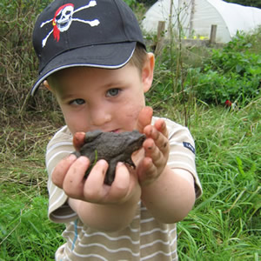
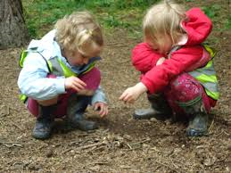
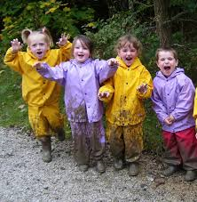
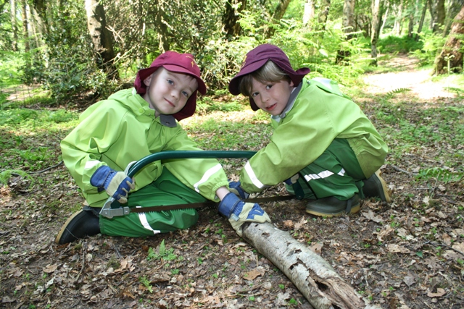

Forest School
Faculty of Education and Sport
Teacher Education

Slide 2


Slide 3
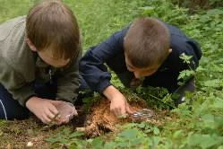
Forest School ethos
Forest school believes in a child's right:
to play
to access the outdoors
to access risk and the vibrant reality of the natural world
to experience a healthy range of emotions, through all the challenges of social interaction
to build a resilience that will enable continued and creative engagement with their peers and their potential.

Slide 4
UoB Forest School
Aims:
To promote, engage in and foster a love of learning through environmental and sustainable resources.
Develop a sustainable relationship between the learner and the outside world.
Promote research opportunities by engaging learners in outdoor education.

Slide 5
Contribution to teaching and learning
Develop external areas into a unique and exciting learning resource accessible to trainees on all Teacher Education programmes.
Develop provision for Early Years Education.
Promote learning through play and the environment.
Develop confidence and self-esteem in all learners.
Promote partnership through conferences, staff development and accredited forest school qualifications.

Slide 6
Partnership
Forest School
Children’s workshops
Staff development
Contributing to student experience
Engaging the community
Research Environmental Education and Alternative Curricula
Engagement of children with Special Needs and Disabilities

Slide 7
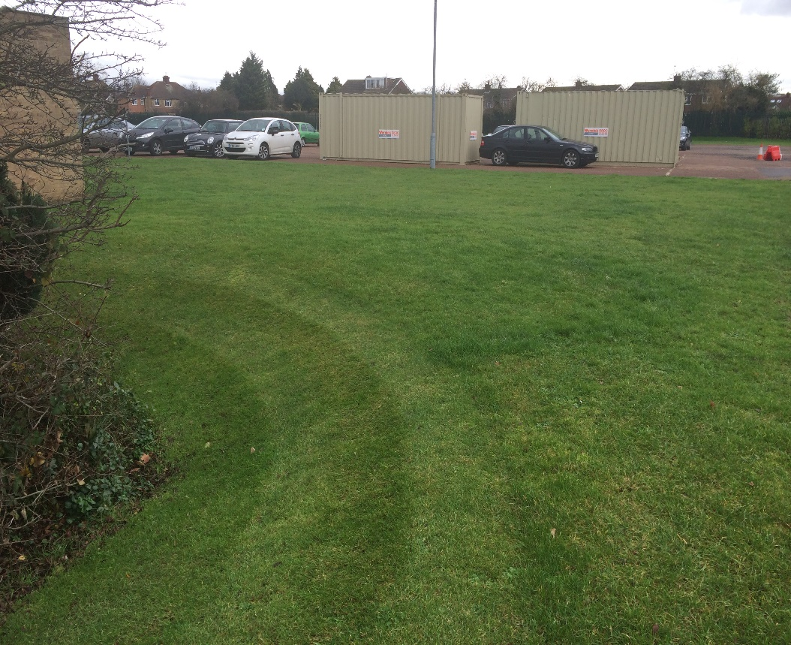
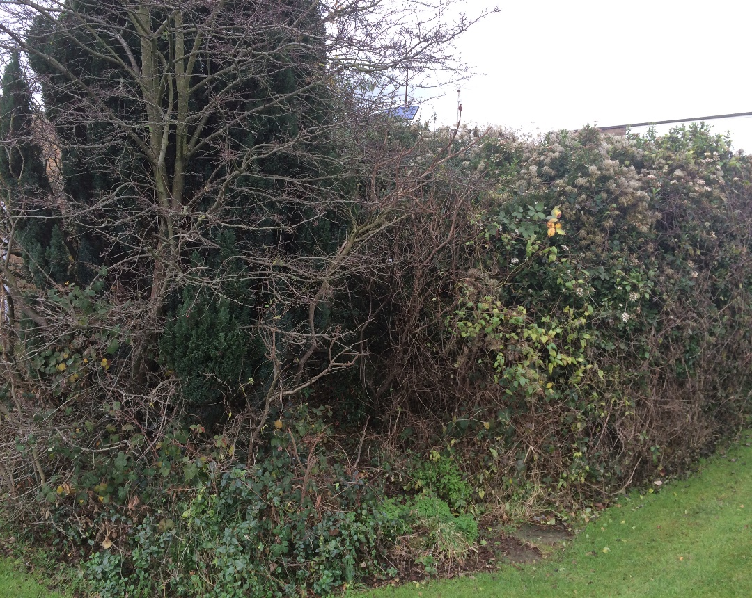
Proposed location

Slide 8
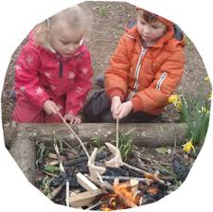
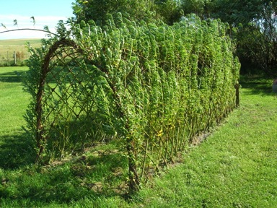
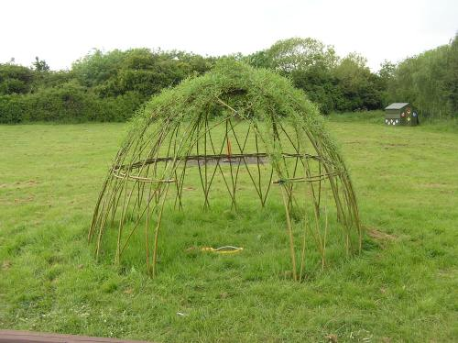
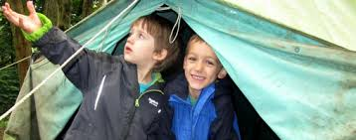
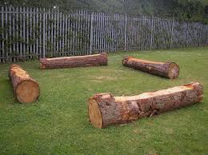
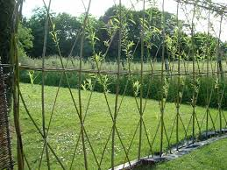

Structures

Slide 9
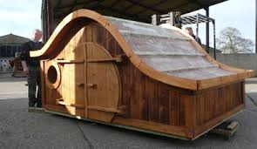
Shelter

