Slide 1
North Northants Family Hubs
Volunteer Academy
Market Engagement Session

Slide 2
Agenda
Agenda item | Description | Lead | Time
Introductions |  | Sorayah | 10.00AM
Setting the scene |  | Sorayah | 10.05AM
Volunteer Support Service Model | Volunteer recruitment, development and retention Lived experience/ peer support | Sorayah | 10.20AM
Support for North Northants organisations | Promoting volunteering opportunities Encouraging good volunteer management practice. | Sorayah and SCW | 10.40AM
Sustainability | Identify opportunities to support sustainability | Sorayah | 11.00AM
AOB |  |  | 11.30AM

Slide 3
Aims of the session
For North Northants Family Hub to share its vision of a future service delivery model and to seek feedback from stakeholders
To plan towards any potential forthcoming procurement arrangements
To build on existing expertise and ensure the best use of the funding resources.
To work in partnership to maximise outcomes through innovative service design
To ensure that we design services that will promote good outcomes for children and families

Slide 4
Background Information
In August 2022, the Government published the Family Hubs and Start for Life programme guide for the 75 local authority areas funded in 2022-25, to establish their Family Hubs and Start for Life Offer
In February 2023 North Northants was identified as one of the LA's to receive funding over a 3- year period to develop Family Hubs.
The DFE accepted the Delivery plan to secure the funding as a result of a series of intensive engagement workshops with over 50 stakeholders and partners
This is a transformation programme providing an opportunity to pilot and transform systems across the piece to ensure families receive the right help at the right time, integrate in the wider community and that children get the very best start in life to help them thrive and achieve to the best of their abilities
The guidance document provided by the DfE outlines how funding is to be spent and monthly meetings are held with the DfE to ensure the project is on track

Slide 5
National Context
The National Centre for Family Hubs was launched in May 2021, led by the Anna Freud Centre and funded by the DfE, to support the upscaling of Family Hubs nationally.
The Early Years Healthy Development Review Report - The Best Start for Life, led by Dame Andrea Leadsom MP, champions Family Hubs as a place where families can access support in the early years of their child’s life, through the delivery of a specific Start for Life offer, incorporating access to Maternity and Health services, alongside support for parenting and reducing parental conflict.
The Government has published the Family Hub Framework which sets out expectations for service delivery under three delivery areas of access, connection and relationships, to which multiple key success criteria are aligned.
Emphasis on services for families with children aged 0-19 (and up to 25 for SEND) requires local authorities to evolve services from the children’s centre offer focussed on babies, young children and their families, to deliver an integrated service that supports the whole family.

Slide 6
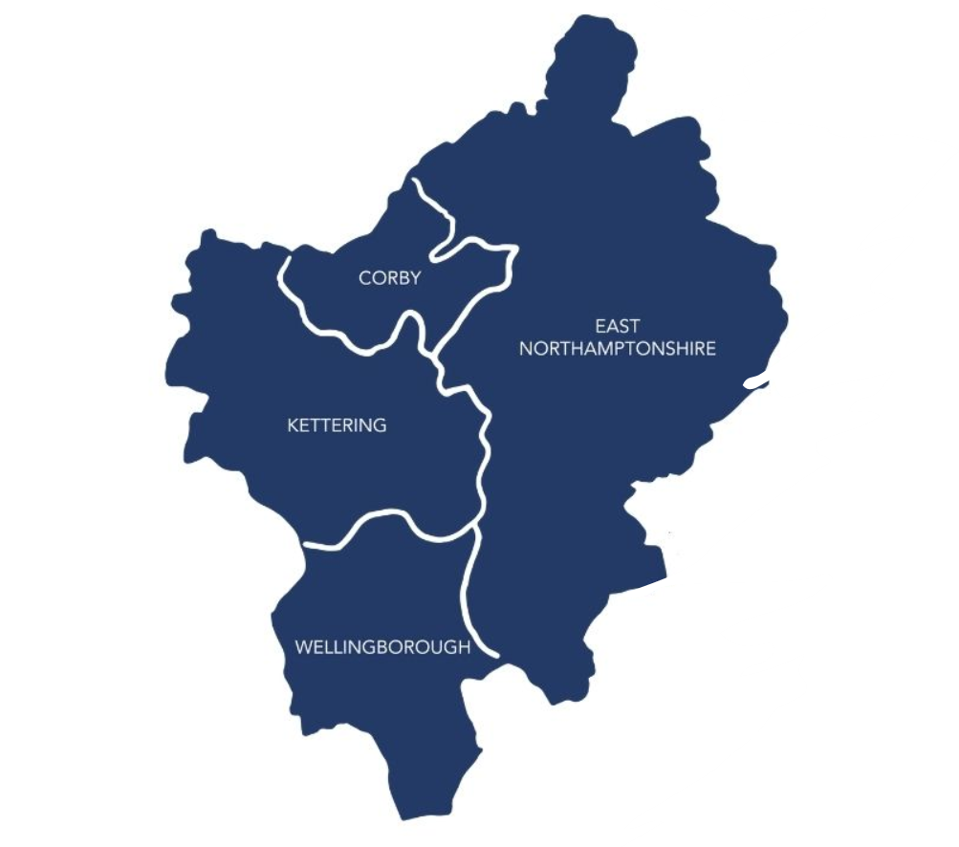
Local Context
An estimated 15,677 under-5s are living in North Northants
3722 babies were born in 2021 in North Northants
6340 (40.5%) under-5s are living in the 0-30% most deprived LSOAs nationally
An estimated 87,010 0-19s are living in North Northants
The development of the Integrated Hub, spoke and virtual offers to children, young people 0-19 (25) and their families will be developed following the locality models adopted by PLACE, education and many other agencies.
In NNC we will aim to develop Family Hub networks in each locality with the start for life offer delivered from one of the main Children's Centre Buildings where possible

Slide 7
What are Family Hub networks?
Family Hub networks are one-stop shops where families can access important services. Hubs deliver services from buildings, community activities and outreach services for parents, carers and families from conception through a child’s early years until they reach the age of 19 (or 25 for young people with special educational needs and disabilities).
The four localities will be:
Family Hubs will enable families to access a range of help including support for physical and mental health, parenting, housing and debt advice and guidance, domestic abuse support, as well as services run by partners and voluntary sector groups but at the heart of Family Hubs are services that give babies a great start in life.
This can include parenting support and infant feeding advice and mental health advice for new parents in the weeks immediately before and after birth and support for parents to build strong relationships with their babies.
Children's Centres across the NNC may be transformed to be part of the Family Hub networks being developed, with expanded and extended services in the community.
Wellingborough
Corby
East Northants
Kettering

Slide 8
What does good volunteer support look like to your organisations?

Slide 9
We are currently reviewing our existing peer support models to improve the integration of peer support
What does peer support look like to you?
Peer Support Models deep-dive

Slide 10
Our commitment to grow and develop peer support networks
We understand that Peer support and community outreach are effective interventions in supporting new parents and signposting to more targeted interventions
We understand that Peer support is an effective intervention in supporting parents with mild mental health difficulties. Peer supporters can provide one and/or group support for parents experiencing mild challenges, such as anxiety or low mood, or parent–infant relationship difficulties.
A good quality peer support programme can provide one-to-one and/or tailored group support for a diverse range of parents and carers (e.g., fathers, families with SEND, LGBTQI+ families and those from culturally diverse backgrounds).
We are keen to develop or expand peer support services with regular high-quality training and clear supervision structures in place

Slide 11
Volunteer Support
Service Model

Slide 12
Volunteer Support Service Model
The Family Hubs Volunteer Academy will aim to create a structured and supportive environment for individuals to develop skills, gain knowledge, and contribute meaningfully to their communities through volunteering.
The Provider will play a key role in supporting people interested in volunteering to access local volunteer opportunities across the Family Hub Network, including the delivery of awareness-raising workshops and training and development sessions on communication skills, project management, teamwork, cultural sensitivity, and specific skills relevant to the Family Hubs Volunteering tasks, e.g., parenting support, PNMH (perinatal mental health), and PIR (parent-infant relationship support) and HLE (home learning environments).
Accessible information will enable everyone to understand what support is available and where it can be accessed, including less engaged groups such as traveller communities or groups where language is a barrier.
Volunteers feel they are empowered to have a voice in the services they are working in methods to contributing
This new service will create pathways to support people in taking the first steps to explore different health and social care career opportunities.

Slide 13
Support for North Northants
Organisations

Slide 14
The successful provider will need to support organisations across North Northants to promote their volunteering opportunities and encourage good volunteer management practice.
Provide a Volunteer Charter and review kit, this includes a checklist of policies and procedures to check if you are ‘Volunteer-ready.
Review volunteer opportunities across North Northants to ensure they are appropriate and suitable for voluntary roles.
Upload and share volunteer opportunities to an online database so that opportunities can be viewed by a wide-audience.
Monitor volunteer data across the area – this is vital so that we can help create a picture, both locally and at national level of volunteer contribution.
Preparing the employed workforce to work with the voluntary workforce to address culture and behaviours that may prevent them from utilising volunteering to deliver services.

Slide 15
Hours Volunteered | Track the number of hours volunteers contribute to show the level of involvement and dedication across services.
Impact on the Community | Evaluate the tangible impact of volunteer efforts on the community. number of people served. resources provided. Positive changes achieved
Skill Development | Measure the skills volunteers acquired or improve through their volunteer work e.g. technical skills, communication skills, leadership skills, and more.
Personal Growth and Self-Esteem | Determine whether volunteers experience personal growth, increased self-esteem, and a sense of accomplishment from their
Social Connections and Networks | Evaluate whether volunteers build new social connections, networks, and friendships within organisations and communities.
Retention and Satisfaction | Measure volunteer satisfaction Measure volunteer's retention/intention to continue volunteering
Training and Learning | Measure volunteers receiving training and opportunities for learning. Evaluate the perceived effectiveness of these training sessions.
Inclusion and Diversity | Evaluate if the volunteer program effectively reaches and engages individuals from diverse backgrounds, fostering inclusivity and cultural sensitivity.
Long-Term Engagement | Assess whether volunteers continue to stay engaged with the organisation beyond the initial volunteering experience, potentially becoming workers, board members, or other long-term supporters.
Outcomes
Outcomes

Slide 16
How do we include and engage specific cohorts?
SEND
Young mums
Fathers and father figures
LGBTQI+
Mental Health
Marginalised groups
Community partnerships with specialist organisations
MDT inductions
Ambassador programs
Enhanced support/ supervision
Lower commitment volunteering roles
“It’s ok, to not be ok” – stigma
Representation
1:1 support

Slide 17
Eligibility
Referrals are accepted from anyone aged 16 and over interested in volunteering, who is already in a volunteering position, and who wants support to explore career pathways and development.
They must be living in the North Northants area
Estimated demand
How many volunteers do we need, and for how long? What skills, qualifications, and experience do they need? How will we match them with the tasks and roles?
Recruitment costs will include advertising, outreach, screening, background checks, interviews, and orientation (multiplying the average price per volunteer by the number of volunteers needed)
Training costs to provide the necessary knowledge, skills, and support to our volunteers to perform their tasks effectively and safely
Other costs Communication, coordination, recognition, rewards, insurance, legal fees, and contingency.

Slide 18
Sustainability

Slide 19
Evaluation and research
Evaluation and research plan
Funded services as outlined in the programme objectives/ strategy will be assessed individually and evaluated appropriately using a range of techniques.
Evaluation will span all programme elements and consider all available information to;
*Understand the impact on children and families themselves to improve services.
* Ensure programme requirements are met and reported to central government as requested.
Full needs assessment in place
Programme objectives/ strategy
Commissioning decisions based on identified need/ strategy
1. Starting point/ baseline/ research
Early childhood board
Star for life and family hub board
Continuous performance/ monitoring/ KPIS

Slide 20
Can we identify any other funding opportunities?
Do you have applicable resources in other industries and could gain economies of scale?
Identifying opportunities that can help sustain the service beyond the life of the programme
Do you have the capacity and tools to diversify?
Strengthening pathways into volunteering
Community assets - opportunities to get people involved

Slide 21
Procurement Timelines

Slide 22
Project Timeline
January 2024
April
December 2026
Contract
Award and mobilisation
End of contract
Service go live
We are accepting quotes up to £90,000
The project will be delivered over 2-years

