Slide 1
Birmingham Virtual School
Enrichment Programme 2024
Request for Information
Lisa Smith – Headteacher, Virtual School

Slide 2
Provider Consultation/Q&A sessions and questionnaire
08th April 10am-11.30am
Click here to join the meeting BVS Enrichment Programme 08th April 10am-11.30am
Meeting ID: 351 679 244 393
Passcode: NC2sBo
Eventbrite registration link: click here to register
11th April 11.30am-1.00pm
Click here to join the meeting BVS Enrichment Programme 11th April 11.30am-1.00pm
Meeting ID: 319 099 168 820
Passcode: 3jNDTf
Eventbrite registration link: click here to register
Questionaries need to be completed and submitted by Wednesday 17 April 2024
Click here for Questionnaire Birmingham Virtual School Enrichment Programme 2024

Slide 3
Introduction
The information set out in this document is advise suppliers about Birmingham Virtual School’s commissioning intentions for the Virtual School Enrichment Programme 2024
The programme is funded via the Looked after Childrens Pupil premium to meet the following requirements;
  Increasing Achievements and the Attainment of Children in Care
  Increasing Attendance of Children in Care
  Supporting their social and emotional skills to effectively access education via universal and targeted support
  Increase their opportunities to access activities and programmes that will increase their cultural capital
  Increase professional skills and knowledge on best practice related to the education of children in care
  Suppliers are invited to review the questions detailed in the questionnaire and respond by the closing date 17 April 2024

Slide 4
About us
Welcome to Birmingham Virtual School
The Birmingham Virtual School (BVS) supports children open to a social worker access high quality education, so they perform well, actively participate and engage and go on to secure good employment, training or further education pathways post 18.
Our service is a statutory service for all local authorities in England and is focussed on the education and welfare all the children and young people who are known to a social worker through a child in need or protection plan, in Birmingham's care or who have previously experienced the care system.
We work in partnership with the child or young person's school, social worker, family and other key professionals both within Birmingham and the other local authorities where children may be placed. This is currently includes 73 different local authorities although the vast majority live and are educated in Birmingham or the West Midlands Region
Even though school is in our title we are not a school. Our role for our children in care is to monitor their educational progress as if they were in one school and advocate for them to make sure are supported at all stages of their education and have the best opportunities to be successful in their adult lives.
More details about us can be found online https://www.birmingham.gov.uk/birminghamvirtualschool

Slide 5
Who we are potentially looking to work with
Emotional support agencies E.g. to support in schools and or in the community.
Enrichment groups and activities in the community E.g. sports, drama, arts, outdoor education.
Education Short Course delivery for Key Stage 4 and 5 students E.g. GCSE religious Studies Short Course, ESOL pre -16.
Physical learning aids E.g. apps to support emotional resilience and or support learning, books and magazines to support reading.
Voluntary organisations E.g. to increase volunteering and funding opportunities for added value.
Training organizations for school staff, other education and social care professionals, families and our young people to take on leadership responsibilities E.g. online and in person training.
An electronic grant distribution E.g. potentially for organisation's to apply for a yearly grant.

Slide 6
We want to create a programme that delivers the following ;
Outcomes | Enhanced cultural fulfilment. Increased skill acquisition, achievement and accreditation. Improved emotional wellbeing and resilience. Greater educational inclusion. Training Increase skills, knowledge of the education professionals on effective strategies to educate children who have experienced adverse childhood experiences. Children and Young People supported through training to lead their own PEPs and undertake other leadership roles so they can further their employability skills and experiences
Outcome Indicators | Accomplishments in and enjoyment of art, drama, music, sport and outdoor learning. Achievement of recognised awards and qualifications. Demonstrable improvement in wellbeing and resilience of children, including their physical, emotional and mental health. Reduced school exclusion (5-16), improved school attendance (5-18) and increased participation in education training and employment with training (16-19). Training Demonstrable improvement in the quality of teaching and educational knowledge and support from home and social care as a corporate parent Pupils confident to lead projects and meetings, share their voice and take active control of decisions about their lives as future care leavers

Slide 7
Service Requirements
Enhanced cultural fulfilment
Access to activities, that exposure young people to music, learning an instrument, the Arts, theatre, Dance, Sport, outdoor learning and visits to destinations outside of their own town/city or country.
Increased skill acquisition, achievement and accreditation
Access to additional qualifications and accredited courses for all with a particular focus on young people at risk of leaving school without qualifications such as NEET (not in education, employment and training), newly arrived unaccompanied asylum seekers (UASC). Supporting young people on to higher education and future careers. To support language barriers for those without English as a first language.
Improved emotional wellbeing and resilience
Services/programmes that provide support/mentoring/coaching to improve young people’s emotional regulation, developing skills and confidence, building positive peer and adult relationships, overcoming attachment and trauma difficulties and early help therapeutic support. Training programmes/course for educators of parent/carers on how they can support a child with all of the above i.e. emotional regulation…

Slide 8
Service Requirements
Greater educational inclusion
Outreach and in-reach services/programmes, alternative provisions to increase attendance or reduce risk of exclusion from school or social exclusion and reduce risk of exploitation within their peers or community Training programmes/course for educators of parent/carers on how they can support a child /young person at risk of education and social exclusion.
High quality professional development for educators working with children/young people who have experienced trauma, loss or who have attachment difficulties; and leadership training for our young people
A range of professional development courses, webinars, courses and e-learning for school staff working to educate and engage children and young people who have experienced adverse childhood experiences.
A range of leadership and self advocacy training opportunities for our young people

Slide 9
Challenges
Number of children in care has increased
Our children live in 63 different local authority areas, although most reside in the West Midlands
Developing the offer further for young people with special educational needs and disabilities.
Activities times need to be the right time for families.
Developing volunteering and leadership within the programme.
We have newly arrived children and young people into the country and they have or will be learning English as an additional language
Seeking match-funding opportunities to increase the scope and reach of the programme.
Ofsted registration of activity providers.
Reducing the number of contracts the council has to manage due to lack of capacity to manage in house.

Slide 10
Previous programmes and lessons learnt

Slide 11
Previous funded programme examples
Music lessons
Access to weekly 30 minute one to one music lessons in school to learn an instrument of the young persons choice as well as working towards accreditation and performance opportunities. This offer gives young people the chance to read music, develop a love of different musical genres and provide them with access to their own musical instrument to care for.
Drama workshops
In partnership with a theatre in Birmingham City Centre we offer whole class school engagements in drama workshops and opportunities to perform their work at a professional venue. There is an offer of full bursary places on their youth company which enhances skills, confidence, peer friendship groups, improvisation and performance opportunities.
Outdoor Learning
This is a unique programme develops communication, independence, employability and learning skills through Outdoor Education training awarded through Duke of Edinburgh and the JASS programme (Junior Award Scheme for Schools), for young people with SEND (who are potentially less able to access school trips, cultural activities and sports engagements) a similar quality experience but one that is equal in recognition and qualifications.
Therapeutic Support.
Mentoring services targeting disengaged young people, enhancing young people’s self-esteem and helping them to work on goals, signpost to career opportunities and build resilience. Offering transition events during holidays breaks to equip young people through this potentially challenging life stage.

Slide 12
Previous funded programme examples
Education Support for newly arrived unaccompanied asylum seekers:
An app to support acquisition of English. Where young people are literate in their own language, the app is configured to display in this language to aid accessibility.
ESOL tuition is provided to newly arrived young to bridge the gap between a young person’s arrival and commencement of a school or college course. Further to this, there is also an intensive 3 day ‘camp’ which is offered for newly arrived UASC during the summer.
Education Resources
Monthly home delivery service of educational magazines, high-quality books and maths games to increase exposure to age appropriate fiction and non-fiction reading material, stories and literacy and numeracy games.
Careers Support and Guidance
Careers, support guidance and career fairs to enhance the offer to that currently provided in school.
Education programmes
Short courses in school holidays to raise aspirations and the career outlook; such as vocational qualifications/experience in hair and beauty courses, motor mechanics, making and recording music to increase self-esteem, motivation, self-efficacy and encourage young people to consider further and higher education.

Slide 13
Professional Development Training for Schools example
A three-day training course on Attachment, Trauma and emotion coaching for all education settings in Birmingham Early Year to 18 years with follow up support for school improvement planning and evaluation of impact. Approx 1000 settings. Network meetings for schools around becoming an Attachment and Trauma Aware Education Setting. Series of webinars, e-learning, qualifications in courses for professionals covering key knowledge, skills and practice related to educating children known to a social worker.

Slide 14
Professional Training for our Young people
Peer Researcher (after school) - 3 post 16 young people have received training from a professional theatre company, to effectively review and evaluate the virtual school’s arts events for children and families in Birmingham.
Junior Award Scheme for Schools (JASS) (after school) - children from ages 8 to 16 complete up to 90 hours outdoor learning courses and progress through bronze , silver and gold levels. They can then continue to an ASDAN award focused on peer mentoring.
Young people trained as commissioners for the council

Slide 15
Feedback and Lessons Learnt
Young People’s Feedback and Lessons Learnt
SEND Feedback and Lessons Learnt
Young people prefer age-specific groups and attend events for socializing. They value adults who are kind, listen, and have expertise. Ownership of a space is important, prompting exploration of creating a dedicated venue for regular workshops. While they recognize their shared foster care experience, they are unaware of being part of BVS but express interest in bringing carers or friends to events. Certificates, awards, and performance opportunities for achievements are highly valued. Young people have mixed views on activity preferences, and there's a need to broaden their understanding of 'arts.' Collaborating with professional artists is aspirational, making them feel valued and important in creative endeavours.
SEND young people lack interactive arts experiences and group activities, with unfamiliarity in STEM, museums, and theatres. High needs necessitate additional staffing resources, hindering SEND school workshop attendance and travel. Young people with SEND engage in family-oriented activities in community settings. Enrichment should prioritize meaningful participation, as the school curriculum lacks exposure to science and museums. Equality and engagement involve young people taking ownership of spaces, fostering independence and communication skills. Opportunities for independence and peer relationships are crucial for positive experiences among young people with SEND.

Slide 16
Feedback and Lessons Learnt
Educational Professionals Feedback and Lessons Learnt
Provider Feedback and Lessons Learnt
Encouraging reflection on achievements, progression, and development for young people (YP) at both school and home through follow-up activities was a key theme in all feedback groups. Independent Reviewing Officers (IROs) prioritize enjoyment, connection, and confidence building in YP activities, emphasizing communication for accessibility. Special Educational Needs and Disabilities Designated Teachers (SEND DTs) recommend hosting more activities within SEND schools, addressing sensory issues and encouraging peer involvement. Governors prefer travel/exchange programs, work experience, and mentoring, suggesting funding for travel and mentoring strategies. Designated Teachers (DTs) propose mentoring, pre-tutoring, and buddy systems to enhance YP comfort in activities. Secondary DTs stress independence and qualifications for YP, focusing on confidence and resilience skills transferable to education.
The presence of arts role models and mentors significantly influences participation, fostering career aspirations. Motivational factors such as festivals, performances, aspirational trips, and achievement sustain engagement in arts and cultural activities. Challenges in hosting workshops include venue hesitancy due to protocol concerns and lack of trauma-informed training. Early participation, typically guided by parents/carers, is crucial, yet transitions in care or education can disrupt continuity. Barriers to arts careers include costs covered within families, reliance on unpaid labour, and a shortage of funded work experience opportunities. These challenges underscore the need for increased support and accessibility in the arts.

Slide 17
Localities, cohorts, data and funding

Slide 18
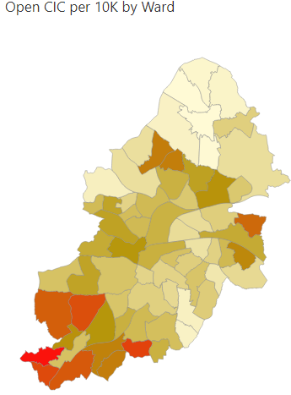
Capacity across localities by Wards in Birmingham
Ward Name | Number of Open CIC by 10K
Acocks Green | 45
Allens Cross | 95
Alum Rock | 31
Aston | 61
Balsall Heath West | 38
Bartley Green | 128
Billesley | 57
Birchfield | 39
Bordesley & Highgate | 70
Bordesley Green | 54
Bournbrook & Selly Park | 52
Bournville & Cotteridge | 92
Brandwood & King's Heath | 61
Bromford & Hodge Hill | 44
Castle Vale | 49
Druids Heath & Monyhull | 147
Edgbaston | 52
Erdington | 82
Frankley Great Park | 179
Garretts Green | 101
Glebe Farm & Tile Cross | 74
Ward Name | Number of Open CIC by 10K
Gravelly Hill | 49
Hall Green North | 14
Hall Green South | 12
Handsworth | 80
Handsworth Wood | 15
Harborne | 80
Heartlands | 26
Highter's Heath | 69
Holyhead | 60
King's Norton North | 105
King's Norton South | 108
Kingstanding | 108
Ladywood | 91
Longbridge & West Heath | 132
Lozells | 58
Moseley | 42
Nechells | 68
Newtown | 61
North Edgbaston | 74
Northfield | 55
Oscott | 29
Perry Barr | 29
Perry Common | 108
Pype Hayes | 94
Ward Name | Number of Open CIC by 10K
Quinton | 54
Rubery & Rednal | 142
Shard End | 121
Sheldon | 34
Small Heath | 43
Soho & Jewellery Quarter | 81
South Yardley | 22
Sparkbrook & Balsall Heath East | 39
Sparkhill | 34
Stirchley | 69
Stockland Green | 68
Sutton Four Oaks | 5
Sutton Mere Green | 9
Sutton Reddicap | 43
Sutton Roughley | 11
Sutton Trinity | 5
Sutton Vesey | 13
Sutton Walmley & Minworth | 30
Sutton Wylde Green | 6
Tyseley & Hay Mills | 52
Ward End | 31
Weoley & Selly Oak | 139
Yardley East | 62
Yardley West & Stechford | 41

Slide 19
Birmingham Children in Care living/educated Out of Birmingham (accurate on 23rd Dec 23)
Type of CIC and education Phase | Total number of CIC
EY 2-5yrs | 448 ( 415 live in the West Mids)
Primary 5-11yrs | 609 (552 live in West Mids)
Secondary 11-16yrs | 753 (638 live in West Mids)
Post 16 – 16-18Yrs | 465 (443 live in West Mids)

Slide 20
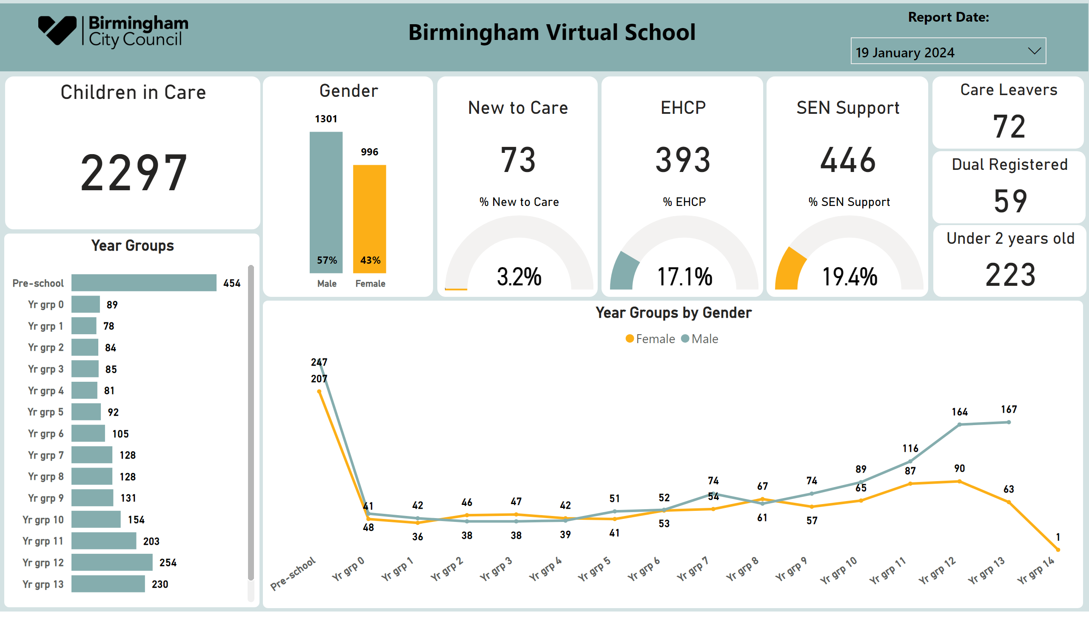
Home
Notes:
textbox
No alt text provided
Year Groups by Gender
No alt text provided
Gender
No alt text provided
Care Leavers
No alt text provided
Children in Care
No alt text provided
textbox
No alt text provided
slicer
No alt text provided
shape
No alt text provided
% EHCP
No alt text provided
% SEN Support
No alt text provided
New to Care
No alt text provided
EHCP
No alt text provided
SEN Support
No alt text provided
Dual Registered
No alt text provided
Unauthorised Absence
No alt text provided
shape
No alt text provided
Year Groups
No alt text provided
shape
No alt text provided
% New to Care
No alt text provided
Under 2 years old
No alt text provided
shape
No alt text provided
image
No alt text provided

Slide 21
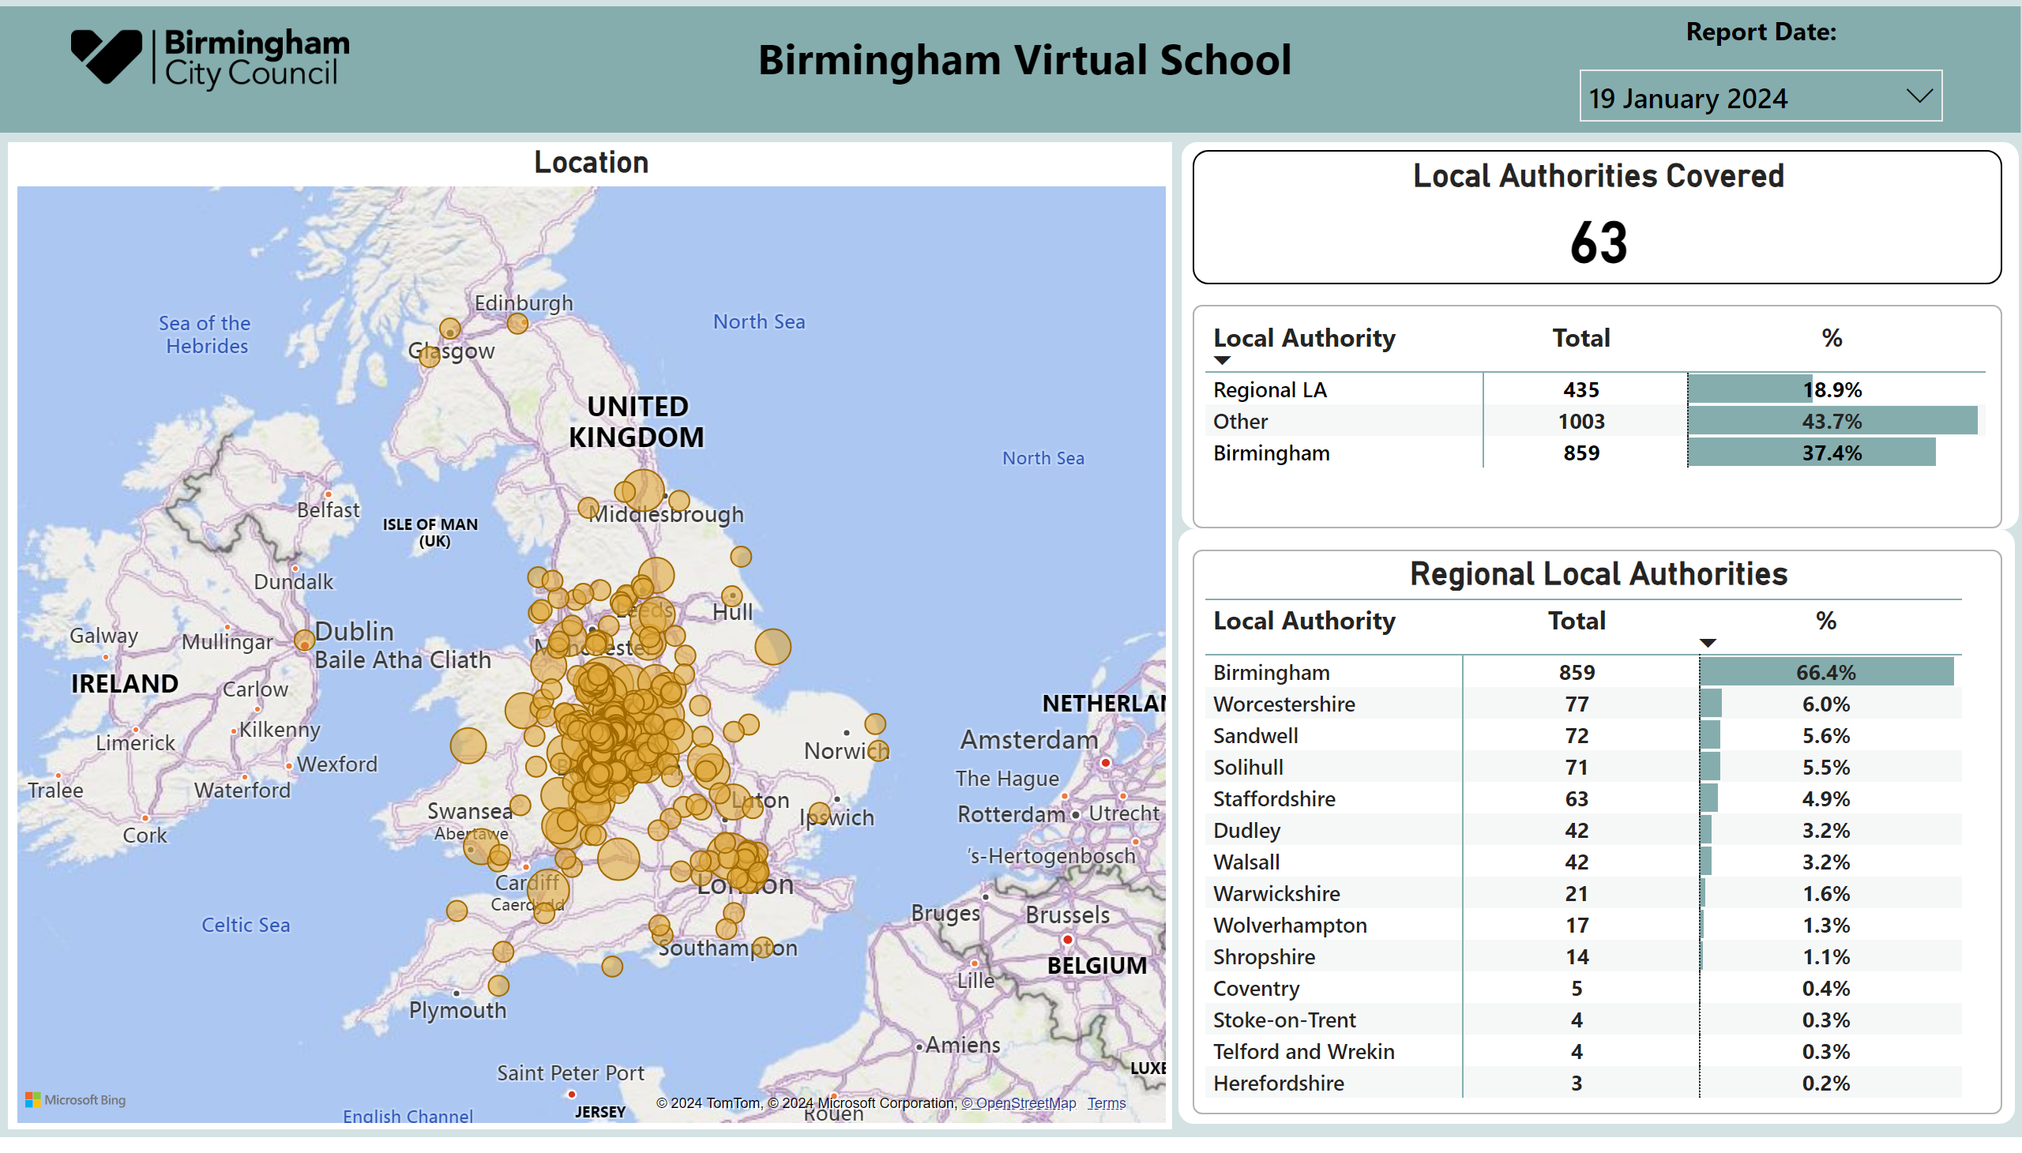
Location
Notes:
slicer
No alt text provided
Location
No alt text provided
shape
No alt text provided
Regional Local Authorities
No alt text provided
slicer
No alt text provided
Local Authorities Covered
No alt text provided
Local Authorities Covered
No alt text provided
shape
No alt text provided
image
No alt text provided
textbox
No alt text provided
textbox
No alt text provided
shape
No alt text provided

Slide 22
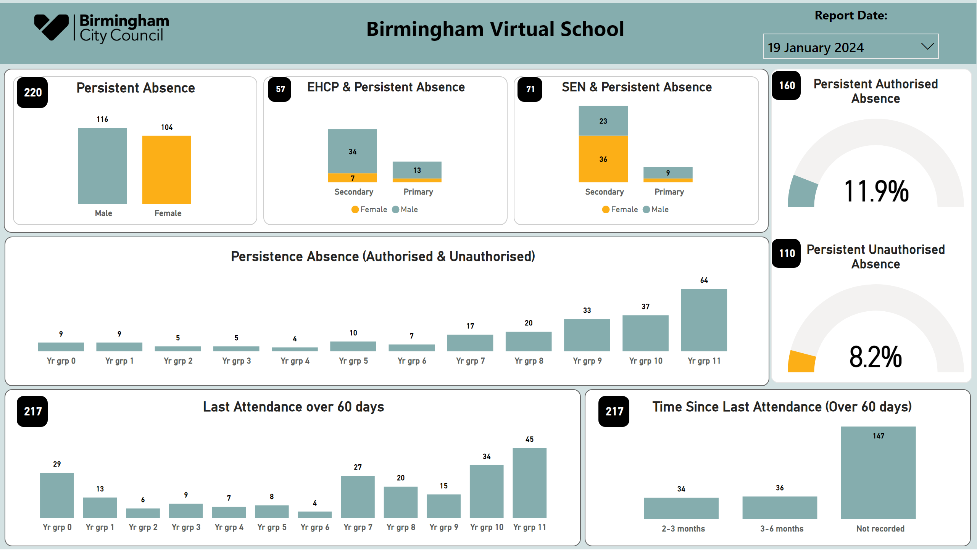
Attendance
Notes:
slicer
No alt text provided
EHCP & Persistent Absence
No alt text provided
Persistent Absence
No alt text provided
shape
No alt text provided
SEN & Persistent Absence
No alt text provided
card
No alt text provided
card
No alt text provided
card
No alt text provided
slicer
No alt text provided
Last Attendance over 60 days
No alt text provided
card
No alt text provided
Persistent Authorised Absence
No alt text provided
shape
No alt text provided
shape
No alt text provided
Persistent Unauthorised Absence
No alt text provided
shape
No alt text provided
card
No alt text provided
card
No alt text provided
Time Since Last Attendance (Over 60 days)
No alt text provided
Persistence Absence (Authorised & Unauthorised)
No alt text provided
shape
No alt text provided
image
No alt text provided
textbox
No alt text provided
textbox
No alt text provided
shape
No alt text provided
card
No alt text provided

Slide 23
Birmingham Children in Care living/educated in Birmingham (accurate end of Autumn Term ‘23) Variation by 20
Type of CIC and education Phase | Fixed term Suspension
EY 2-5yrs | N/A
Primary 5-11yrs | 10 pupils for 21 episodes of Fixed Term Exclusion
Secondary 11-16yrs | **101 pupils for 230 episodes of Fixed Term Exclusion

Slide 24
Emotional and Mental Health Concerns
Age range | Rated by professionals as Red, Amber around concerns for child/young persons emotional and mental health
Primary 5-11yrs | 3.7% of cohort (20 children) indicated as high level of concern/need In previous audit 2021-2022 number of targets relating to emotional health was highest in years 6 and 7 – transition year
Secondary 11-16yrs | 3.17% of cohort (23 young people) indicated as high level of concern/need In previous audit 2021-2022 number of targets relating to emotional health was highest in year 10
Post 16 – 16-18Yrs | 0
Audit in emotional health on EPEP 21-22 found:
Highest numbers of FTE were in years 10/11
The 2018 audit identified 12 young people who had the highest number of targets set on EPEP related to emotional support. In 2021-2022 these young people have significant reductions in the number of emotional support targets set by schools and over 90% of those whose emotional support needs were identified and addressed earlier, have 0 FTE in the longer term.

Slide 25
How we will Fund the programme
The Virtual school is allocated a pupil premium grant which is eligible for pupils 5 to 18 years. This is to be used to close the gap in attainment and progress between Children in Care and their peers. It can also be used where the young person has additional assessed social, emotional and mental health needs on activities, interventions and programmes that address these personal barriers to enable them to further engage and progress with their academic learning.
The Virtual School recognises that some children may wish to continue to access programmes/interventions/accredited courses between the ages of 16 to 18 for which BVS will be seeking a provider who can seek further funding streams, grants and volunteering to enable extended participation for these young people as the current pupil premium for these young people is currently less that £55 per pupil per annum.
The programmes/interventions will be for children and young people that live in and outside of Birmingham

Slide 26
Service model examples

Slide 27
Service Model for Delivery
Based on the Service Requirements on the next slides we are considering options for the service model of the programme. Please complete the questionnaire and indicate your preferred option(s) and feedback

Slide 28
Possible Service Model – Options for consideration:
Option 1 – One organisation to deliver the entire programme
Overall electronic grant and sufficiency management
Activity and enrichment providers
Training providers

Slide 29
Possible Service Model – Options for consideration:
Option 2 –
One organisation to deliver the activity providers
Separate contacts for training
Overall electronic grant and sufficiency management
Direct BCC contracts for training providers
Activity and enrichment providers

Slide 30
Possible Service Model – Options for consideration:
Option 3
Activity provider are pre signed up to T&C’s for BVS to spot purchase activities from.
Training providers have a direct contract with the council to deliver training.
A Framework of activity and enrichment providers
Direct BCC contracts for training providers

Slide 31
Possible Service Model – Options for consideration:
Option 4
Activity provider and training providers have a direct contract with the council to deliver training.
Direct BCC contracts for activity providers and training providers

Slide 32
Consultation/Q&A Sessions and Contact Details

Slide 33
Consultation/Q&A sessions and questionnaire
08th April 10am-11.30am
Click here to join the meeting BVS Enrichment Programme 08th April 10am-11.30am
Meeting ID: 351 679 244 393
Passcode: NC2sBo
Eventbrite registration link: click here to register
11th April 11.30am-1.00pm
Click here to join the meeting BVS Enrichment Programme 11th April 11.30am-1.00pm
Meeting ID: 319 099 168 820
Passcode: 3jNDTf
Eventbrite registration link: click here to register
Questionaries need to be completed and submitted by Wednesday 17 April 2024
Click here for Questionnaire Birmingham Virtual School Enrichment Programme 2024

Slide 34
If you need to contact us or have any questions, please get in touch birminghamvirtualschool@birmingham.gov.uk
Contact Details

