Slide 1
Pre market engagement event – Camden VCS
Monday 11th July 2022
2.30pm

Slide 2


Policy Context: NHS Long Term Plan and The Community Mental Health Framework for Adults & Older Adults
“Joined-up services and improved information sharing will give adults and older adults greater choice and control over their care, and support them to live well in their communities”
How this will work:
“focus on people living in their communities with a range of long-term severe mental illnesses, and a new focus on people whose needs are deemed too severe for IAPT services but not severe enough to meet secondary care “thresholds”
Organisations in a local area work more closely together to manage the resources available to them
A joined-up service across mental health, physical health and social care
Interventions readily available and accessible at the location most appropriate to someone’s needs
Integrated NHS & VCS partnership models

Slide 3
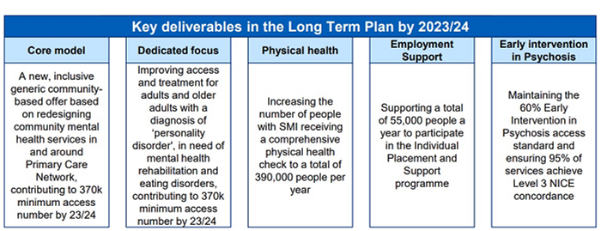
The Vision: The End Goal in 2023 - 2024
  Core integrated teams wrapped around PCNs,
  Community services for PD, ED and community rehab are developed,
  Other more intensive/specialist services are sufficiently expanded (e.g. EIP),
  The minimum outputs (community team activity, IPS, EIP and physical health checks) are delivered
  Expected outcomes including around inequalities are defined and measurements put in place
  A whole life course approach to services are adopted taking into consideration the differing needs of transitioning young adults, adults and older adults,
  A core offer developed across North Central London but geographies will shape their model based on their needs

Slide 4
Seamless and universal offer intensified according to need
Core Community Teams will be the primary healthcare provider (HCP) for red/amber patients with integrated input from RN
RN and GP will be primary healthcare provider (HCP) for green patients with integrated input from Community Teams
Support is ‘stepped up’ and ‘stepped down’ in a flexible manner, based on need – instead of being ‘discharge’ people are supported in the setting most appropriate for their needs at any given time.
Evolving Community Mental Health Model
Core Community MH Team
Integrated, responsive, personalised -
Blended Team of Psychiatrists, Population Health Nurses, Psychology, Social Work, OT, Social Prescribing, Welfare Rights, VCS and Peer Support
Core Team linked to PCN
Network of voluntary sector providers
Entry into the voluntary sector is streamlined and support is accessed in a coordinated way, drawing upon the strengths of a range of different but connected organisations
Intensive services e.g.:
Psychosis
Personality disorder
Complex depression & anxiety
Eating disorders
Borough or NCL level services for most complex needs
Primary Care Network (PCN)
“no wrong door” into MH support
Wider community
The voluntary sector ensures that the individual benefits from the full range of resources available in the borough
Core Team seamlessly embedded in local community network

Slide 5
Aims of the core teams
A truly integrated service with secondary mental heath, the VCS, primary care, social care and community assets and some physical health provision working together to support the whole population through a combination of prevention, supporting people to stay well and responsiveness to changes in need
The core teams aim to:
support individuals struggling with their mental health and wellbeing, including people who don’t usually engage with services and those isolated or disconnected, to be as connected and as well as possible in their homes and in their communities,
To take a ‘whole person’ approach, supporting people with their mental health in the context of the social determinants of wellbeing such as social contact, welfare, physical activity and beyond.
To utilise the skills and approach of the VCS organisations to ensure everyone introduced to the service feels heard, understood, and treated as a full person

Slide 6
VCS provision
It is proposed that the contract will be 2 years plus 1 year plus 1 year.
The VCS provision will be:
Community Development
Co-produce responses to local mental health needs through information sharing, training, and the co-creation of groups and events to support wellbeing.
Help improve access and experience of services for people with mental health needs in the PCN neighbourhood.
Enable awareness of community approaches and emerging local mental health need to be integrated within the work and culture of the local mental health Core Team.

Slide 7
VCS provision
Welfare Rights
Ensure that the Core Teams are equipped to support people with welfare rights issues through:
Training and supporting Core Team 1:1 staff, and staff in community organisations with welfare related work
Creating strong links with welfare providers to participate in managing flow of referrals across providers
Holding a client caseload of complex work
Key Working
Provide flexible, practical and emotional support which is:
Connected and integrated with other support provided in Core Teams and the local community
Supports a holistic view of mental health which helps work with the social and wider determinants of mental health

Slide 8
Timescales
The proposed timescales are as follows
Invitation to Tender released – end of July
Providers will have 6 weeks to bid
Evaluation of bids – October
Award contracts - November
Service commences – 1st April 2023

Slide 9
Questions for the attendees
Does our vision and services seem something that you would be interested in providing? Any challenges you foresee in delivering this service?
How would you foresee delivering this service – as one organisation or as a provider collaborative?
The length of the contract is proposed to be 2 years plus one year, plus one year. What are your thoughts on this length?
We are currently considering the type of contract to award this. What are your thoughts?
The proposed timescales allows potential bidders 6 weeks. How long do you need to respond to a tender of this nature?

