Slide 1
ITT Provision Expansion
March 2018

Slide 2

An announcement …
In December 2017, DfE published ‘Unlocking Talent, Fulfilling Potential’ which sets out the Department’s plan for improving social mobility through education.
The DfE Press Release of 1st October 2017, announced a series of measures to place education at the heart of the government’s ambition to provide opportunity for all.
The measures announced included:
… supporting our best teacher trainer providers, including top Multi Academy Trusts, with Northern Powerhouse funding to expand their reach into challenging areas in the north that do not currently have enough provision so more areas benefit from excellent teacher training, and help increase the supply of great teachers to the schools that need them the most...
Our plans will deliver targeted action where it is needed most, focusing on people and places that have not yet benefitted from the improvement seen elsewhere and by others.

Slide 3
… and an invitation
We are keen to support accredited ITT providers, who intend to reshape their ITT provision to:
Increase trainee supply in areas of poor teacher recruitment and retention
Improve the supply of newly qualified teachers to category 3 and 4 schools located in challenging areas
Promote category 3 and 4 school improvement through their involvement in ITT
Remove obstacles to social mobility
We welcome bids that can support schools in challenging areas such as the Category 5/6 ‘Achieving Excellence Areas’ and the 12 Opportunity areas
Additionally providers may propose areas for expanded provision outside these areas, provided they offer compelling evidence of need and potential impact in their bids.

Slide 4
The Challenge
Significant successful expansion of school-led ITT capacity 2012 – 2018, with 99 new SCITTs established since 2012. Current market consists of:
68 HEIs
176 SCITTs
873 School Direct lead schools
Expansion has not always delivered the teachers needed by schools most in need – there are local variations in teacher supply
Almost 90% of the country is within 5 miles of a school involved in ITT. However, providers are centred around major urban areas. Relatively limited provider coverage in Category 5/6 ‘Achieving Excellence Areas’ and Opportunity Areas.
Supply issues are exacerbated where schools are Ofsted ‘less than good’ rated
Can be exacerbated in Category 5/6 ‘Achieving Excellence Areas’– ‘cold-spot’ areas
Lack of supply limits capacity for school improvement

Slide 5
The Challenge
Lack of engagement of ‘less than good’ schools in ITT
We know that NQTs often take up employment in the schools and/or areas in which they train
Half of ITT graduates remained within 25 kilometres of their ITT provider when starting their first job as an NQT.
ITT graduates on average travelled less distance between leaving their ITT provider and starting as an NQT in 2015 than they did in 2010
We believe that if we can attract trainees to our most challenging areas, and offer opportunities for trainees with ties to these areas to remain locally, they will progress to teaching in the schools, and areas, in which they trained.
Teachers are not very mobile as a profession, mostly staying within commuting distance when moving schools. This can have a positive impact on the supply of teachers in those areas that struggle the most.
The Department’s recent Analysis of teacher supply, retention and mobility (February 2018) provides a tool to analyse census data for teacher vacancies by region and local authority. Figure 1.8 provides a map showing employment rates of ITT providers and regions.
This pilot is designed to improve teacher supply and increase social mobility in challenging areas and schools.
The pilot also aims to achieve a school improvement objective by engaging Ofsted category 3 and 4 schools in ITT.

Slide 6
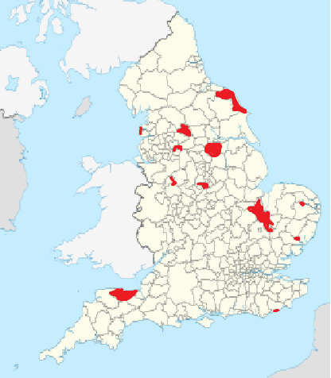
Opportunity Areas
2016 Social Mobility Commission index showing lowest social mobility areas.
Combined figures with the ‘School standards/capacity to improve’ data
Also considered coastal, rural and urban areas.
Opportunity areas currently have the greatest challenges and fewest opportunities:
Blackpool, Oldham, Scarborough, Derby, Norwich, West Somerset, Hastings, Stoke-on-Trent, Ipswich, Bradford, Doncaster, Fenland & East Cambs.
Northern areas focused on Urban regions
Southern focuses on more sparsely populated rural areas

Slide 7
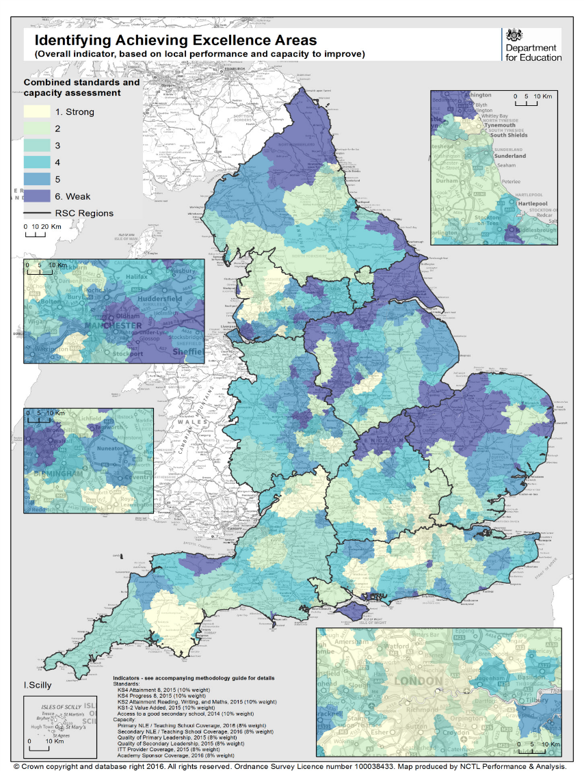
Achieving Excellence Areas
Achieving Excellence Areas (AEAs) were a policy in the Education Excellence Everywhere White Paper.
The analysis has been conducted using Local Authority Districts because they provide a familiar set of locations.
The AEAs analysis combines indicators which show educational performance with indicators which show capacity to improve to define areas which are most in need of support.
There area a total of 11 indicators –summarised below:
Access to a good secondary school
Attainment and progress data
System Leader coverage
Initial Teacher Training (ITT) provider coverage
Quality of leadership
Academy sponsor coverage
These indicators are then combined to provide an overall score to identify the AEAs.
In these areas:
Few children have access to a good school
Insufficient high quality teachers, leaders, and sponsors to deliver improvement

Slide 8
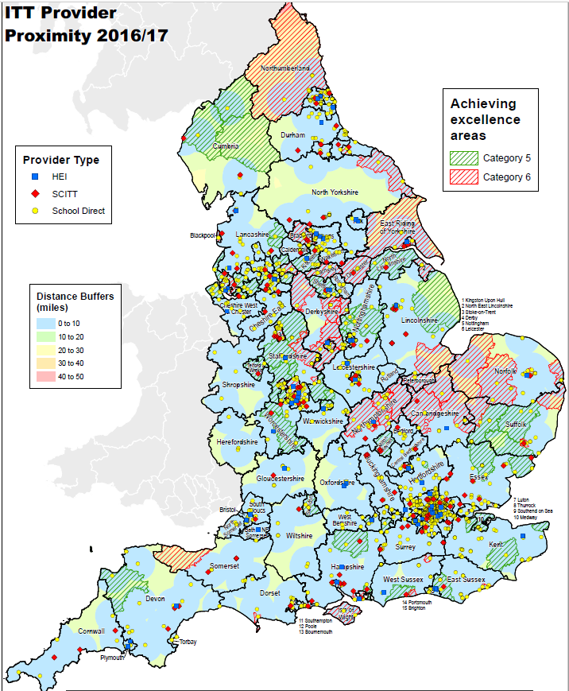
ITT Provider Coverage
East Midlands: 23 providers
East of England: 31 providers
London: 46 providers
North East: 20 providers
North West: 31 providers
South East: 41 providers
South West: 31 providers
West Midlands: 34 providers
Yorkshire and the Humber: 28 providers
Provider distribution is clustered around major urban conurbation areas
Majority of country is within 10 miles of a provider
More Limited coverage in Category 5/6 ‘Achieving Excellence’ areas and OAs

Slide 9
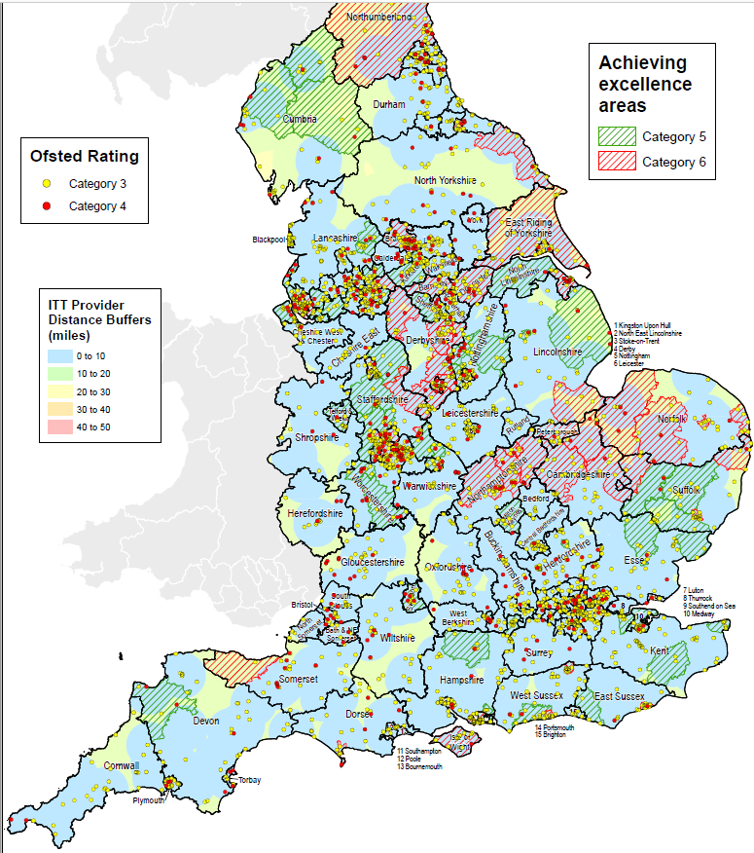
Ofsted Category 3/4 schools
Ofsted Category 3/4 schools are clustered around urban centres
Significant clusters in Merseyside, Greater Manchester, and West Yorks regions
Note the distribution in more rural areas
However, in comparing maps, we can see that the Category 3/4 schools have a significantly wider distribution than the distribution of ITT providers

Slide 10

Stakeholder views
We have spoken to representatives from nine ‘Outstanding’ providers, UCET and NASBTT about how we might address this challenge.
Response was helpful; providers suggested expanding their reach locally and through developing outreach ‘hubs’ outside their existing areas of operation.
As part of school improvement, ITT would help schools that are less than ‘good’ to achieve 'good' and maintain it.
Strong capacity building, including mentor training for schools would be needed.
Some concerns that working with more challenging schools might have a negative impact on providers’ Ofsted judgements:
Schools graded 3 or 4 by Ofsted often don’t feel confident enough to engage in ITT, or decide to focus on school improvement.
There is a misconception in the sector that Ofsted discourage ITT partnerships from utilising grade 3 and 4 schools for ITT.
You can be a provider working with a poor school and the quality of the work with that school could make you an Outstanding provider.

Slide 11
The evidence
Open University (Hurd, S. 2007, The Impact of Trainee Teachers on School Achievement) reports that
… training-active schools achieve higher test scores at both Key Stage 2 and Key Stage 3 than the schools that are not involved in school-based training; and
… in secondary schools that host more than 7 trainees, additional trainees bring about further gains in average Key Stage 3 scores, even after allowance has been made for ability, social and school characteristics (p1).
Does school‐based initial teacher training affect secondary school performance?- Hurd 2008
…at Key Stage 3 level at age 14, while there appears to be a very small depressing effect on achievement in schools with low numbers of trainees, there is a significant positive effect on achievement in schools with larger numbers of trainees…
The Costs and Benefits of Different Initial Teacher Training Routes- Institute for Fiscal Studies 2014
…the majority of schools report that the benefits of participating in initial teacher training outweigh the costs…
…Calculating the monetary value of the ratio of benefits to costs implies that the benefits outweigh the costs for all routes at primary and secondary level…
Ofsted (2003) An evaluation of the Training Schools programme: Report HMI 1769 (London, Office for Standards in Education). As a result of increasing their focus on ITT:
Teachers have become more reflective and analytical as a result of supporting trainees to the benefit of their own teaching
Teachers have gained from the mentor training and other staff development provided
Two-thirds of schools noted improvement in teacher recruitment and retention and more than one-third noted an improvement in teacher morale

Slide 12
Who is eligible to take part?
ITT providers currently judged ‘Outstanding’ by Ofsted.

Slide 13
Objectives
There are four objectives you must address when submitting a bid:
Increase trainee supply in areas of poor teacher recruitment and retention
Improve the supply of newly qualified teachers to category 3 and 4 schools located in challenging areas
Promote category 3 and 4 school improvement through their involvement in ITT
Remove obstacles to social mobility
Delivery requirements for your proposals:
Expand the reach of your outstanding provision
Include Ofsted category 3 and 4 schools that are new to ITT schools in your training offer
Develop tailored training programmes to support trainees training in the target schools
Support trainees to secure employment in target schools and further support them in their early career development

Slide 14
Timeline
We will invite bids from eligible providers from w/c 19th March 2018.
You must submit your Expression of Intent form by 30th April 2018
Bids must be submitted by 3rd June
We will assess bids from providers by the end of June 2018
We will inform successful bidders by the end of July
Providers will start recruiting trainees from autumn 2018.
These recruits would then commence training in September 2019.
The first NQTs will be employed from September 2020.

Slide 15

Funding
Support for those who are successful can include:
Seed-funding to subsidise the establishment of new provision;
Payments to providers to support trainees training in a participating grade 3 or 4 school new to the partnership;
Payments to schools to support trainees training in a grade 3 or 4 school new to the partnership;
Payment for providers to support NQTs who secure a teaching post in a participating eligible school, in their first year of teaching.

Slide 16
Bidding Documentation
Before completing a submission, interested parties must first submit an Expression of Intent form to ITT.INNOVATION@education.gov.uk, stating their accredited provider name, target expansion region/partner schools (where known), and provider contact information.
This is a single stage process.
You will need to provide applicant information, eligibility information and a bid, which will include the following information:
a strategic overview
a detailed delivery plan with supporting evidence against the remaining criteria
a list of proposed partner schools.
countersigned agreements from proposed partner schools.

Slide 17
Top tips for bid writers
The best bids will:
use clear and concise English, and will be well structured and presented
address the criteria in the bidding documentation
draw on the relevant evidence base in relation to trainee and NQT supply, and teacher retention in the target area
include a clear and detailed delivery plan that identifies the measures you will take to meet the objectives
include a clear financial plan and risk register, identifying how you will achieve value for money and sustainability of provision
provide details of a quality assurance process that focuses on continuous improvement

Slide 18
Management and Evaluation
Partnerships whose bids are successful will start implementation work in July 2018 to take effect from the 2019 trainee cohort and beyond.
Each successful partnership will be closely monitored and supported by the department. There will be a dedicated project lead for each bid and we will agree specific progress targets with each bidder. These targets will form part of the agreement between us and the partnership from the outset, with ongoing monitoring and evaluation against them to assess success. This is likely to involve:
NCTL expert associate support visits
provision of summary progress reports from you, including qualitative, quantitative, and financial developments
participation in occasional face-to-face workshops and/or online events
We will expect to work with successful providers to monitor progress and capture learning. Our aim is to use ongoing findings from this exercise to provide insight, develop future policy, and promote change across the wider sector.

