Slide 1
Raydon Parish Council
Proposed refurbishment works to:
Layby outside the Church
The Street Raydon Suffolk IP7 5LW

Slide 2
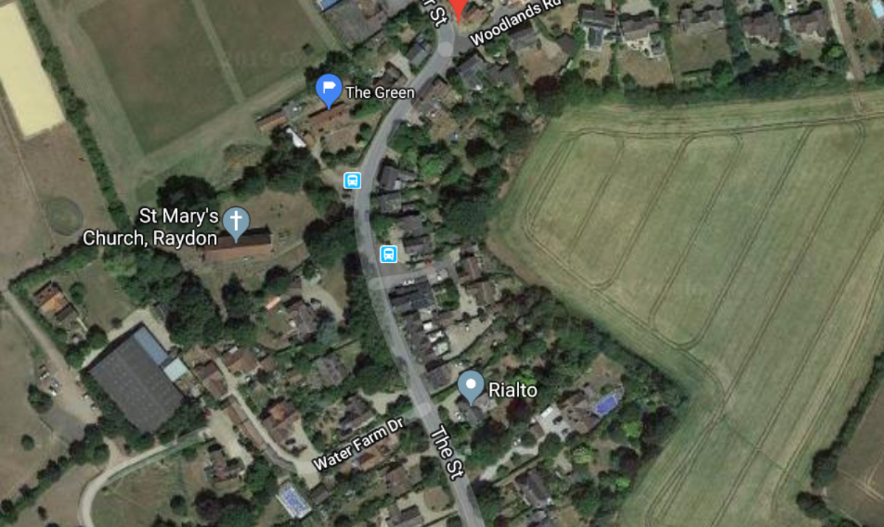
Layby location
Layby outside the Church
The Street Raydon Suffolk IP7 5LW

Slide 3
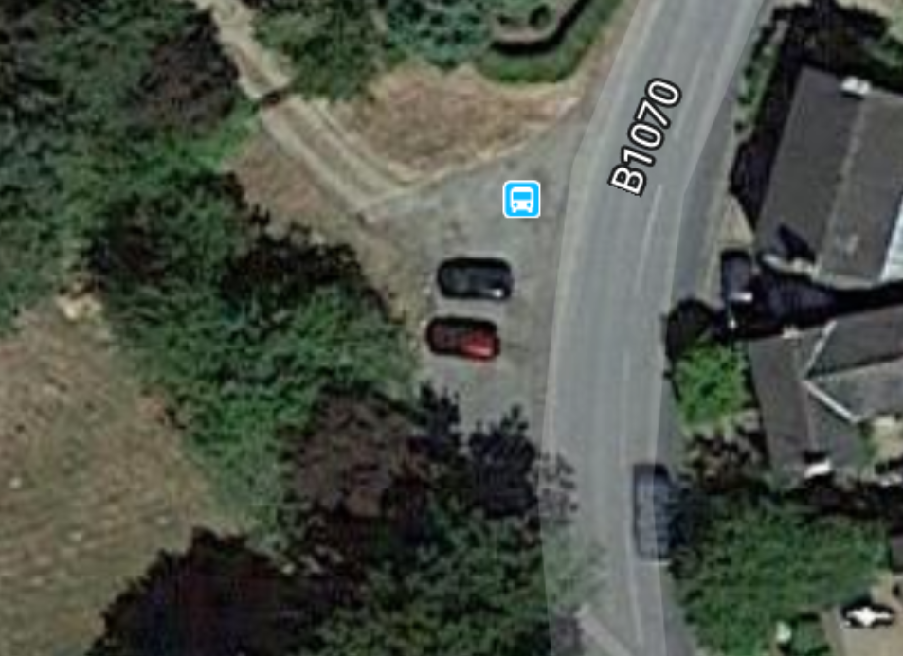
15
7
Approx location of works
Blue line – new kerb to
grass verge
Yellow line – existing kerb
Red line – merge with
existing pavement
White line – thermoplastic
road marking 75mm wide
31
11
12
6

Slide 4
Scope of works
Remove all weak tarmac surfacing and any vegetation within surface. Weedkill
Supply and install new kerb 125 x 150mm edging to grassed verges in concrete bed and haunching
Clean out existing road gulley.
Prepare existing tarmac surface. Make good any weak areas in base course.
Overlay new SMA wearing course. Match surface into existing surfaces of adjacent footway.
Repaint white lines to drop kerb and church vehicle entrance crossovers.
Set aside bench seat during the works and replace on completion.
Allow for all preliminaries including safety, health and welfare provisions
Review and comply with the requirements of the Authority
Technical Contact
Keith Lovering – Raydon Parish Councillor
07939 075143 – keith.lovering16@gmail.com

