Slide 1
Recommissioning of Children and Young People’s mental health services Pre-engagement market event 13 October 2020

Slide 2
Vision for the Future
Our vision is for children and young people to have support for their mental health and emotional wellbeing needs provided within a system that is:
Based on needs of children, young people and families with a focus on goals for those individuals and improvement in outcomes
Timely and Flexible to need, locality and mode of delivery
The new model will focus on partnership approach with collaborative solutions, collaborative thinking, inclusion and development of all sectors including the voluntary and community organisations
Full engagement of lead model, we anticipate the not for profit sector is part of the solution
Delivered in an effective and efficient way
Be place based and delivered when and where according to the need of the children, young people and families
Adaptive to change and supported with learning based organisations

Slide 3
Draft model
Lead provider
Single point of referral – Triage / MDT
Getting Advice
Emotional health and wellbeing services , mental health support teams in schools ,health visitors, school nursing , Chat Health, Keep your Head
Getting help
24 hour digital support ,Bereavement ,ACE/ Trauma ,Child well being practitioners, third sector consortium
Getting More help
Specialist services –CAMHS , Crisis support , FRS, Eating disorders , FCAMHS
Getting risk support
Inpatient – severe mental health crisis
( Spec comm/ collaborative commissioning – new models of Care )
Graduated response . Flexible, seamlessly move across areas of need/s
Focus on improving outcomes
Co-production and CYP participation at all levels

Slide 4
Current model
Delivery of short term evidence based mental health interventions for those children and young people aged 5 – 18 year in Peterborough and 5 – 25 years in Cambridgeshire.
Provision of one to one sessions, Anxiety, Bereavement, ASD, Low Mood, Mental Health & Resiliency, Tactics – football, Encore –music, Creative Minds, Parent Groups
Average 4 sessions but up to 12 sessions 1:1
Delivery of evidence based intervention (CBT / IPTA)
Aim to deliver: Managing Getting Advice (30%)
Getting Help (60%)
Getting more help/risk (10%)
Robust triage process
Online resources, signposting, collaborative working
Develop SPOE

Slide 5
Need
CYP Mental Health Needs Assessment
https://cambridgeshireinsight.org.uk/wp-content/uploads/2020/06/CYPMHNA-15.6.20.pdf
National data shows prevalence of mental health conditions in CYP is increasing.
Estimate that in C&P there are over 20,000 CYP aged 5-19 years with a diagnosed mental disorder.
The number of diagnosed mental health conditions in CYP in C&P is forecast to grow by 10% between 2019 and 2024.

Slide 6
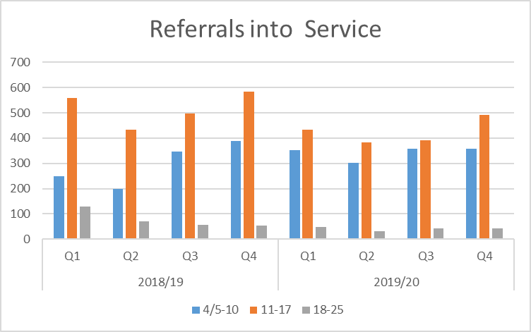
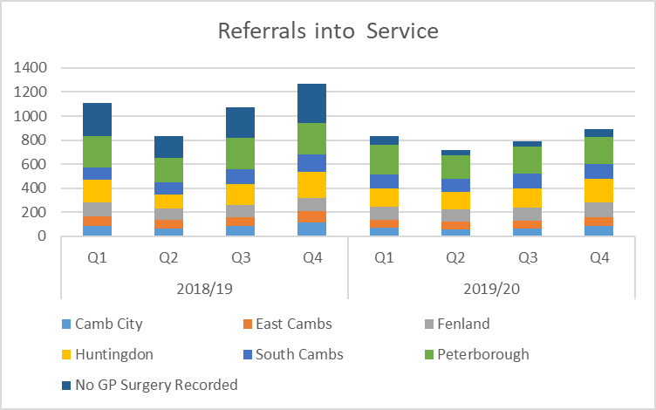
Current Service Activity

Slide 7
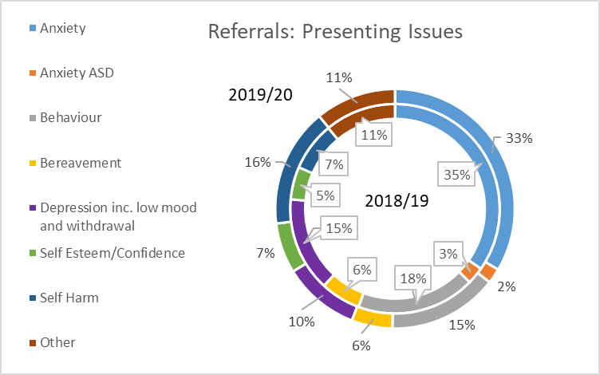
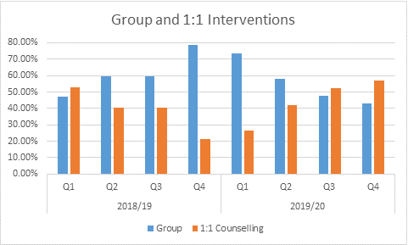
Current Service Activity

Slide 8
Current Online activity 2019/20
68.5% of activity outside of office hours
Average of 100 counselling chat sessions per month
Average of 738 messages exchanged per month
13.17% from BAME community
Top issue for females
Anxiety/Stress
Suicidal Thoughts
Self Harm
Family Relationships
Self Worth
Friendships
Depression
School/College issues
Bullying
Sadness
Loneliness
Body Image
Top issues for males
Anxiety/Stress
Depression
Suicidal Thoughts
Family Relationships
Trust Issues
Self Harm
Bullying
Trauma
Sleep Difficulties
Sexuality
School/College issues
Psychotic Episodes

Slide 9
Current Online activity 2019/20
Q4 Age (years)

Slide 10
Systems Issues and Challenges
Waiting times for services are long and vary across different localities
Children and Young People advise that the emotional wellbeing and mental health system is disjointed
The current mental health system does not have the capacity to keep pace with demand
The current model is a standard offer across Cambridgeshire and Peterborough and does not address locality variation in demand, need, accessibility, choice, inequalities and other available services.
Gap in current provision for those children and young people who have higher needs but those that cannot be addressed through specialist services
Multiple referral points and lack of clarity of the gatekeeping of children and young people which results in bounce around the system and poor experience for many.
Covid-19 adverse impact on children and young people and the surge in demand that may result.
The requirement for the whole emotional wellbeing and mental health system to act together to support the children and young people of Cambridgeshire and Peterborough as we move through restoring and recovering out communities peri and post Covid-19.

Slide 11
Intended commissioning Outcomes from future service model
Graduated seamless response based on I Thrive framework -Increased flexibility to move through different services
Single point of referral
CYP getting their needs met by the right service, at the right time at the right place .
Reduced waiting lists
Improved access to services (times, locations, methods)
Improved uptake of digital offer
Improved Planning for transitions to adult services
CYP participation and co-production
Place-based partnership approach to delivery

Slide 12
Current thinking of commercial features
Contract length – 3 years + an optional 2 years
Value – The approximate value of the contract is £950,000
The new contract would commence on 1 July 2021
The contract would be with Cambridgeshire and Peterborough Clinical Commissioning Group but is jointly commissioned with Cambridgeshire County council and Peterborough City Council

Slide 13
Useful weblinks
https://cambridgeshireinsight.org.uk/wp-content/uploads/2020/06/CYPMHNA-15.6.20.pdf (needs assessment)
https://www.cambridgeshireandpeterboroughccg.nhs.uk/your-health-and-services/children-and-young-people/ (Local Transformation Plan for children’s mental health)
https://fis.peterborough.gov.uk/kb5/peterborough/directory/localoffer.page?familychannel=8 (Peterborough Local Offer)
www.cambridgeshire.gov.uk/localoffer
https://www.longtermplan.nhs.uk/ (NHS long term plan)
https://www.england.nhs.uk/integratedcare/stps/view-stps/cambridgeshire-and-peterborough/ (Sustainability and Transformation Partnerships)
https://www.keep-your-head.com/cyp

