Slide 1
LMB Building Minor Works Project
User Requirement (Drawings)
Page 1 of 12

Slide 2
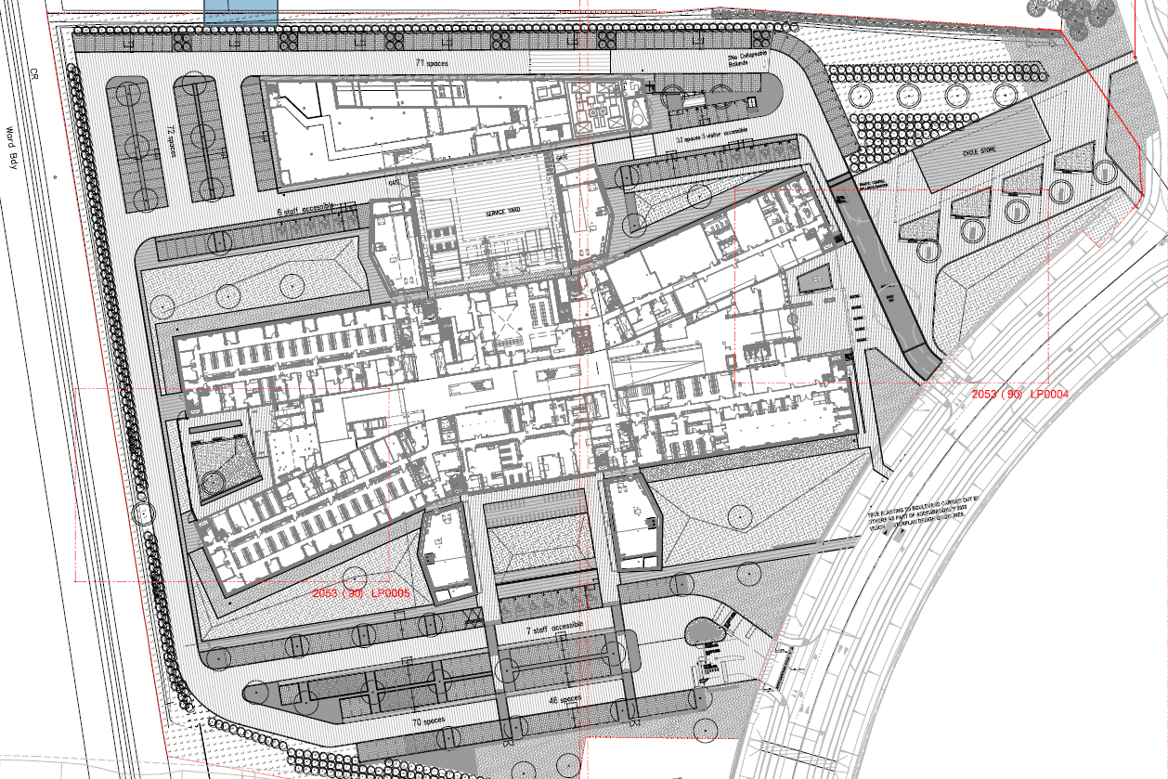
MRC Laboratory of Molecular Biology Site Layout

Slide 3
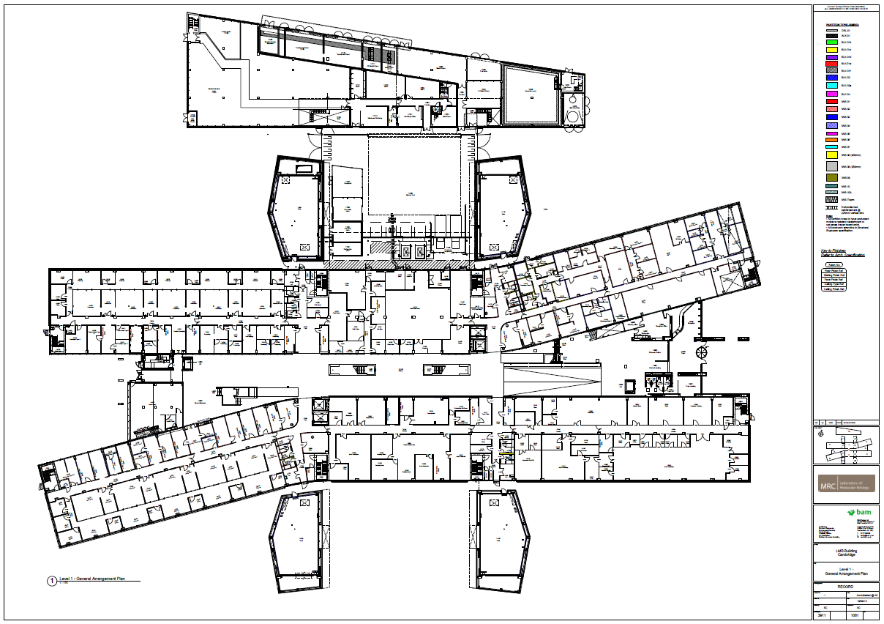
MRC Laboratory of Molecular Biology Ground Floor GA

Slide 4
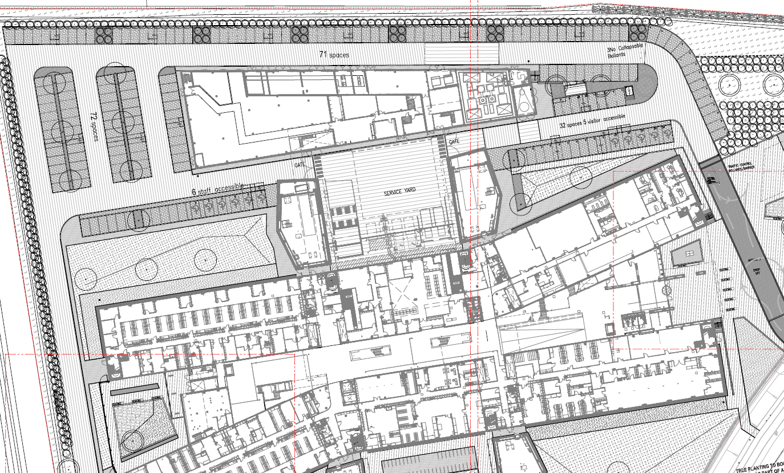
Potential Site Set-up Compound and Builders’ Access

Slide 5
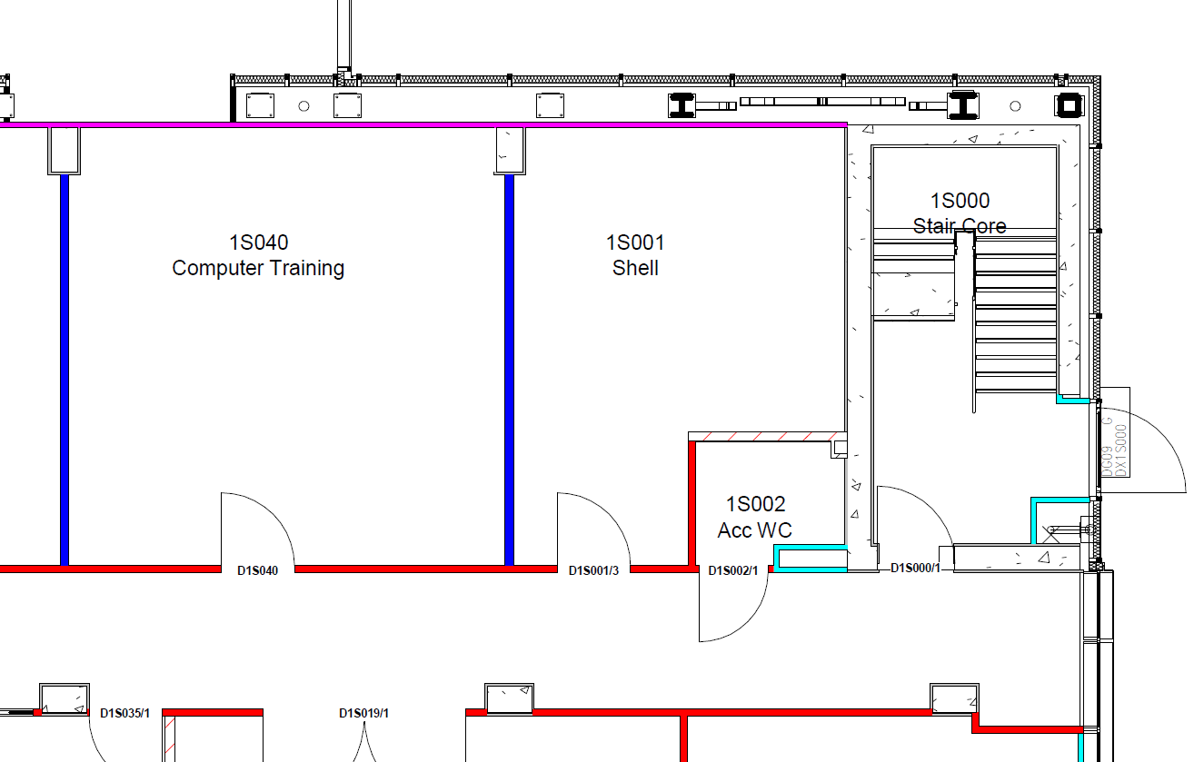
Current Shell Facility (1S001)

Slide 6
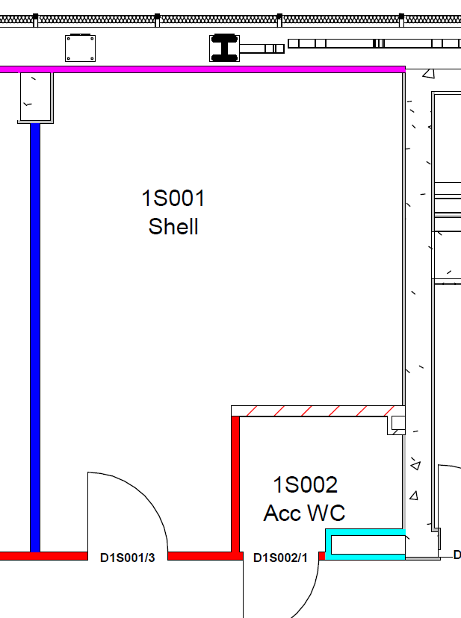
Outline Architectural Specification Note: Where a manufacture/actual material is specified it is deemed to be ‘or equal approved’ Please see relevant NBS specification for product details and associated detailed specifications
FLA-01 Laboratory Worktop: 20mm Trespa 750mm deep including upstand to wall. Butt joint level sealed with silicone mastic. All exposed edges to be chamfered . Include upstand: 20mm Trespa 50mm high. Butt jointed sealed with silicone mastic to match current installation elsewhere within the laboratory.
930mm high bench Support: Frame epoxy coated metal 910mm high (providing 850mm clear below for fridges); span between supports to be maximum 2000mm. Peninsular benching to be modular (2000mm sections), each removable or replaceable with lower bench. Allow for recessed end panel fixing. Provide adjustable ‘floor rail’ for clipping of underbench units.
FLA-02 Storage cupboards: 840mm tall x 600mm deep x 500mm wide –
- Material: Carcass and door fronts manufactured from 19mm thick MDF moisture
resistant panel (EN 622-5), covered with 0.8mm melamine laminate to both faces,
manufactured by FINSA or equivalent approved. Unit Assembled using allen type screws and capped with plastic. Finish/ Colour: Finsa RAL-9010. All edges lipped with PVC edging material at 2 7 1mm thicknesses. Plinth, made from height adjustable Ø50mm plastic skates (4x) manufactured by Hafele or equivalent approved, screwed directly to the unit base Unit to be secured to bench frame with securing clip.
2 No. shelves 18mm melamine set back 10mm from door to be adjustable at 30mm c/c
Drawer fronts to be rebated to accommodate the drawer base
Hinge, opening 270 degrees, epoxy coated , DIN 68857. Handles, “D” type made from zamak alloy (aluminium, zinc, and magnesium) with matt chrome finish.
PTI-05 – Paint General wall and ceiling finish Washable, wipeable Dulux vinyl silk emulsion. Preparation and application to be in strict accordance with manufacturer’s written recommendations. Fire rated finish required: Class 1 – general laboratories, Class 3 – rooms smaller than 30m2.
SFL-04 - 2mm vinyl Gerflor (www.gerflor.co.uk), fully welded sealed similar to Gerflor Tarasfe Uni Edelweiss vinyl (with spar clean finish) Ref. No. 7618 hot welded.
SKI-04 - Generally in areas of laboratory and equipment room plasterboard partitions: Vinyl skirting to all areas with vinyl floor: 150mm high 3mm thick coved skirting.
FLA-015 - Sink and Drainer: Stainless steel rectangular, flat bottomed with three reinforced tap mounts and reinforced drainer (slight fall to the sink). Rounded corners. Sink: 500l x400w x300d mm - overall size of sink to be accommodated 500mm bench module and fully mastic sealed onto surface of benchtop. – refer (40) series generally refer SAN21 for taps.
SAN-021 - Broen Boss epoxy coated swan neck with wrist blade controls with removable 1/4" BSP serrated nozzles. Equal and approved ranges may be submitted at tender along with costing information. Set back 40mm from edge of basin.
New Architectural Room Layout
FLA-02
FLA-01
FLA-02
FLA-015
FLA-01

Slide 7
Electrical / Mechanical Services Layout
Outline M&E Specification Note: Where a manufacture/actual material is specified it is deemed to be ‘or equal approved’. Please see relevant M&E specifications for further product details and detailed installation specifications
ENVIRONMENTAL STANDARDS
Lighting: As per existing lighting layout
Lighting: 450/500 LUX for general laboratory at 930 mm (AFFL) working plane.
Lighting Controls: local switch mounted on trunking adjacent to door to provide on/off /dim control
Electrical:
230V twin 13A SSO: 1 per 2000mm above bench top and generally where dado at height of 1000mm AFFL
230V twin 13A SSO: 1 per 1000mm below bench level (where fixed benching only) at height of 450mm AFFL
Dado trunking: Perimeter low level dado trunking height 450mm to underside of trunking, Standard wall trunking height 1000mm to underside of trunking.
Each non essential ring circuit serving 13A TSSOs will have a RCD located at DB
Sockets to be colour coded in line with MRC on-site standards (eg Clean earth non essential supply = blue faceplate with white rocker) MK preferred supplier
Data Outlets: No: 1 twin RJ45 per 3000mm Location: above bench mounted on centre of 3-compartment trunking.
Mechanical:
IHWS + ICWS outlets to sink. IHWS flow and return and thermostatic mixer valve to be located behind bench frame, surface mounted to wall.
Pipe type to be Uponor multi-layer pipe using approved compression joints only. Drainage connection and and bottle trap to be Gerberit HDPE connections to suit. Contractor to ensure appropriate rodding considerations are accounted for.
Compressed air outlets to be terminated 1200mm AFFL employing Spectrolab termination fitting (Spectrolab gas regulator to be free issued to contractor). Fitting to ensure inclusion of local ¼ turn isolation immediately prior to point of use. Local branch in ISV from main compressed air distribution be provided with ¼ turn isolation and local regulation. Pipework to be 15mm grease free copper with braised joints to match existing installation.
FLA-01
2
FLA-015
2
FLA-01
CA outlet
3-compartment trunking
Data socket
Trunking run

Slide 8
NBS Specification – See appendix B

Slide 9
Mechanical Specification – See appendix C KJT / RMF Specification

Slide 10
Electrical Specification See appendix D KJT / RMF Specification

