Slide 1
GovPrint Cloud Market Engagement
21st May 2024
Picture box
Picture box

Slide 2
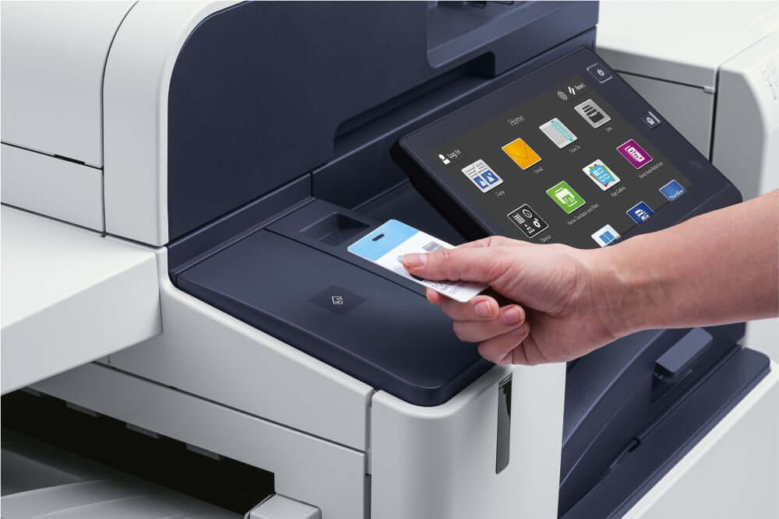
Agenda
Welcome & Introductions | 13:00-13:05
Today’s objectives | 13:05-13:10
GPA + GovPrint Background | 13:10-13:20
GovPrint Strategy | 13:20-13:25
Previous Market Engagement | 13:25-13:35
RM6361 GovPrint Lot | 13:35-13:40
Commercial Information | 13:40-13:45
Next Steps / Further Engagement | 13:45-13:50
Q&A (if time available) | 13:50:14:00

Slide 3
Introductions

Slide 4
Introduction to the GPA team
Chief Technology Officer
Kean Jones
Technical Architecture
Allan Gardner
IT Service Delivery
Paul O’Toole
IT Programme Delivery
Steve Nelson
Keith Houghton - GovPrint lead
David John - Commercial Lead
Naomi Clarke - Commercial Advisor
Jackie Gould - CCS MFD Category Lead

Slide 5
Today’s Objectives
Today’s market engagement session aims to provide suppliers with:
A recap on what GPA is and what we do
Provide an overview of GPA’s market requirements for a GovPrint Cloud:
Explain the background of GovPrint Cloud and our delivery strategy
Market engagement so far and what we learnt from the market engagement
Explain some of our key requirements for GovPrint Cloud

Slide 6
GPA Strategy
Government Property Agency (GPA) is a public sector property holding company creating great places to work for civil servants.
We define the strategy, and deliver outcomes, for the Government’s office and warehouse portfolios.
We act as the single landlord for our government department clients.
We provide workplace services to our clients, where required.
Using our civil service know-how and commercial expertise, we are transforming the estate to be shared, sustainable and provide value for money.
GPA has developed a 10 year strategy, covering the period 2020-30. Over this timescale we expect to transform the way the general purpose government estate supports public service delivery by:
Improving the experience of the workplace for civil servants;
Enabling increased working across departmental boundaries within the public sector;
Supporting moves from London to the nations and regions of the UK;
Taking a locality planning approach to optimise the government estate, and working with local authorities to embed our contribution to place-making;
Responding to the changes in ways of working being accelerated as a result of responses to COVID-19; and
Improving the sustainability and condition of the estate.

Slide 7
GPA Strategy
Government Property Agency (GPA) is a public sector property holding company creating great places to work for civil servants.
We define the strategy, and deliver outcomes, for the Government’s office and warehouse portfolios.
We act as the single landlord for our government department clients.
We provide workplace services to our clients, where required.
Using our civil service know-how and commercial expertise, we are transforming the estate to be shared, sustainable and provide value for money.
GPA has developed a 10 year strategy, covering the period 2020-30. Over this timescale we expect to transform the way the general purpose government estate supports public service delivery by:
Improving the experience of the workplace for civil servants;
Enabling increased working across departmental boundaries within the public sector;
Supporting moves from London to the nations and regions of the UK;
Taking a locality planning approach to optimise the government estate, and working with local authorities to embed our contribution to place-making;
Responding to the changes in ways of working being accelerated as a result of responses to COVID-19; and
Improving the sustainability and condition of the estate.

Slide 8
GPA Strategy
Government Property Agency (GPA) is a public sector property holding company creating great places to work for civil servants.
We define the strategy, and deliver outcomes, for the Government’s office and warehouse portfolios.
We act as the single landlord for our government department clients.
We provide workplace services to our clients, where required.
Using our civil service know-how and commercial expertise, we are transforming the estate to be shared, sustainable and provide value for money.
GPA has developed a 10 year strategy, covering the period 2020-30. Over this timescale we expect to transform the way the general purpose government estate supports public service delivery by:
Improving the experience of the workplace for civil servants;
Enabling increased working across departmental boundaries within the public sector;
Supporting moves from London to the nations and regions of the UK;
Taking a locality planning approach to optimise the government estate, and working with local authorities to embed our contribution to place-making;
Responding to the changes in ways of working being accelerated as a result of responses to COVID-19; and
Improving the sustainability and condition of the estate.

Slide 9
GovPrint Background
GovPrint started as a project within the Government Digital Service (GDS) - Common Technology Services programme to deliver shared printing across government
Shared print service required for GPA’s initial hubs (shared occupancy buildings) as part of a shared IT stack
GPA procured the first iteration of GovPrint via RM3781 and deployed it to 4 GPA hubs
GPA procured the second iteration of GovPrint via RM6174, this included the ability to deploy the GovPrint service to wider GPA locations and non GPA locations, this service is now being deployed
GPA has undertaken previous market engagements to understand the feasibility of delivering interoperability between cloud print services provided by different suppliers
GPA worked with CCS on RM6174, cloud printing was added but not a GovPrint specific lot
With the new framework there will be a specific GovPrint lot (RM6361 - Lot 4)
The aim of this market engagement is to share details of upcoming procurements for GovPrint

Slide 10
GovPrint Delivery Strategy
Strategic Context
‘One Estate’ is a core component of the Civil Service Interoperability Programme and is an enabler for Civil Service Reform.
Civil Service Operations Board (CSOB) has mandated that Government departments should adopt common property technology (PropTech) to create interoperable buildings that support mobile working - flexible estate supporting flexible working - this includes GovPrint
GovPrint is part of a range of GPA PropTech services supporting interoperability including Single Building Shared Networks, GovWifi, GovPass, Space Booking and Audio Visual Standards
The ability for users to access print services across the government estate is a core requirement to delivering interoperable buildings
Interoperability is core to GPAs approach to all PropTech
Delivering GovPrint
Delivery options
Single print service across government - not deliverable
Enable guest printing in all print services - would not provide a user friendly and consistent service plus high management costs and security risks
Move to a ‘GovPrint ecosystem’ with multiple interoperable cloud print services that can support flexible service delivery

Slide 11
GovPrint Delivery Strategy
GovPrint Strategy
GPA adopted a multi-phase approach to deliver the GovPrint ecosystem
Phase 1 - Single GPA contract with single supplier - single supplier for cloud and hardware (current situation)
Phase 2 - Additional hardware providers as service expands - single supplier for cloud / multiple suppliers for hardware
Phase 3 - Interoperable cloud services - multiple suppliers for interoperable cloud and hardware

Slide 12
Previous Market Engagement
RM6361 (replacement of RM6174) Prior Information Notice (PIN) issued 16th November 2023 (2023/S 000-034740).
TechUK Webinar held on 24th November 2023 with follow up 1-2-1 supplier sessions.
Suppliers submitted responses to 10 key questions on 12th January 2024.
Responses determined future strategy:

Slide 13
What we learnt from Market Engagement
GPA’s goal of interoperable clouds with multiple suppliers is not currently feasible, but possible in the next 2-3 years
Key challenges GPA will need to support solution of for interoperability to be feasible.
Suggestion to develop printing standard with MOPRIA or PWG
Interoperable Cloud remains GPA’s long term goal. How this will be achieved remains to be determined however further market engagement is likely.

Slide 14
GovPrint Future Strategy
Going forward GovPrint will be supported via two key procurements:
GovPrint Cloud - Single Cloud contract placed by GPA
GovPrint Lot under RM6361 framework for Devices and Associated Services with multiple suppliers placed by CCS
This supports the following procurement models for our clients desiring GovPrint:
Consume GPA GovPrint Managed service (Use GPA contracts for devices and cloud - Managed by GPA)
Client managed GovPrint Service (Client places call off contract for devices and uses GPA cloud contract)
Client owned devices accessing GovPrint (Client owns devices and uses GPA cloud contract)

Slide 15
GovPrint Cloud Requirements
User Journeys
Follow me print / direct print
Scan to email / scan to cloud storage
Users manage themselves e.g. registration, linking cards, forgotten passwords etc.
Integration with other GovX services
GovWifi - preferred method to connect print devices to the GovPrint Cloud
GovPass - preferred method for authentication at print devices
Cloud Service
Multi-tenant SaaS service model and public cloud deployment model
GPA may wish to consider a dedicated public sector instance
Tenancy structure
Each client (department) has their own tenancy
Print devices can be shared across tenancies
Loose coupling with client IdAM (no central identity service)

Slide 16
GovPrint Cloud Requirements
Cloud Service (cont.)
EUC client
Single driver / client for all supported print devices
Support for Windows, Mac, Chrome and mobile devices
Print device client
Support for leading hardware suppliers
Simple intuitive and consistent UI
Extend beyond general office devices e.g. higher volume, wide format
Note: suppliers on CCS RM6361 GovPrint lot will supply fully compatible products
Service management
Minimal client administration
Simple to onboard new clients, locations and print devices
Dashboard - role based functionality - tenancy settings, status, reporting etc
Service availability
Availability is critical as service scales
Service designed to be resilient

Slide 17
GovPrint Cloud Requirements
Security
All relevant NCSC guidance must be followed / supported
Cloud Security Principles are critical
Aggregation of data across government is a risk and the solution needs to appropriately support and manage this risk
Service delivery
Potentially complex support model
GovPrint Cloud provider must work with hardware suppliers - development and support
Hardware suppliers must with GovPrint Cloud provider
Interoperability
Provider to deliver interoperability with current cloud provider under GovPrint 2

Slide 18
Commercial information

Slide 19
Procurement Process
2 Stage Procurement - Supplier Selection followed by Invitation to Tender (ITT)
Selection Stage - Prospective suppliers complete a questionnaire with PASS/FAIL questions. All suppliers who achieve a PASS in all questions will be Invited to Tender (ITT).
The selection questionnaire includes an assessment of the suppliers financial health and capability to perform the requirements.
ITT will be based on a number of qualitative questions + cloud based pricing, volume discounts will be sought.
Pricing evaluation will be on Price Per Quality Point (PQP) = Price / Technical Score [The compliant supplier with the lowest PQP will be the successful supplier].
Contract based on Government Mid-Tier Contract Terms - https://www.gov.uk/government/collections/the-mid-tier-contract
Zero volume commitment
The contract is for an initial term of 3 years and five extension options of 1 year each (3+1+1+1+1+1).
Maximum contract value of £9.75m over full 8 year term.

Slide 20
Social Value
The following Social Value Model Award Criteria (MAC) will be assessed:
4.1 - Additional Environmental Benefits
6.1 - Tackling Inequality in the workforce
6.2 - Supporting in work progression
7.1 Support health and wellbeing in the workforce
Review the Social Value Model for more details: https://www.gov.uk/government/publications/procurement-policy-note-0620-taking-account-of-social-value-in-the-award-of-central-government-contracts
Social Value - The Successful Supplier must sign up to using Social Value Portal to track social value performance over the life of the contract.

Slide 21
GPA Market Engagement: Social Value
What is Social Value?
Who are Social Value Portal (SVP)?
Social Value at GPA
GPA Supplier Journey
Confidential © 2023 socialvalueportal.com

Slide 22
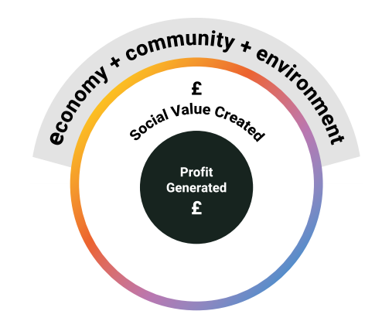
What is Social Value?
Who is Social
Value Portal (SVP)?
GPA's Social Value goals:
Put simply, Social Value is the value that an organisation contributes to society beyond operational profit. Wherever actions from the public, private or third sectors improve quality of life, help communities thrive, and safeguard our environment, Social Value is created.
Social Value Portal provides a clear mechanism for maximising Social Value at tender stage and in manging and reporting delivery.
We collaborated with the National Social Value Taskforce to develop the Social Value TOM System™ – a framework that creates connection between strategy and delivery by quantifying Social Value.
For Central Government clients, SVP have mapped the Social Value Model to the Social Value TOM System™ which means Suppliers can easily fulfil the needs of the Central Government and the Social Value Model with regards to Social Value.
Embed Social Value TOMs in procurement processes
Monitor and measure Social Value outcomes
Collaborate across supply chain to unlock Social Value
Continuously improve Social Value practices
Confidential © 2023 socialvalueportal.com
Notes:
Put simply, Social Value is the value that an organisation contributes to society beyond operational profit. Wherever actions from the public, private or third sectors improve quality of life, help communities thrive, and safeguard our environment, Social Value is created.
Find out more in the Social Value Toolkit 101 on our website.
1. Embed social value TOMs in procurement processes: Integrate social value criteria into procurement procedures, ensuring that suppliers are evaluated not only on cost and quality but also on their ability to deliver social benefits via the TOMs. Collaborate with procurement teams to develop evaluation criteria and scoring mechanisms.
2. Establish mechanisms to track and measure the social value generated by GPA activities. Use the Social Value Portal (SVP) to develop appropriate metrics and reporting systems to capture the impact on communities, the environment, and other relevant stakeholders across the GPA.
3. Engage with internal and external stakeholders and strategic partners to gather input, share best practices, and foster collaboration in implementing social value TOMs. Seek feedback from communities, service users, and other relevant parties to ensure that social value objectives are aligned with their needs and aspirations.
Conduct training sessions, workshops, and awareness campaigns to educate GPA staff about the importance of social value and the implementation of TOMs. Share success stories and lessons learned to inspire and motivate others to embrace social value principles.
Regularly review and evaluate the effectiveness of social value TOMs implementation. Identify areas for improvement and implement corrective actions to enhance the impact and efficiency of social value initiatives.

Slide 23
GPA Supplier Social Value Journey
Step 1:
Attend Market Engagement Session
Step 2: Submitting your tender
Step 3: Evaluation
Step 4:
Award to Mobilisation!
Step 5: Delivering Social Value
Understand GPA's Social Value requirements on the contract
Consider the Model Award Criteria and Social Value TOM System KPIs in the appendix to inform your responses
Your tender will be evaluated by evaluators at GPA and Social Value Portal
You've been successful! Congratulations. Your journey with Social Value Portal now begins
Enter delivery data on a quarterly basis
Explore Bidder Toolkit: Win More Bids to understand Social Value.
Data is reviewed on a quarterly basis
Through your submission, provide an indicative timeline for delivery for the Social Value offered throughout the contract
All evaluations are subject to a moderation process
In a mobilisation meeting with GPA Commercial Lead and a Social Value Portal representative, confirm your commitments against the KPIs. GPA give Supplier details for the project on the platform.
Download project reports to use in conversation with the GPA Commercial Lead to monitor your delivery
Be prepared to ‘Win work and deliver results under the Social Value Model’ against Model Award Criteria (MACs) and using the Social Value TOM System™
Evaluators want to see clear, relevant, realistic, deliverable responses that demonstrate genuine commitment deliver Social Value on the contract
Answer the specific Social Value questions asked within the ITT. Be concise, focused and genuine
Receive Supplier training on how to use the SVP platform
Consider the realistic targets that you will be able to deliver against post-award, ready for mobilisation!
Set targets on the SVP platform
Remember that SV is all about additionality - going beyond the core contract
Confidential © 2023 socialvalueportal.com
Notes:
So what are buyers looking for?
Buyers in the public sector look for suppliers that can deliver quality goods, services, or works at competitive prices. They also look for suppliers that can demonstrate their commitment to delivering social, environmental, and economic benefits to the local community.
Tenders require Social Value to be demonstrated by both financial value and supporting evidence.
Based on our experience and feedback from Local Authorities, buyers tend to look out for this pointers:
Tangible, quantifiable outcomes
Proportionate proposals
Qualitative evidence to support
Local impact
Realistic plans
Transparency and feasibility
Strong commitments; active delivery post-award

Slide 24
Indicative Procurement Timeline
Look out for the Contract Notice on https://www.gov.uk/find-tender - Anticipated 17th June 2024 . Documents to include:
Selection Questionnaire, Financial Viability Risk Assessment (FVRA) and Schedule of Requirements (SOR)
Responses to Selection Questionnaire due 16th July 2024
Responses evaluated and successful Suppliers Invited to Tender (ITT) - 29th July 2024
Maximum 35 calendar days for supplier to submit bid - 2nd September 2024
Preferred supplier selected and standstill period begins September 2024
Contract Award October 2024

Slide 25
Industry Questions and GPA Answers from Webinar
Industry Question | GPA Response
Is endpoint isolation required for follow me and direct printing? | End point isolation is required. End point isolation is enforced within the design of GovWifi and the GPA Shared Network. GovWifi enforces client isolation and within the GPA Shared Network there is no internal route between EUC devices and the Print VLAN.
Just to confirm this is a new service requirement and not an evolution / transition of an existing service | It is an evolution of the existing service.
How will this process affect the current gov print 2 set up | The new service will not replace the existing service. The existing service will continue until the end of the existing contract.
What are your default cloud storage destinations? | These will be defined in the ITT but are likely to include cloud storage services offered by Microsoft and Google.
Sorry I meant is this replacing any of the Gov print 2 | The new service will not replace the existing service. The existing service will continue until the end of the existing contract.
for Keith: Could you share, if possible, who is the current provider/ sole supplier for interoperability in existence with Gov Wifi? | GovWifi is a shared authentication service that is operated by GDS (https://www.wifi.service.gov.uk/). The network infrastructure required to deliver GovWifi is provided by the client and not by the GovWifi team.
Are you able to supply a list of the vendors that will receive the RFI | The selection questionnaire and SOR will be published on https://www.gov.uk/contracts-finder and available for all suppliers to view and respond to. The Invitation To Tender (ITT) will be viewable to only those suppliers who pass the selection stage.
Will we be able to have access to and a test area for GovPass API integration support? | This requirement can be supported

Slide 26
Questions

Slide 27
Thank you for joining.
gov.uk…/government-property-agency
/government-property-agency
@UKGovPropAgency

