Slide 1
Early Supplier Engagement Event
Domestic Heat Distribution Systems Evidence Gathering & Heat Network and Electricity Generation Assets Dynamic Purchasing System (HELGA)
Friday 3rd May 2019

Slide 2
Welcome
Jon Saltmarsh
Head of Built Environment, Technology & Systems Team
Science and Innovation for Climate and Energy

Slide 3
Agenda
10:00 | Welcome | Jon Saltmarsh | Built Environment Team
10:10 | Pre-Market Engagement | Ben Brenton | BEIS Procurement Team
10:30 | Research Requirements | Catherine Clark | Built Environment Team
11:15 | HELGA | Adam Garbutt | Crown Commercial Service
12:00 | Optional Private Q&A Sessions

Slide 4
Procurement Pre-Market Engagement Session
Presented by: Ben Brenton
BEIS Procurement Team

Slide 5
What BEIS would like to achieve today
Suppliers have further knowledge of this requirement and can ask questions at any time. Suppliers can plan ahead for this requirement and the procurement process.
BEIS has a better understanding and further information for this requirement before going out to market.
Suppliers offer innovation / tell us previous lessons learned. Help fill in the blanks of the specification. Tell us expectations that seem unrealistic. Tells us any risks that may occur and mitigations explored.
This presentation and the Q&A will also be published when the ITT is advertised. There will be an opportunity to ask additional questions today and at a later stage in the tendering process but timelines will be restricted and communications shared throughout the tendering community.

Slide 6
Procurement within BEIS
First point of call - existing frameworks including, but not restricted to, Crown Commercial Services Frameworks.
Requirements between £10,000 and £118,000 excluding VAT Contracts Finder. https://www.gov.uk/contracts-finder
OJEU (official Journal European Union) Contracts above £118k excluding VAT procured using the system BIP Solutions DELTA. Also advertised via Tender Electronic Daily. Suppliers should register with BIP DELTA for this requirement. This is free of charge.
https://www.delta-esourcing.com/

Slide 7
Procurement Route: Heat Networks and Electricity Generation Assets (HELGA) RM3824
Product types:
Service 1 - Energy Advisory, Design and Technical Services: Technical services relating to the advice and design of any demand management or generation type
Service 2 - Delivery Services: Delivery services to install, manage and maintain any demand management or generation type
Service 3 - Energy Purchase Agreement: Provision of Energy Purchase Agreements through direct or indirect opportunities
Service 4 - Commoditised Products: Access to commoditised products through bulk purchasing
Service 5 - One Stop Shop: One stop shop solution to deliver full end-to-end advisory, design, delivery, energy purchase agreements, and commoditised products.
Where opportunities will be advertised on HELGA, suppliers must register. It can take CCS up to 15 working days to register a supplier, so please build this into your timeline as necessary. Registration link here: https://supplierregistration.cabinetoffice.gov.uk/dps

Slide 8
Procurement Timeline for this requirement
Please note that these dates may be subject to change:
ITT to be advertised: Tuesday 14th May 2019
Questions received: 12pm (midday) Friday 24th May 2019
Answers published: Monday 3rd June 2019
Tender Deadline: 12pm (midday) Friday 14th June 2019
Suppliers alerted of outcome: Monday 1st July 2019
Contract Start Date: Monday 8th July 2019
TO BE ELIGIBLE TO BID INTO THIS PROJECT, YOU MUST BE A REGISTERED SUPPLIER ON HELGA BY 13th May 2019

Slide 9
Terms and Conditions for this requirement
BEIS standard terms and conditions will be applied to this requirement. Except the Liability, which will be amended from £4,000,000 to £1,000,000.
The Terms and Conditions will not be amended after ITT publication. Therefore, potential service providers should raise any concerns today so that any changes can be made before the ITT is issued.
Suppliers should not amend the T&Cs and submit changes with their proposal. This is effectively submitting a non-compliant proposal and will result in self-deselection.

Slide 10
Lead Suppliers and Consortiums
Suppliers are allowed to submit bids as consortiums, however the ‘Lead Supplier’ must be named.
Suppliers can submit bids individually as well as joining up and bidding as a consortium. Suppliers should declare this information with both BEIS and the supplier/s they would be joining up with as a consortia.
Suppliers should agree confidentiality arrangements between themselves and the consortium. This is for suppliers to arrange and agree between themselves and BEIS will not be involved in this specific element of the ITT. Suppliers should note the general confidentiality clause within the Department’s Terms and Conditions.

Slide 11
ANY QUESTIONS?

Slide 12
Domestic Heat Distribution Systems Evidence Gathering
Catherine Clark
Built Environment Team
Science and Innovation for Climate and Energy

Slide 13
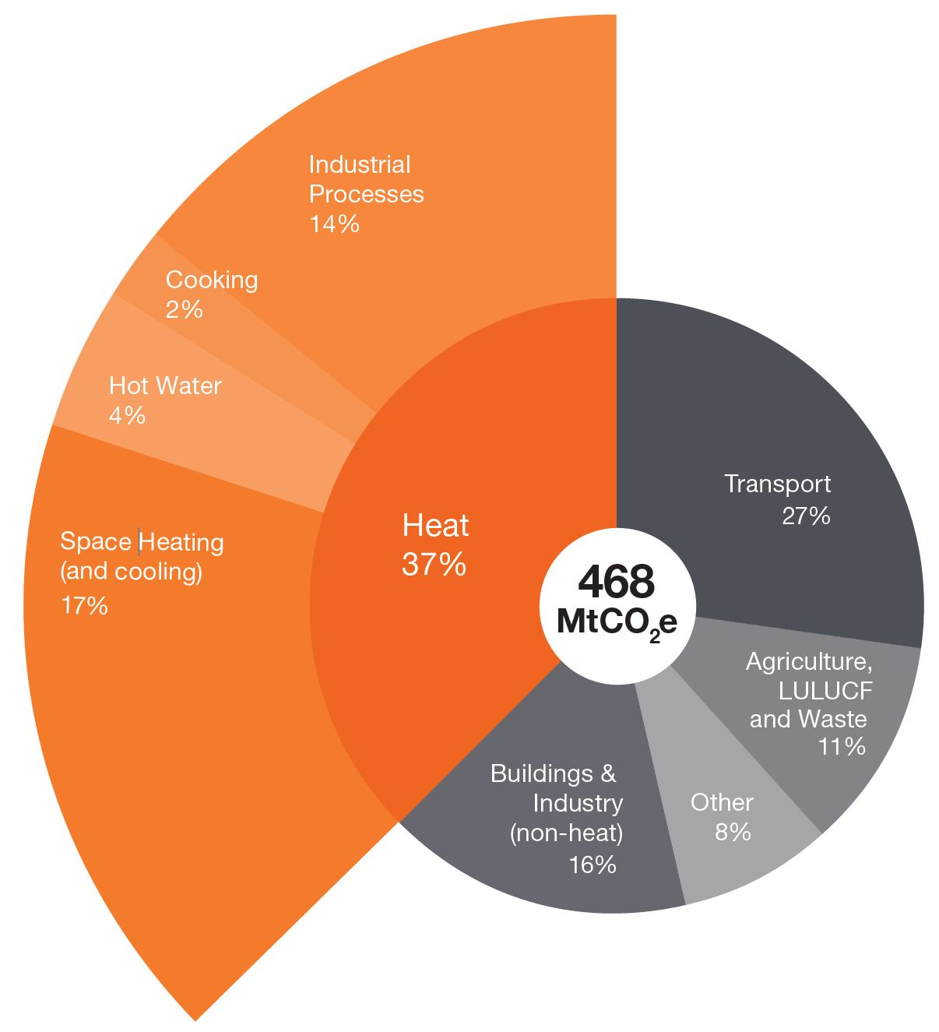
Why are we doing this research?
Estimated UK emissions attributable to heating, 2016

Slide 14
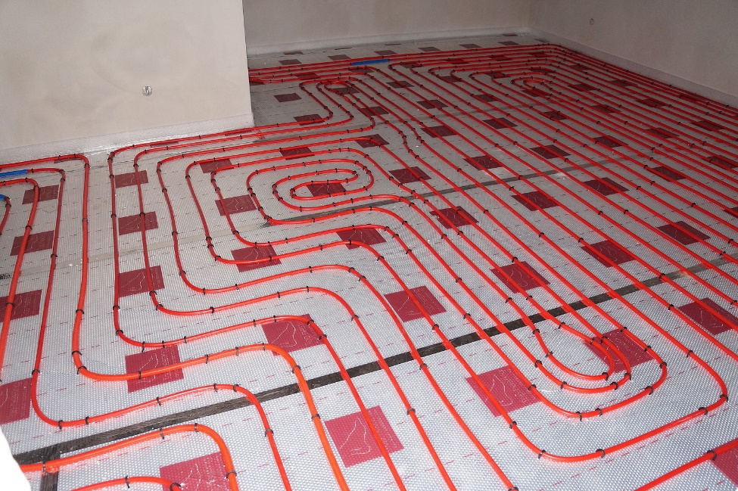
Domestic Heat Distribution Systems

Slide 15
Project Aims
To increase our understanding of existing heat distribution systems in the UK housing stock
To identify opportunities to improve the performance of domestic heat distribution systems

Slide 16
Split into two Lots
Lot 1
Review of existing heat distribution systems in the UK housing stock
Lot 2
Examining measures to improve the performance of domestic heat distribution systems

Slide 17
Lot 1 Objectives
Review of existing heat distribution systems in the UK housing stock
To consolidate and increase our understanding of domestic heat distribution systems including current technologies and their operating principles
To explore both present and past design, installation, commissioning, operation, and maintenance practices
To assess the current and potential market for heat distribution systems

Slide 18
Lot 1 Objectives continued…
Review of existing heat distribution systems in the UK housing stock
To identify applicable standards, policies and regulations
To better understand capital, installation, operation, and maintenance costs
To build up an evidence base of heat distribution systems across the current housing stock

Slide 19
Lot 1 - Scope
Wet systems (hot water radiators and underfloor heating)
Warm air systems (heated by heat pumps or gas-fuelled)
Room heaters
Electric heat distribution systems

Slide 20
Lot 2 Objectives
Examining measures to improve the performance of domestic heat distribution systems
To review the technical performance and maintenance of heat distribution systems
To identify measures to improve their performance
To analyse the energy and cost savings of the identified measures
To assess the current and potential market for performance-enhancing products

Slide 21
Lot 2 - Scope
Product based interventions
Active maintenance / recommissioning
More efficient heat emitters
Heat recovery
De-aeration
Radiator additives
Inhibitors
Heat transfer modifiers
Other (including new and innovative products)
Hydraulic balancing
Power flushing
Magnetic filtration
Scale reducer
Other
Lot 2 will exclusively look at boiler and radiator systems

Slide 22
Suggested Methodology (both Lots)
Desk-based study (literature review and market research)
Stakeholder engagement (e.g. installers, manufacturers, trade associations etc.)
Analysis / Modelling
Reporting

Slide 23
Reporting
Documenting your findings
Address all the research questions in the Invitation to Tender (“ITT”)
Recommendations for further work (including methodology and cost)
Lot 1 e.g. housing surveys
Lot 2 e.g. testing products in the lab

Slide 24
Evaluation criteria
Please note that this is subject to change:
BEIS Terms and Conditions – Pass/Fail
Conflict of Interest – Pass/Fail
Understanding of the Requirements – 15%
Methodology – 25%
Quality Assurance – 5%
Resource and Capability – 20%
Project Management and Risk – 10%
Price – 25%

Slide 25
Budget and Timeframe
Lot 1: £35,000 - £50,000
Lot 2: £25,000 - £40,000
July 2019 - January 2020 (7 months)

Slide 26
Discussion and Q&A
Opportunity for feedback

Slide 27
Heat Networks and Electricity Generation Assets (HELGA) DPS
Supplier Presentation
Presented by Adam Garbutt
3rd May 2019

Slide 28
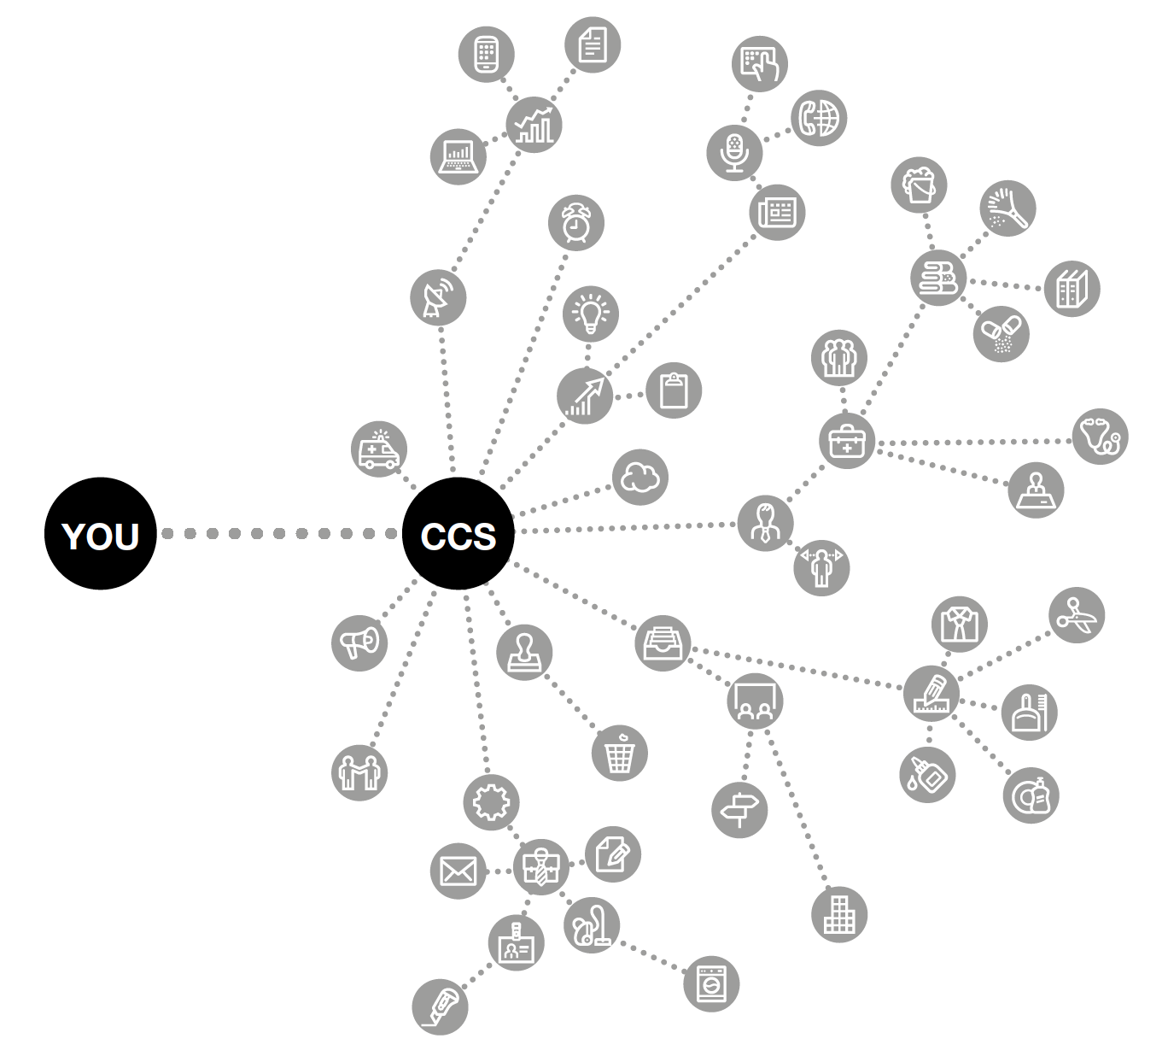
Agenda
Introduction to HELGA
Scope
Customer Journey
Benefits
Roles and responsibilities
Q&A opportunity
CCS
CC

Slide 29
Introduction to HELGA
What is HELGA?
HELGA stands for Heat Networks and Electricity Generation Assets
The agreement allows public sector bodies to procure a range of Energy Demand Management and Generation Products and Services through a flexible, easy-to-use and regulation-compliant process.
Designed to be flexible enough to allow customers to define their own requirements, the HELGA agreement provides access to the full range of demand reduction and energy generation services. This can range from a simple energy audit to a multi-million pound installation.
Users of the HELGA agreement have access to a wide range of market-leading suppliers. This drives value for money and, customers benefit from a streamlined procurement process which reduces the cost of the tender and ensures compliance to public procurement regulation.

Slide 30
Introduction to HELGA
The HELGA Products/Services covering the full journey of energy demand management and generation are as follows:
Energy Advisory, Design and Technical Services | Delivery Services | Energy Purchase Agreement | Commoditised Products | One Stop Shop
Technical services relating to the advice and design of any demand management or generation type | Delivery services to install, manage and maintain any demand management or generation type | Provision of Energy Purchase Agreements through direct or indirect opportunities | Access to Commoditised Products through bulk purchasing | One-stop-shop solution to deliver full end to end advisory, design, delivery, energy purchase agreements, and commoditised products.

Slide 31
Dynamic Purchasing System (DPS)
Why are we using a DPS for HELGA?
Every energy demand management or generation project is unique, so a traditional framework would not be suitable for many potential customers
The DPS is a more flexible approach which allows:
Individualised projects tailored to each customer’s needs
A wide range of specialist suppliers, including SME and regional suppliers for appropriate projects
An evolving list of available technologies as advances in energy management are made
N.B Even as part of the registration process a supplier indicated they are involved in ‘Virtual Power Plants’ so the offering could develop

Slide 32
Scope of the HELGA agreement
The duration of the HELGA DPS agreement is 4 years with the option to extend for a further 1 year, with the value estimated at £800m across its lifetime
Customers may enter into a contract with a supplier for a period of their determining, which may exceed the duration of the HELGA DPS Agreement.
The flexibility of the contracting period allows the customer to determine appropriate contracting timelines required in order that the supplier can meet the needs of the customer for large and complex projects.
One advantage of the DPS is that suppliers register on the platform anytime throughout the term once they have gone through a process to on-board to enable a constant competitive supplier base throughout the term
There is no direct award option, each procurement exercise will need to be a competitive process

Slide 33
Scope of the HELGA agreement
HELGA has been developed with energy demand management and generation in mind, and offers access to a range of suppliers for:
Electricity generation from e.g. solar panels, wind turbines or generators
Heat supply from e.g. heat pumps or biofuels
Heat networks
Combined Heat and Power generation
Heat and Power Purchase Agreements
Energy Efficiency and Demand Management in buildings, including energy storage technologies such as batteries

Slide 34
Offering
Who can use the agreement?
Products/Services available?
Customer Journey
Benefits
Access to specialist suppliers
Free to access
Expert guidance
Range of technologies
OJEU compliant
Flexible
Central Government
Local Government
Health
Devolved Administrations
Education
Emergency Services
Not for Profit
Housing Associations
Energy Advisory, Design and Technical Services
Delivery Services
Energy Purchase Agreement
Commoditised Products
One Stop Shop
Register on DPS
Export Supplier List
Define Requirement
Call for Competition
Evaluation
Award
Publish

Slide 35
Customer Journey
Define your Products / Service requirements
Create high level Specification with key requirements
Create initial supplier shortlist for pre-market engagement to assist requirement
Finalise specification incorporating any responses from pre market engagement, if used
Identify evaluation criteria, panel and any special requirements
Request evidence of works carried out if required
Evaluate all written proposals received against evaluation criteria and scoring
Publish specification to all shortlisted suppliers, including timescales, deliverables and evaluation criteria
If required carry out Capability Assessment
Export a refreshed supplier shortlist from the DPS
Proceed to award. Inform CCS of contract award via HELGA DPS
Provide feedback to all suppliers who participated
Issue Contract Award

Slide 36
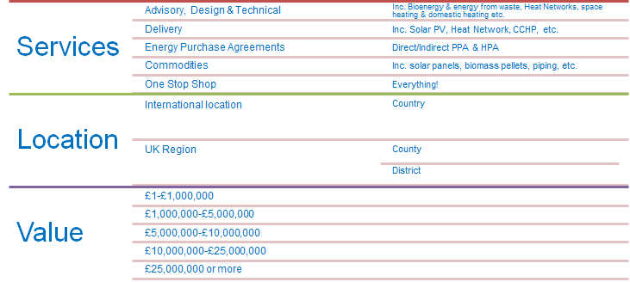
Supplier Filtering
Suppliers register for a range of Filters which allow customers to select suppliers with the right skills and capabilities for their needs:

Slide 37
Customer Charter
CCS’ role is to provide customers with advice and guidance to help them get the best out of the HELGA DPS.
We can help with any queries such as the best way to appoint a supplier and advice on structuring evaluation criteria.
CCS manages the overarching HELGA DPS and the suppliers at agreement level.
Customers are responsible for managing the contract with your appointed supplier. CCS is able to help with any issues that may require escalating.

Slide 38
Roles and Responsibilities
Customer
Supplier
CCS
Management of supplier at contract level – including issues
Provide a clear specification
Act in a fair and transparent way
Pay suppliers within 30 days
Regular communication
Provide feedback
Provide expert advice and consultation
Submit management information in timely manner
Ensure DPS agreement obligations are met
Adhere to KPI requirements
Management of DPS system
Management of suppliers at agreement level
Provide help and guidance
Act as escalation point
Supplier compliance

Slide 39
Benefits
The HELGA DPS offers a number of key benefits for customers:
Dynamic – customers can build specifications, competitions and contracts to suit their needs
Easy to Use – simple electronic process using widely available systems
Market access – access to a wide range of suppliers, driving competition and offering an increased scope of services
Supplier filtering – quickly find relevant suppliers for competitions, including local and SME suppliers to suit customer’s requirements
Compliance - Fully compliant with UK and EU regulations

Slide 40
Q&A Opportunity
Questions?

Slide 41
Keeping in touch
info@crowncommercial.gov.uk
0345 410 2222
www.gov.uk/ccs
@gov_procurement
Crown Commercial Service

Slide 42
Private Q&A Sessions
builtenvironmentresearch@beis.gov.uk

