Slide 1
Open Market Engagement – Early Years Foundation Stage (EYFS) reforms
Early Years Quality and Outcomes Division
June 2020

Slide 2
Objectives of this information pack
To provide you with:
Context of EYFS reforms
Importance of supporting the Early Years workforce in implementing the reforms:
Awareness and understanding of key changes to the Early Learning Goals and Early Years Foundation Stage Profile and new curriculum guidance
An understanding of what we aim to achieve through the proposed activity and expected timelines.

Slide 3
EYFS reforms - context
2017 manifesto commitment
Strengthening literacy and numeracy in the early years.
Social mobility agenda
Secretary of State ambition to reduce the proportion of children who do not achieve at least expected levels across all Early Learning Goals in the ‘communication & language’ and ‘literacy’ areas of learning at the end of Reception year by half by 2028.
Primary assessment consultation 2017
Strong demand from the sector to make improvements to the EYFS amidst widespread support for what is seen as a valued assessment in the EYFS Profile.
Calls for clearer Early Learning Goals and better alignment with Key Stage 1.

Slide 4
EYFS Profile reforms – in summary
Our reforms were announced in June 2018 and they underpin two key objectives: reducing teacher workload and improving outcomes- particularly in language, literacy and maths
Revising the Early Learning Goals so that they:
Focus on strengthening language and vocabulary development to help close the ‘word gap’
Strengthen literacy and numeracy outcomes at the end of reception year
Better prepare children for Key Stage 1 – by better aligning with Year 1
Are based on the latest evidence in childhood development – and the strongest predictors of future attainment
Are clearer for teachers to interpret – making the EYFSP assessment more straightforward and reliable.
Streamlining assessment guidance and reviewing the moderation process to:
Reduce teacher workload

Slide 5
EYFS reforms – timelines
We piloted the revised ELGs and new approaches to the moderation process with 24 schools from September 2018 – in partnership with the Education Endowment Foundation and NatCen.
NatCen published an independent evaluation of the pilot in autumn 2019.
We launched a public consultation on 24 October 2019, the consultation closed on 31 January 2020.
Expect to have published government’s response to the consultation by spring 2020 and to have laid regulations by summer 2020.
National roll-out will be from September 2021- giving the sector a year to prepare to implement the revised EYFS.
We wrote to headteachers of all primary and infant schools (maintained and academies) to offer them the opportunity to voluntarily participate as an Early Adopter in 2020.

Slide 6
EYFS reforms – support
Support to implement the reforms will include:
Development of exemplification materials and webinars to support practitioners to undertake the EYFSP assessment process
An online support offer for PVI and childminder settings providing guidance about how to implement the reforms
Information events for LA’s to provide them with the knowledge they will need to support schools and settings in their area implement the reforms
This procurement is for the LA information events only. Other procurements will be advertised separately.

Slide 7
Events for Local Authorities - overview
Local Authorities (LAs) are currently a key source of EYFSP assessment training and support for reception teachers.
Currently, LAs also have the statutory responsibility to externally moderate EYFSP judgements in 25% of primary schools by the end of each academic year. Government has consulted on the proposal to remove this requirement and a Ministerial decision has not yet been taken.
We anticipate that many reception teachers and head teachers will approach their LA for advice when implementing the new EYFSP for the first time.
It is therefore important that LAs are fully briefed to ensure support and messaging to schools is consistent across the country throughout the implementation period.

Slide 8

Proposal for LA events
We propose to hold a series of virtual events for Early Years representatives from all LAs early in 2021 to:
Set out the key messages, context and rationale behind the final policy changes and ensure consistent messaging across central and local government.
Go through the key policy changes and how they should be interpreted and offer LAs the opportunity to ask procedural and policy questions about implementation.
Encourage knowledge-sharing and dissemination of best practice across Local Authorities, including on moderation of EYFSP judgements if the statutory duty is retained.
This will ensure that LAs are prepared to start offering advice and implementation support to schools as they prepare for national implementation in the lead up to September 2021.

Slide 9
Draft specification
Plan and deliver ten virtual events for Local Authority representatives early 2021, including:
Managing communications with LAs and organising sign-up to events;
Acting as facilitator for all ten events;
Liaising with external speakers stipulated by the DfE
Providing a suitable online platform for hosting these sessions;
We anticipate the virtual events will:
Group attendees from eight regions in England to facilitate local good practice and insight sharing;
Offer free places to a maximum of two representatives per Local Authority;
Offer approximately 30 places per event to ensure manageable online capacity which encourages conversation
Take place in January and February 2021.
We require sector experts with experience and who have good knowledge of the issues and challenges within Early Years.

Slide 10
Timeline
Our proposed timeline is as follows:
Date | Activity
Early July 2020 | Launch procurement
September 2020 | Award contract/s
January/February 2021 | Deliver events

Slide 11
Commercial process

Slide 12
Stages of the bidding process – Open Competition
Bidders submit ITT response/
proposal including costings
Desktop evaluation of bidders’ written responses
Final moderation
Notification of results, intention to award and feedback
10 day grace period
Contract award
Commencement of Contract
Invitation to tender (ITT) published on DfE e-tendering portal ‘Jaggaer’
Competition Stages

Slide 13
Standard Supplier Questionnaire (SSQ)
A Standard Supplier Questionnaire asks potential suppliers to initially self-declare their status against the exclusion grounds and selection questions.
The SSQ is structured in 3 separate parts:
Part 1 - of the SSQ covers the basic information about the supplier: e.g. contact details, trade memberships, details of parent companies, group bidding etc.
Part 2 - covers a self-declaration whether or not any exclusion grounds apply e.g. insurance cover must be the minimum level required as stated in the SSQ etc.
Part 3 - covers a self-declaration regarding whether or not the company meets the selection criteria in respect of their financial standing and technical capacity.

Slide 14
Supplier Registration Service (SRS)
It is a mandatory requirement for all bidders to register with the Supplier Registration Service for Government. This is a Crown Commercial Service/Cabinet Office portal, which contains details of over 225,000 suppliers, of which 4,300 are registered as delivering goods and services to the Authority and its agencies.
The Authority will use data provided through the Supplier Registration Service to conduct financial assessment and due diligence checks to ensure that potential bidders do not expose the DfE to unacceptable levels of financial risk.
The portal provides both suppliers and buyers with a single place to create and share commercial information and if not already registered, bidders should do so via the following link: https://supplierregistration.cabinetoffice.gov.uk/

Slide 15
Jaggaer – DfE e-Tendering Portal

Slide 16
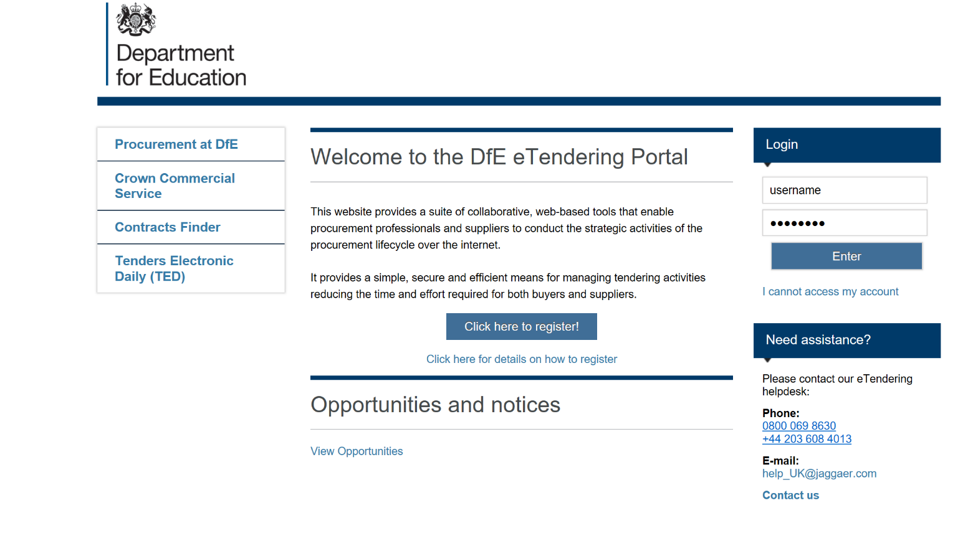
Jaggaer registration: https://education.app.jaggaer.com/web/login.html

Slide 17
What organisations must not do
Canvass help, assistance or opinion on the tender or the procurement process in general from any DfE employee or other Government Department, Agency or NDPB other than through the e-Tendering portal message board.
Submit a partially completed tender as this will not be evaluated.
Submit a tender after the closing date and time - any tenders published after the deadline will not be considered.

Slide 18
Further information
Further information will be made available on contracts finder after this event, including the market engagement slides and Q&A response pack.
Please register on Jaggaer to be kept up to date on all ITT developments.
Contact us at: EYFS.CONSULTATION@education.gov.uk if you have any questions.
Please note, once the procurement is open for competition all communication is to be directed through the Jaggaer portal. We will not respond to questions outside of Jaggaer.

Slide 19


