Slide 1
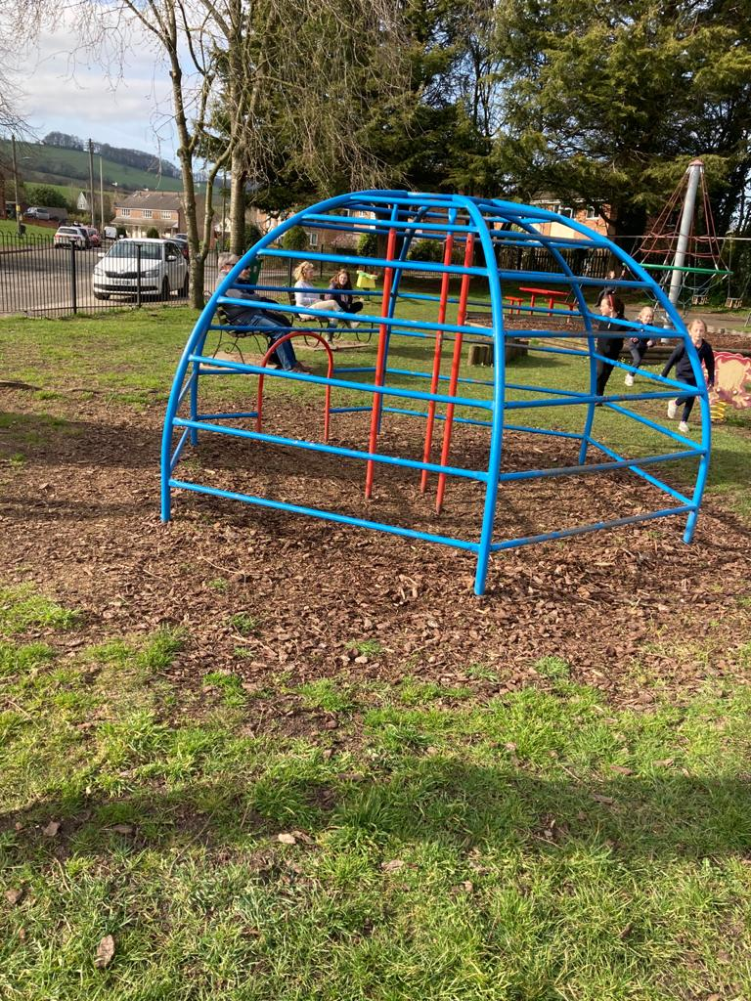
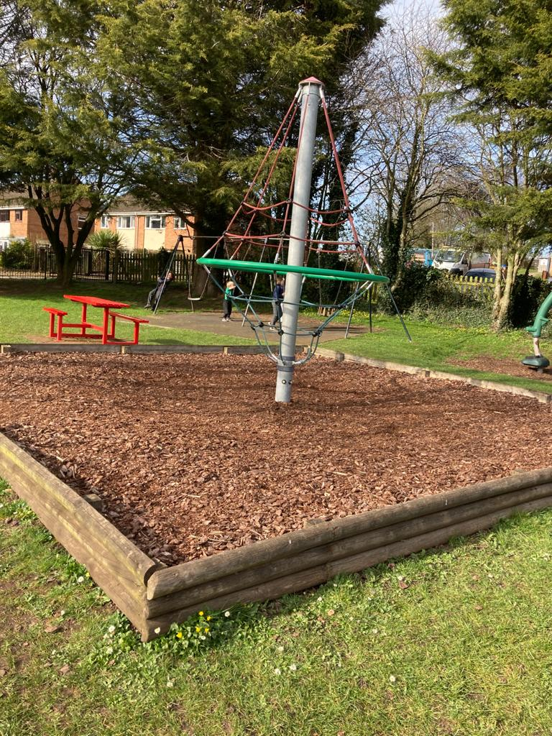
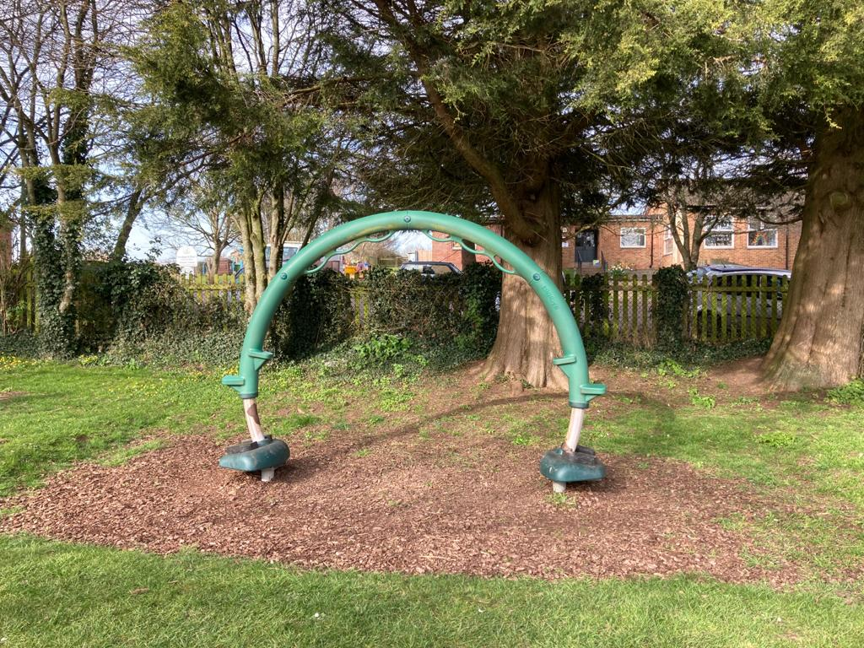
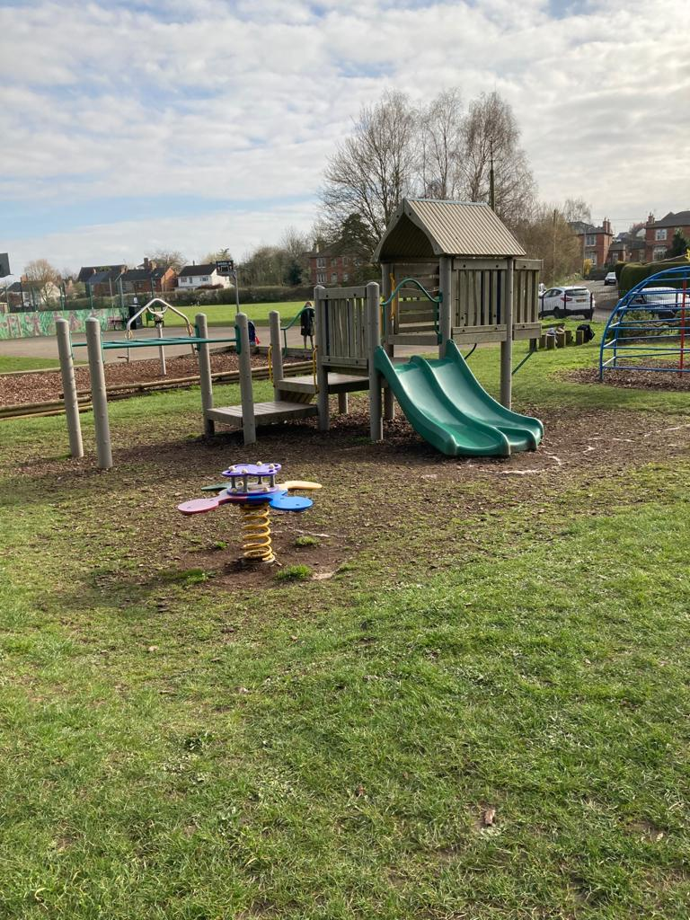
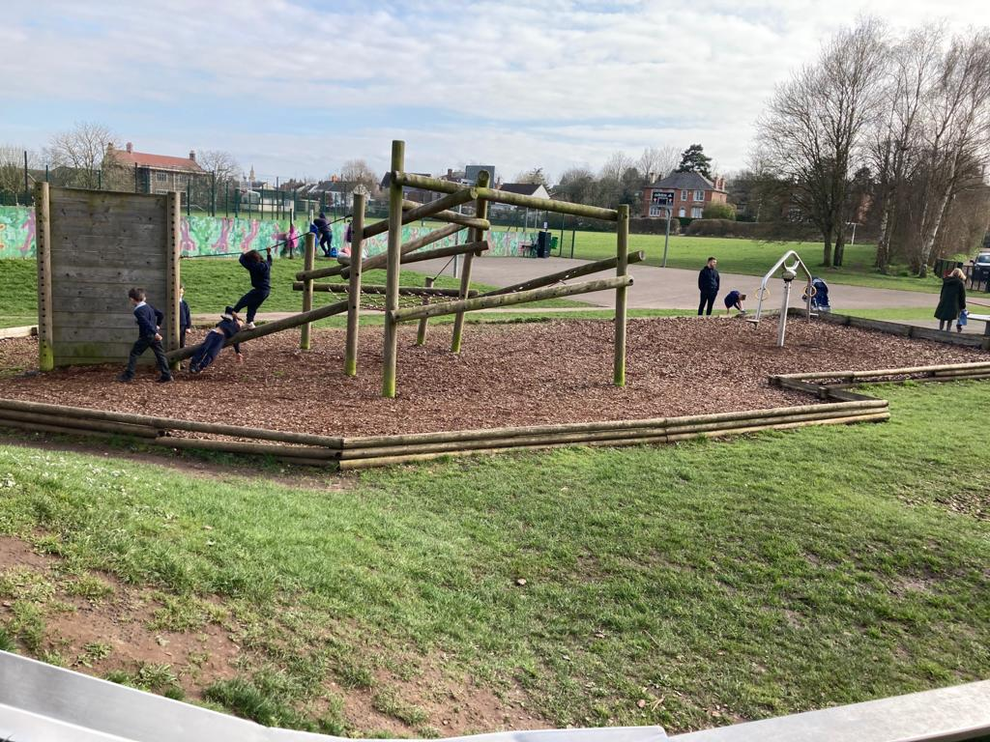
1 2 3 4
1 Measured as a circle 5 metres in diameter, drop – 2.13 meters (7’)
2 Measured as a square 6.7 metres per side, drop – 2.43 metres (8’)
3 Measured as a rectangle 6 x 3.7 metres , drop 1.4 meters (4’6”)
4 Measured as a square 7.7 metres per side, drop 1.5 meters (5’)
5 Measured as a rectangle 17 x 9.2 metres, drop – 2.13 m (7’), 3.65m (12’), 2.43 m (8’)
Note this is maximum dimensions as you can see its shaped
All dimensions are approximate
5

