Slide 1
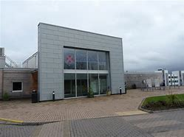
Procurement Approach
Simon Arthurs – Director of Finance & Su Matthews Interim Procurement Manager

Slide 2
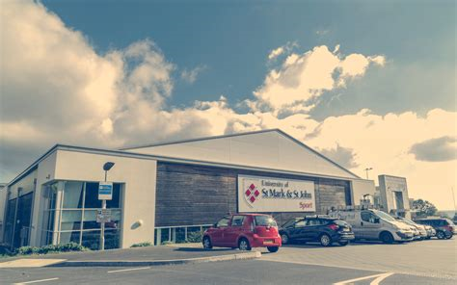
2015 No. 102
PUBLIC PROCUREMENT
The Public Contracts Regulations 2015
Made - - - - 4th February 2015
Laid before Parliament 5th February 2015

Slide 4
Openness

Slide 5
Procurement Procedure
Restricted Procedure
Stage 1 – Despatch of Call for Competition to receipt of tenders – 30 calendar days
Shortlisting (minimum of 5)
Stage 2 – Despatch of Invitation to Tender – 25 calendar days

Slide 6
When & Where ………….
We are aiming for a tender go live by Friday 17th May 2019;
You will receive a courtesy email from us with a link to the tender pack;
The OJEU Notice will be published via Tenders Electronic Daily;
https://ted.europa.eu/TED/browse/browseByBO.do
The Tender Documents will be accessible via Contracts Finder; https://www.gov.uk/contracts-finder

Slide 7
Questions

