Slide 1




Department for Education
Schools Water Strategy
Early Supplier Engagement

Slide 2



Schools Water Strategy Background
1
Making every pound count
The Schools Water Strategy (SWS) is an invest to save strategy aimed at reducing the risk of flooding in schools.
In April 2022 the Department for Education (DfE) Sustainability and Climate Change Strategy (SSCS)1 was announced. Two of the Strategic aims in this strategy are:
Resilience to climate change: adapting our education and care buildings and system to prepare for the effects of climate change as well as a better environment for future generations
Enhancing biodiversity, improving air quality and increasing access to, and connection with, nature in and around education and care settings.
The current SWS goal is to reduce the risk of flooding in 800 schools by 2026, which we have been working towards for a number of years.
One element of the strategy is to reduce surface water flooding in the school estate. We currently achieve this by awarding match funded grants to delivery providers such as Lead Local Flood Authorities (LLFA), Water Companies and Charities / Non-Profit organisations to install Sustainable Drainage Systems (SuDS)2 within the grounds of Schools that are at risk of flooding. Schools who can provide match funding are also eligible to apply and deliver their own project. The SuDS in schools' scheme is a match funded scheme where the DfE, at their discretion and where the criteria allows can fund up to 50% of the SuDS design and construction project costs.
The whole grant management life cycle is currently managed internally by the SWS SuDS Project Team. The aim of this notice is to gather initial information around the capability and interest of external grant management suppliers in providing the grant management services set out on slide 4 ‘Scope of Requirements’.
1 https://www.gov.uk/government/publications/sustainability-and-climate-change-strategy
2 Update to the SuDS Manual - GOV.UK (www.gov.uk)
2
2

Slide 3

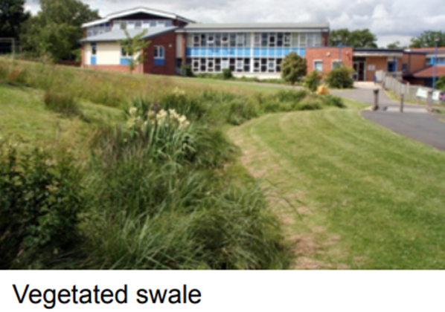
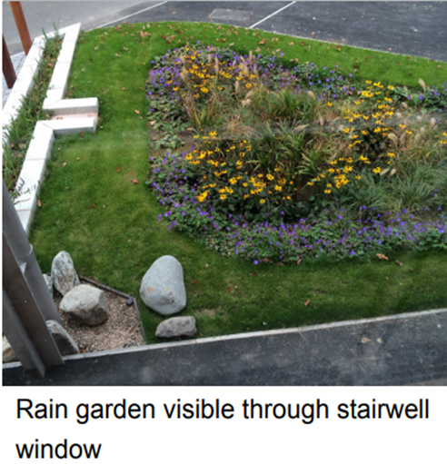
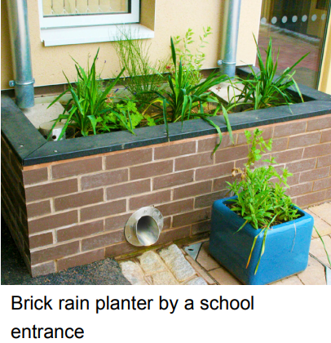
SuDS Solutions
1
Making every pound count
The grants that are managed are for the delivery/installation of SuDS solutions. SuDS mimic nature and typically manage rainfall close to where it falls. SuDS can be designed to transport (convey) surface water, slow runoff down (attenuate) before it enters watercourses, they provide areas to store water in natural contours and can be used to allow water to soak (infiltrate) into the ground or evaporated from surface water and lost or transpired from vegetation (known as evapotranspiration).
SuDS projects are retro fit minor construction works the value of the grant being managed is typically from £50K to £900K.
Examples of SuDS Solutions:
Tree Pit
3
3

Slide 4
Scope of Requirement
1
Making every pound count
The Schools Water Strategy is reviewing delivery options to provide flexibility around the number of grants delivered, which may be through utilising a 3rd party to provide Grant Management services. The aim of this notice is to gather initial information around Grant Management suppliers and what services are available in the market.
Potential scope of the DfE requirements
Grant advertisement (Find a Grant - Home - Find a grant (find-government-grants.service.gov.uk))
Grant application assessment and evaluation against DfE specified criteria
Grant Offer Letter drafting and issuing
Grant performance and query management
Grant payment claim processing and payment
Grant assurance management (see slide 5)
*Nb: the final scope of requirements have not yet been confirmed. If any procurement activity does arise the requirements will be refined pending the results of market research.
If the Department for Education does conduct any procurement activity for Grant Management services, this would likely be via the Crown Commercial Services - Fund Administration & Disbursement Services DPS (FAADS) framework.
4
4

Slide 5
Government Funding Payment Assurance
1
Making every pound count
HM Treasury rules mandate when Government Funding is issued by an Authority, the Authority is required to obtain assurance to ensure the public funds are being spent in accordance with the terms of the grant agreement.
When the Department for Education (Authority) issues a grant agreement, we seek assurance from the Grant Recipient that:
the money has been spent for the intended purpose of the grant agreement
the money has been spent in a regular & proper way and represents value for money
As some of the SuDs grants are issued to private Water Companies this grant programme operates a 100% assurance check on every grant payment claim that is made. Payment assurance is carried out by asking the Grant Recipient to submit evidence for the value of the payment claim. The typical of evidence we ask for (list is not exhaustive):
Contractor invoices – e.g. Design Consultants, Construction Contractors or,
Confirmation of internal overhead costs
Copies of final designs.
Email evidence from the school to confirm they are happy to procedure with the design.
Pictures of the installed solutions
Email evidence from the school to confirm the SuDS solutions have been installed as agreed.
The payment assurance process is essential in ensuring public funds are spent as per the grant agreement and that value for money is being achieved. The DfE expects any 3rd party who are grant managing grants on their behalf to fulfil the necessary assurance requirements, with the same level of due-diligence for every payment claim.
5
5

Slide 6

Response Required
1
Making every pound count
If your organisation has capabilities to deliver the type of Grant Management described in the previous slides, the Department welcomes your response to the set questions in the Microsoft Teams form linked below. Please submit your response following the below process, any responses submitted outside of the below process may not be reviewed.
Review the questions in the Microsoft Form (linked below)
Collate your answers to submit via the Microsoft Form
Any queries must be submitted to the SWS mailbox below by 31/07/2024
Final responses must be submitted via the Microsoft form below by 07/08/2024
Where attachments are requested, please submit these to the SWS mailbox (details below)
Microsoft Form:
https://forms.office.com/e/4xyxyxw2Xx
Q16 Grant Management Average Cost Exercise:
Please Note: Attachments cannot be submitted to the Department via the Microsoft Forms, there are certain questions in the Microsoft Form that require attachment submissions and these attachments should be sent by email submission to the following mailbox: SWS.Commercial@education.gov.uk.
Please state GM- your company name as written in question 3 of the Microsoft form as the subject of the email.
6
6

Slide 7
To note
1
Making every pound count
This notice and document do not constitute a call for competition to procure any services for the Department. The procurement of any services will be carried out in accordance with the relevant Government Procurement Regulations. The purpose of this PIN is to gather feedback from interested and capable parties only, future market engagement and/or opportunities will be advertised accordingly.
Please submit any queries to the SWS mailbox – SWS.Commercial@education.gov.uk
7
7

