Slide 1
Energy Innovation Needs Assessments 2.0
Pre-ITT Supplier Event – 31/03/2023

Slide 2

Some Admin
Have a smartphone ready with you. Or separate browser if more convenient.
Log into Slido:
Go to Slido.com
Use code: #1245221
Or use QR code:
Q&A on Teams – moderation rules:
Need to remain anonymous
Only use Teams Q&A
You can post your questions at any point – will be answering them at the end, if possible.
If any questions remain un-answered by the end we will respond by correspondence, sharing the answer with all participants and publicly alongside the ITT when published.
Questions and answers will be anonymised when published. However, do not share any information you do not wish to be shared with other participants (use Slido for any feedback)

Slide 3
Agenda – Event Objectives
EINA Intro and Background
Purpose and key objectives
Key 2019 EINA outputs
EINAs 2.0 – expected changes
Similarities
Key differences
Barriers and enablers
Notes on expectations
Timeline and ITT info
Commercial
Feedback and Q&A
Presentation objectives:
Provide potential suppliers with context to project
Outline timeline and expected ITT requirements
Respond to any questions relating to presentation/project
Opportunity for those interested to connect with other suppliers
15min
20-30min
15-30min

Slide 4






EINAs 2.0 Purpose and Objectives
Aims to answer the question: which energy/NZ technology innovations are likely to benefit the UK most when supported by the government?
Meant for: NZ innovation funding prioritisation and Net Zero strategy decision making, in preparation for 2024/5 Spending Review.
Provides:
An analytical framework to identify NZ/energy technologies where government innovation support can be most beneficial to the UK.
An evidence base outlining the requirements for successful commercialisation for such innovations/technologies.
How: by identifying technologies that…
Delivers: comprehensive evidence base:
… have the greatest potential system benefit to the UK energy system
1. Quantified role of technologies in the energy system rather than focusing on the contribution of individual components
2. Quantified scale of the business opportunity to the UK by complimenting the system modelling with economic analysis of domestic and export opportunities
Comparable outputs across technologies to facilitate prioritization
… benefit the UK economy through business opportunities
… are likely to benefit from UK government support to realise the identified opportunities
3. Understanding of innovation needs for successful commercialization by assessing UK capabilities and barriers to market adoption.

Slide 5

Key 2019 EINA Outputs (1/3)
System modelling:
Technology deployment pathways
Innovation Value
Opportunity Costs
Economic Impacts:
GVA estimates to 2050
Jobs estimates to 2050
Both based on above system modelling
Qualitative evidence:
Deep-dives into selected technology families
Evidence from expert engagement
12 Sub-theme reports

Slide 6

Key 2019 EINA Outputs (2/3): System Modelling
System modelling provided tech deployment pathways to base overall EINAs on a consistent whole system basis. How do technologies and demand/supply balance under different conditions.
“Innovation value” and “opportunity costs” key metrics from system modelling
CAPEX (£/kW) – e.g. Floating offshore wind
Cost
Energy System Cost
1
No innovation Scenario
2
Low Scenario Innovation Value
2020
Time
2050
1
3
Innovation Scenarios
Mid Scenario Innovation Value
Low Innovation:
Mid Innovation:
High Innovation:
2
Cost
Efficiency - e.g. Floating offshore wind
High Scenario Innovation Value
3
%
2020
Time
2050
2020
Time
2050

Slide 7
Key 2019 EINA Outputs (3/3): Economic Impacts
Technology deployment to Jobs – job calculators simplified step by step breakdown:
Tech Deployment
UK Market Share %
ONS GVA multiplier
ONS GVA/Worker
Calculator
Market Turnover
Calculator
Calculator
Calculator
Component Costs
UK Turnover
GVA
Jobs supported
Colour code:
Assumption
Data
Metric

Slide 8
EINAs 2.0 – Output similarities
System modelling:
Technology deployment pathways
Innovation Value
Opportunity Costs
Economic Impacts:
GVA estimates to 2050
Jobs estimates to 2050
Both based on above system modelling
Qualitative evidence/assumptions:
Expert engagements
Evidence synthesis
Same method, but NZ + equivalent alternatives
Updated calculators + improved features
More selective and in depth

Slide 9
EINAs 2.0 – Key differences
System modelling:
Wider range of scenarios
Not used for early shortlisting
Barriers and enablers:
Comparative overview
Quantitative analysis of key barriers/enablers, for instance:
Skills (based on job calculator projections)
Grid/Infrastructure needs (based on system modelling)
Material/component needs
Energy security considerations
Need to be accounted in early shortlisting
Can be a comparative modelling output
Economic Impacts:
No transport sector
Potential basis for skills/components analysis
Key area of additional focus – stressing the needs part of the EINAs and addressing key shortcoming of previous iteration
General:
Higher selectivity for in-depth analysis
Closer cooperation with BEIS - sector teams and ongoing internal work in department

Slide 10
Innovation barriers and enablers
2019 EINAs were mostly focused in identifying opportunities from innovation – at least quantitatively
EINAs 2.0 would add depth by evidencing the level of challenge needed to unlock such opportunities
Energy System Benefits
Some Priority
High Priority
Energy System Benefits
Low Priority
Some Priority
Economic Benefits
Barriers & Enablers
Economic Benefits
Use: not as determinant of priority, rather understanding of gaps that need addressing.
Examples: skills, comparative advantage, infrastructure, market framework, finance access…
It’s only feasible to go in depth in some areas – so the hope is to leverage existing core EINA workstreams – system modelling and economic impacts. Skills, infrastructure/grid and supply chain needs are the highest demand ones.

Slide 11
Early Shortlisting
While all technologies need to be accounted for at system modelling stage, some selectivity is expected when moving to further in depth analysis.
Early shortlisting criteria should focus on relevance to UK net zero context. Indicative example:
Starting technology list
All net zero/energy technologies
Step 1: Critical for Net Zero
Step 1
Please note: only an indicative example and not a prescriptive requirement. Suppliers to determine most robust approach for their bid.
Step 2: Critical For Energy Security
Step 2
Step 3: Relevant timing/TRL?
Step 3
Step 4: UK Relevant?
Step 4
Step 5: Benefits from intervention?
Step 5
Shortlisted technologies
Early technology shortlist for analysis
Consider in next step
Consider to keep
Consider to remove
Confirmed

Slide 12
Note on System Modelling
Model expectations:
At least equivalent to UK TIMES in terms of model type
Be able to cover all GHGs, either within model or with complementary models
Not expect BEIS resource to fill-in the gaps
Provide the same or higher level of deliverables and value as compared to UK TIMES
Choice of model:
This will be based on both model quality and value provided to BEIS
UK TIMES is our in-house model, which provides value by:
Future proofing analysis – scenarios can be updated easily
Using UK TIMES for this project allows leveraging a multitude of internally developed scenarios, including recent ones as part of the net zero society work. This provides value by saving the project scenario development time.
Given timeline, not having to re-approve scenarios and assumptions brings expediency value to the project.
Other equivalent models are eligible, but should provide the same or higher value to BEIS compared to using UK TIMES
Please note: the use of UK TIMES will not be through BEIS resource – only feedback and sense checking provided.

Slide 13
BEIS internal resources relevant for project
There are internal assets and analysis workstreams that can contribute towards this project. Suppliers could use some of these for supplementing reach and quality of project. They should not however rely on these for any dependencies or core deliverables, unless explicitly advised so by BEIS. Further detail will be provided within ITT.
Models:
UK TIMES: only feedback and scenarios/model spec – no resource can be made available for system modelling. Scenarios can however be made available.
DDM: only feedback and assumptions, or model spec where needed/relevant.
International comparative model: framework covering key global technology innovation data – in development.
On-going/available analysis/research:
Work by BEIS sector teams: internally available evidence on specific sectors/recent analysis.
Expert elicitation: on-going interview based thematic analysis involving around 50 experts.
NZIP experience/evidence: what we have learned delivering the Net Zero Innovation Portfolio or predecessors.

Slide 14
High-level Indicative Timeline
Procurement
Analysis
Synthesis
~28th April 23
~mid/late June 23
ITT Published
Contract Award
Final analysis QA and confirmation
Core analysis
ITT Closed
Plans finalised
Core results expected
Merging findings and reporting
~End May 23
~Late July 23
~Late March 2
Please note: clear sequential delivery milestones expected throughout the analysis period, to be recommended by suppliers and confirmed with BEIS over planning period. QA is also expected on ongoing basis.

Slide 15
ITT – what to expect
Max budget: £480,000
ITT will focus on supplier/consortium proposed methodology and relevant outputs, in terms of quality, breadth and deliverability. Supplier technical skills and domain expertise are likewise very important.
One section will provide methodology baseline recommendations: should be seen as guidelines showing how the project could be approached so to provide an understanding of BEIS expectations. Suppliers should aim at proposing something that improves on this or that is at the very least equivalent.
One section on expected outcomes: these are strict requirements we would need regardless of approach proposed by the suppliers.
One section on evidence and resource available in BEIS to share with suppliers for this project
This is an indicative overview of the ITT but is subject to change at BEIS discretion.

Slide 16
Commercial – Terms & Conditions
BEIS Standard T&Cs are expected to form the basis of the contract, we will publish the final version of the T&Cs at the time of the ITT.
They will be final and any bids submitted on condition that T&Cs are amended will be effectively submitting a non-compliant bid.
• Intellectual Property:
- Any New IPR created under the Contract is owned by the Buyer (BEIS)
• Liability:
- Except for certain exclusions, each Party's total aggregate liability under the Contract is no more than 150% of the estimated annual Charges due under this Contract.
If you have questions about the T&Cs you can ask them today or during the ITT Q&A window.
All Q&A raised during the ITT publication period will be anonymised and shared with all bidders.

Slide 17
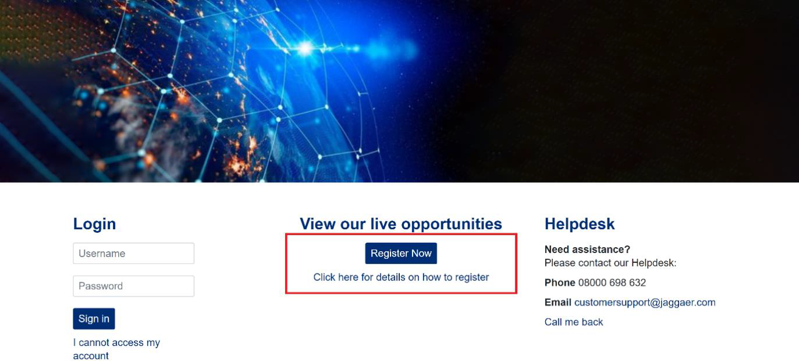
Commercial – Application process
Organisations must apply by first registering to the live Jaggaer Portal (https://beisgroup.ukp.app.jaggaer.com/) and then apply for the programme.
If applying as a consortium only the lead needs to put in an application.

Slide 18
Feedback and Consortiums
Some feedback for us in BEIS (keep an eye on Slido for question changes):
Does any part of the presentation concern you from a delivery perspective?
Overall, how do you feel about the project?
Was this presentation clear/useful? Or any other feedback!
Consortiums:
A wide range of skills and expertise needed for this project – a consortium can help with this.
BEIS will provide an opportunity for people to share their details with other supplier event participants by email if they desire so.
We will be sending an email asking for your consent and the information to be shared with participants (contact name, email, organisation, expertise).

Slide 19
Q&A

