Slide 1
UKSA International Bilateral Fund – Request for Information
UKSA International Relations Team
2022

Slide 2
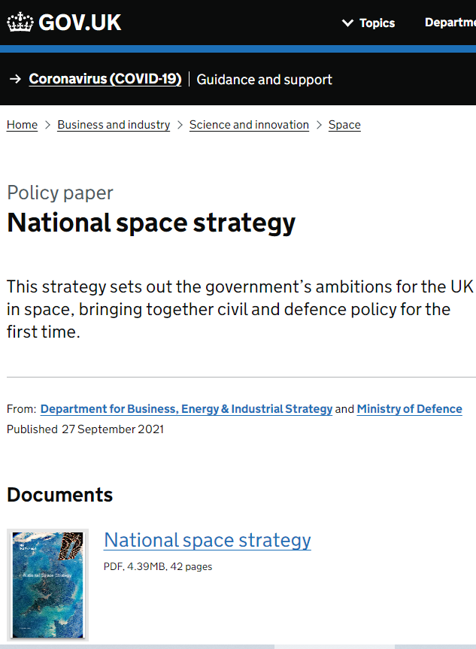
Why are we funding international collaboration?
The Integrated Review and the National Space Strategy highlight the UK’s ambition to collaborate internationally, to unlock growth and to deliver resilient capabilities and services.
The IBF will meet these ambitions by focusing on projects with the UK’s strategic priority countries and emerging space nations.

Slide 3
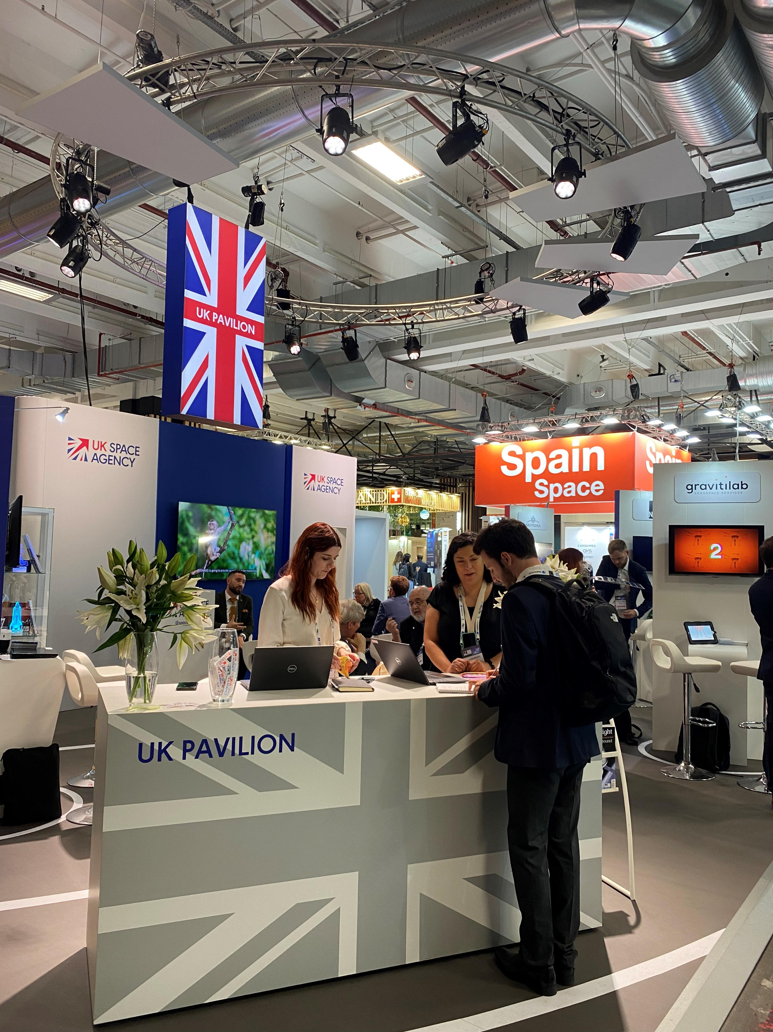
Key objectives
Stronger relationships with international partners and become a trusted partner of choice
Increase UK space sector inward investment and exports
Develop UK capabilities in collaboration with our international partners.

Slide 4
The International Bilateral Fund
To November 2022
November to December 2022
RFI opens 31st October
RFI Deadline 5th Dec
Identify routes to work with partners nations on projects.
January to April 2023
Early 2023 - Project Call is opened
Could include grants and/or contracts.
April 2023 Onwards
Funding awarded
Introduction of IBF to:
- International Partners
- UK sector
Begin to identify potential projects.
The fund will leverage £20m worth of investment across UKSA’s eight priority areas.
Will deliver on our value proposition to catalyse investment, build and develop UK missions and capabilities, and to champion space on the international stage.
Project focusses therefore open and could include global challenges, e.g. climate change.

Slide 5
Why have we issued a Request for Information?
This IBF-RFI will help guide UKSA’s next steps and aid our understanding of potential projects that the sector is currently exploring or would like to explore, with international partners.
The RFI will specifically ask respondents to provide information on:
Potential International partner
A description of the proposed project
The link from the proposal to the UKSA priorities
The responses received will be analysed to identify common themes and countries and will inform the approach taken with the fund.

Slide 6
What you will need to provide for the RFI Questionnaire?
Your Contact Details
Location
Primary activities (e.g. component manufacturers, research, space applications etc.)
A Perspective International Partner
Name the country(s)
Description of how this partnership can meet the objective of building stronger relationships.
Theme (e.g. Earth Observation, Space Surveillance and Tracking etc)
Objectives of the project (TRL raising, fundamental science, demonstration etc)
Indication of the maturity of the project/concept.
Indicative costs
Duration.
Identify which UKSA priority area the project relates to
Approximate number of employees
A brief description of your proposed project, including:
How it aligns with UKSA
How the project will catalyse investment into the UK space sector,
Support missions and capabilities
Champion space.
Please refer to the UKSA Corporate Plan for details on UKSA priorities.

Slide 7
Next Steps – Industry and Academia
Key Dates:
Deadline for responses:
16:00 Mon 5 December 2022
Business case approval
Set to be issued in December 2022
Call for proposals to be issued:
Early 2023
If you have any questions/queries about the process, please contact: ibf@ukspaceagency.gov.uk
Notes:
Answers to the RFI should be a submission of no more than two-pages A4 as either Microsoft Word or PDF file and emailed to: ibf@ukspaceagency.gov.uk with “IBF-RFI” as the subject line.
Deadline for responses: 16:00 - Monday 5 December 2022.

Slide 8
Thank you! Questions?

Slide 9
International Relations Team | ibf@ukspaceagency.gov.uk gov.uk/ukspaceagency twitter.com/spacegovuk

