Slide 1
OPSS research project: Electric Vehicle Smart Charge Points (EVSCP) conformance testing
04/11/2021

Slide 2
Agenda
Intros
OPSS and the research programme
Background to the regulations and OPSS’ role
The project aims and plan
Procurement process

Slide 3
Office for Product Safety & Standards (OPSS)
OPSS is a directorate of the Department for Business, Energy and Industrial Strategy (BEIS).
Created in 2018 to deliver consumer protection and to support business confidence, productivity and growth.
We are the national regulator for:
Product safety incl. all consumer products and more recently construction products (except for vehicles, medicines and food).
Legal metrology, ensuring weighing and measuring instruments are accurate and reliable (NMO Technical Services).
We are also responsible for government policy on standards and accreditation, hallmarking, market surveillance, and product safety at our borders.
As well as regulating, OPSS is the UK Government’s enforcement authority for a range of goods-based and environmental regulations, including:
ROHS
Eco-design & Energy Labelling
Batteries
End of Life Vehicles
EU Timber Regulation & FLEGT
Alternative Fuels Infrastructure
Heat Networks
Conflict Minerals

Slide 4
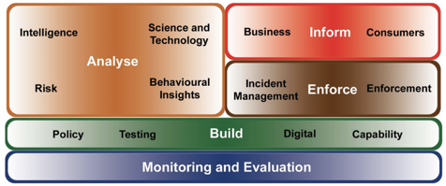
Background: Research at OPSS
OPSS Science, Engineering and Research Team:
Provides evidence and advice for the development of policy, and the delivery and enforcement of product safety regulations. ​
Core functions include:
Commissioning and undertaking research
Providing up-to-date scientific evidence and advice
Assessing product safety
Managing access to external experts and scientific databases

Slide 5
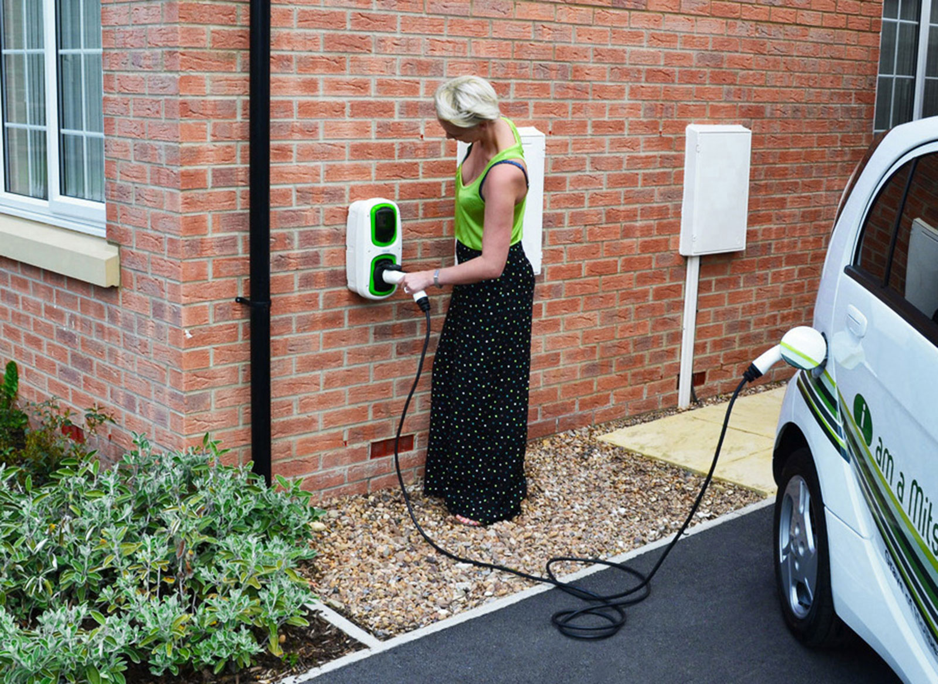
The regulations and OPSS’ role
The Electric Vehicles (Smart Charge Points) Regulations 2021 (‘the regulations’) were laid in Parliament on 28 October 2021, and will come into force 30 June 2022, except for the cyber requirements which will come into force 30 December 2022.
The regulations will mandate that all private (domestic and workplace) charge points sold in Great Britain must be “smart” and meet certain minimum device-level requirements, enabling consumers to have the technical capability to take part in smart charging.
This will a) help facilitate the transition to EVs by reducing their impact on the energy system b) maximise the potential of EVs to provide additional benefits to the electricity network and consumers.
OPSS has been designated as the enforcement authority for these regulations and will need to develop an approach to assessing compliance of Electric Vehicle Smart Charge Points (EVSCP).
This research will inform this approach by developing options for assessing compliance with the EVSCP regulations.
From an enforcement perspective, the products will be tested after being placed on the market for conformance with the regulations. Currently, no standard exists to allow testing and conformance validation by either the manufacturer or by a regulator; and it will be to industry to create solutions to the requirements within the regulations.

Slide 6
Summary of Requirements in the Regulations
Requirement | Description of the requirement
Scope | The legislation will apply to new private chargepoints sold, meaning domestic and workplace chargepoints, used to charge vans and passenger vehicles. The legislation applies to Great Britain only.
Smart functionality | “Smart functionality” means a chargepoint must have the ability to— (a) send and receive information and; (b) respond to external signals by modulating the rate of electricity flowing through the charge point. The legislation will also mandate that a compliant chargepoint must be capable of supporting demand side response (DSR) services.
Monitoring and metering of energy consumption | The chargepoint should meter or calculate electricity consumed to a minimum accuracy level, be capable of taking readings every 1s, and be capable of measuring the time any charging event lasts. The chargepoint should provide a method for the consumer to view this information.
Default smart charging | When a consumer first uses their chargepoint, they must be asked to input a charging schedule. This charging schedule must be pre-set to charge at times of low energy demand. Consumers must be able to edit or remove this setting at any point.
Cyber and data security/privacy | Requirements in line with ETSI EN 303 645 (a globally applicable Cyber Security standard) will be mandated, with additional requirements on security logging and physical protections.
Randomised time delay | Mandate a random time delay between a smart chargepoint receiving a signal to turn on/off/up/down, and it responding to that signal. There are some exceptions to this requirement.
Interoperability | All chargepoints must retain their smart functionality upon the consumer switching energy supplier.
Safety | Chargepoints must be configured so that the user can't override certain smart functions in a way that may cause a health and safety risk.
Assurance | All requirements will be self-assured. There will be no certification requirements. When a chargepoint is sold, it must be accompanied by a statement of compliance. There must also be a technical file available for the chargepoint, and a register of chargepoints sold must also be kept.

Slide 7
The project
Aims & objectives
The aim of this research is to develop options for assessing compliance of EVSCPs against the regulations.
The objectives are as follows:
To develop options for an assessment process which are outcome based and ‘solution agnostic’
To describe assessment process options and outcomes, as well as other means of demonstrating conformance
To assess and evaluate options
To test and validate the assessment process
Budget & Timeline
Maximum £88k
Tender will go live: 08/11/21
Bid close date: 29/11/21
Phase 1 (£50k): 10/12/21 – 31/03/22
*Break clause
Phase 2 (£38k): 01/04/22 – 01/07/22
Output
Report describing and reviewing options for the assessment process, including methodology/results from ‘proof of concept’ testing.

Slide 8
Suggested project methodology
Requirements from the regulations available
Draft regulatory guidance
Development of assessment process options [Phase 1]
1) Conduct in-depth review of regulations and draft guidance 2) Carry out desk analysis looking at standards, best practice and other relevant documentation 3) Consult stakeholders 4) Develop assessment process options 5) Develop a procurement and test plan for phase 2 6) Produce interim report
*** BREAK CLAUSE ***
Testing and validation of assessment process [Phase 2]
7) Procure EVSCP 8) Test against proposed assessment process. 9) Evaluate and update assessment process 10) Run stakeholder workshop to validate 11) Produce final report
Final report containing analysis of assessment process options for testing compliance of EVSCPs {July 22}

Slide 9
Procurement Process
OPSS are part of Central Government – subject to public sector procurement rules and Government policies on procurement
Procured through Contracts Finder
Procured via Contracts Finder
~£88k
Managed by
UK Shared Business Services given as organisation name on Contract Notice
Tender process run through Delta
eSourcing platform

Slide 10
Thanks for listening. Questions? Stephen.James@beis.gov.uk Shayan.Yaghoobi@beis.gov.uk

